Slide 1


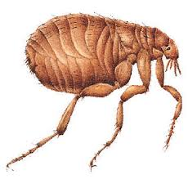
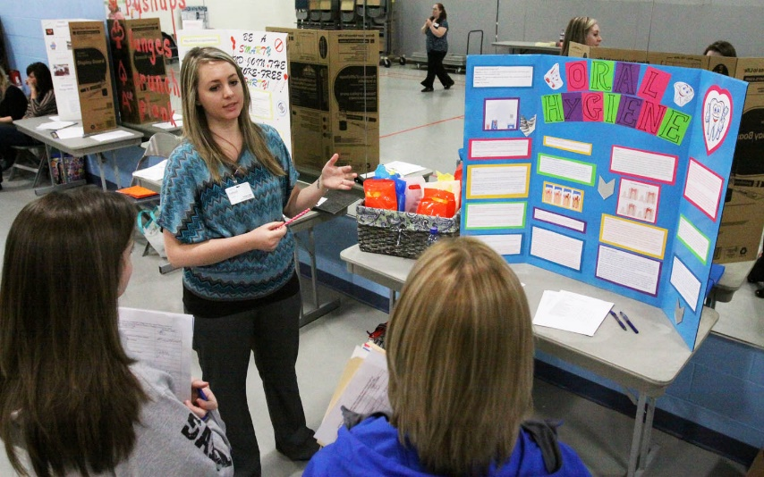
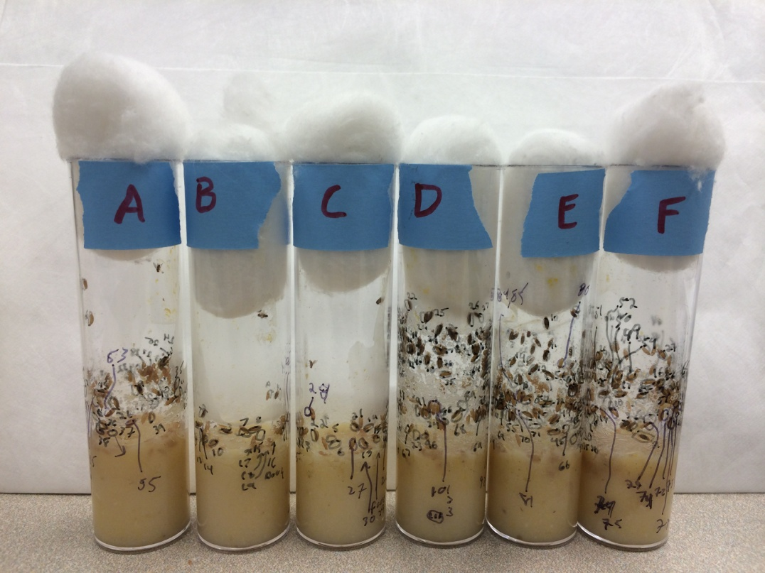
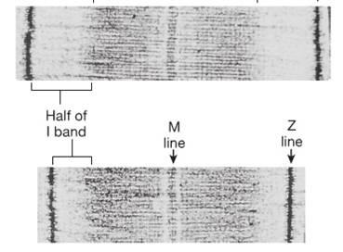
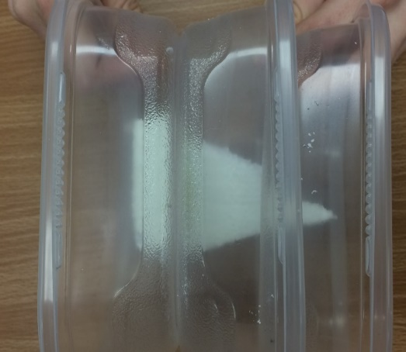
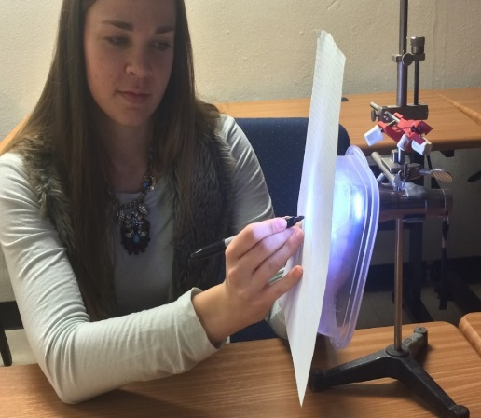
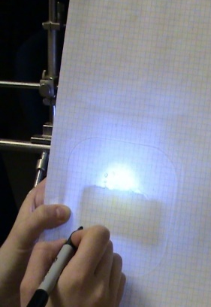
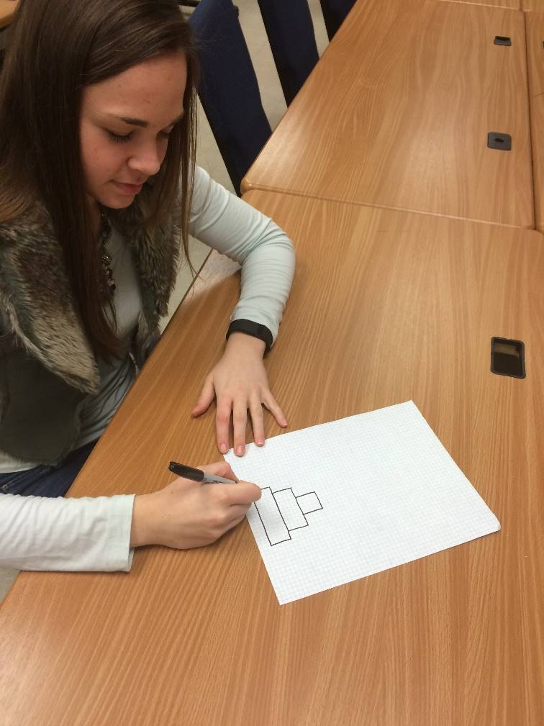
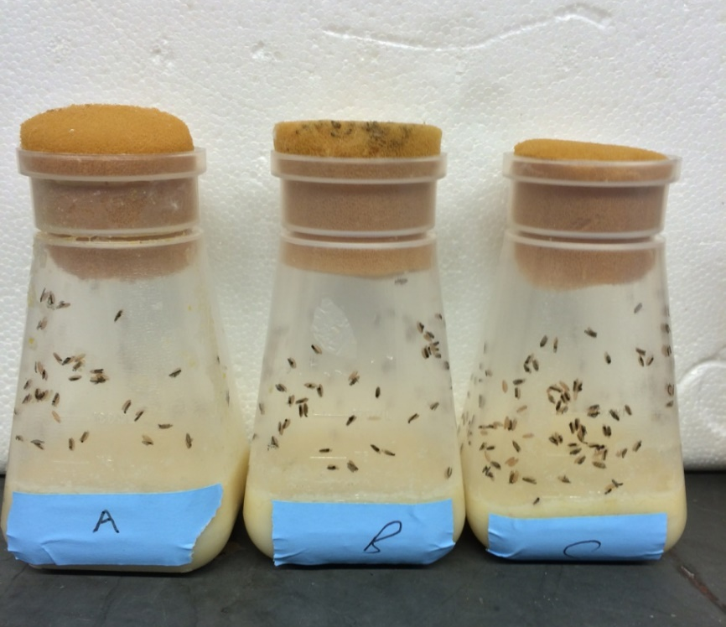
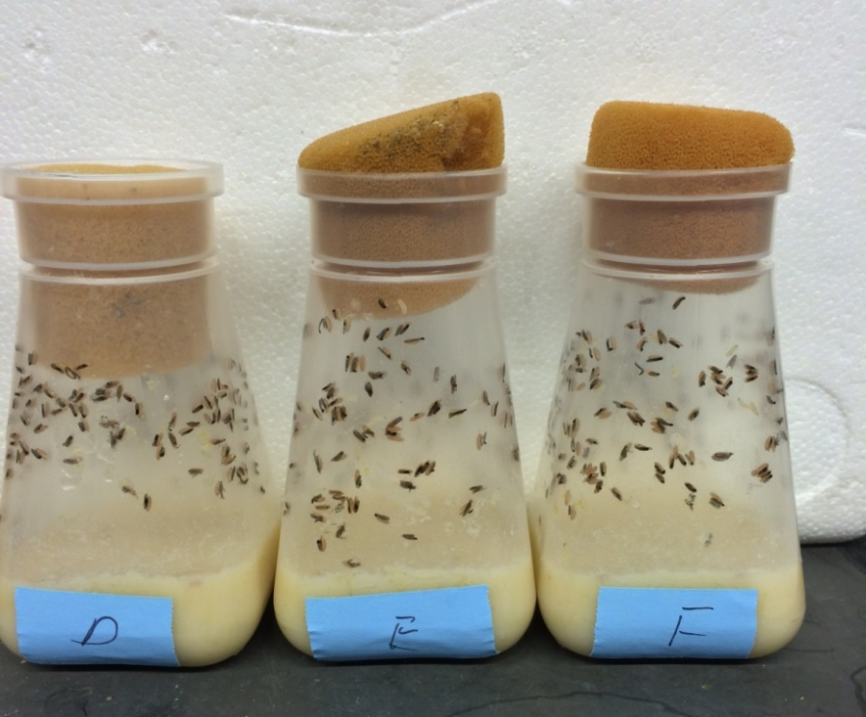
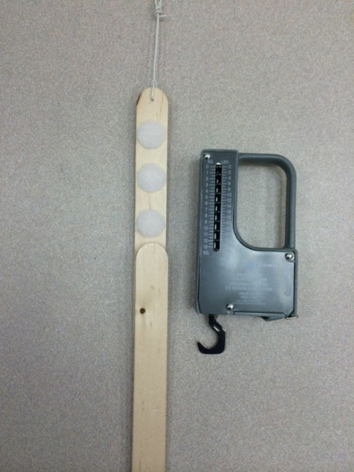
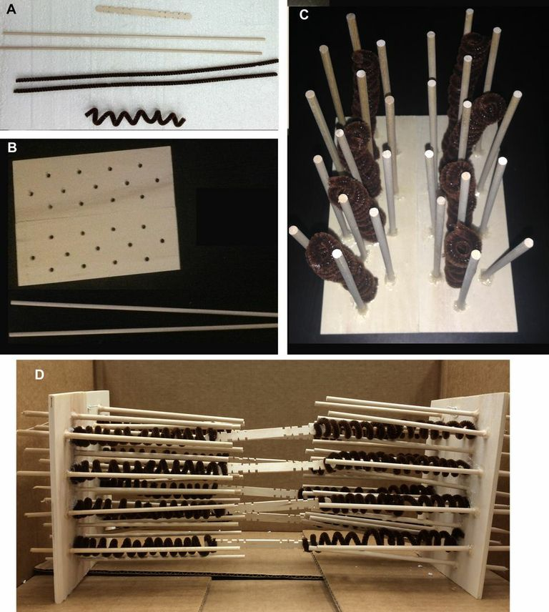
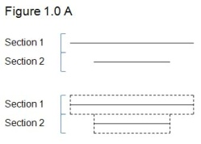
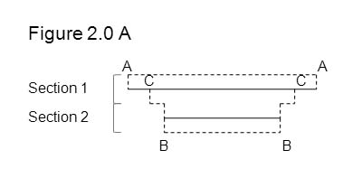
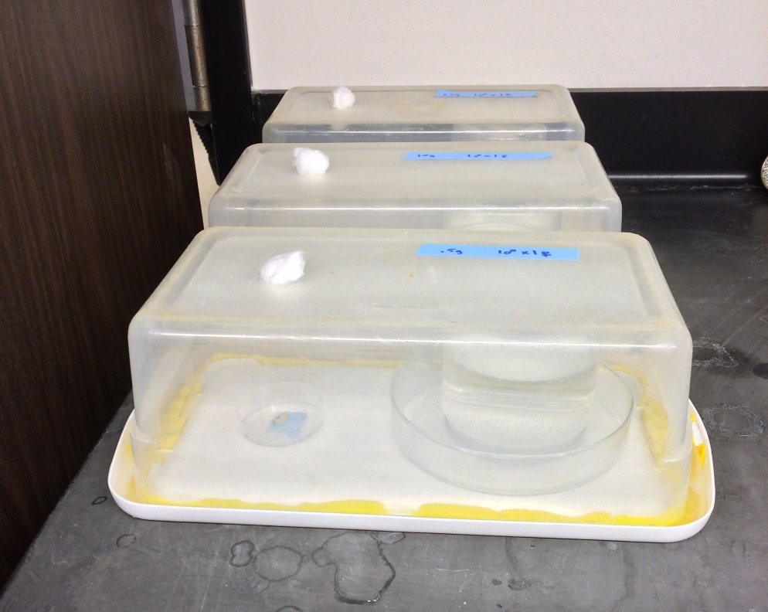
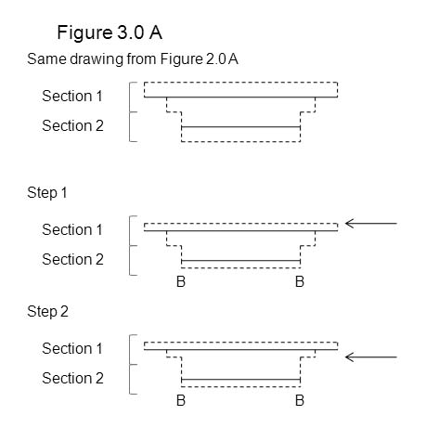
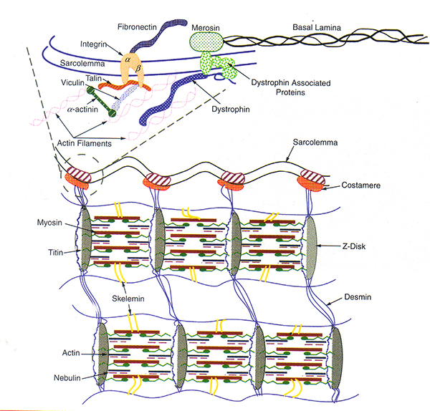
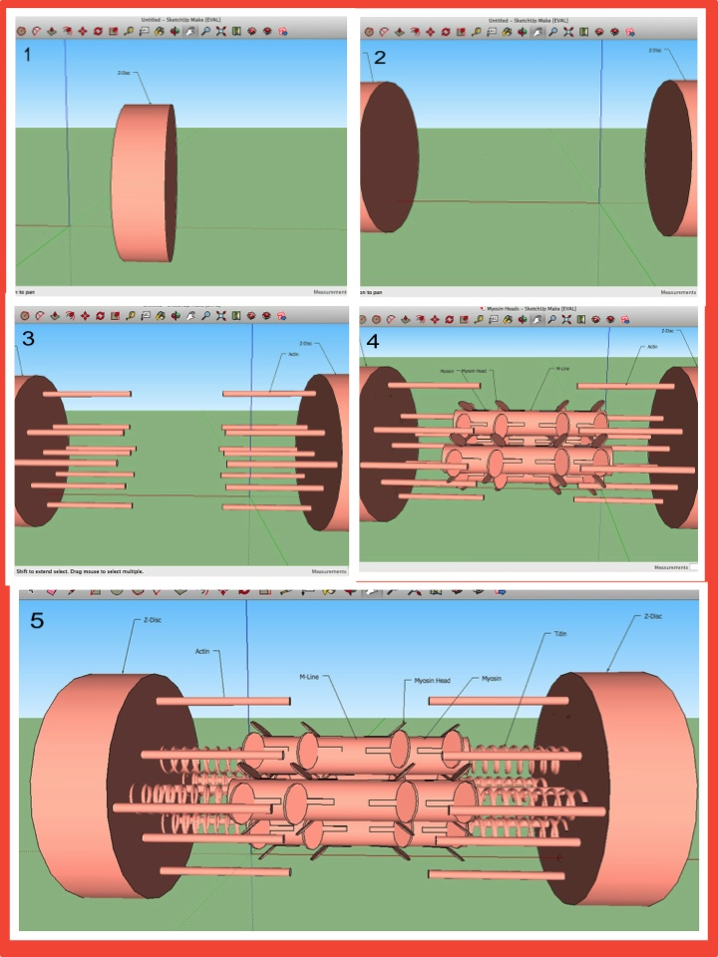
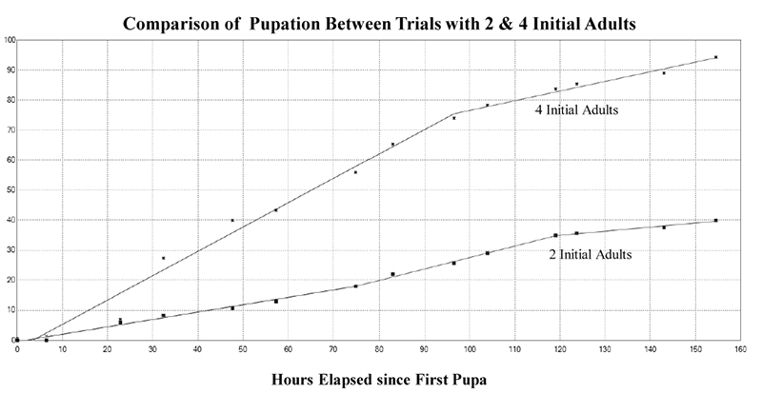
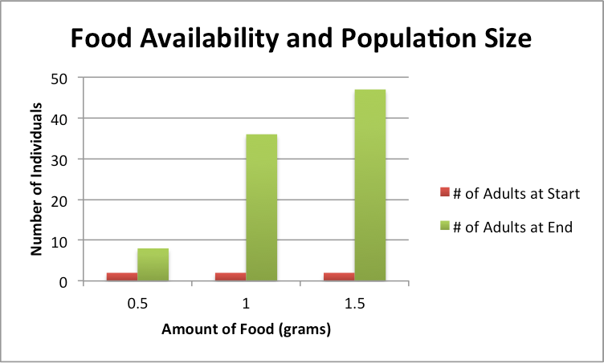
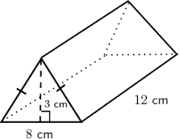
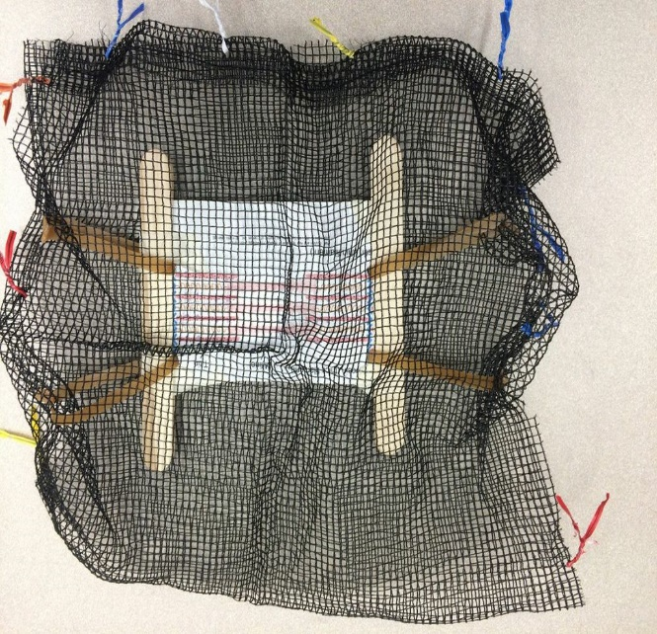
The healthy flea model: Public health education with 7-12 grades
Danielle Middleton¹, R.M. Krall², K. Zeidler-Watters³, D. Johnson³, S. Mayo³, R.L. Cooper¹
¹ Dept. of Biol., Univ. of KY.; ²Dept. of STEM, Univ. of KY.; ³PIMSER College of Education, Univ. of KY., Lexington, KY
INTRODUCTION
Skeletal muscle structure and health related around a focus of muscular dystrophy
Population dynamics with food and space resources: Examples with fruit flies
Imaging science: Stereology, geometry and math integration with biological concepts (3D-2D issues)
In preparation for implementing the Next Generation Science Standards (NGSS) in Kentucky, many middle and high school science teachers are examining ways to meet these new standards for teaching. The new standards seek to redefine the metric of science proficiency from one characterized by the acquisition of a factual foundation to an inquiry based understanding through a three-dimension approach that includes crosscutting concepts, science and engineering practices, and disciplinary core ideas. Through this approach, students will take on the role of scientists and engineers as they address applicable problems in society through both inquiry and design practices (i.e., physical and computation models, literature survey, hands on activities, problem based learning). We work with many teachers across the state to prepare them for the NGSS and have helped to develop various classroom modules that exemplify the three dimensions.
We are now developing module projects on numerous health issues (COPD, obesity, nutrition, importance of exercise for skeletal muscle health, various disease states as muscular dystrophy and imaging in biological systems). Students will investigate the health issues in the form of everyday scenarios with the objective of promote a learning style that is both problem-based as well as hands-on. The ability to retain and understand a concept is enhanced with hands-on activities. There is a common expression for active engaged learning, which applies here, “hands-on minds-on” (Hitt et al., 2005; Pheeney, 1997). The ability of middle and high school students to use the appropriate science and engineering practices such as modeling to represent the human disorders while interrelating the core ideas of the various disciplines (physics, biology, chemistry, math and engineering), should promote the importance of both increased learning within the disciplines and a healthy lifestyle.
One goal of this project is to examine if the modules we developed are useful for the advancement of NGSS standards in the classroom so we are examining student pre & post-test content knowledge as well as integrative understanding of the topics in these various educational modules. To further examine the integrative understanding, we have created a culminating event that requires students to showcase their investigations and knowledge while promoting community health.
The culminating module event for the participating students is presenting their work and research in an interactive public forum that will help students recognize the importance of their academic efforts outside the classroom environment. Demographics show that many Kentucky students reside in rural counties with health departments that lack the resources for annual health fairs that provide the public with free screening and information. Our goal is to provide these populations with a viable alternative that utilizes an established and popular rural community staple, the weekly flea markets (or swap meets). The Healthy Flea Annual Showcase will be held at local flea markets in partnership with local health departments and health entities, further illustrating the science and engineering principles to students.
Middle school level
Middle school level
One can create various scenarios for a classroom to work on:
What Are the real sizes of synaptic vesicles in nerve terminals (electron microscopic images)?
What is the area of a synapse within a nerve terminal (electron microscopic images)?
What is the volume of a tumor ?
How many serial sections would be required to have less than a 10% error in true area or volume of the object ?
• Provide the history of the sarcomere and cross sections of different bands. (2 D figures)
• List or label the vocabulary for a sarcomere.
• How do the cross sections create a banding pattern? Have the students create their models (2 D-3 D models).
• Possible use of ppt. for modeling.
• Use tongue depressors and Velcro strips to illustrate force. Use of different numbers of patches to mimic number of myosin heads. Probes or weights used to measure force.
Module 1: Rate of population growth depending on #of females and elclosion rate
One goal of this project is to examine if the modules we developed are useful for the advancement of NGSS standards in the classroom so we are examining student pre & post-test content knowledge as well as integrative understanding of the topics in various educational models. To further examine the integrative understanding, we have created a culminating event to showcase their investigations and knowledge while promoting community health.
An example of 2 sets of conditions, repeated 3 times.
1 female :1 male vs
3 females :1 male
Mark each pupa as they form. Take out adults at a particular day before pupas elcose. Then count the rate of eclosion by releasing the flies each day.
Middle school level
1. Students will calculate different versions of the estimated areas for each object observed in each section. The students can combine the images on the graph paper and try to determine the full structure with these serial sections.
Stretched
Module 2: Food choice of adults and effects on larvae
CONCLUSION
Show stretched and contracted
states of sarcomere
Skeletal Muscle: Fits with NGSS on cell structure and function. Model building complies engineering practices for NGSS. Using Sketchup provides a computational aspect to this module. In addition, a real life scenario can be used as a theme for the module with skeletal muscle disorders.
contracted
2. Determining the Area with an Edited Version of the End Sections
Fly Model: With the world on the cusp of a population crisis, there has never been a more important time for students to understand what factors influence a population’s growth (UNESCO, 1999; Lutz, 2013; United Nations, 2014). These modules incorporate biological concepts, mathematical analysis, and computer skills to expound some of the intricacies of how a population changes. The experiments performed are simple and consist mostly of creating an environment in which the populations can thrive. The modules also take up limited class time, for the data collection takes but a few minutes a day. The principles learned via these experiments will grant students a better understanding of both the ecological underpinnings of a population as well as the implications of current human population growth.
EMG
with
Back Yard
Brains
Module 3: Pupa and adult behaviors in response to diet as a larvae .
Closed system 1 male: 1 female but each container with different amounts of food. Let the chamber go until populations die out and then count total number of adults.
3. Determining the Area with a More Realistic Edited Version of the End Sections and edges
High school level
Take the same drawing done in part 2.0 and take off half of the width in the end sections (step 1). Then draw a line down a fourth (1/4) of the way from the projected section (step 2), and go to the edge of the second projected section (step 3). This corrects for end sections as well as the large stair step effect on average.
• Discussion of muscle cells and disease.
• Discussion of muscular dystrophy.
• Create muscular dystrophy models to give example as to how the
disease works. (build up from Middle school models)
• Descriptive explanation of the disease and treatments prognosis
• 3D modeling with Sketch Up or ppt
Math/Biology: This module examines 2D image projections for reconstruction of 3D objects allows a student to develop various approaches on their own to see 1st hand the problems in the real world. With literature searching in scientific journals and resources students will be exposed to new concepts and ideas.
Determining the best way to process 2D images for 3D reconstructions provides the students with integration of algebra, geometry, and calculus to biological problems.
High school level
Using Excel and Joinpoint to Analyze Data:
High school level
METHOD
Instead of just slicing the object into 3 slices the given object could be sliced into 4 or 6 slices and area estimated with including the error for the end sections as a comparison for only using 3 slices.
We have three main projects we are introducing to middle and high school teachers with IRB approval for conducting surveys of student learning and teacher practices of implementing the modules.
The students take a pre-test, take part in the hands-on activity, instructed on the content and then complete the post-test a few days later after they had time to talk about the projects in their classrooms.
The three modules are:
Skeletal muscle structure and health related around a focus of muscular dystrophy.
Population dynamics with food and space resources: Examples with fruit flies
Imaging science: Stereology, geometry and math integration with biological concepts (3D-2D issues)
Each project has a middle and a high school level project and each has been aligned with the NGSS in various ways (models, computational, literature research, integration of graphing and data collection).
These projects are currently being conducted in various schools in KY and are actively on going.
References
For more of a challenge, the volume of the triangular prism can be tackled and the error in volume. This can be related to 3-D imaging in MRI machines and the level of section thickness used for the size of the object with an acceptable error in estimating volume.
Atwood, H.L. and Cooper, R.L. (1996) Assessing ultrastructure of crustacean and insect neuromuscular junctions. Journal of Neuroscience Methods 69:51-58
Coffey, A., & Atkinson, P. (1996). Making sense of qualitative data: Complementary research strategies. Thousand Oaks, CA: SAGE Publications.
Lutz, W. (2013). The future population of the world: what can we assume today? Dunstan House, London, UK.
Johnstone, A.F.M., Viele, K., and Cooper, R.L. (2011) Structure/Function assessment of crayfish neuromuscular junctions. SYNAPSE 65(4):287-299. doi: 10.1002/syn.20847,
Pheeney, P. (1997) Hands-on, minds-on: Activities to engage our students. Science Scope 21(4): 30-33.
SS Lead States (2013) Next Generation Science Standards: For States, By States. Washington, DC: The National Academies Press.
Uteshev VV, Pennefather PS. 1997. Analytical description of the activation of multi-state receptors by continuous neurotransmitter signals at brain synapses. Biophys J 72:1127–1134.
Using Netlogo modeling software, students can run a simulation that corresponds to each module. Just as in the live models, students will be able to alter certain variables, such as amount of food and number of initial females, to test their hypotheses.
The volume can be approached is using geometry (½ b*H*W) for a true measure and compared to the estimated measures obtained by the projected images and taking the various errors in measurement for the end sections as well as the between sections.
For calculus based students a triple integral can be used to determine volume and compared to the geometric approach as well as to the estimates from the projected lines with thickness.
Investigate the comparative differences in skeletal muscle from different animals.

