Slide 1
Some basics on fluid flow & physics
It is not so bad !!!

Slide 2
Tubes
Pump

Slide 3
Tubes
Pump

Slide 4
Higher level
Lower level
Constriction
or a clog
Tubes
Pump
Bernoulli's principal

Slide 5
Higher level
Walls have build up
Produces
turbulent flow
Lower level
Tubes
Pump
Eddies and turbulence breaks up the stream.
Slows down flow and can build up back pressure

Slide 6
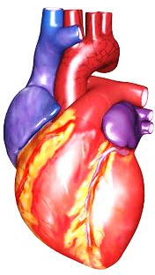
Blood Flow
Your body contains about 5.6 liters of blood that circulates throughout the body three times every minute.
“A healthy heart pumps about 2,000 gallons of blood through 60,000 miles of blood vessels each day” (The Human Heart).
Your heart beats about 72 times per minute, 100,000 times in one day, and about 35 million times in a year!
36 Interesting Facts About the Human Heart. January 26, 2010 Random Facts. <http://facts.randomhistory.com/human-heart-facts.html>.
http://www.pbs.org/wgbh/nova/heart/heartfacts.html

Slide 7
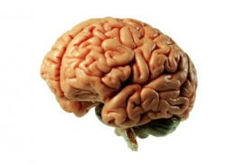
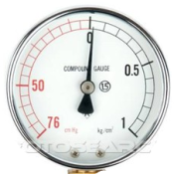
Carotid sinus
(neck)

Slide 8

Blood is carried away from the heart through the aorta and then through arteries that get progressively smaller. Arteries carry oxygenated blood to different organs of the body such as the brain, liver, kidneys, and muscles.
What happens to blood pressure when the aorta becomes less elastic?
Notes:
Answer: The blood pressure will increase.

Slide 9
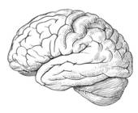
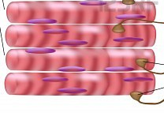
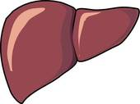
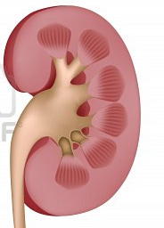

Slide 10
Elastic aorta
maintains
pressure wave

Slide 11
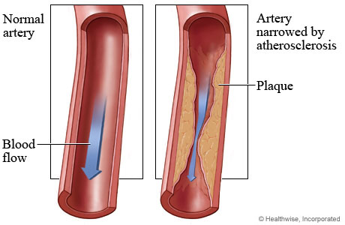
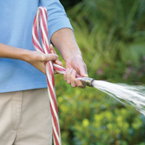
Atherosclerosis
Atherosclerosis is characterized by a build up of plaque in the arteries, which can block blood flow to the rest of the body.
Illustration: Think of a water hose. What happens when the hose is pinched?
Notes:
Concept: When a water hose is pinched, less water is able to flow through the hose. Atherosclerosis works the same way: plaque hardens along the inside of arteries and prevents blood flow from moving along the vessels smoothly.

Slide 12
Increase in blood pressure
Vasoconstriction

Slide 13
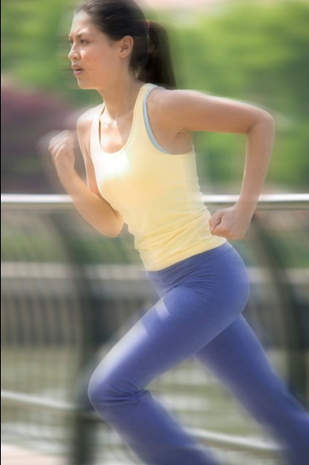
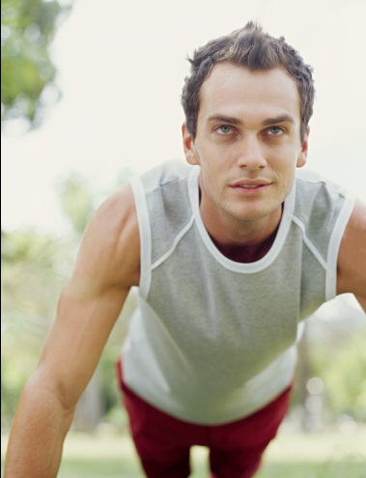
When a skeletal muscle is used during exercise, what happens to blood flow to the muscle?
Let’s find out!

Slide 14
Notes:
Concept: More blood is pumped to the skeletal muscles during exercise to provide more oxygen for the active muscles.

Slide 15
Delivery more Oxygen
Dilate blood vessels to muscle
Notes:
Concept: More blood is pumped to the skeletal muscles during exercise to provide more oxygen for the active muscles.

Slide 16
The Effects of Body Fat on Blood Flow
What happens to cardiac output when body fat increases?
Would blood pressure increase or decrease?

Slide 17
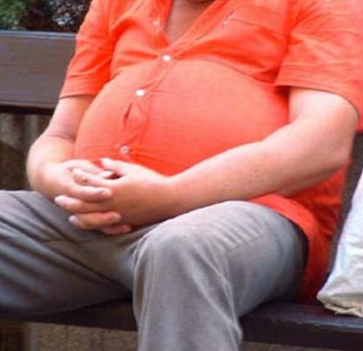
With an increase in body fat, more blood vessels are needed to provide the fat tissue with blood so that the tissue can receive oxygen. The workload of the heart increases because it must pump blood through the additional blood vessels.
The heart rate increases and the arterial walls experience a higher blood pressure.

Slide 18
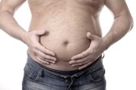
Blood pressure

Slide 19
Hypertension: What is it and what are the effects of it?
Hypertension is a condition where blood pressure is elevated in the arteries. It can lead to numerous health problems such as:
Rupturing of blood vessels
(in the brain Death of brain cells)
Heart disease
Renal failure
Vision problems

Slide 20
Increased blood pressure
to brain
HYPERTENSION
Increased blood pressure
to organs

Slide 21
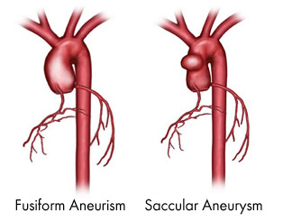
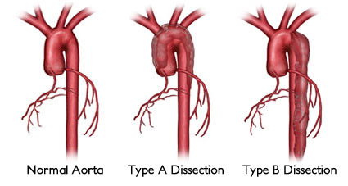
http://www.cedars-sinai.edu/Patients/Health-Conditions/Aortic-Aneurysm.aspx
Notes:
http://www.cedars-sinai.edu/Patients/Health-Conditions/Aortic-Aneurysm.aspx

Slide 22
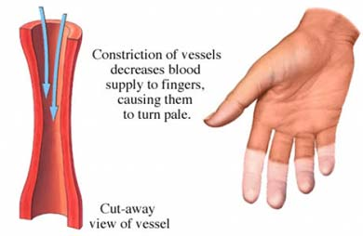
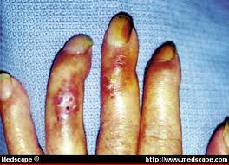
http://www.empowher.com/media/reference/scleroderma
Cold : Raynaud's disease
Smoking: vasoconstriction

Slide 23
What did we learn ?
You tell me !

Slide 24
Circulatory System
Systolic – contraction 120
Diastolic - relaxation 70
120/70

