Slide 1

Clay turner
2008-2009
Beckman scholar

Slide 2
Pre-Beckman
Started conducting research in Dr. Cooper’s lab during my junior year of high school
Investigated the role of Serotonin on behavior and development in the fruit fly
Participated in the science fairs
Data collected during high school and freshman year of college was published in the European Journal of Neuroscience
Then began investigating the role of Dopamine in the fruit fly
Preliminary work studies were completed before I applied
A music and biology double major at UK

Slide 3
Pre-Beckman Conferences
Oral Presentations:
Kentucky Academy of Sciences. Eastern Kentucky University November 12, 2006
Society for Integrative and Comparative Biology national annual meeting. Orlando, FL. January 4-8, 2006
National Conference on Undergraduate Research. Salisbury , Maryland. April 8-10, 2008
Poster Presentations:
Bluegrass Chapter for the Society of Neuroscience annual meeting. March, 2005
University of Kentucky Society for the Promotion of Undergraduate Research Showcase. April 25, 2006
Neuroscience annual meeting. Atlanta, GA. October 15-17, 2006
Bluegrass Chapter for the Society of Neuroscience annual meeting. March 12, 2007
University of Kentucky Society for the Promotion of Undergraduate Research Showcase. April 25, 2007
Bluegrass Chapter for the Society of Neuroscience annual meeting. March 12, 2008

Slide 4
Beckman Research

Slide 5
Introduction
It is well established that activity can influence the formation of neural circuits during development.
Neuromodulators are compounds that enhance or depress such activity.
Thus it is important to know the role of neuromodulators during neural development.
Notes:
5

Slide 6
Why drosophila?
It is a simple model system that provides an advantage over vertebrates to modify genetically and for electrophysiological studies on identifiable cells.
Notes:
6

Slide 7
Why drosophila?
It is a simple model system that provides an advantage over vertebrates to modify genetically and for electrophysiological studies on identifiable cells.
Drosophila has a short development cycle, only about a week to adult, so many trials can be done.
Notes:
7

Slide 8
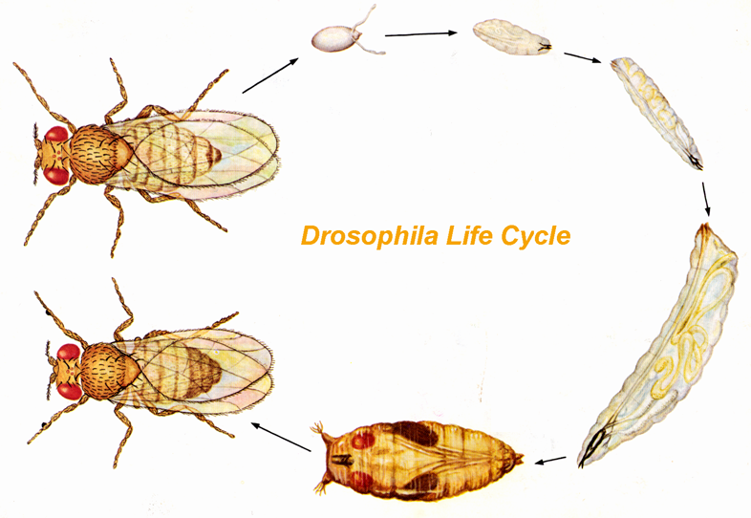
Development
egg
1st instar
24 hrs
24 hrs
2nd instar
24 hrs
5 days
3rd instar
48 hrs
pupa
Notes:
8

Slide 9
Why drosophila?
It is a simple model system that provides an advantage over vertebrates to modify genetically and for electrophysiological studies on identifiable cells.
Drosophila has a short development cycle, only about a week to adult, so many trials can be done.
Serotonin neurons are symmetrically aligned down the process of the brain making visual assessment of quantity and location feasible.
Notes:
9

Slide 10
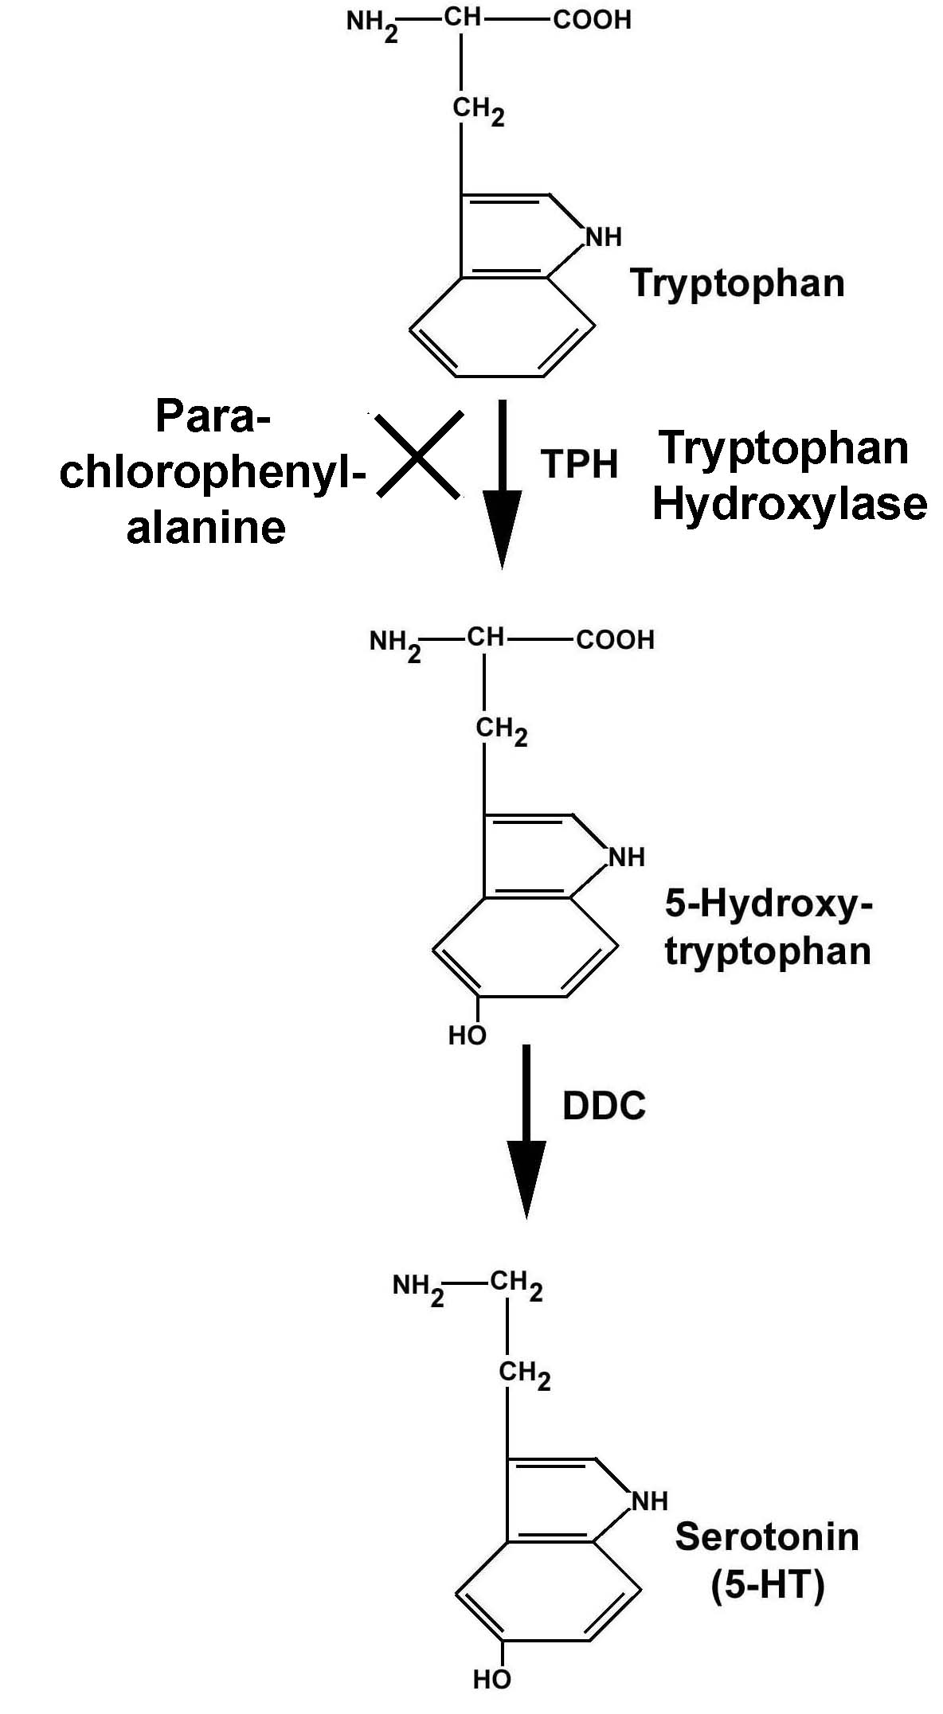
procedure
The wild type strain of Drosophila melanogaster Canton S were used.
Some were fed 0.01g of Para-chlorophenylalanine (p-CPA), an inhibitor of Tryptophan Hydroxylase, a rate limiting enzyme in serotonin biosynthesis pathway. This drug was used to abolish the synthesis of serotonin.
Notes:
10

Slide 11
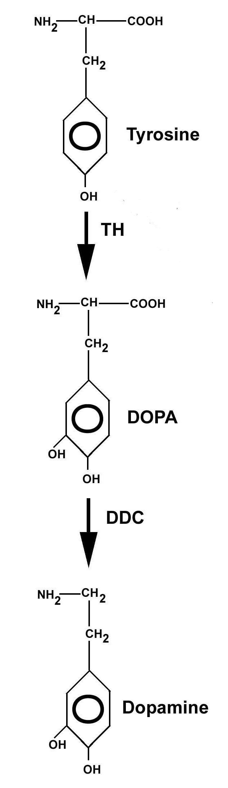
Some were also fed different concentrations of ά-METHYL-DL-p-TYROSINE-METHYL-ESTER (AMVT) ranging from .001 grams/ml water to .00001g/ml water in 0.5g of yeast paste.
AMVT
Notes:
11

Slide 12
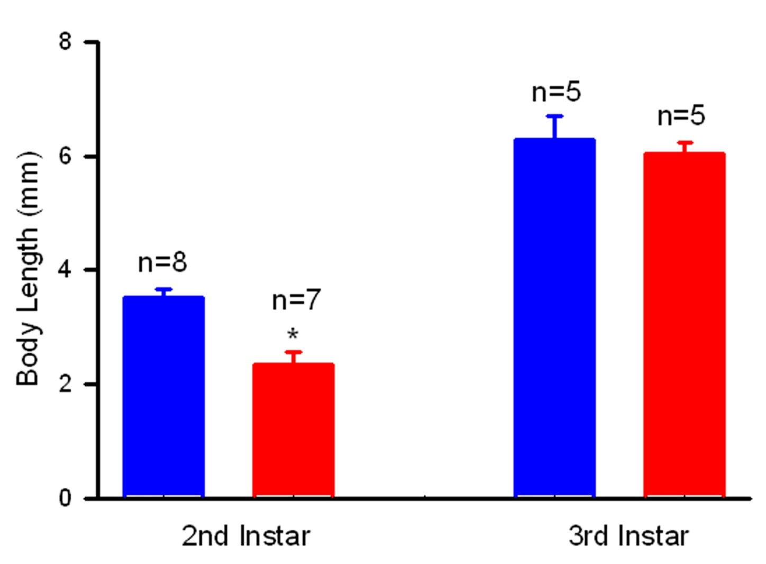
Control Animals
pCPA Animals
Larval body length during development
The pCPA has somehow severely altered the overall development cycle of the animal. This can be attributed to not eating or a problem with the brain and/or muscular development.
Notes:
12

Slide 13
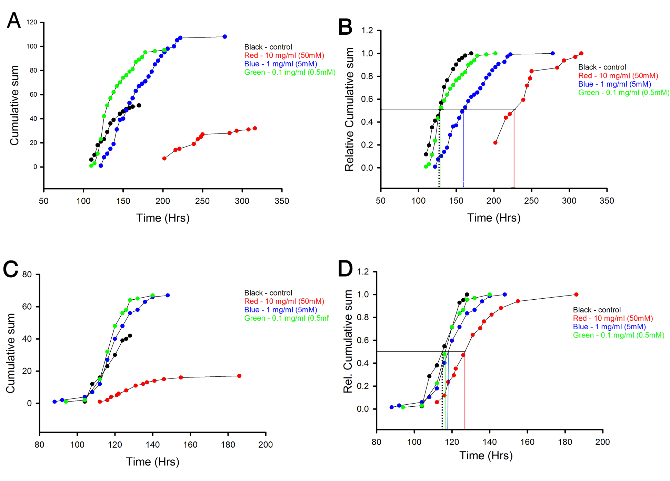
Growth Curves p- CPA
Egg – pupation
Egg – pupation
Pupa - eclosion
Pupa - eclosion
Notes:
13

Slide 14
AMVT Fed Flies
Control
0.00001g
0.0001g
0.001g
Egg-Pupation
B
A
Egg-Pupation
Cumulative sum
Relative Cumulative sum
Control Animal Brains
C
D
Pupa-Eclosion
Pupa-Eclosion
Cumulative sum
Relative Cumulative sum
A
Pupation
10 um
Control Animal Brains
C
D
Eclosion
Eclosion
10 um
Notes:
14

Slide 15
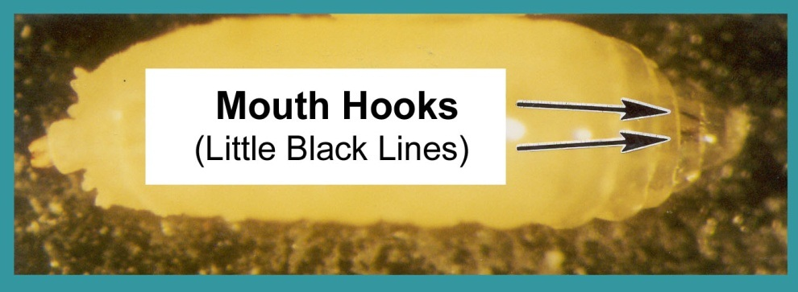
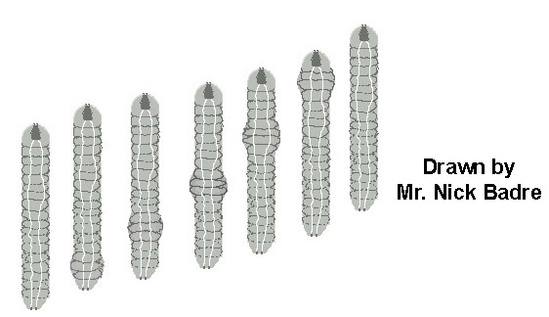
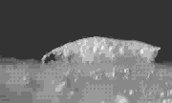
Behavior studies
Behavioral assays were carried out on 3rd instar larvae or the “Wandering Phase”.
Mouth hook movements were counted for one minute while the animal was in a yeast solution.
Body wall movements were counted for one minute while the animal was in an apple juice agar.
Notes:
15

Slide 16
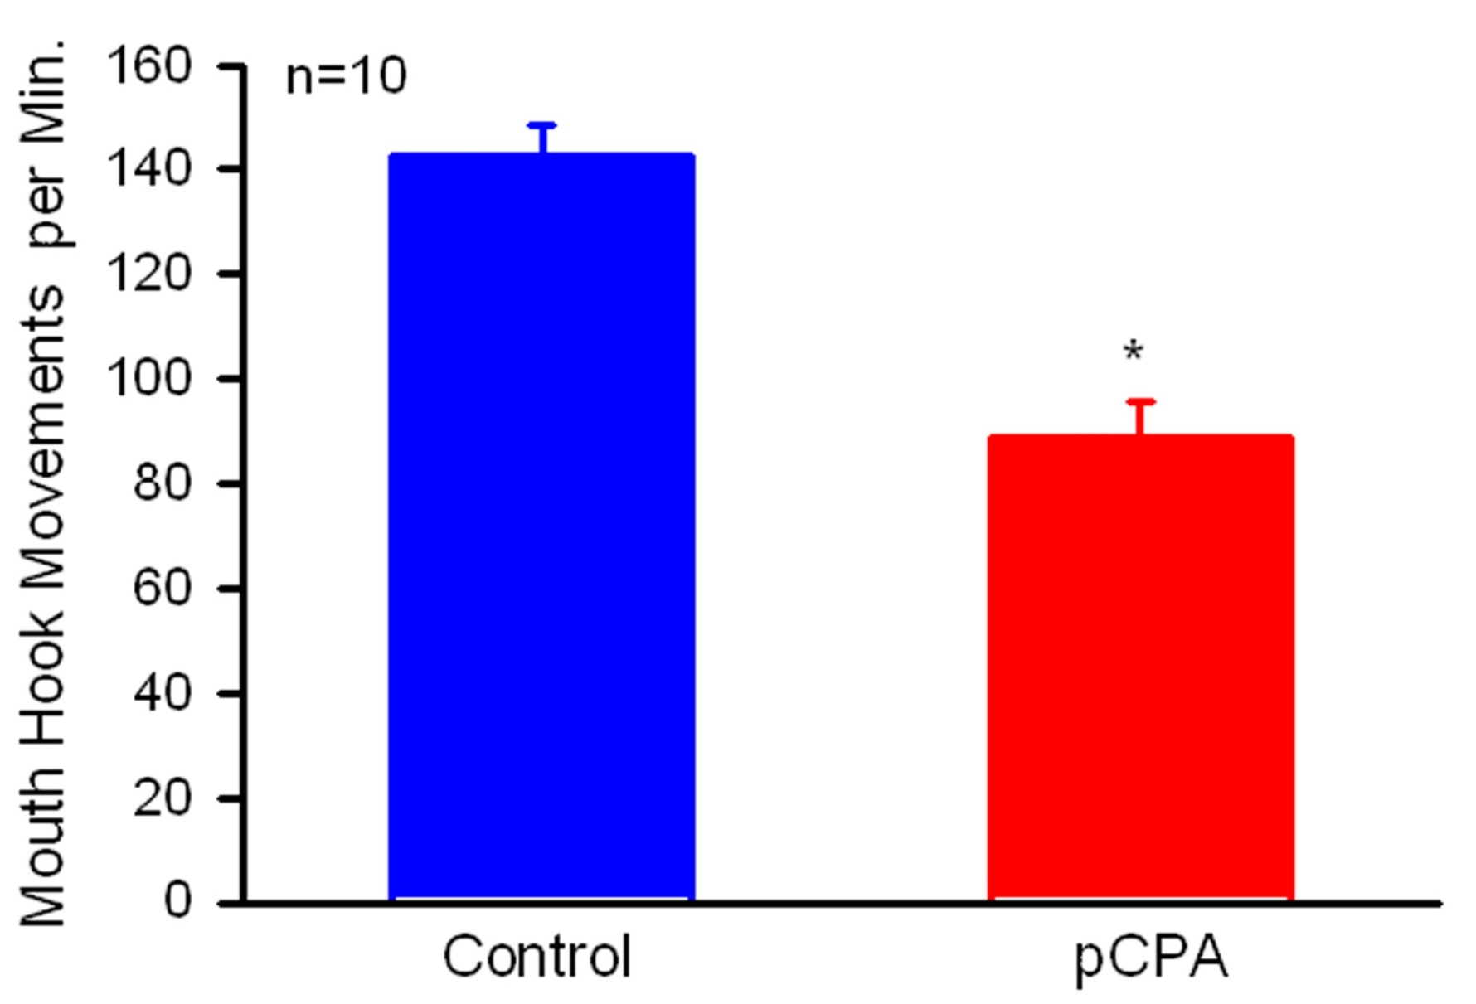
Notes:
16

Slide 17
Notes:
17

Slide 18
Notes:
18

Slide 19
Stress Tests
Larvae
3rd instar larvae and adults were monitored for survival in a stressful condition
Adults
Notes:
The animals were placed in an incubator at 30 degrees centigrade, some fed AMVT, and pupa were counted after four days
19

Slide 20
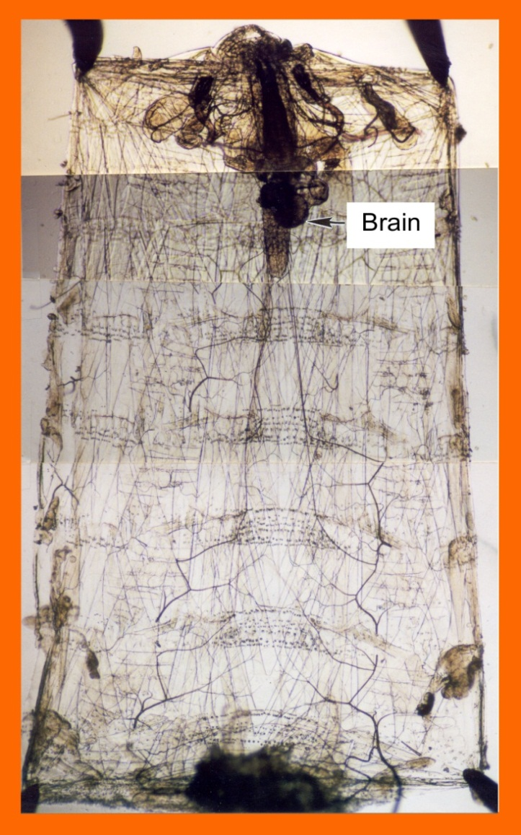
Electrophysiological
Recordings
1) 3M KCl microelectrode inserted into muscle 6, segment 3.
2) EPSPs monitored for 2’ 30’’
3) Then 10mM Dopamine
Notes:
20

Slide 21
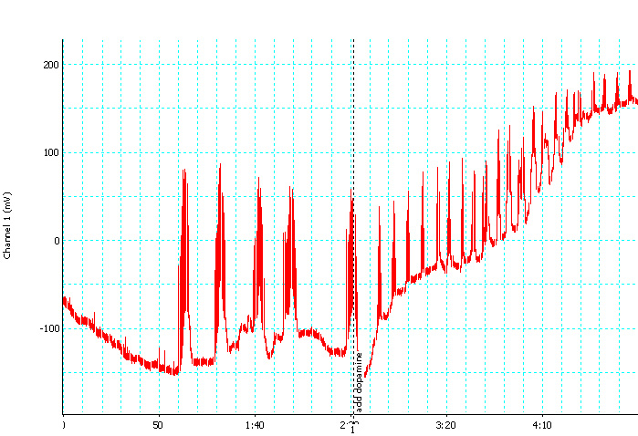
Control
Add Dopamine
Notes:
21

Slide 22
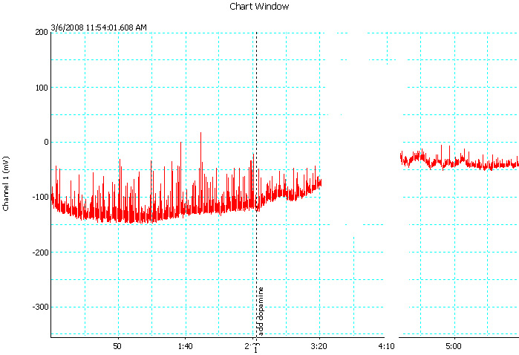
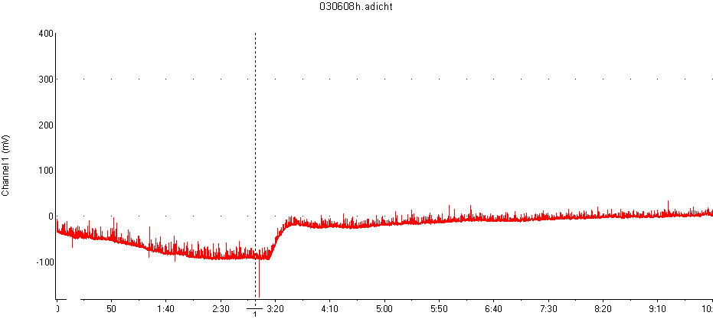
0.001g AMVT
Add Dopamine
0.00001g AMVT
Add Dopamine
Notes:
22

Slide 23
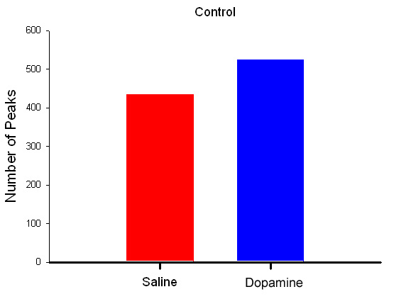
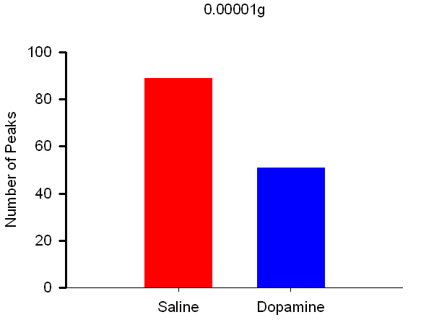
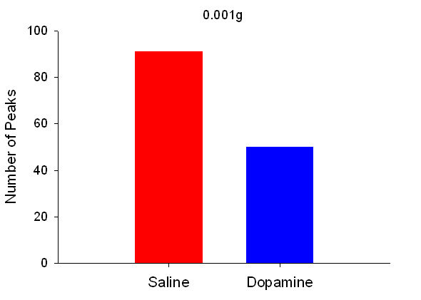
Control
Add Dopamine
Notes:
23

Slide 24
Heart Rate Studies
Dissect larvae and remove viscera, exposing heart.
Allow animal to remain in saline for one minute.
Count heart beats for two minutes in saline.
Remove saline and replace with 10mM Dopamine solution.
Count heart beats for first minute and record, then the count for the second beat and record.
Notes:
24

Slide 25
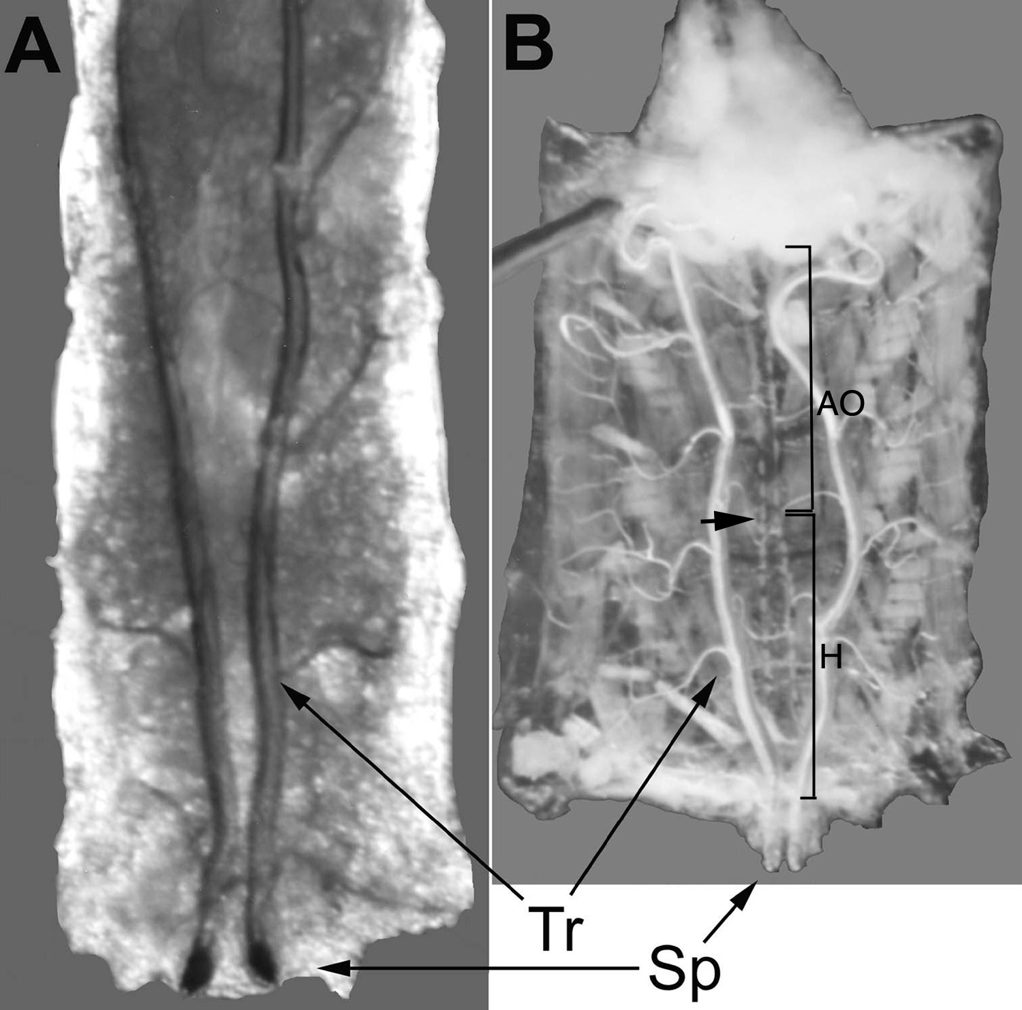
Notes:
25

Slide 26
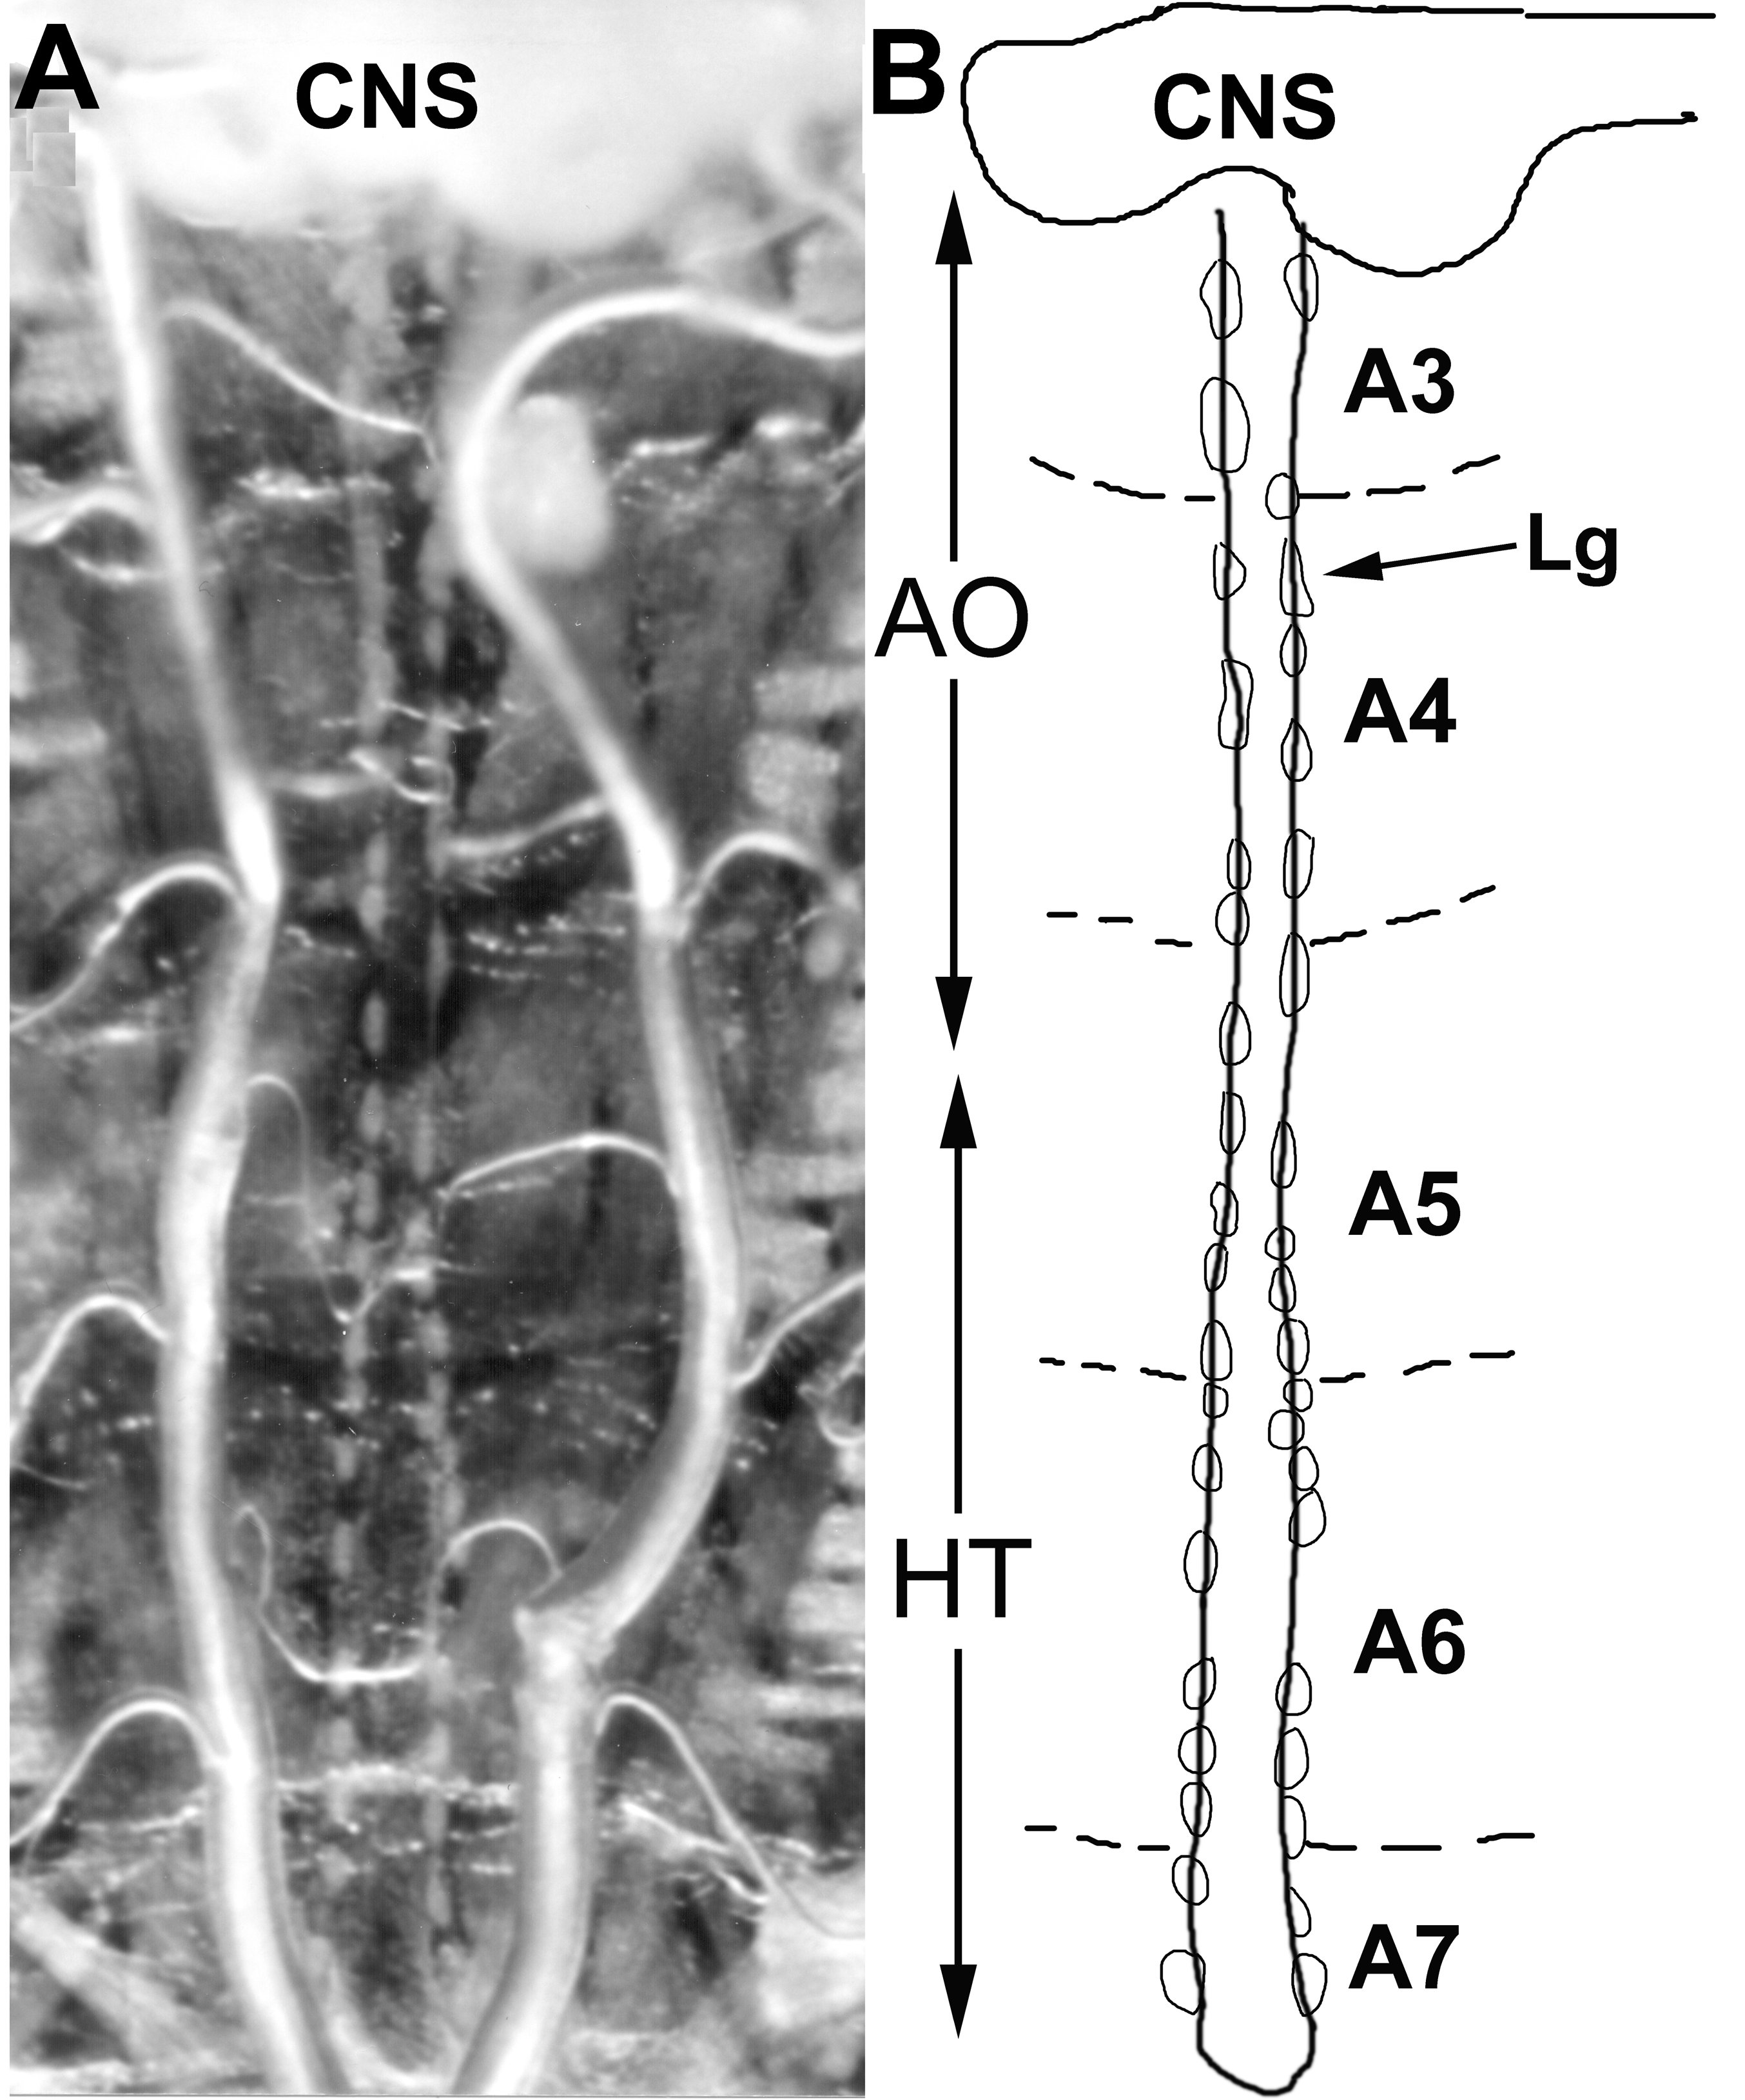
Notes:
26

Slide 27
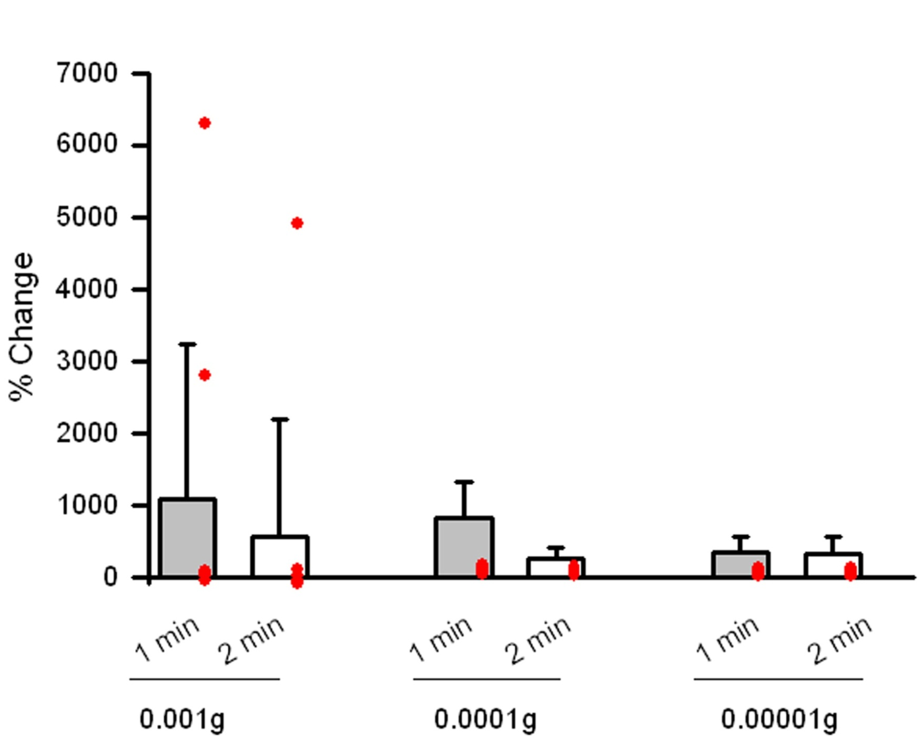
AMVT fed larvae
N=9
N=10
N=10
Notes:
27

Slide 28
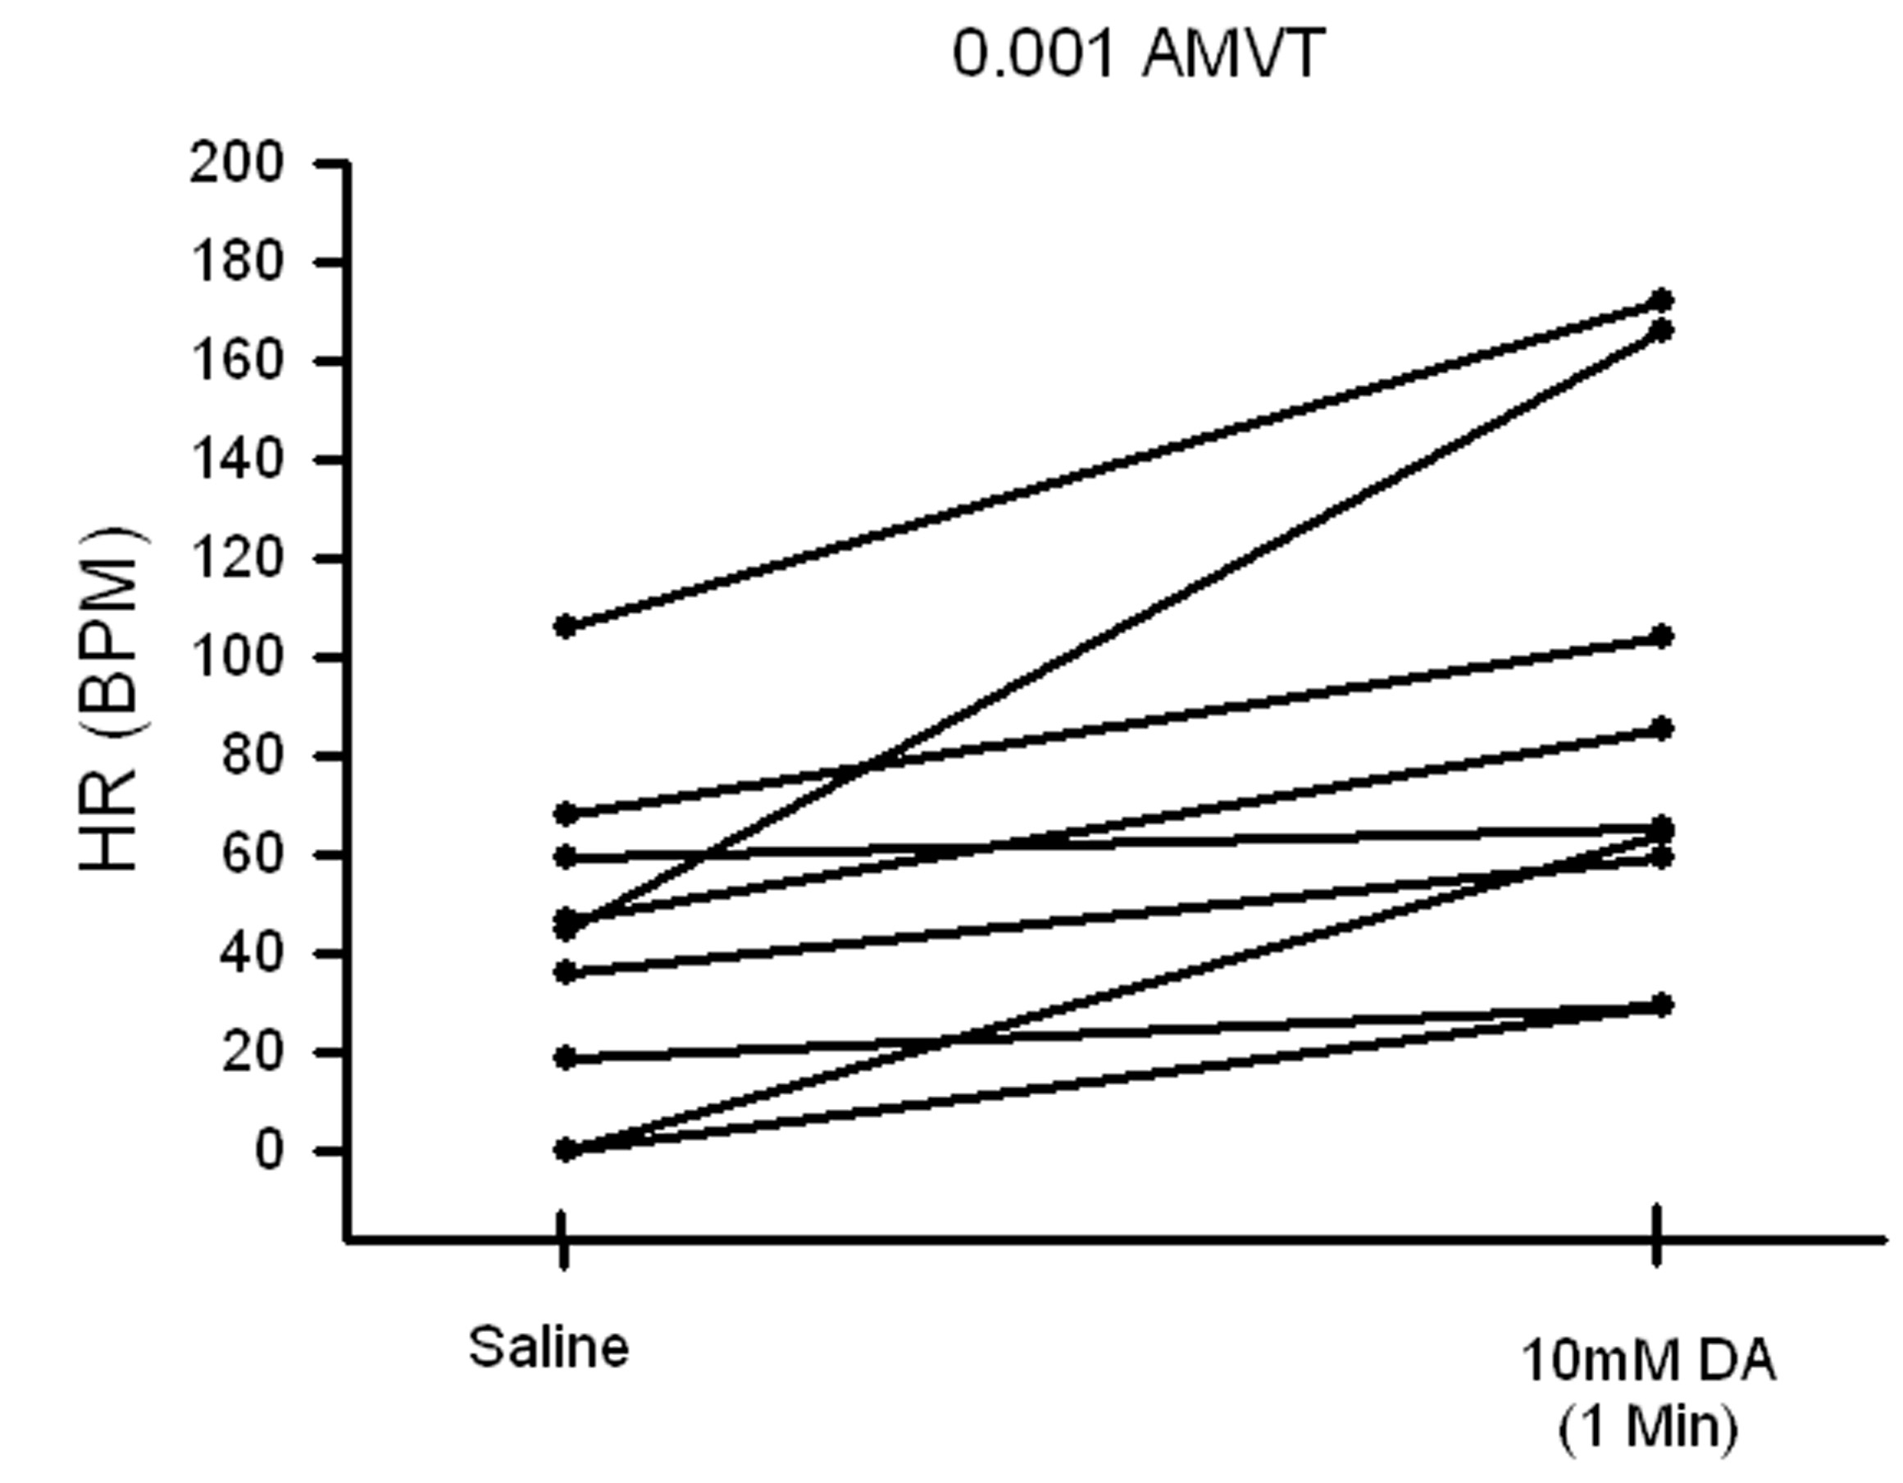
N=9
Notes:
28

Slide 29
summary
An altered serotonergic system:
Retards larval development from egg to pupation.
Slows down locomotive and mouth hook movements.
An altered dopaminergic system:
Does not severely alter development time.
Mouth hook movements decreased by administering AMVT, but not dependent on exposure time.
Body wall movements decreased with AMVT and is dependent on exposure time.
A warmer climate may increase survival of larvae fed AMVT but decreased it in adults.
Decreased motor unit activity to Dopamine in electrophysiological recordings.
Increased the mean heart rate at a dose response.
Notes:
29

Slide 30
ACKNOWLEDGMENTS
I thank Mr. Nick Badre (UK) for use of his drawing. I thank Ms. Sameera Dasari (UK) for insightful suggestions and Dr. Robin Cooper (UK) for mentoring the project. I would like to thank Liquin Wang for preparing the bacteria cultures.
Notes:
30

Slide 31
Beckman Conferences
Oral Presentations:
Tri Beta National Conference. Northern Kentucky University. April 8-10, 2008
Kentucky Academy of Sciences. University of Kentucky. November 1, 2008
Society for Integrative and Comparative Biology national annual meeting. Boston, MA. January 2-7, 2009
National Conference on Undergraduate Research. LaCrosse , Wisconson. April, 2009
Poster Presentations:
University of Kentucky Society for the Promotion of Undergraduate Research Showcase. April 23, 2008
European Drosophila Neuroscience Conference. Wurtzburg, Germany. September 6-10, 2008
National Society for Neuroscience Conference. Washington, D.C. November 16-18, 2009
Posters at the Capitol. Frankfort, KY. February 1, 2009
Bluegrass Chapter for the Society of Neuroscience annual meeting. March, 2009
University of Kentucky Society for the Promotion of Undergraduate Research Showcase. April, 2009

Slide 32
Post-Beckman
One more year of undergraduate studies
Application to medical school has been submitted
Last year, I completed my Gaines thesis where I researched the role of the bass in Old Time Appalachian music
I hope to get back into research this school year and continue during medical school

