Slide 1
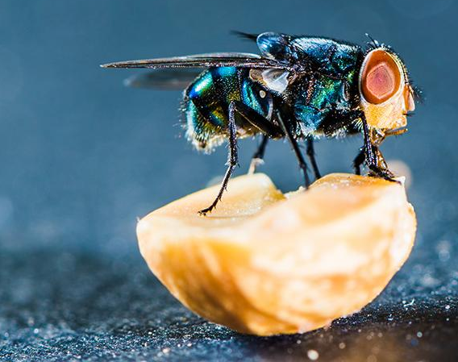
NGSS Connections to the Body Farm Module

Slide 2
NGSS Connections to the Body Farm Module
High School
Main Connections
HS-LS2-1 . Use mathematical and/or computational representations to support explanations of factors that affect carrying capacity of ecosystems at different scales.
HS-LS2-2: Use mathematical representations to support and revise explanations based on evidence about factors affecting biodiversity and populations in ecosystems of different scales.
Supporting Connections
HS-LS2-3: Construct and revise an explanation based on evidence for the cycling of matter and flow of energy in aerobic and anaerobic conditions.
HS-LS2-4: Use mathematical representations to support claims for the cycling of matter and flow of energy among organisms in an ecosystem.
HS-LS2-8: Evaluate the evidence for the role of group behavior on individual and species’ chances to survive and reproduce.

Slide 3
NGSS Connections to Body Farm Module
Middle School
Main Connections
MS-LS2-1: Analyze and interpret data to provide evidence for the effects of resource availability on organisms and populations of organisms in an ecosystem
MS-LS2-4: Construct an argument supported by empirical evidence that changes to physical or biological components of an ecosystem affect populations.

Slide 4
NGSS Connections to Body Farm Module
Middle School
Supporting Connections
MS-LS2-3: Develop a model to describe the cycling of matter and flow of energy among living and nonliving parts of an ecosystem.
MS-LS2-4: Construct an argument supported by empirical evidence that changes to physical or biological components of an ecosystem affect populations.
MS-LS4-4: Construct an explanation based on evidence that describes how genetic variations of traits in a population increase some individuals’ probability of surviving and reproducing in a specific environment.
MS-LS4-6: Use mathematical representations to support explanations of how natural selection may lead to increases and decreases of specific traits in populations over time.

