Slide 1
Experiment
Obtain a tube of water and a straw.
Exhale deeply through the straw into the water.
Make observations.
Why might your observations be different than the people near you?

Slide 2
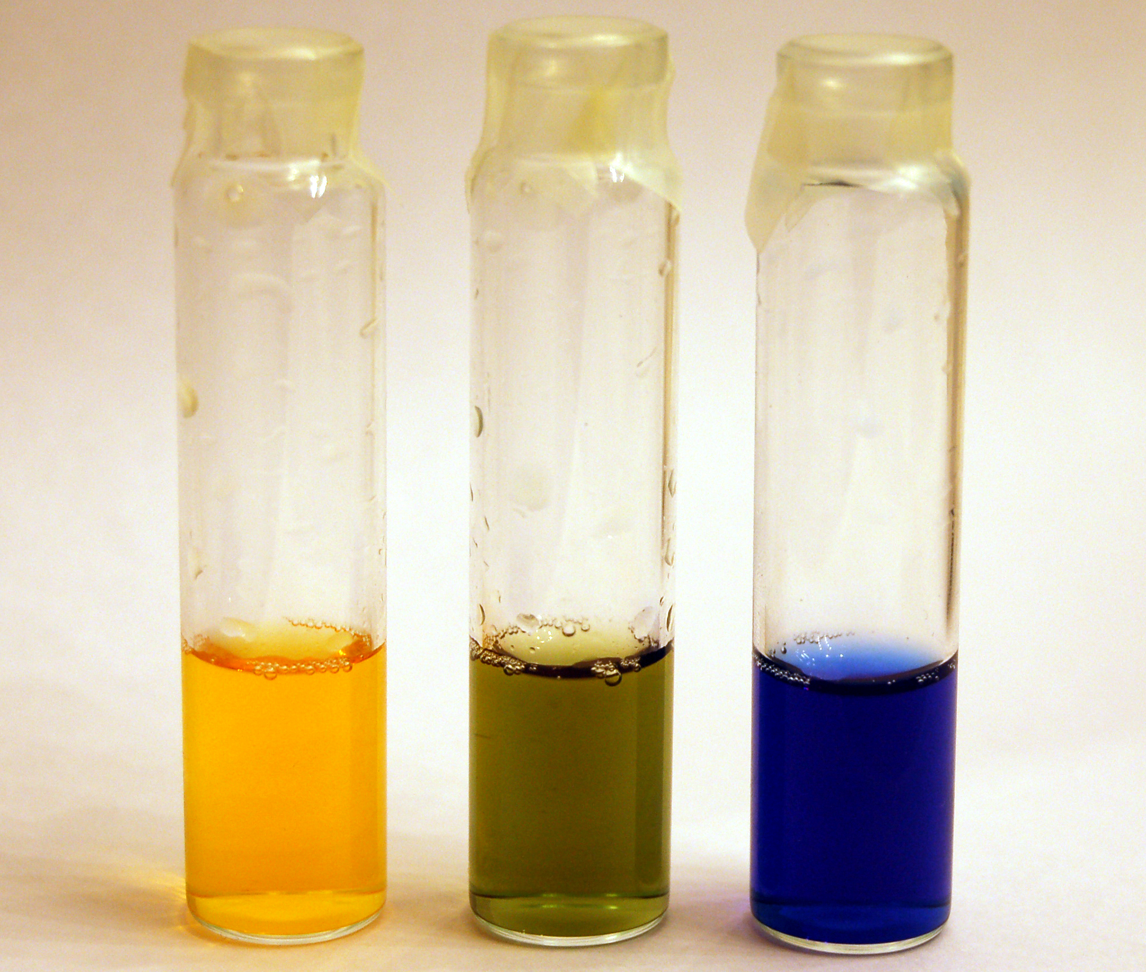
pH Indicator Bromothymol Blue
acidic
basic

Slide 3
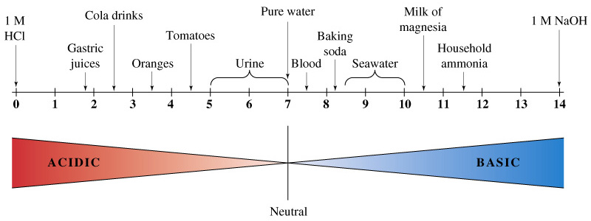
pH scale pH = -log [H+] a
[H+]=1•10⁻¹
[H+]=1•10⁻¹⁴
http://cwx.prenhall.com/bookbind/pubbooks/hillchem3/medialib/media_portfolio/15.html
Notes:
Activity coefficient. Temperature is a factor.

Slide 4
Example
pH = -log [H+]
What would be the pH of 0.01M solution of HCl (like your stomach acid)?
pH = -log [H+]
pH = - -2
pH = 2

Slide 5
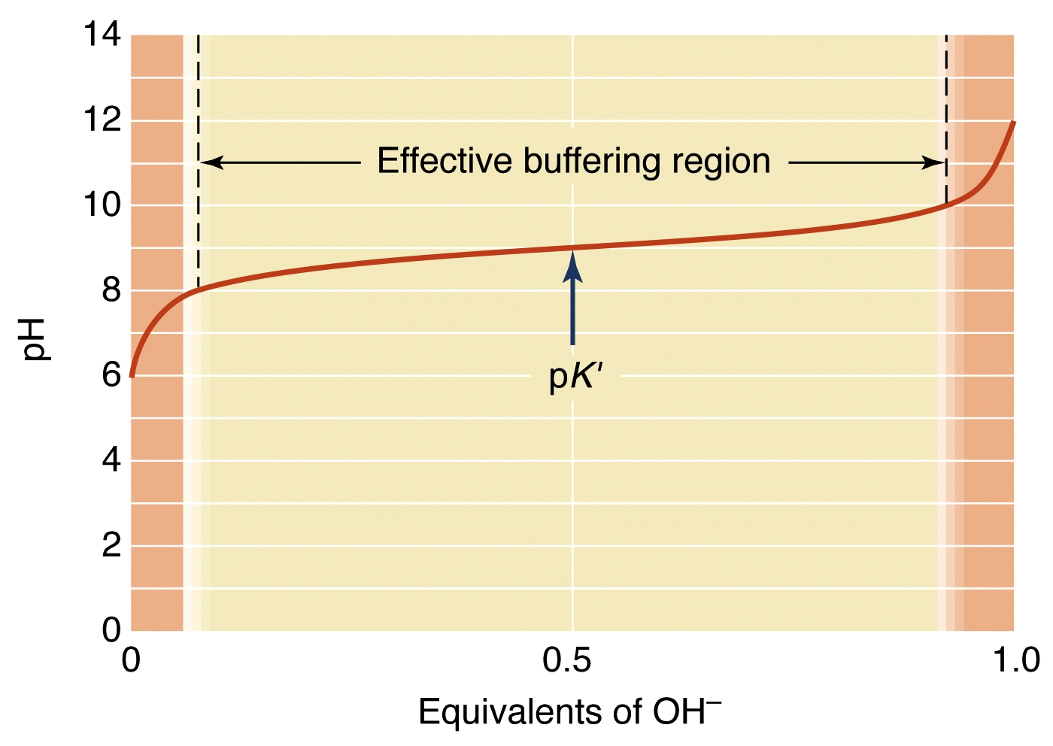
Buffers
Notes:
Buffers are mixtures of a weak acid and its conjugate base that resist change in pH when either strong acid or strong base is added

Slide 6
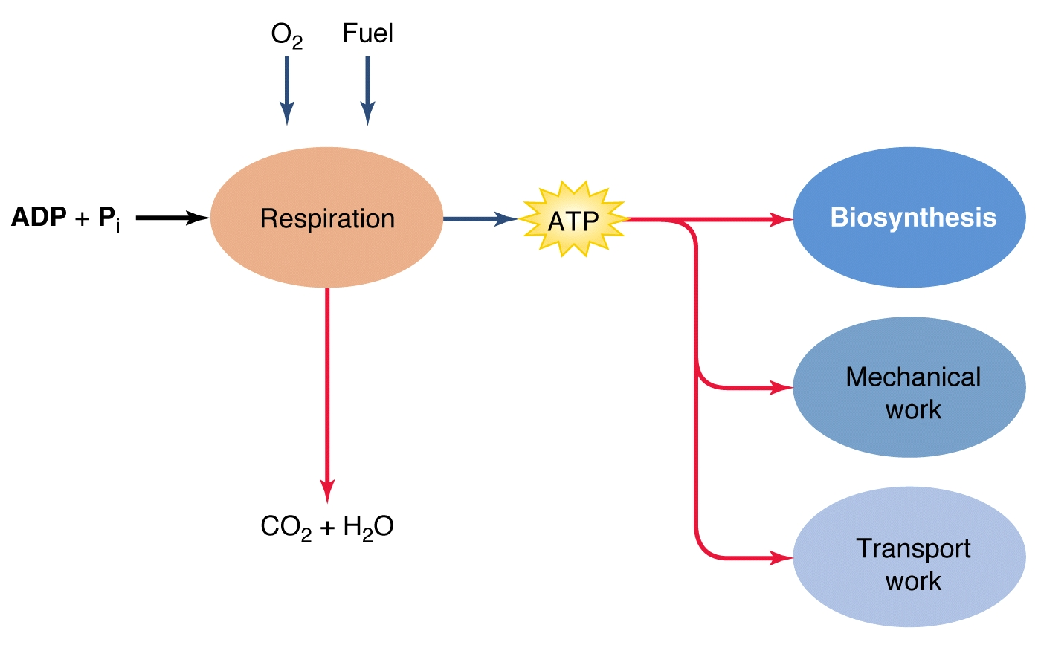
Cellular Respiration
(Glucose )C₆H₁₂O₆ + 6O₂ → 6CO₂ + 6H₂O

Slide 7
Inside the cell

Slide 8
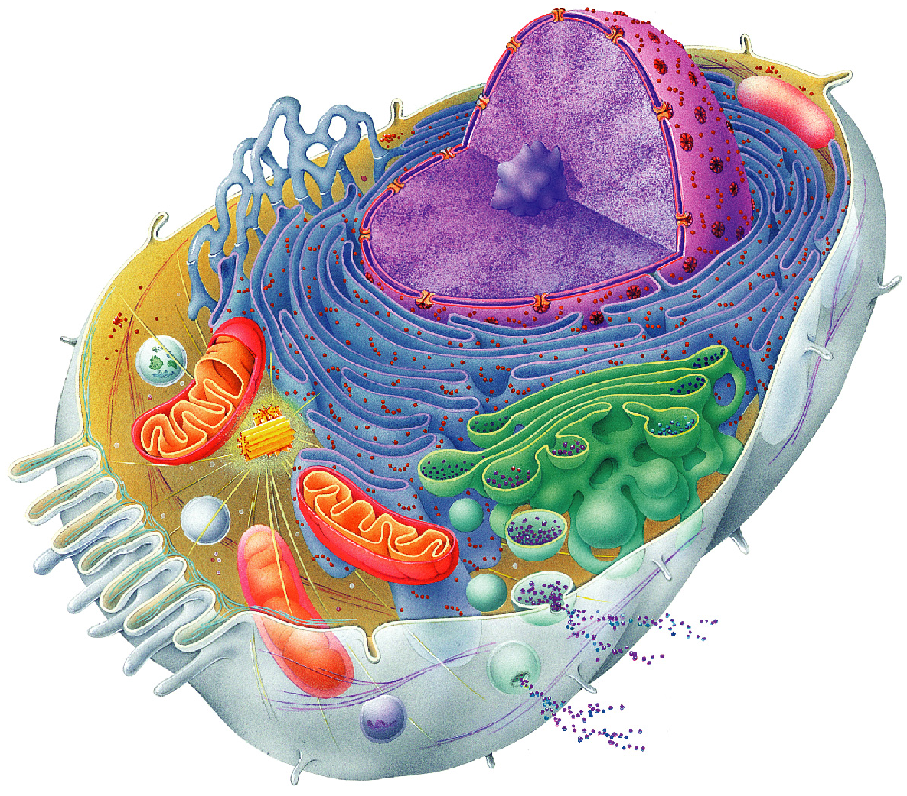
Chromatin
Nuclear envelope
Nucleolus
Nucleus
Plasma
membrane
Smooth endoplasmic
reticulum
Cytosol
Lysosome
Mitochondrion
Centrioles
Centrosome
matrix
Rough
endoplasmic
reticulum
Ribosomes
Golgi apparatus
Microvilli
Secretion being released
from cell by exocytosis
Microfilament
Microtubule
Intermediate
filaments
Peroxisome
Figure 3.2

Slide 9
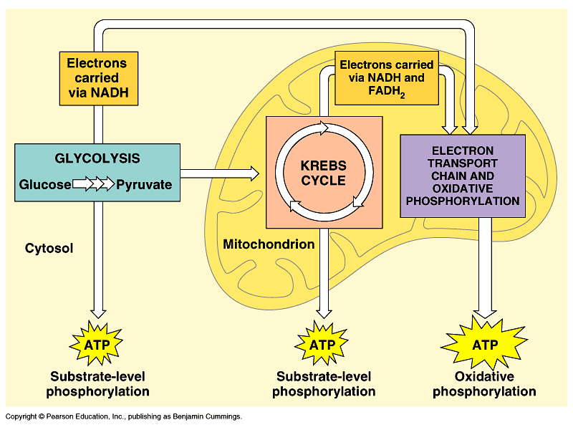
Location for Cellular Respiration

Slide 10
What happens to CO₂ in blood?
What happens to CO₂ in water?
CO₂ + H₂O ←←→→ HCO₃⁻ + H⁺
Carbonic Anhydrase
CO₂ + H₂O ←←→→ HCO₃⁻ + H⁺
Notes:
H+ is the reason that the pH decreases in your blood that H+ is buffer just like the containers.

Slide 11
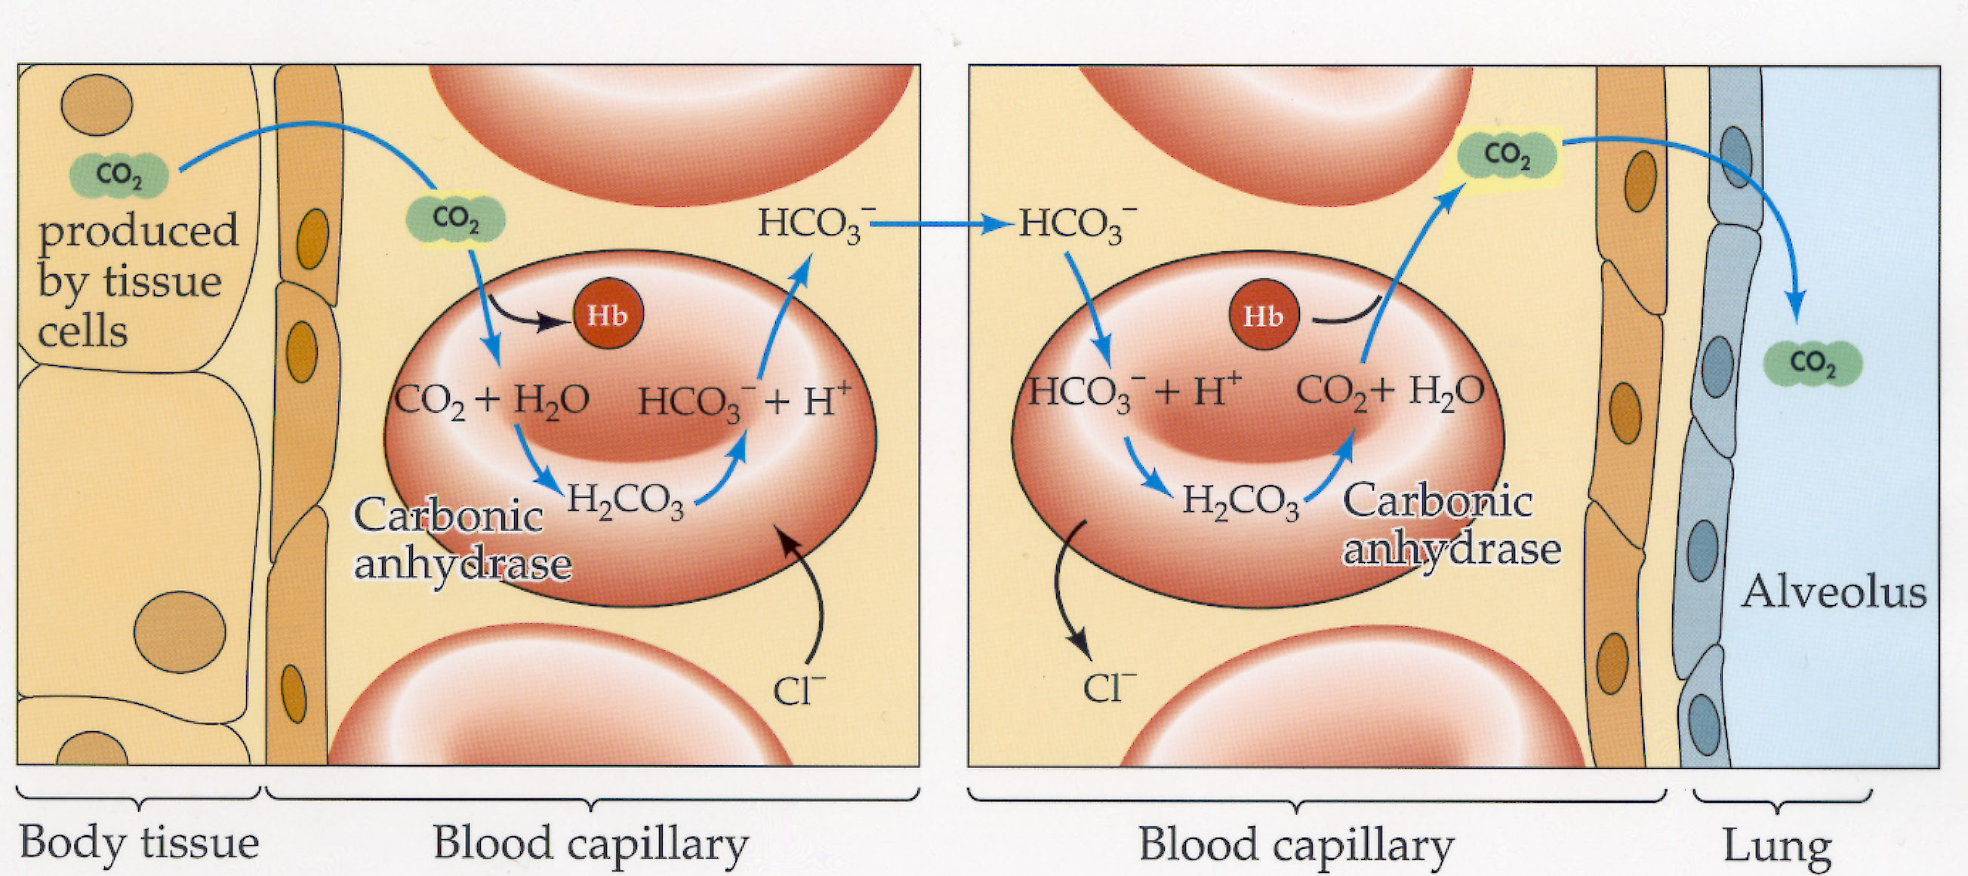
Gas Exchange
Notes:
Carbon dioxide is buffered by making bicarbonate and bicarbonate is carried in blood and then CO2 is reconverted in the lungs and exhaled. Related to speed of CA
Hemoglobin can bind H+ and CO2

Slide 13
CO₂

Slide 14
CO₂ + H₂O ←← HCO₃⁻ + H⁺
High pH
in body
CO₂
Low pH
CO₂ + H₂O →→ HCO₃⁻ + H⁺

Slide 15
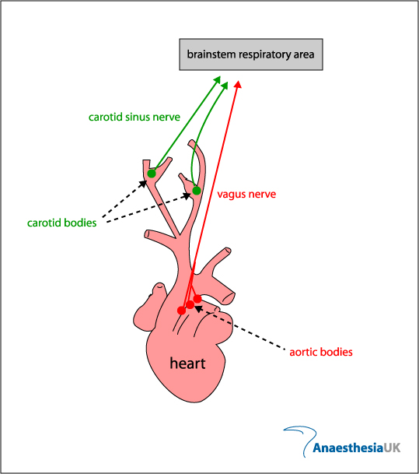
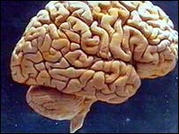

Slide 16
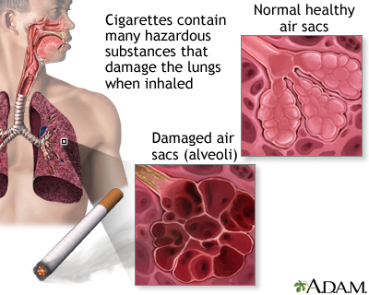
Chronic obstructive pulmonary disease (COPD)
Notes:
Cigarettes contain many hazardous substances that damage the lung when inhaled, including tar nicotine, carbon monoxide, and cyanide. Long-term exposure to secondhand tobacco smoke and/or repeated respiratory infections also can increase a person's risk for chronic obstructive pulmonary disorder.
What will happen to the amount of CO2 in your blood? What will happen to the pH?

Slide 17
COPD
High blood CO₂ , low blood O₂ but normal breathing rate.
Blood O₂ a little low so breath in O₂ by O₂ tank.
This can increase blood O₂ but it slows down breathing rate.
This leads to increase blood CO₂ , and decrease in pH (acidic).
BALANCE of blood O₂ and blood CO₂ / pH

