Slide 1
Synaptic transmission
Quantal analysis
Indexing synaptic transmission (a number)

Slide 2

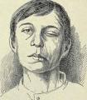

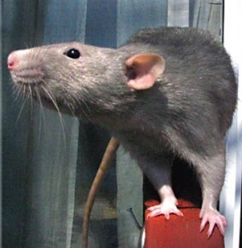
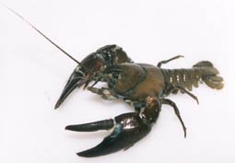
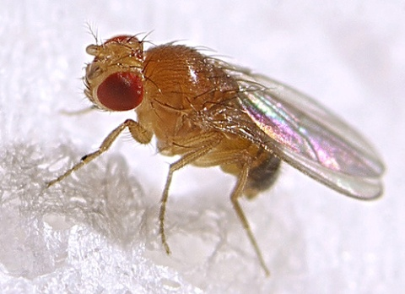
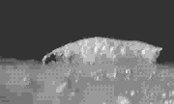
The neuromuscular junction
Notes:
Since the nervous system is so complex and important for vitality, toxic chemicals can affect many different parts of this system. And the direct result of motor neuron damage can cause muscular weakness and paralysis.
At the end of this slide---our lab is interested in how the vesicles recycle during repetitive motor activity and how they are packed after release.
Ringer 1880’s

Slide 3
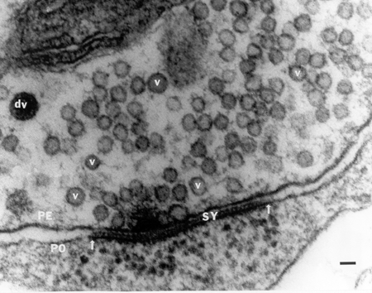

Slide 4
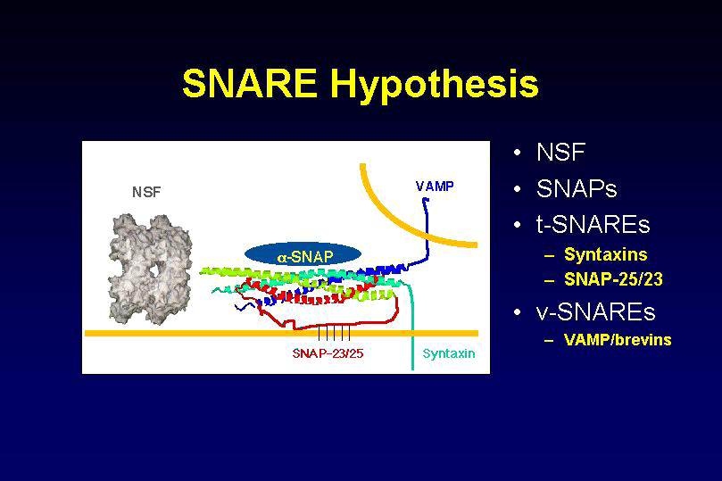

Slide 5
Whiteboard work- NMJ history of quantal synaptic transmission. Katz 1954.

Slide 6
∑ (# of failures)(0) + (# of singles)(1)+ (# of doubles)(2)…
Mean quantal content =
Total number of stimulus trials
Mean amplitude (or area) of evoked quantal events
Mean quantal content =
Mean amplitude (or area) of spontaneous quantal events

Slide 7
Minis
Some evidence for distinct differences from evoked and spontaneous release pools.
Chung et al. 2010 - hippocampal GABAergic inhibitory synapses.
Fredj & Burrone, 2009 - rat hippocampal neurons.
Sara et al., 2005 - rat hippocampal neurons.
Controversial (Wilhelm et al., 2010 ... same pool )

Slide 8
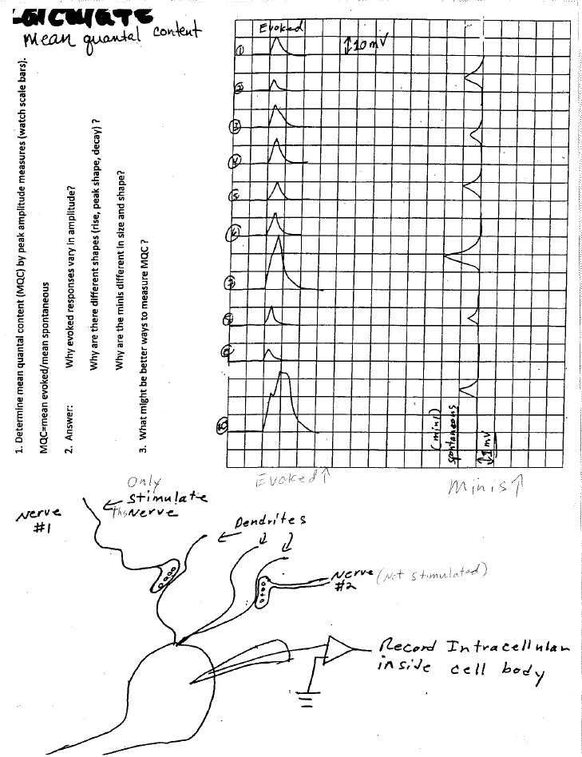

Slide 9
PRESYNAPTIC
POSTSYNAPTIC

Slide 10
PRESYNAPTIC
AP
POSTSYNAPTIC

Slide 11
Not saturated

Slide 12
Saturated
Notes:
Given two synapses. One saturated one not. Saturdated one might give a slight larger amp, given more receptors get bound, then probably one will see a broader and flatter peak. Receptor /transmitter rebound-not cleared and activation/inactivation would occur.

Slide 13
Not saturated
Off center
Notes:
Smaller EPSC with same time constant.

Slide 14
Not saturated
Saturated due to
smaller synapse
With same amount
of transmitter
Notes:
Shorter and braoder. Time constant reduced or two curves

Slide 15
3
1
2
Not saturated to
saturated based on
vesicle size and amount
released.
1
2
3

Slide 16
Not saturated
but not enough time
to recycle and refill
Time

Slide 17
RP
Not saturated
but not enough time
to recycle and refill
but can recruit from RP
Time
RP

Slide 18
Not saturated
but increase density
of postsynaptic receptor
density
Time
Test ?
Notes:
So how to test such possibilities? Density with exogenous application. But the other issues are more difficult. In addition one has to think of structure of the synapses. Both pre and post as the effect the recordings and which type of recording is made.

Slide 19
Focal recording
Intracellular muscle
recording
nerve
muscle
Case 1:
Case 2:
Missing quanta

Slide 20
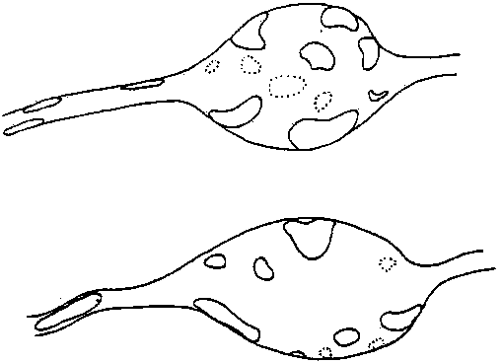

Slide 22
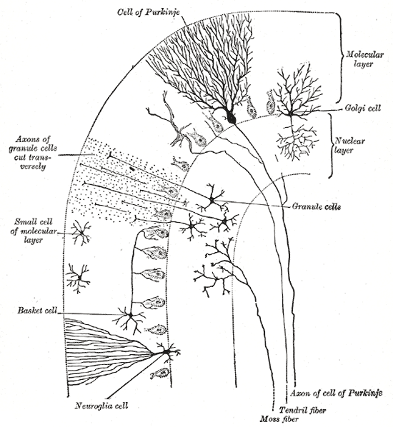
http://en.wikipedia.org/wiki/Purkinje_cell#mediaviewer/File:Gray706.png

Slide 23
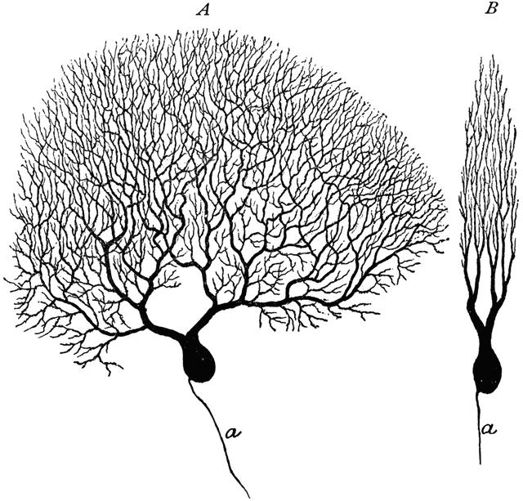
http://etc.usf.edu/clipart/53100/53184/53184_purkinje.htm

Slide 24
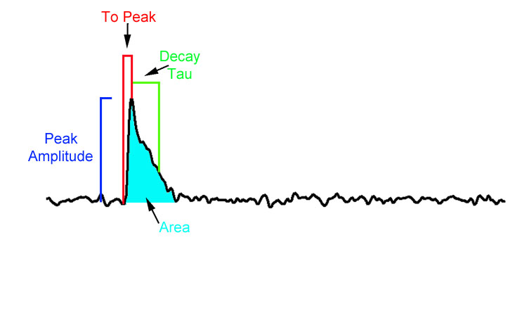
Classical Quantal Counting Methods vs. New Stochastic Measurements.
More accurately measure n (number of docked sites) and p (probability of fusion at a site).
Find subsets of quantal events.

Slide 25
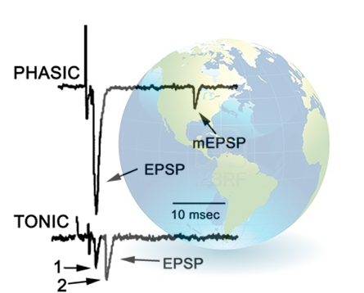
Citizen science with high school students and adults from around the world participating in analysis of synaptic transmission
http://web.as.uky.edu/Biology/faculty/cooper/Citizen%20Science%20folder/CitizenScienceProjectPage.htm

