Slide 1

Swimming Injuries
UK Swim & Dive Intro
By: Kristen Wilson

Slide 2
Common Areas of Injury for Swimmers
  Shoulder
  Knee
  Back

Slide 3
Shoulder
  Impingement Syndrome

Slide 4
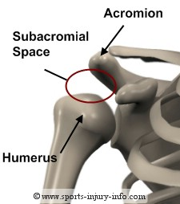
What is it?
Caused by the inflammation of the tendons surrounding the rotator cuff.
  The rotator cuff is made up of four principal muscles and is responsible for supporting and creating movements.
  One of the rotator cuff tendons become pinched between the bones which form the shoulder joint.
One main cause of impingement syndrome is rotator cuff tendonitis.
  This inflammation of the tendons creates less room for the tendons to travel through the subacromial space.

Slide 5
Why Swimmers?
Constant shoulder movement gradually causes the tendons to rub against the underside of the acromion, which can cause pain and irritation.
Poor technique of stroke mechanics can reinforce movements that are too stressful on the shoulder.
Swimmers tend to have strong muscles in their chest and the front of their shoulders, but the backside of their shoulders are weaker.
  This can cause the shoulder to be forward rounded.
  Forward rounded shoulders decreases the space available at the shoulder joint causing one or more tendons to be trapped when the arm is raised.
Common over-use injury.

Slide 6
Treatment
Stretch before and after exercise
  Stretch tight chest muscles
  Good Stretches for Shoulder
Strengthen rotator cuff muscles
Pain medications
Discontinue activities that cause shoulder pain
Correction of stroke mechanics
Impingement Treatment
Conclusion

Slide 7
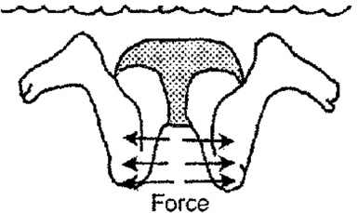
Knee
  Breaststroke Knee
  Breaststroke Kick

Slide 8
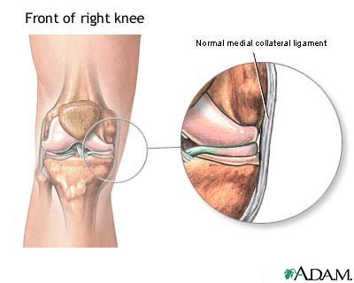
What is it?
Most common in swimmers who swim a lot of breaststroke.
Mostly due to the position of the knee during breaststroke kick.
The rotation in the kick affects
the medial collateral ligament,
which runs along the inner
side of the knee.
If painful exercise does not
stop, it can lead to a MCL
tear.

Slide 9
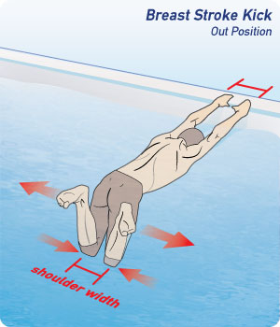
Why Swimmers?
A swimmer can have swimmer’s knee no matter what stroke they swim, but it is most common in breaststrokers.
The breaststroke kick puts extra force on the inside of the knee.

Slide 10
Treatment
Medication to reduce swelling and pain
Rest from breaststroke kick
Stretches to improve flexibility

Slide 11
Lower Back
  Lumbar Vertebrae

Slide 12
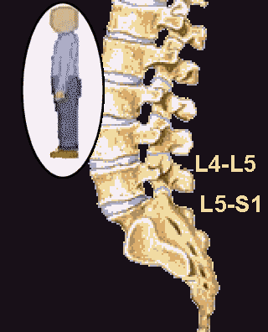
What is it?
Lower back injury is common in swimmers.
While swimmers experience back pain in their upper back between their shoulder blades, low back pain is more common.
Continuous stress placed on the lumbar spine causes much pain.
Low back pain can be the sign of many things.
  Muscle spasms
  Tight muscles
  Overuse
  Disc problems

Slide 13
Why Swimmers?
A common complaint of swimmers with lower back pain is that flip turns are very painful.
Another complaint is completing dolphin kicks.
  Usually, swimmers perform dolphin kicks coming off the wall after a flip turn and when they swim butterfly.
  Flip turn with dolphin kick
  Slow motion butterfly

Slide 14
Treatment
Medication
Heat before exercise
Ice after exercise or when it is inflamed
Resting from flip turns and dolphin kick
Stretching
Physical Therapy

Slide 15
Weights
  Good Techniques

Slide 16
Technique
The swim team here at UK lifts weights three times a week.
A lot of the lifts include heavy weights.
If you are not careful and use good techniques, then you can easily injure yourself.
Power Clean

Slide 17
Conclusion
Impingement Syndrome
Swimmer’s Knee
Low Back pain
Weights

Slide 18
References
http://www.nsmi.org.uk/articles/swimming-injuries.html
http://www.nismat.org/traintip/swimmershld
http://www.youtube.com/watch?v=xLB-IrNuuV0
http://www.youtube.com/watch?v=uDeoO3XPfS8&feature=related
http://www.youtube.com/watch?v=KjlID6KwPX4
http://www.youtube.com/watch?v=T9eDAQxL5cA
http://www.youtube.com/watch?v=zmiyhPop6GI
http://www.youtube.com/watch?v=dggpMIKYaA0&feature=plcp

