Slide 1
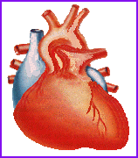
Neonate Heart

Slide 2
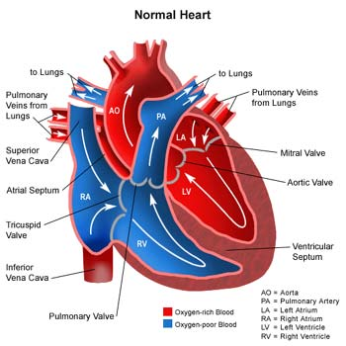
Notes:
In 2nd century AD Rome, the Greek physician Galen knew that blood vessels carried blood and identified venous (dark red) and arterial (brighter and thinner) blood, each with distinct and separate functions.
In 1025, The Canon of Medicine by the Persian physician, Avicenna, "erroneously accepted the Greek notion regarding the existence of a hole in the ventricular septum by which the blood traveled between the ventricles." Despite this, Avicenna "correctly wrote on the cardiac cycles and valvular function", and "had a vision of blood circulation" in his Treatise on Pulse.^{[6]} While also refining Galen's erroneous theory of the pulse, Avicenna provided the first correct explanation of pulsation: "Every beat of the pulse comprises two movements and two pauses. Thus, expansion : pause : contraction : pause. [...] The pulse is a movement in the heart and arteries ... which takes the form of alternate expansion and contraction."[
In 1242, the Arabian physician, Ibn al-Nafis, became the first person to accurately describe the process of pulmonary circulation, for which he is sometimes considered the father of circulatory physiology.^{[8]} Ibn al-Nafis stated in his Commentary on Anatomy in Avicenna's Canon:
"...the blood from the right chamber of the heart must arrive at the left chamber but there is no direct pathway between them. The thick septum of the heart is not perforated and does not have visible pores as some people thought or invisible pores as Galen thought. The blood from the right chamber must flow through the vena arteriosa (pulmonary artery) to the lungs, spread through its substances, be mingled there with air, pass through the arteria venosa (pulmonary vein) to reach the left chamber of the heart and there form the vital spirit..."
Finally William Harvey, a pupil of Hieronymus Fabricius (who had earlier described the valves of the veins without recognizing their function), performed a sequence of experiments, and published Exercitatio Anatomica de Motu Cordis et Sanguinis in Animalibus in 1628, which "demonstrated that there had to be a direct connection between the venous and arterial systems throughout the body, and not just the lungs. Most importantly, he argued that the beat of the heart produced a continuous circulation of blood through minute connections at the extremities of the body. This is a conceptual leap that was quite different from Ibn al-Nafis' refinement of the anatomy and bloodflow in the heart and lungs."^{[10]} This work, with its essentially correct exposition, slowly convinced the medical world. However, Harvey was not able to identify the capillary system connecting arteries and veins; these were later discovered by Marcello Malpighi in 1661.
http://en.wikipedia.org/wiki/Cardiovascular_system

Slide 3
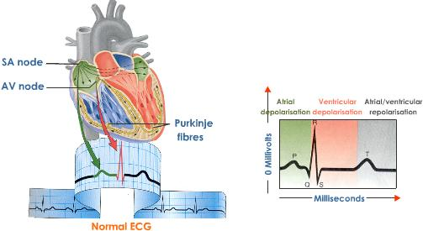

Slide 4
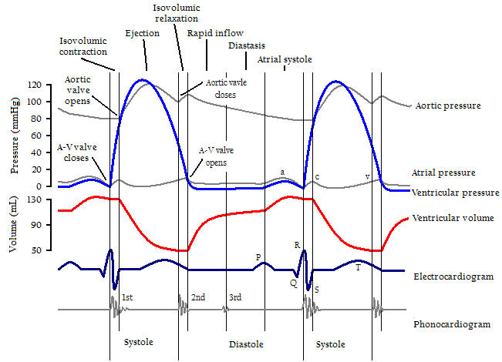
Cardiac cycle related to sounds & values:

Slide 5
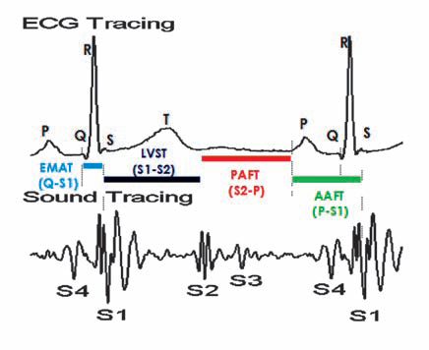

Slide 6
Normal heart sounds are associated with heart valves closing,
causing changes in blood flow
Common:
S₁ : The first heart tone, or S₁, forms the "lubb" of "lubb-dub“
Closure of the atrioventricular valves
S₂: The second heart tone, or S₂, forms the "dub" of "lubb-dub“
Closure of the aortic valve and pulmonary valve at the end of ventricular systole
Not so common: In young children can hear. IN NEONATES ONE SHOULD NOT HEAR S3 AND S4.
S₃: Also called a protodiastolic gallop, ventricular gallop, or informally the "Kentucky" gallop (S1=ken; S2=tuc; S3=ky). It is not of valvular origin.
S3 is thought to be caused by the oscillation inrushing blood from the atria.
S₄: The rare fourth heart sound is sometimes audible in healthy children and again in trained athletes. Is called a presystolic gallop or atrial gallop.
Producing a rhythm sometimes referred to as the "Tennessee" gallop where S4 represents the "tenn-" syllable.
Notes:
The third heart sound is benign in youth and some trained athletes. Later in life it may signal cardiac problems like a failing left ventricle as in dilated congestive heart failure (CHF).
S4
This gallop is produced by the sound of blood being forced into a stiff/hypertrophic ventricle. It is a sign of a pathologic state.

Slide 7
What is a Murmur?
It maybe a normal or abnormal sound that is heard secondary to turbulent blood flow.

Slide 8
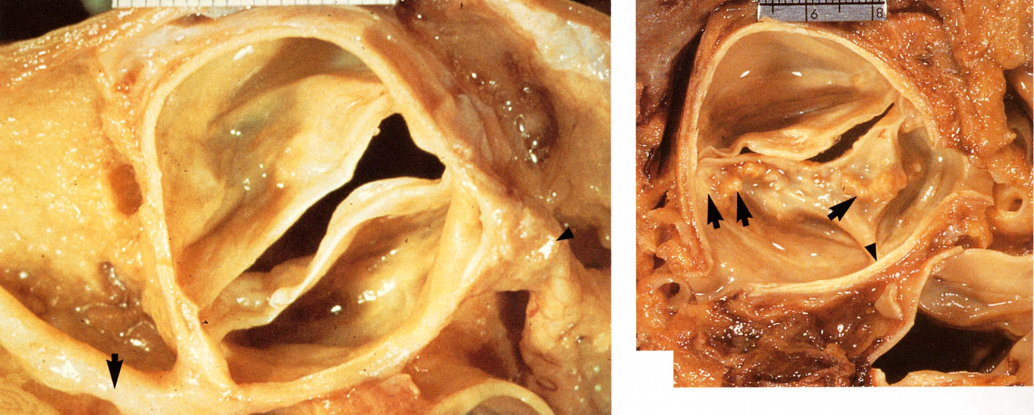
Aortic

Slide 9
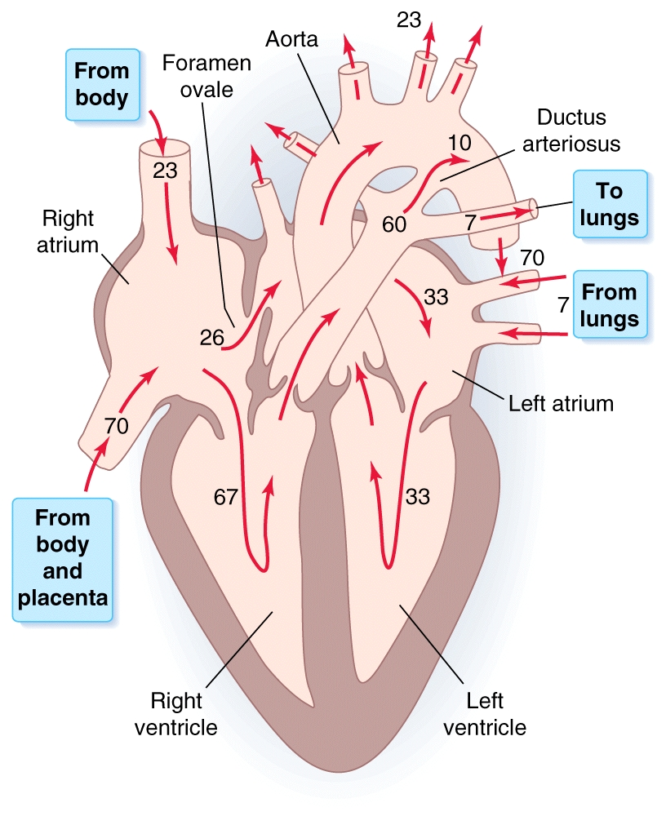

Slide 10
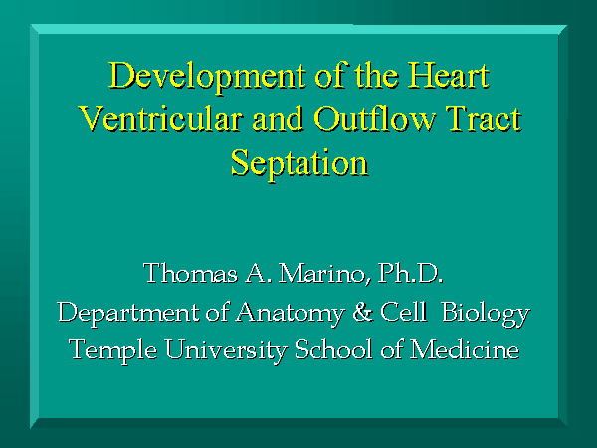
Embryonic Development
http://isc.temple.edu/marino/embryo/cardio.htm
Notes:
http://isc.temple.edu/marino/embryo/cardio.htm
http://www.indiana.edu/~anat550/cvanim/

Slide 11
http://isc.temple.edu/marino/animations/heart.avi
Human heart
Notes:
http://www.uic.edu/com/surgery/embryo/looping_lo.mov

Slide 39
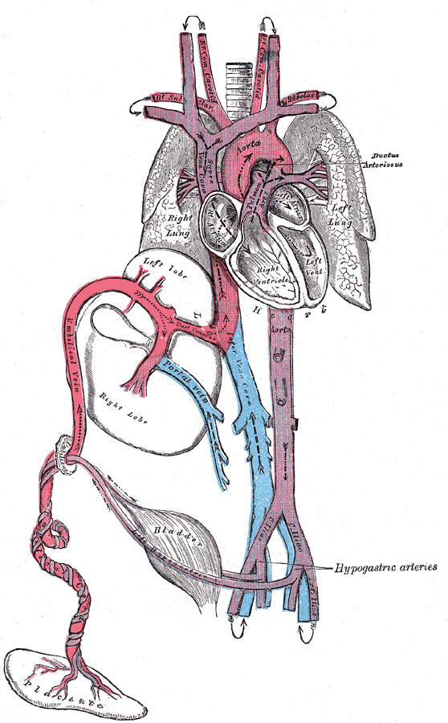
Fetus Heart: Before & After Birth
Ductus arteriosus
Foramen ovale
Ductus venosus

Slide 40
Sounds
Normal
http://depts.washington.edu/physdx/heart/demo.html
Ventricular septal defect

Slide 41
Indomethacin
In humans, postnatal indomethacin can cause closure of the ductus arteriosus, and is used therapeutically when this structure remains patent in preterm neonates (Heymann et al., ’76).
Ductal constriction can also occur in utero after maternal indomethacin administration (Moise et al., ’88).
In addition, infants exposed to prenatal indomethacin were more likely to require surgical ligation of their PDA due to either a lack of response to postnatal indomethacin or a reopening of the duct after initial closure.
Pediatrics in Review Vol.28 No.4 April 2007
Notes:
http://teratology.org/updates/56pg282.pdf

Slide 42
The human heart beats more than 3.5 billion times in an average lifetime.
The human embryonic heart begins beating approximately 21 days after conception.
The human heart begins beating at a rate near the mother’s, about 75-80 BPM.
The embryonic heart rate (EHR) then accelerates linearly for the first month of beating, peaking at 165-185 BPM during the early 7th week.
This acceleration is approximately 3.3 BPM per day, or about 10 BPM every three days
( increase of 100 BPM in the first month).
After peaking at about 9.2 weeks after the normal menstrual period (LMP), it decelerates to about 150 BPM (+/-25 BPM) during the 15th week after the LMP.
After the 15th week the deceleration slows reaching an average rate of about 145 (+/-25 BPM) BPM at term.
The regression formula which describes this acceleration before the embryo reaches 25 mm in crown-rump length or 9.2 LMP weeks is:
There is no difference in male and female heart rates before birth
Notes:
OBGYN.net "Embryonic Heart Rates Compared in Assisted and Non-Assisted Pregnancies
Terry J. DuBose http://www.obgyn.net/english/pubs/features/dubose/ehr-age.htm Sex, Heart Rate and Age]

Slide 43
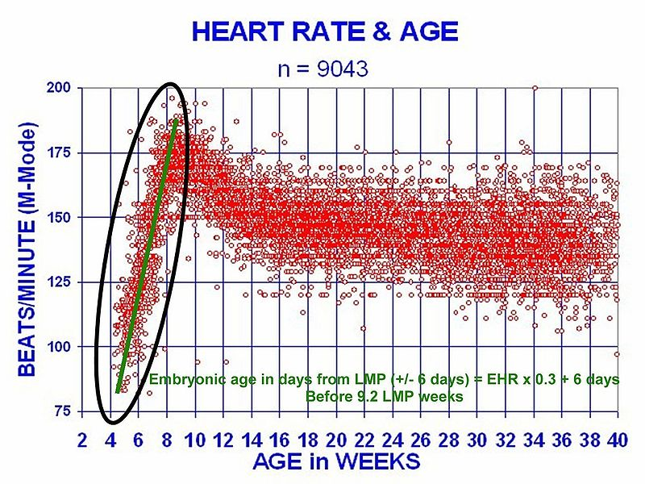
Terry J. DuBose, M.S., RDMS; Director Diagnostic Medical Sonography Program University of Arkansas for Medical Sciences
Notes:
DuBose TJ, Cunyus JA, & Johnson L; Embryonic Heart Rate and Age. J Diagn Med Sonography 1990; 6:151-157.
DuBose TJ; FETAL SONOGRAPHY, W. B. Saunders Co. 1996, pp. 263-273.

Slide 44
Congenital Heart Diseases: Neonate & Young Infant
Significant congenital heart disease (CHD) may be diagnosed at virtually any age.
Some conditions always are discovered in neonates; others rarely are identified during infancy.

Slide 45
Pediatrics in Review Vol.28 No.4, 2007

Slide 46
Pediatrics in Review Vol.28 No.4, 2007

Slide 47
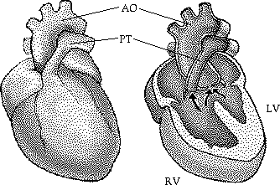
Tetralogy of Fallot
This condition results from a single error: the conus septum develops too far anteriorly giving rise to two unequally proportioned vessels- - a large aorta and a smaller stenotic pulmonary trunk.
The four main characteristics of Tetralogy of Fallot are:
(1) pulmonary stenosis
(2) ventricular septal defect (VSD) of the membranous portion (the septum is displaced too far anteriorly to contribute to the septum)
(3) overriding aorta (the aorta straddles the VSD)
(4) right ventricular hypertrophy due to the shunting of blood from left to right. (The pressure in the right ventricle is increased causing the walls of the right ventricle to expand.)
Total Correction: mortality less than 3%

Slide 48
Tricuspid Atresia:
Total Correction: mortality less than 3%
Transposition of the great arteries
Total Correction: mortality less than 2%
Pulmonic stenosis
Total Correction: mortality less than 1%
Truncus Arteriosus (various types)
Mortality is > 10%
Hypoplastic left heart syndrome
Mortality ~10%
Perry et al. 2010. Maternal Child Nursing Care, 4th Edition. Chapter 48

Slide 49
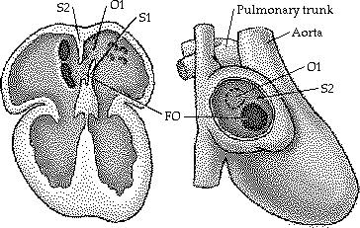
Septal defects
At the end of the seventh week -final stage of development.
Fetus does not use its lungs, most of the blood is diverted to the systemic circulation. Foramen ovale and the septum primum
At birth the child will use its lungs for the first time: more blood pulmonary circulation.
The pressure increase in the left atrium will force septum primum to wall- two septa fuse
(common atrial septum)
O1 = Ostium primum
S1 = Septum primum
FO = Foramen ovale
S2 = Septum secundum

Slide 50
ECG: Neonate
Arrhythmias in fetuses and newborns are relatively common, occurring in up to 90% of newborns and in 1% to 3% of pregnancies (NeoReviews Vol.9 No.6 2008 e242,2008 American Academy of Pediatrics, Fetal and Neonatal Arrhythmias)
Weak arterial pulses and right heart overload in the electrocardigram suggested the diagnosis of hypoplasia of the left heart. Impaired coronary perfusion to portions of the right and left ventricular myocardium. Pulmonary vasoconstriction from hypoxia. Myocardial ischemia on the electrocardiogram (The Journal of Pediatrics Volume 81 (2): 243-250 )
SIDS: A prolonged QT interval may be an important cause for SIDS. (Schwartz et al., The New England Journal of Medicine, 1998 338(24):1709-1714.

Slide 51
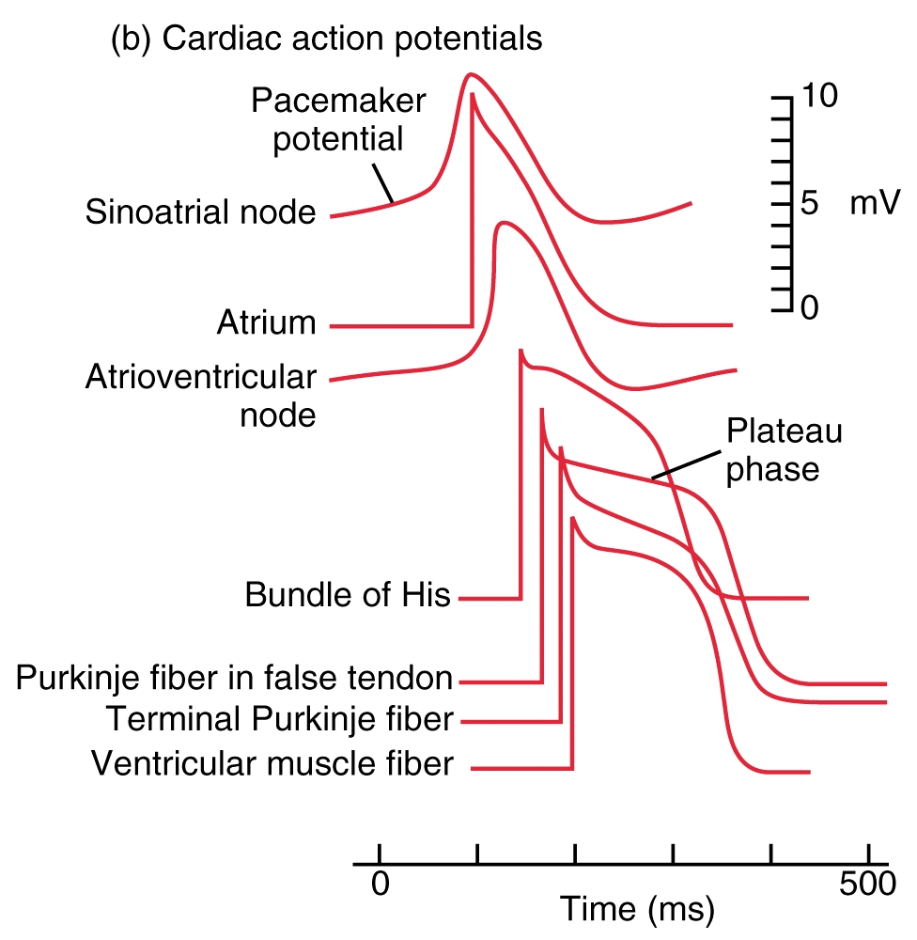

Slide 52
MUSCLE CONTRACTION
Na⁺
K⁺

Slide 53
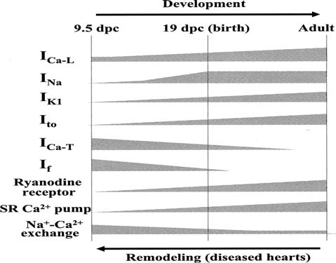
Brugada syndrome : Genetic disease, abnormal ECG sudden cardiac death (Sudden Unexpected
Death Syndrome -SUDS). First described in 1992, ventricular fibrillation mutation in Na+ ion channel

Slide 54
Ion channels
Recent evidence indicates that between 5 and 15% of SIDS cases carry potentially lethal loss-of-function mutations in cardiac channelopathy genes.
(Future Cardiol. 2009 Mar;5(2):201-7. Sudden infant death syndrome and cardiac arrhythmias. Morris JA, Harrison L, Brodison A, Lauder R. Department of Pathology, Royal Lancaster Infirmary, Lancaster LA1 4RP, UK.)
Morphological changes in the mitochondrial network likely accompany the uncoupling with mitochondrial fission dampening the signals leading to cardiomyocyte death.
(J Bioenerg Biomembr. 2009 Apr;41(2):133-6. Uncouple my heart: the benefits of inefficiency.

Slide 55
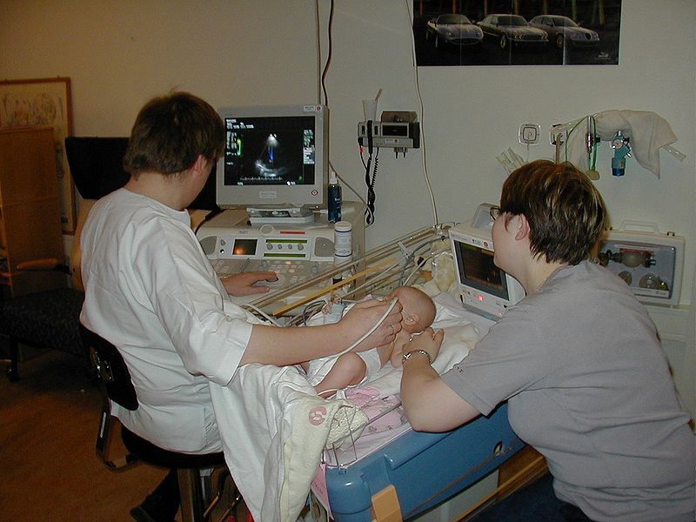
Sonographer: Pediatric echocardiography

