Slide 1
Gap junctions

Slide 2
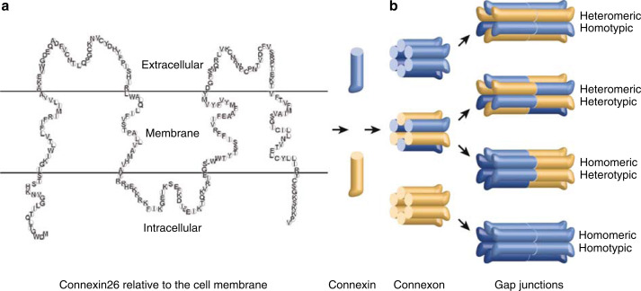
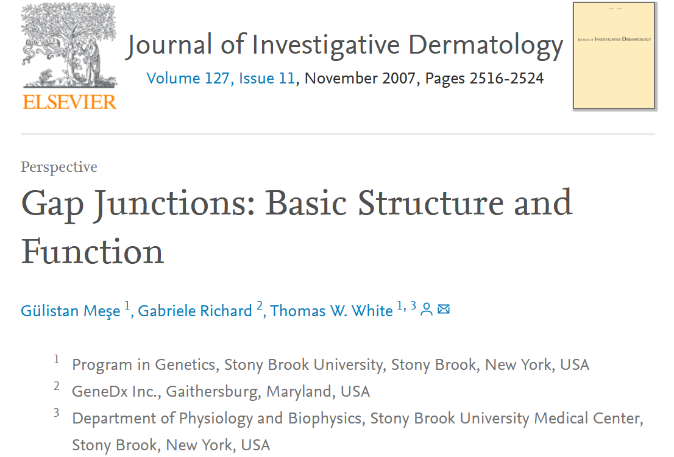
https://www.sciencedirect.com/science/article/pii/S0022202X15331821

Slide 3
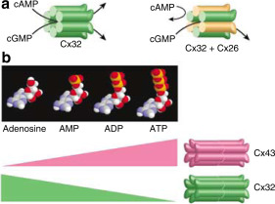

Slide 4
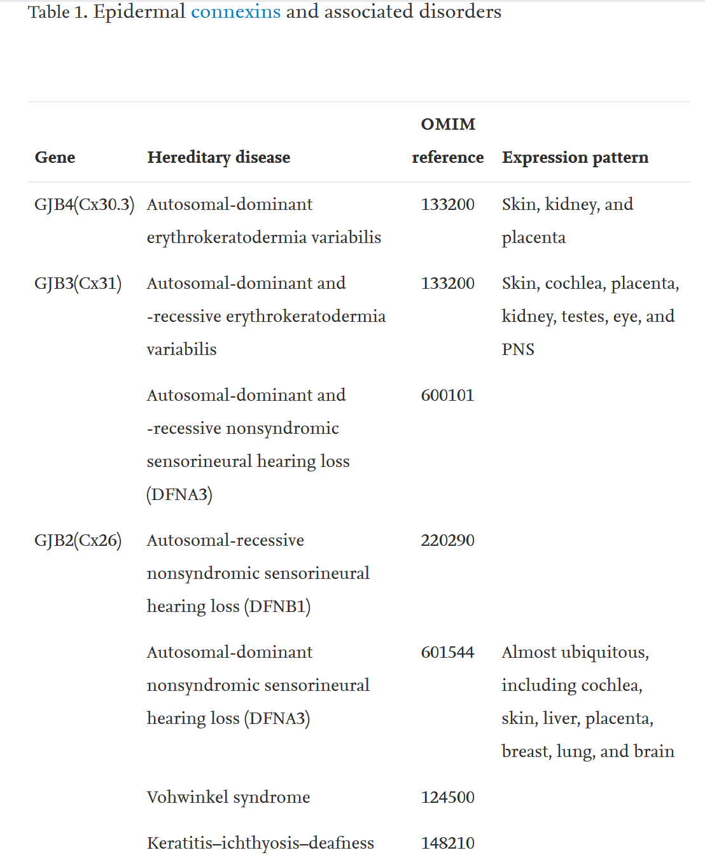
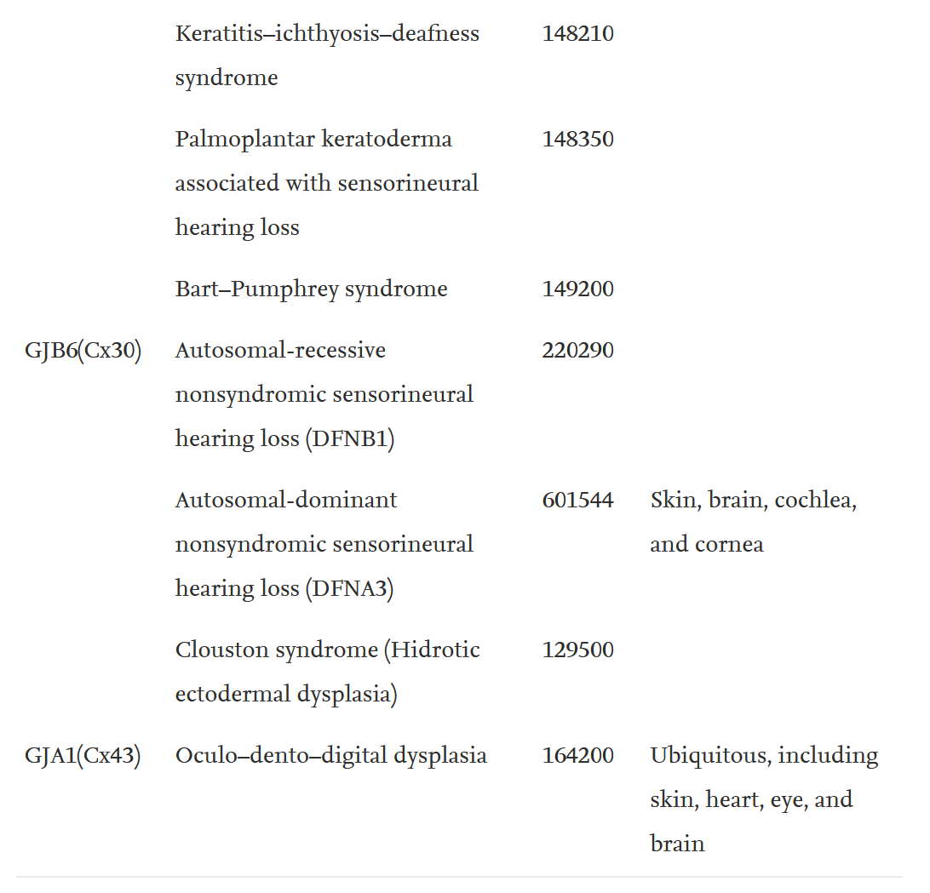

Slide 5
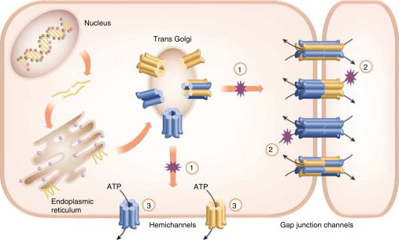

Slide 6
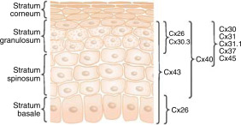
Figure 4. Expression pattern of connexins in the epidermis. At least nine connexin isoforms have been shown to be expressed during epidermal morphogenesis with distinct spatial and temporal expression pattern as well as some overlapping distribution. Cx43 is the most broadly expressed, whereas Cx26 is limited to basal keratinocytes in palms and soles, or occasionally cells in the granular layer. Cx40 is present throughout the spinous and granular layers, whereas the remaining six connexins are restricted to the upper spinous and granular layers.

Slide 7
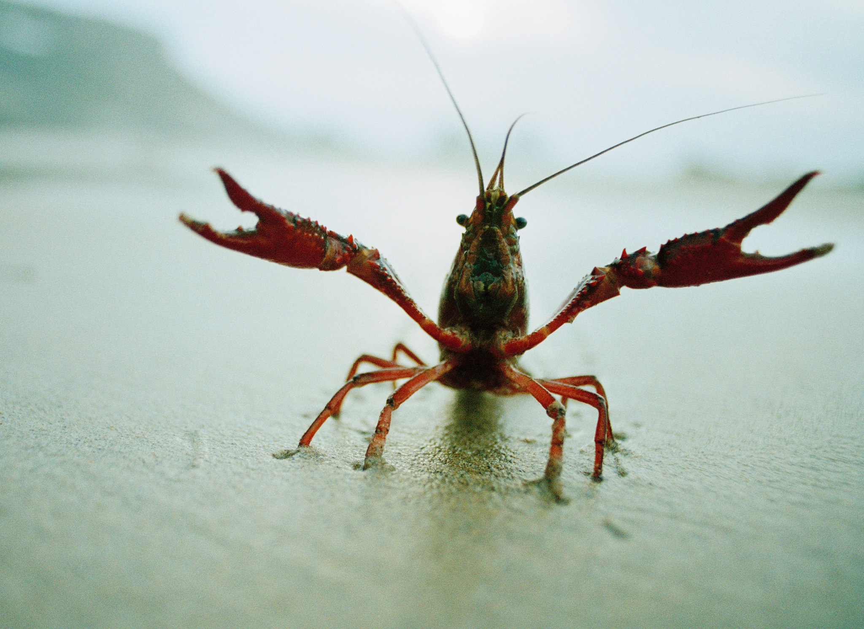
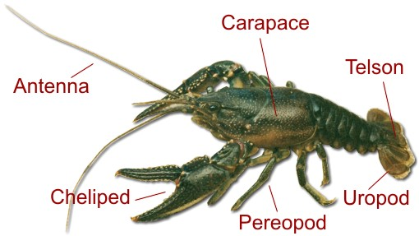

Slide 9
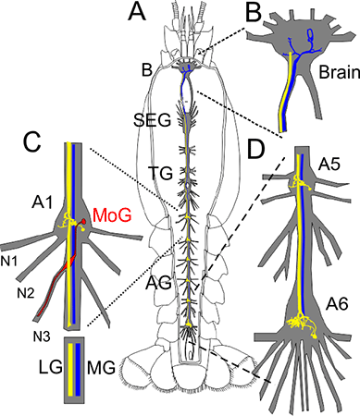
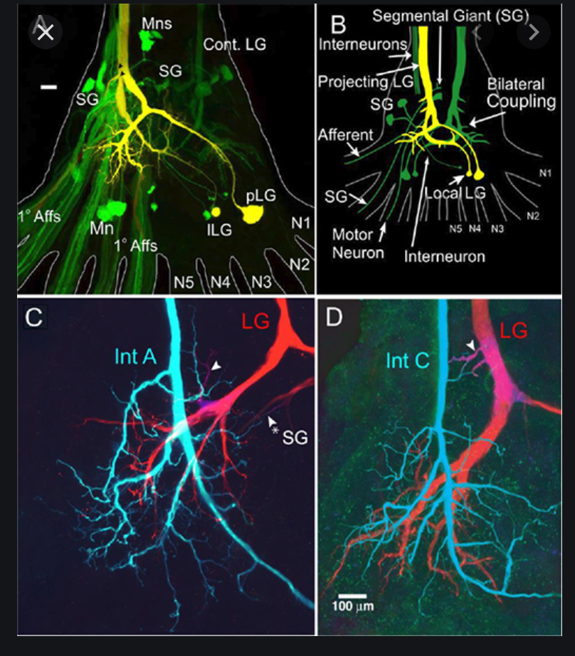
Edwards, D. (2017, May 24). Crayfish Escape. Oxford Research Encyclopedia of Neuroscience. Retrieved 4 Jan. 2021, from https://oxfordre.com/neuroscience/view/10.1093/acrefore/9780190264086.001.0001/acrefore-9780190264086-e-158.

Slide 10
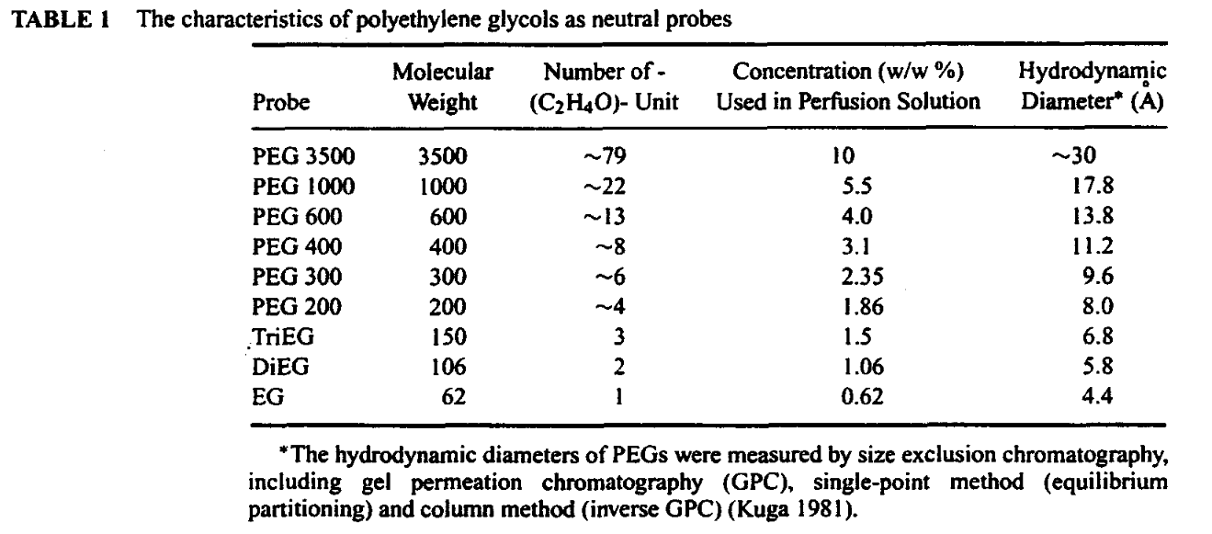

Slide 11
Where else are gap junctions used ?
In humans ?
Given the important role of gap junctions in animal cells, you might wonder if they also exist in plant cells. However, gap junctions are absent in plant cells.
Plant cells contain channels called plasmodesmata. Edward Tangl first discovered these in 1885. Animal cells do not harbor any plasmodesmata per se, but scientists have discovered a similar channel that is not a gap junction. There are a number of structural differences between plasmodesmata and gap junctions.
(https://sciencing.com/difference-between-gap-junctions-plasmodesmata-8714824.html)

Slide 12
Crayfish:
“Increase in gap junction resistance with acidification in crayfish septate axons is closely related to changes in intracellular calcium but not hydrogen ion concentration”
The data indicate that the increase in junctional resistance induced by acidification is more closely related to [Ca²⁺]_{i} than to [H⁺]_{i}.
In conclusion, this study shows lack of a direct relationship between intracellular pH and channel gating in crayfish septate axons. In these cells intracellular acidification causes an increase in [Ca2+]i that closely matches a parallel increase in junctional resistance. This suggests that acidification may close these gap junction channels via changes in internal free calcium. Whether the same mechanism takes place in other cell systems remains to be proven.
Peracchia, C. Increase in gap junction resistance with acidification in crayfish septate axons is closely related to changes in intracellular calcium but not hydrogen ion concentration. J. Membrain Biol. 113, 75–92 (1990). https://doi-org.ezproxy.uky.edu/10.1007/BF01869608

