Slide 1
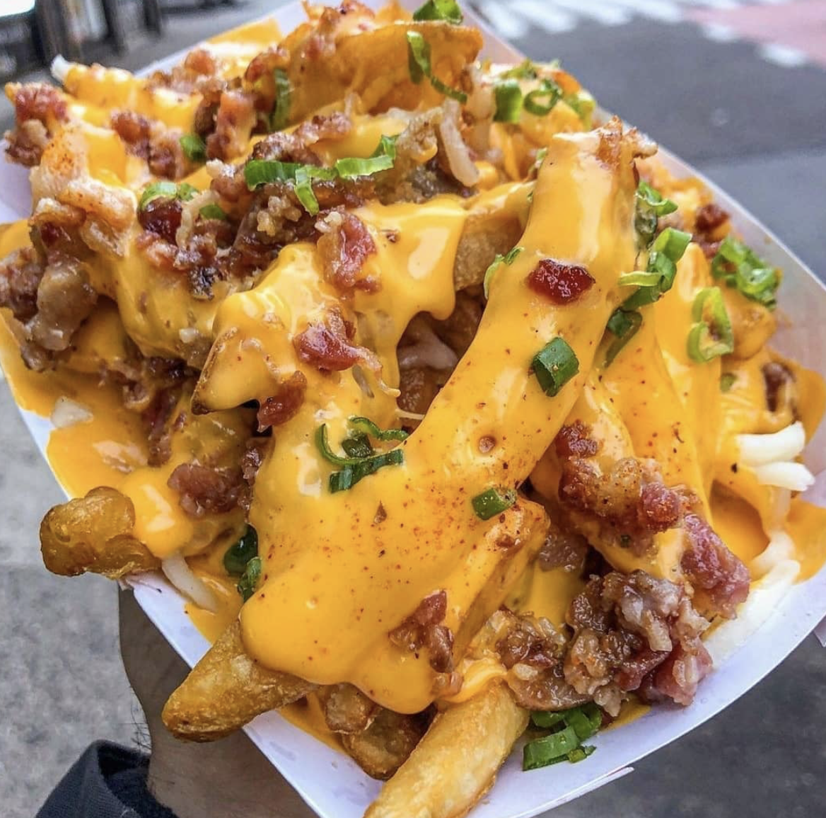
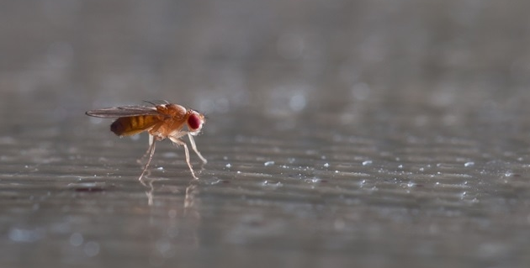
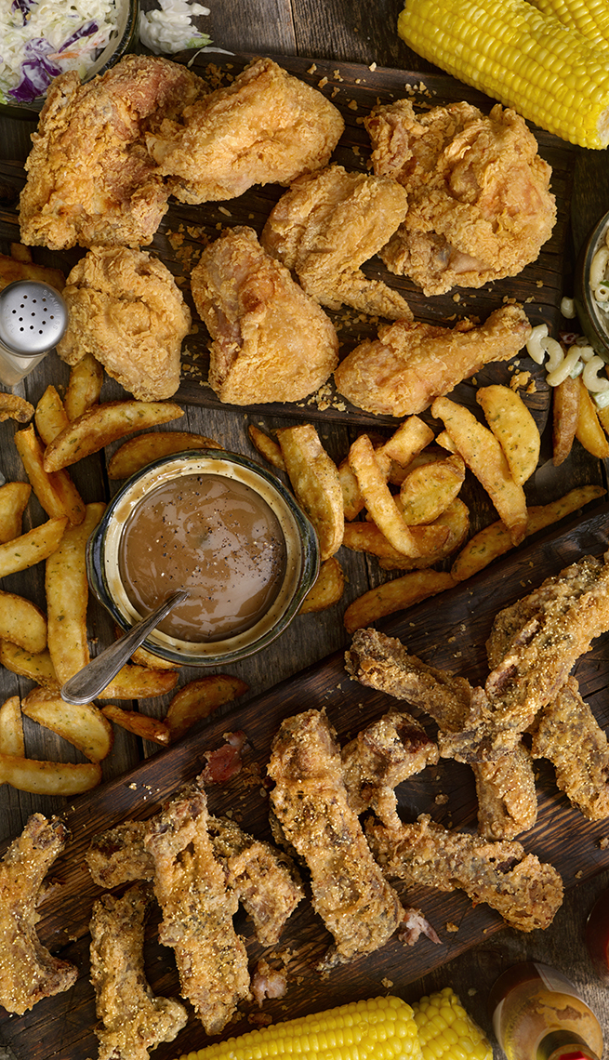
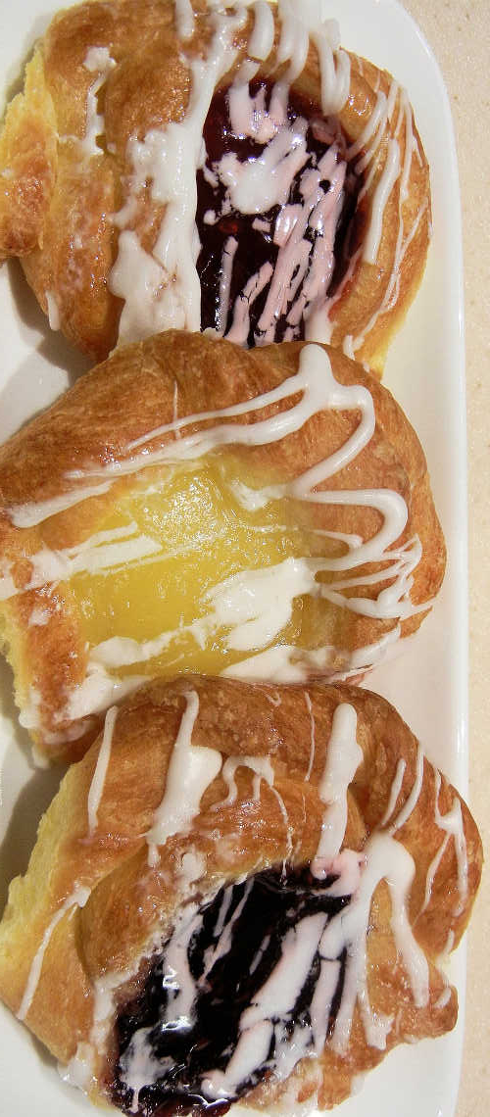
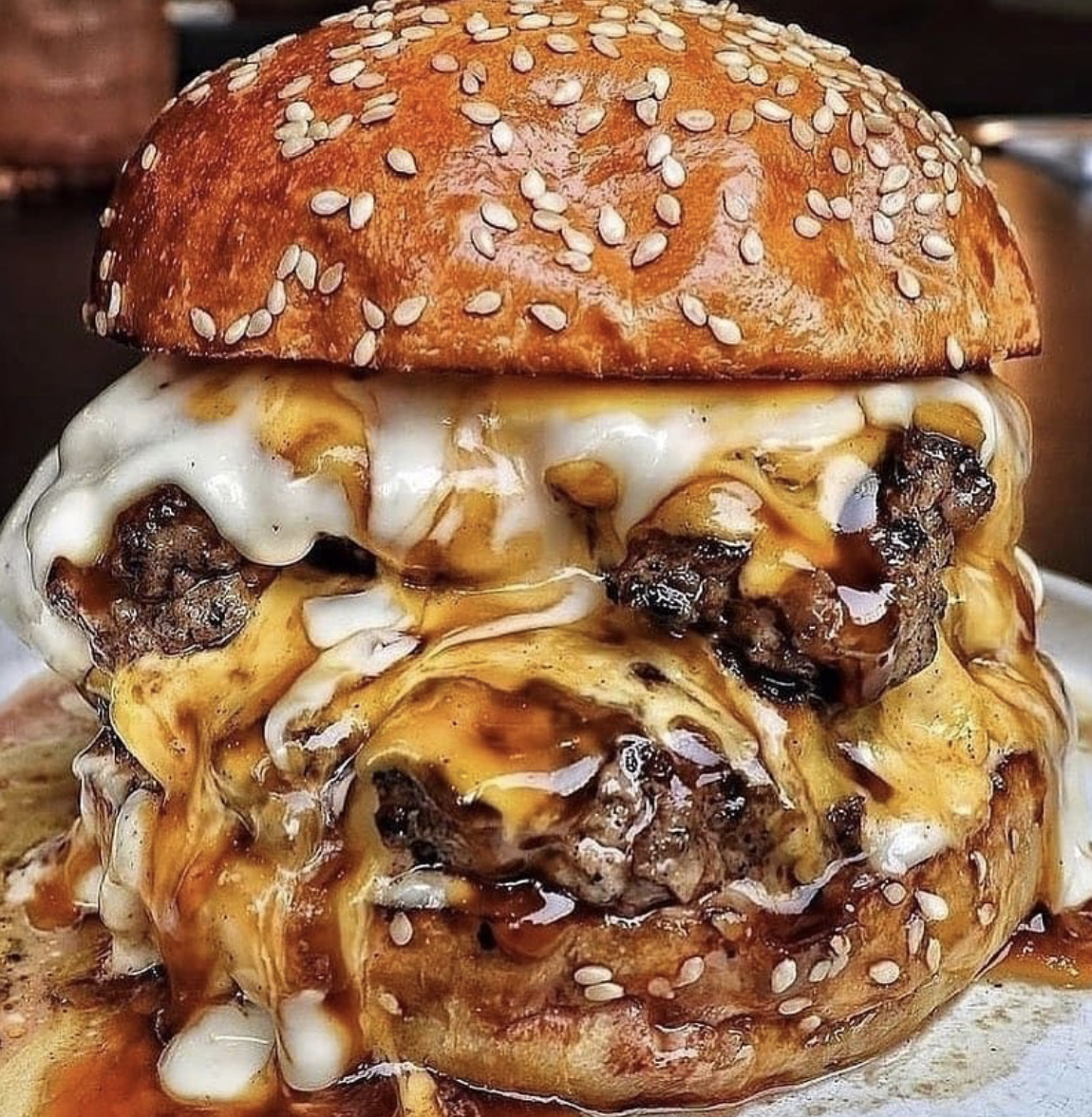
An active learning approach to teach aspects of human dietary health using fruit flies as a model
Brittany L. Slabach, Trinity University
Robin L. Cooper, University of Kentucky
ViABLE 2021

Slide 2
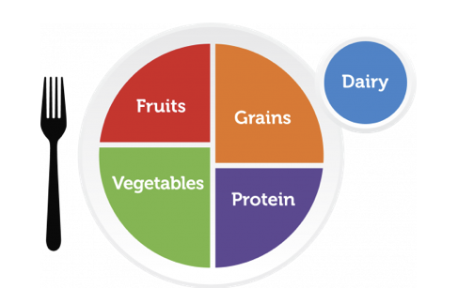
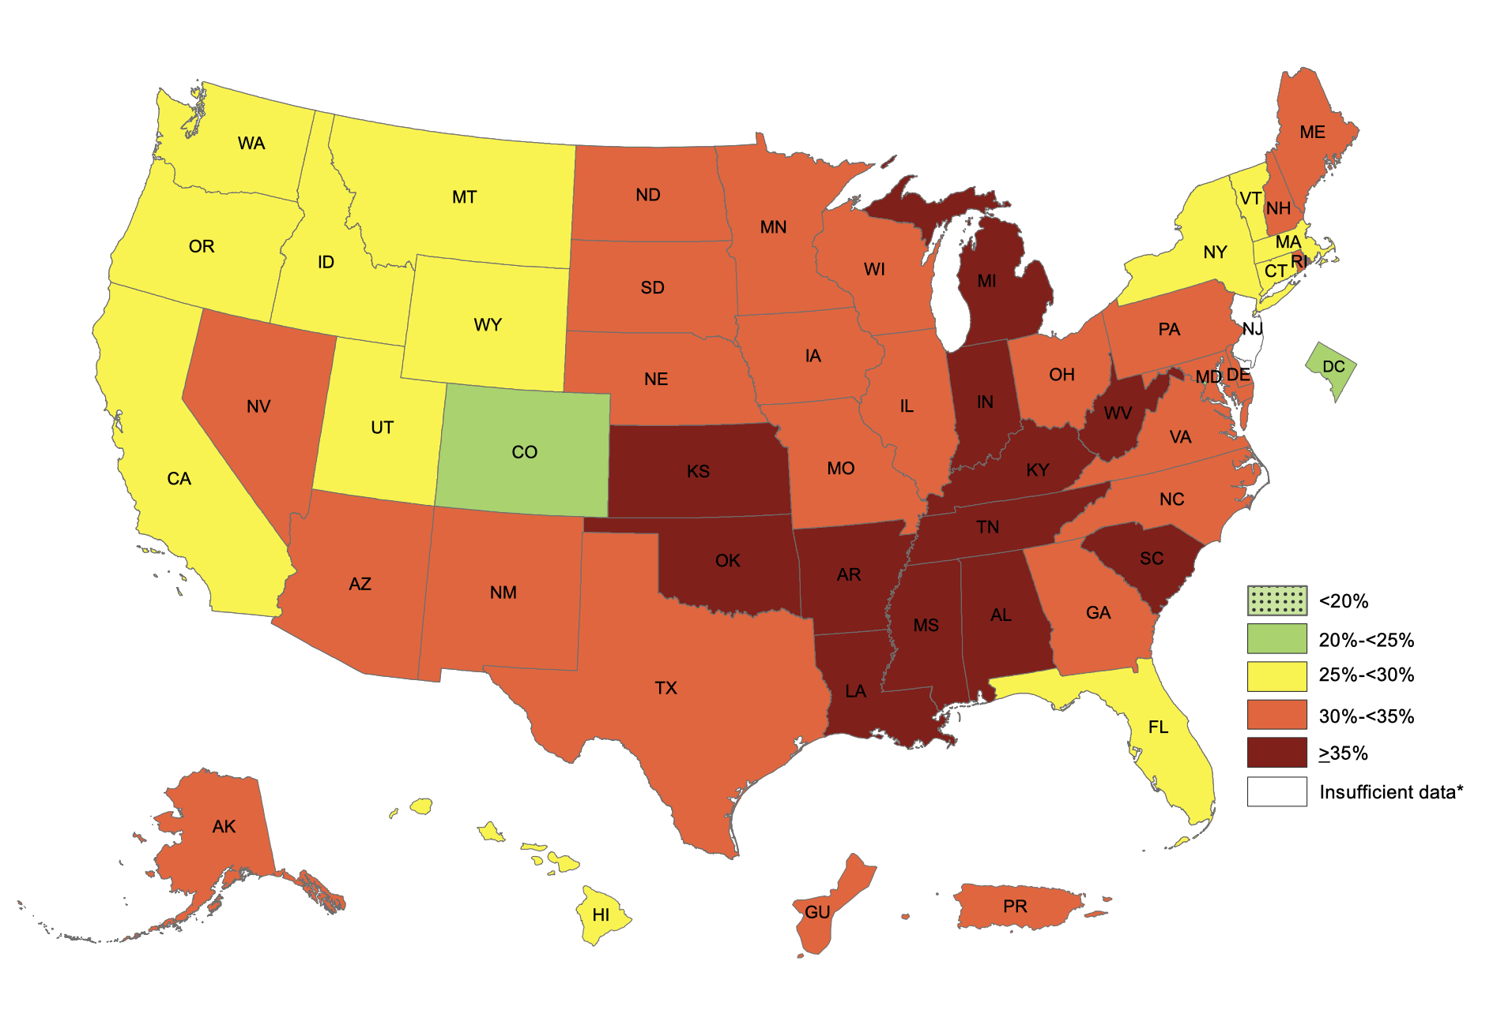
Teaching about diet and health
Metabolic needs and homeostasis
Energy balance – Energy in, energy out
Framed in relation to socio-ecological factors and health: obesity, heart disease, stroke, etc.
While important – bridging the gap between these concepts and individual, real-world applications can be difficult
Prevalence of self-reported obesity by state (CDC 2019)
Notes:
Mention that in classes such as Human anatomy and physiology; vertebrate zoology or phys, developmental biology – discussion of minerals and importance of those to physiological function is usually discussed.

Slide 3


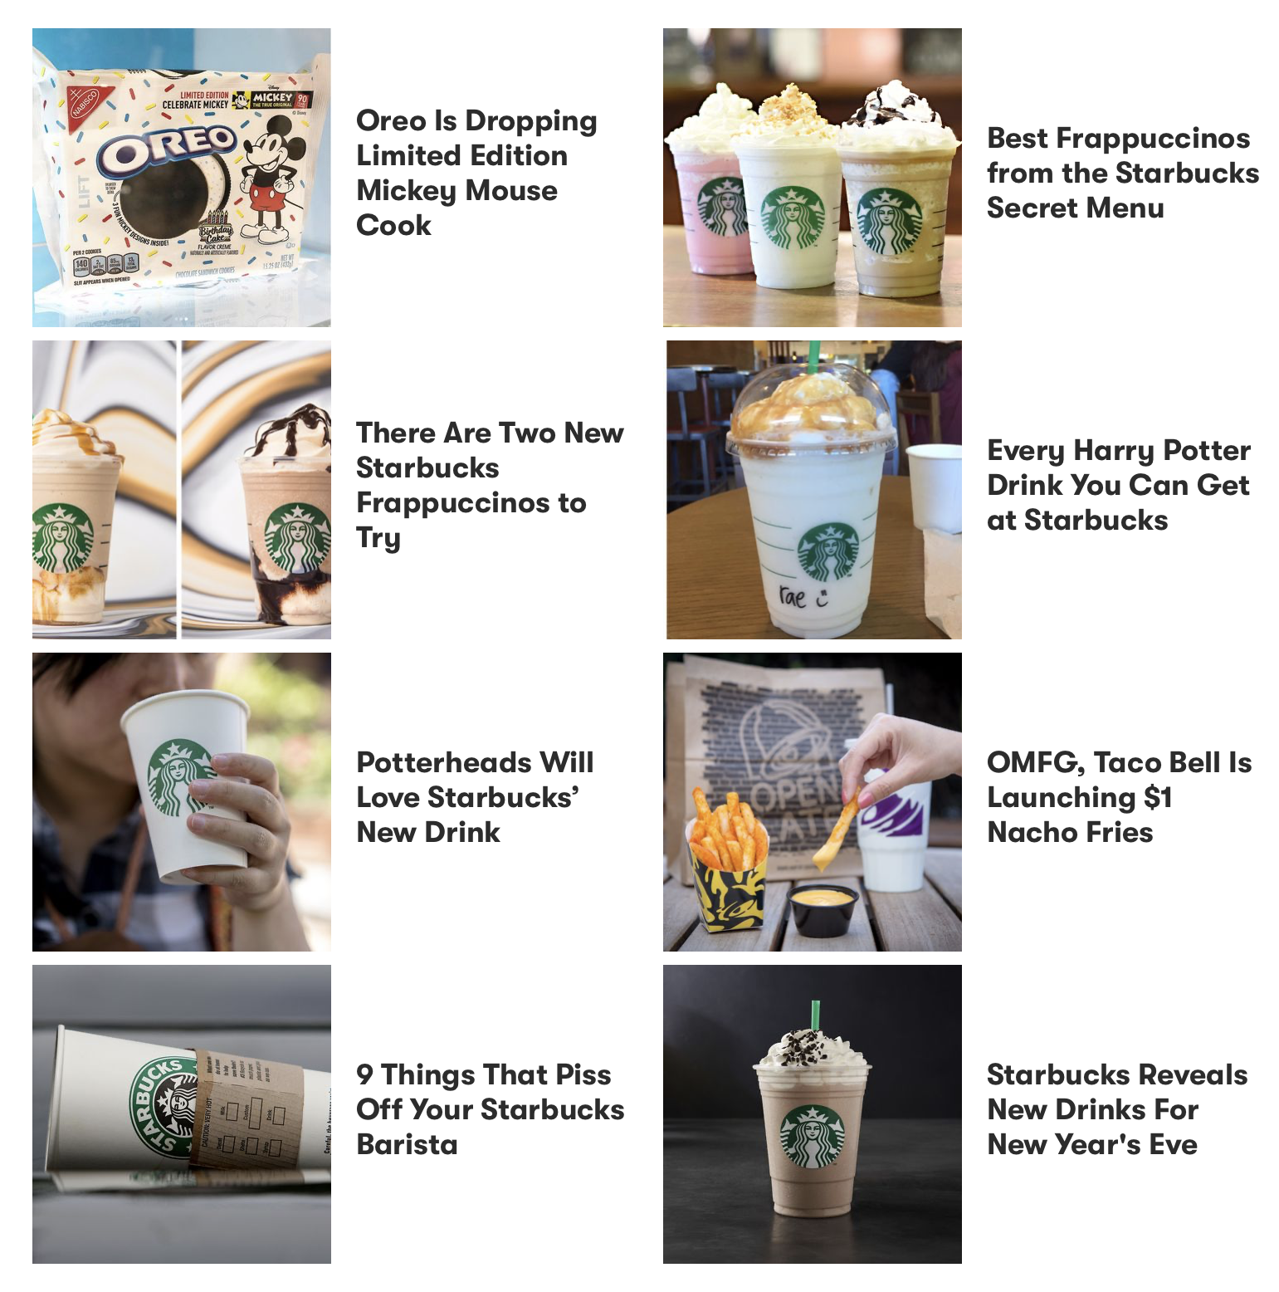
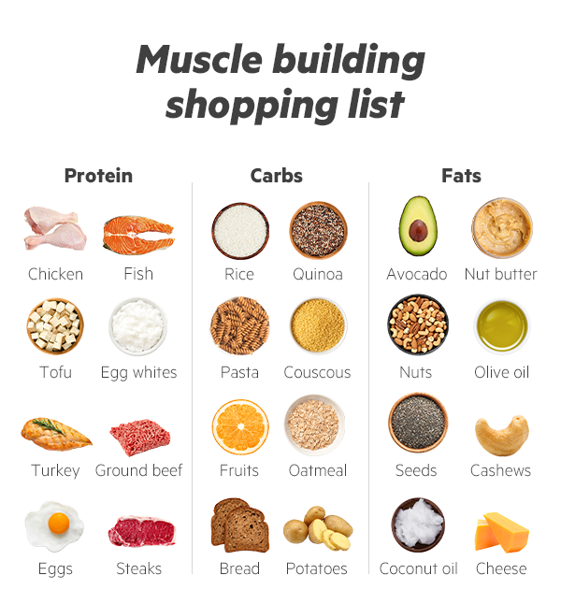
Teaching about diet and health

Slide 4
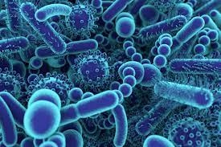
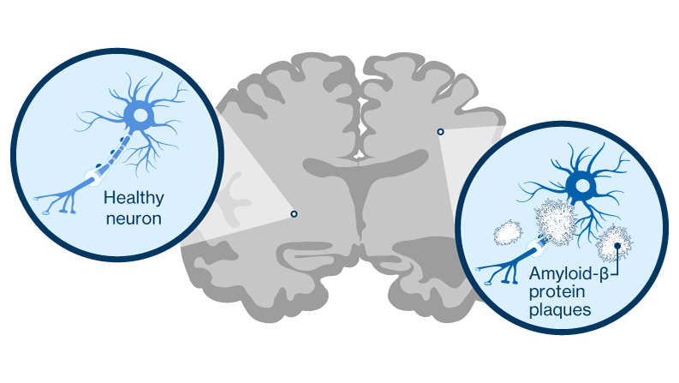
Teaching about diet and health
Dietary treatments for disease have been around for more than 2000 years
Ketogenic diet (high fat; low protein) has been used since the 1920s to treat epilepsy
Research on the connection between the gut microbiome and disease has surged in the past decade

Slide 5
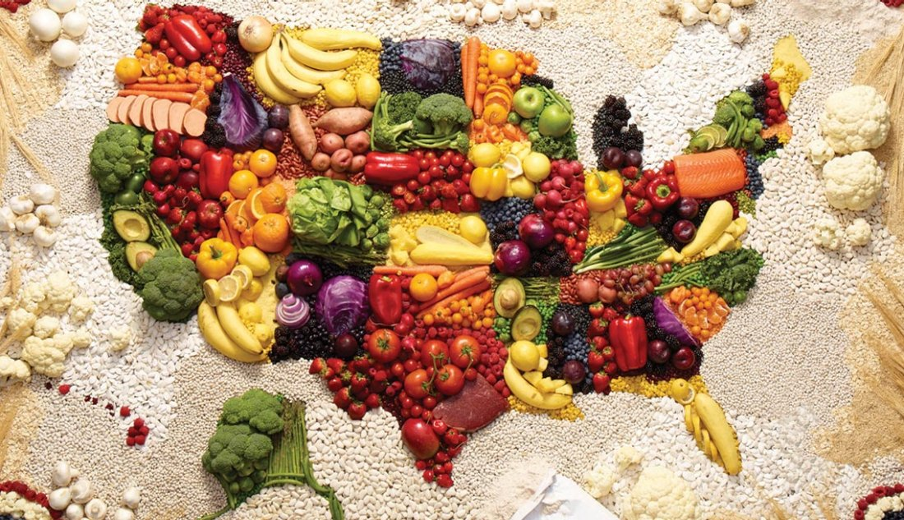
Teaching about diet and health
Objective: to provide a means to explore the relationship between diet and physiological mechanisms in a simplified manner
Given our focus on human dietary health, we chose three different experimental diets:
  High fat (Ketogenic)
  High protein
  High sugar

Slide 6
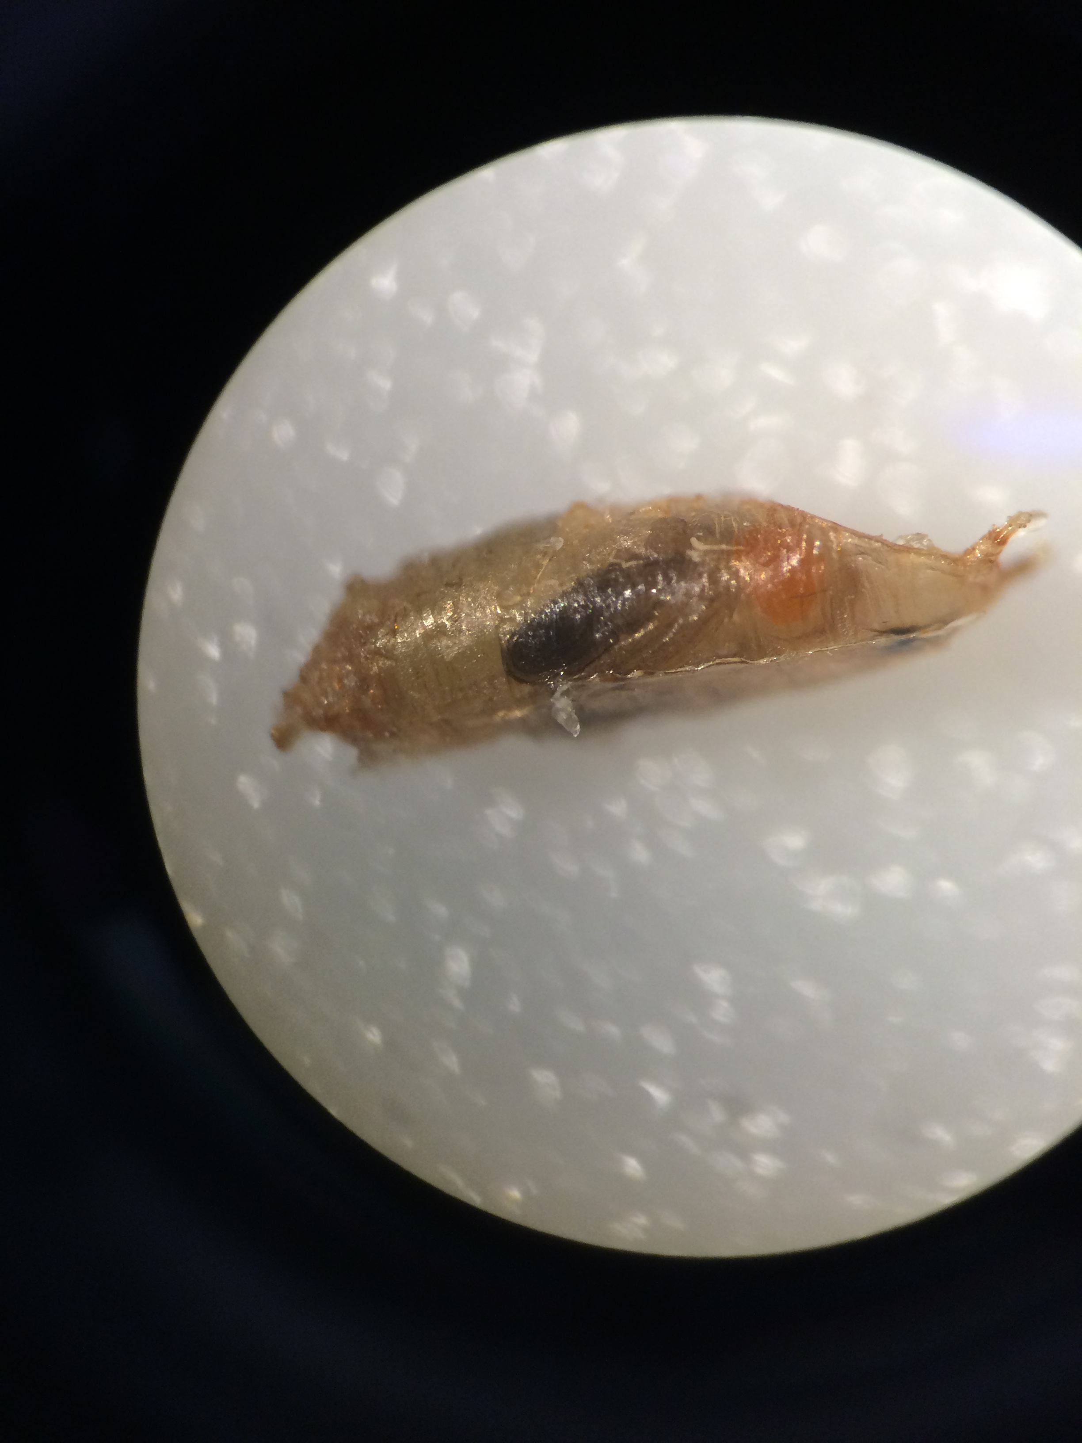
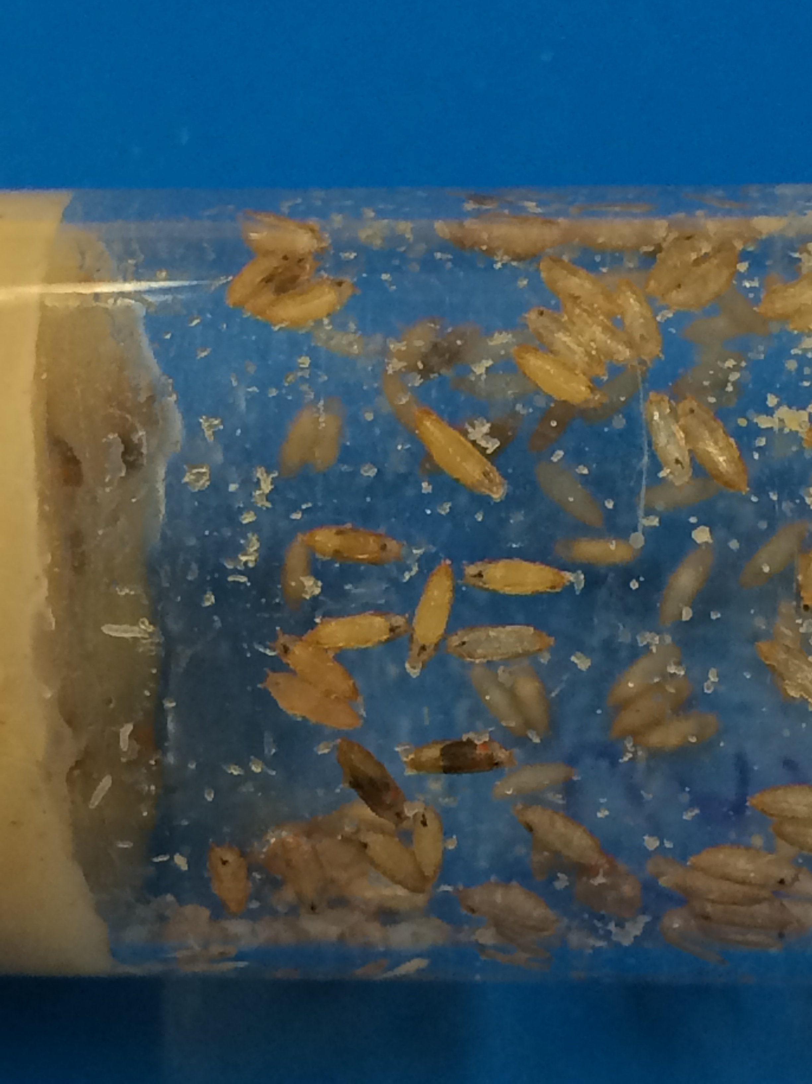


Activity Background
Developed for high school and undergraduate classrooms
Utilizes the common lab model Drosophila melanogaster
Integrative series to explore the influence of diet on:
  Growth and behavior
  Neural mechanisms
  Fecundity
  Survival and population dynamics
Activities can also be run individually and tailored to individual classroom needs

Slide 7
Activity Background
Today’s presentation will focus on two activities:
  Influence of diet on the development of D. melanogaster
  Effects of diet on behavior
Activities can be set up simultaneously
Can be stand-alone activities or sequential
Can be completed in a single laboratory period or adopted to multiple laboratory periods
Notes:
We have provided an instructional handout on and example student handouts on the conference and activity website.

Slide 8
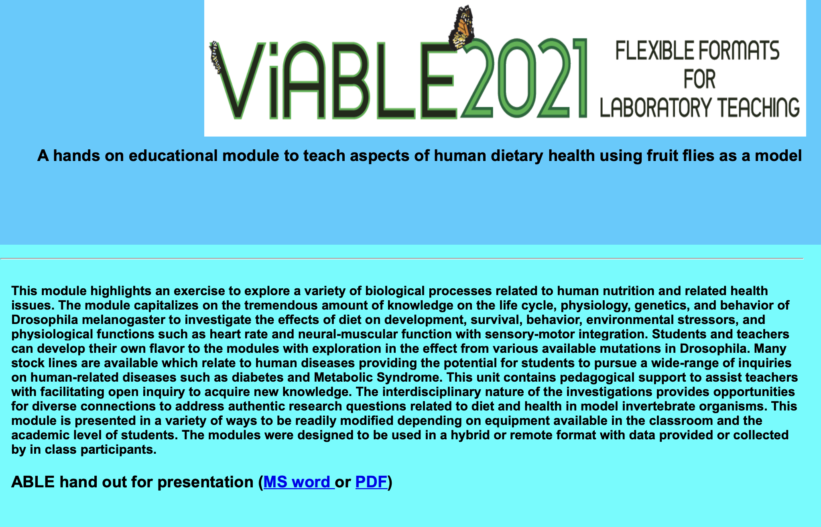
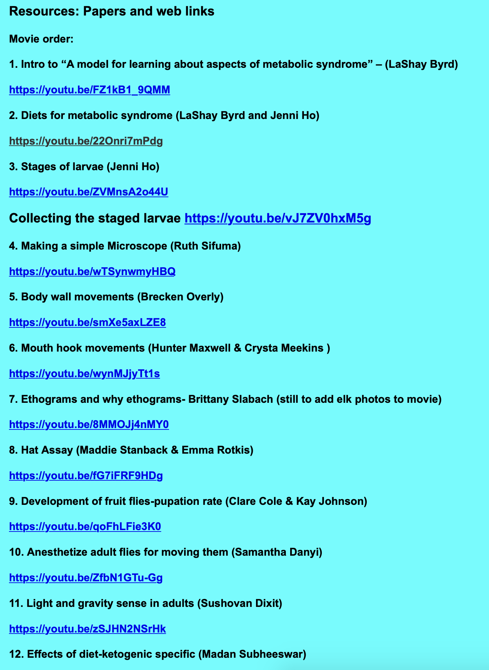
Activity Website
Activities and supplementary materials are available on the website
Supplementary handout
Informational movies and extra resources

Slide 9
Learning Objectives
To explore the role of diet in physiological and developmental processes
To generate informed hypotheses regarding the effects of diet on the development and behavior of Drosophila melanogaster
Design and conduct an experiment to test the hypotheses
Make connections to broader topics of physiology and health

Slide 10
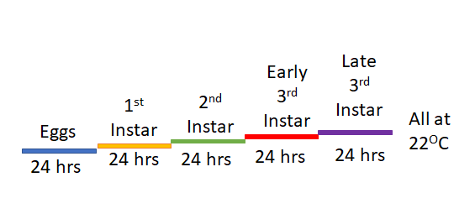
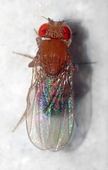
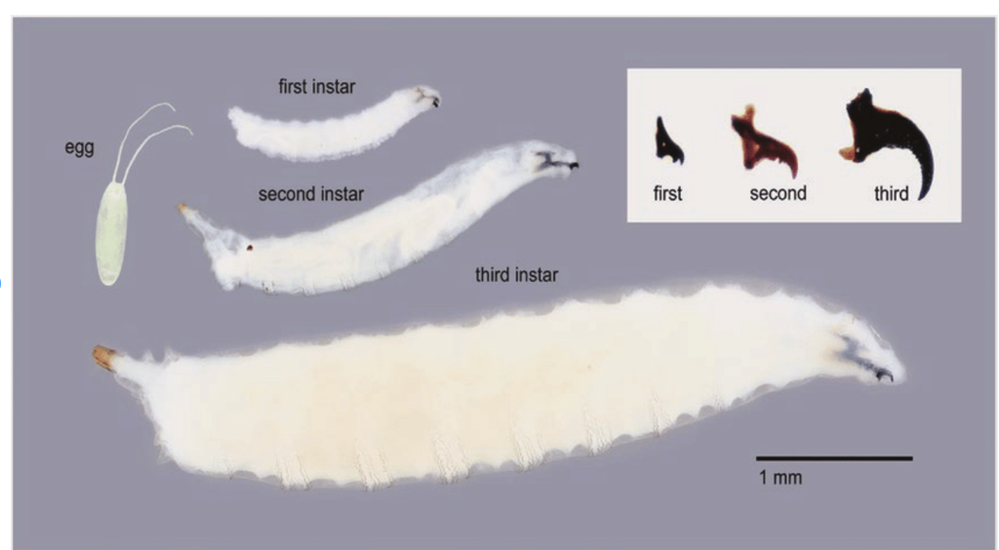
Benefits of working with D. melanogaster
D. melanogaster is the most common organism used in genetic studies
Easy to care for and culture
Mature quickly
Morphological characteristics across life stages are easy to identify
Multiple genetic lines are available allowing activities to be tailored to specific objectives
Growth stages of D. melanogaster

Slide 11
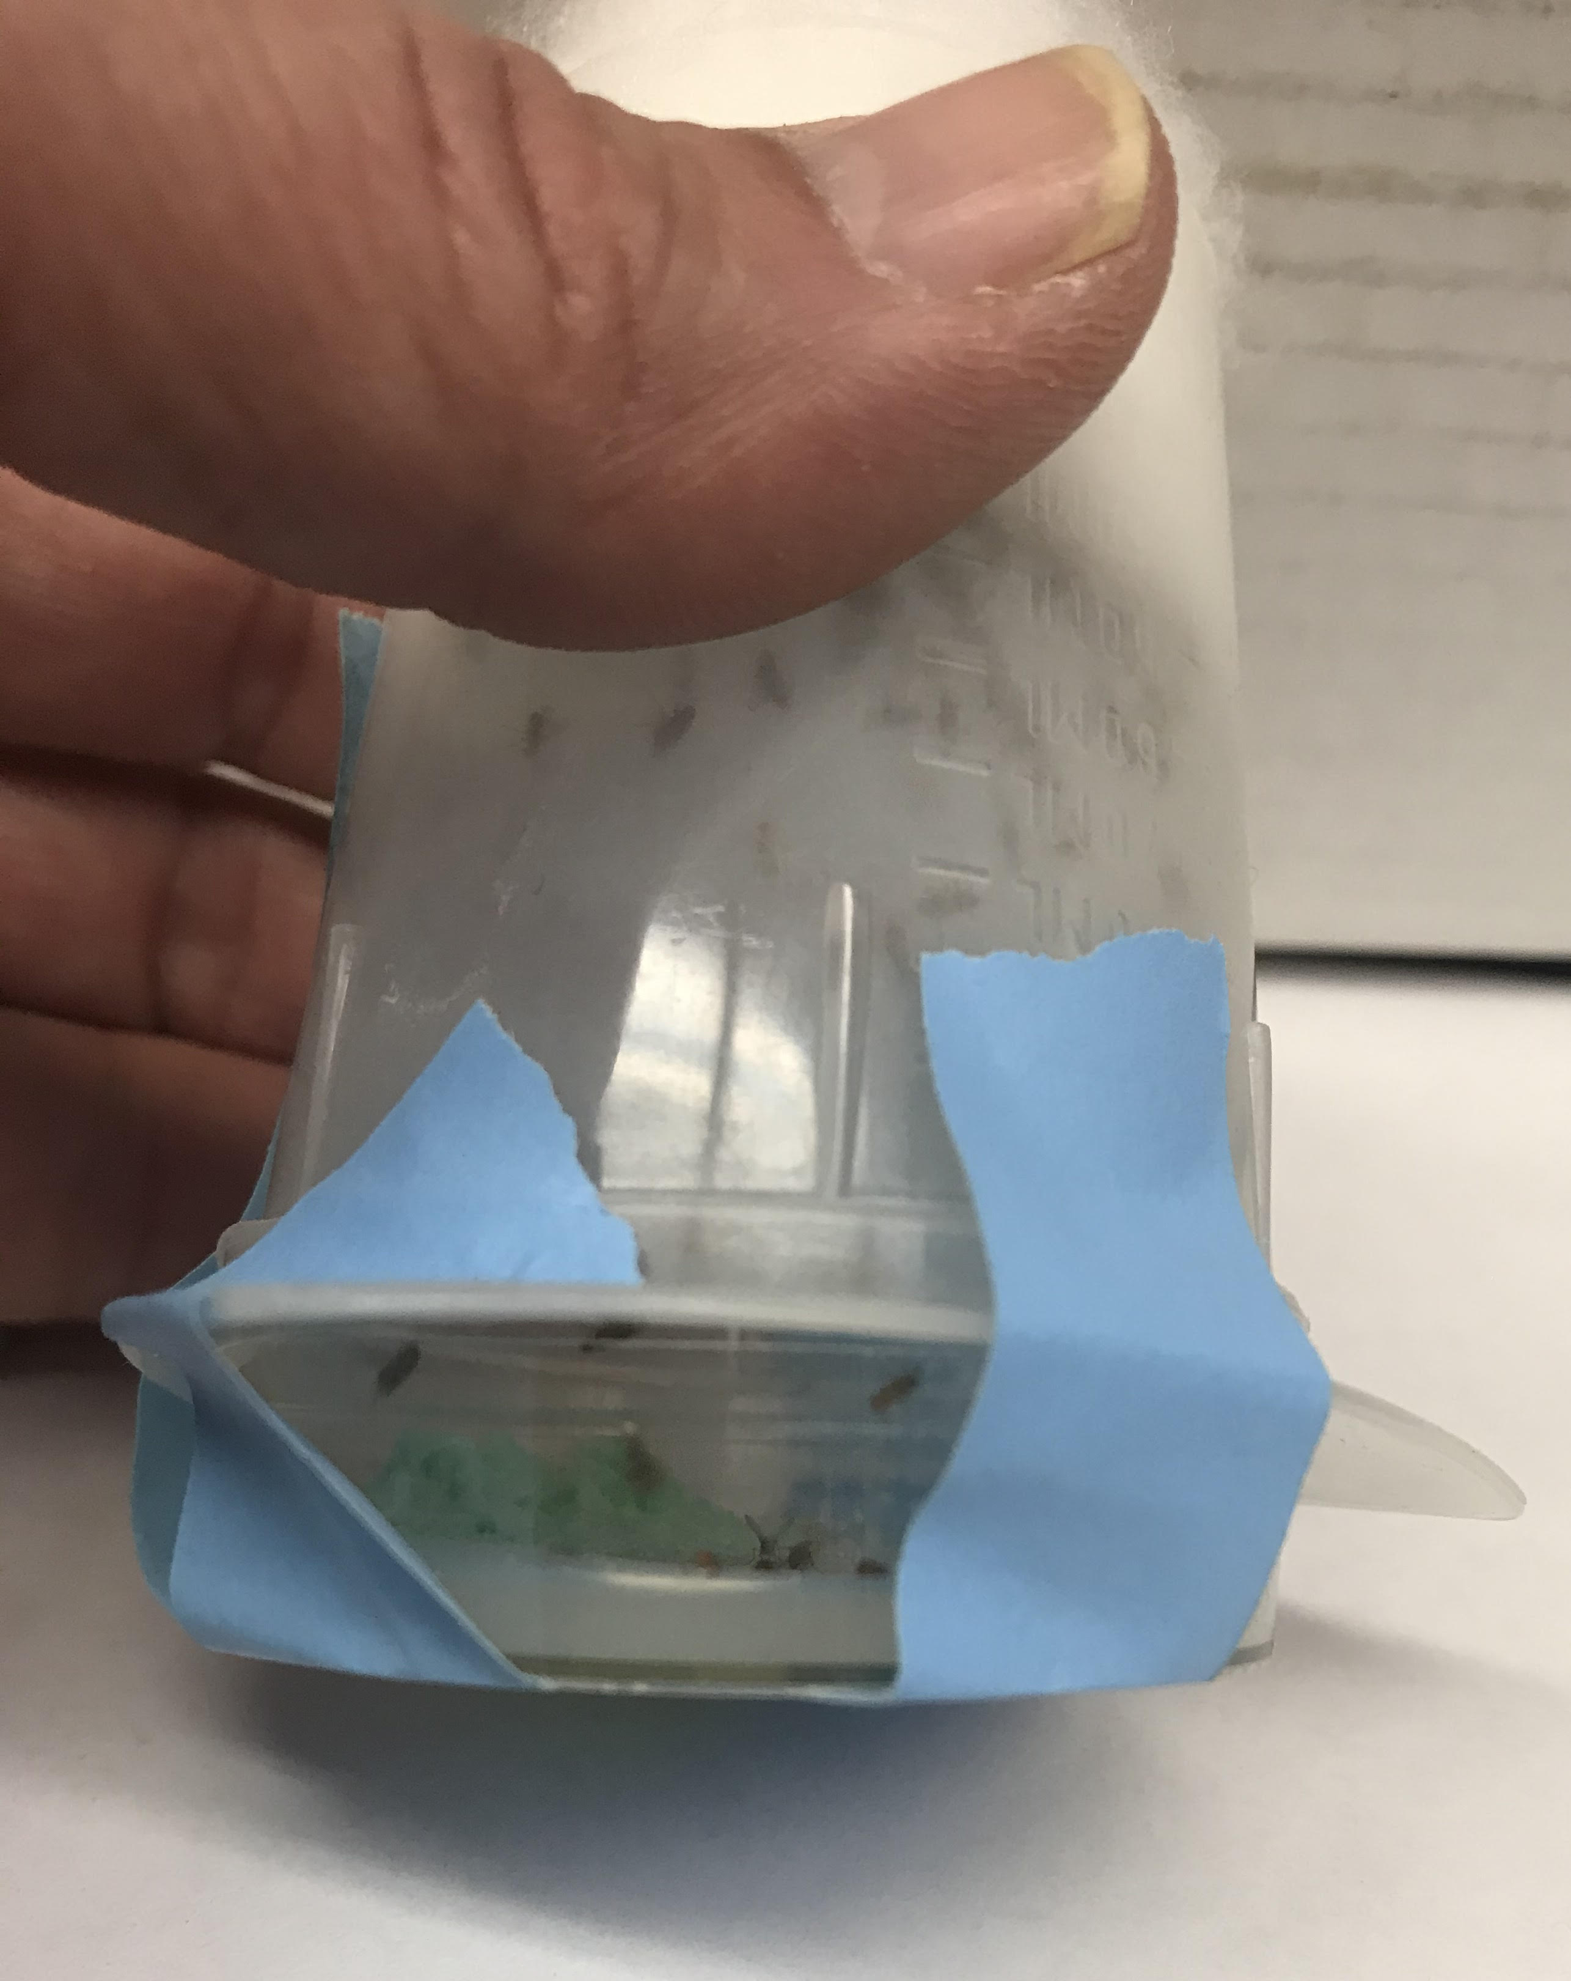
Establishing a D. melanogaster fly colony
For activities, 1st, 2nd and 3rd instar larvae can be used
Establishing a colony is the easiest way to have larvae ready for activities when needed
Establishing a colony 2 weeks prior to the activity is ideal
A plastic beaker and petri dish serves as a fly cage
Standard fly media – can be purchased or made with ingredients from the grocery
Eggs and larvae can be collected at set time intervals for activity (Movie available on website)
Growth stages of D. melanogaster

Slide 12
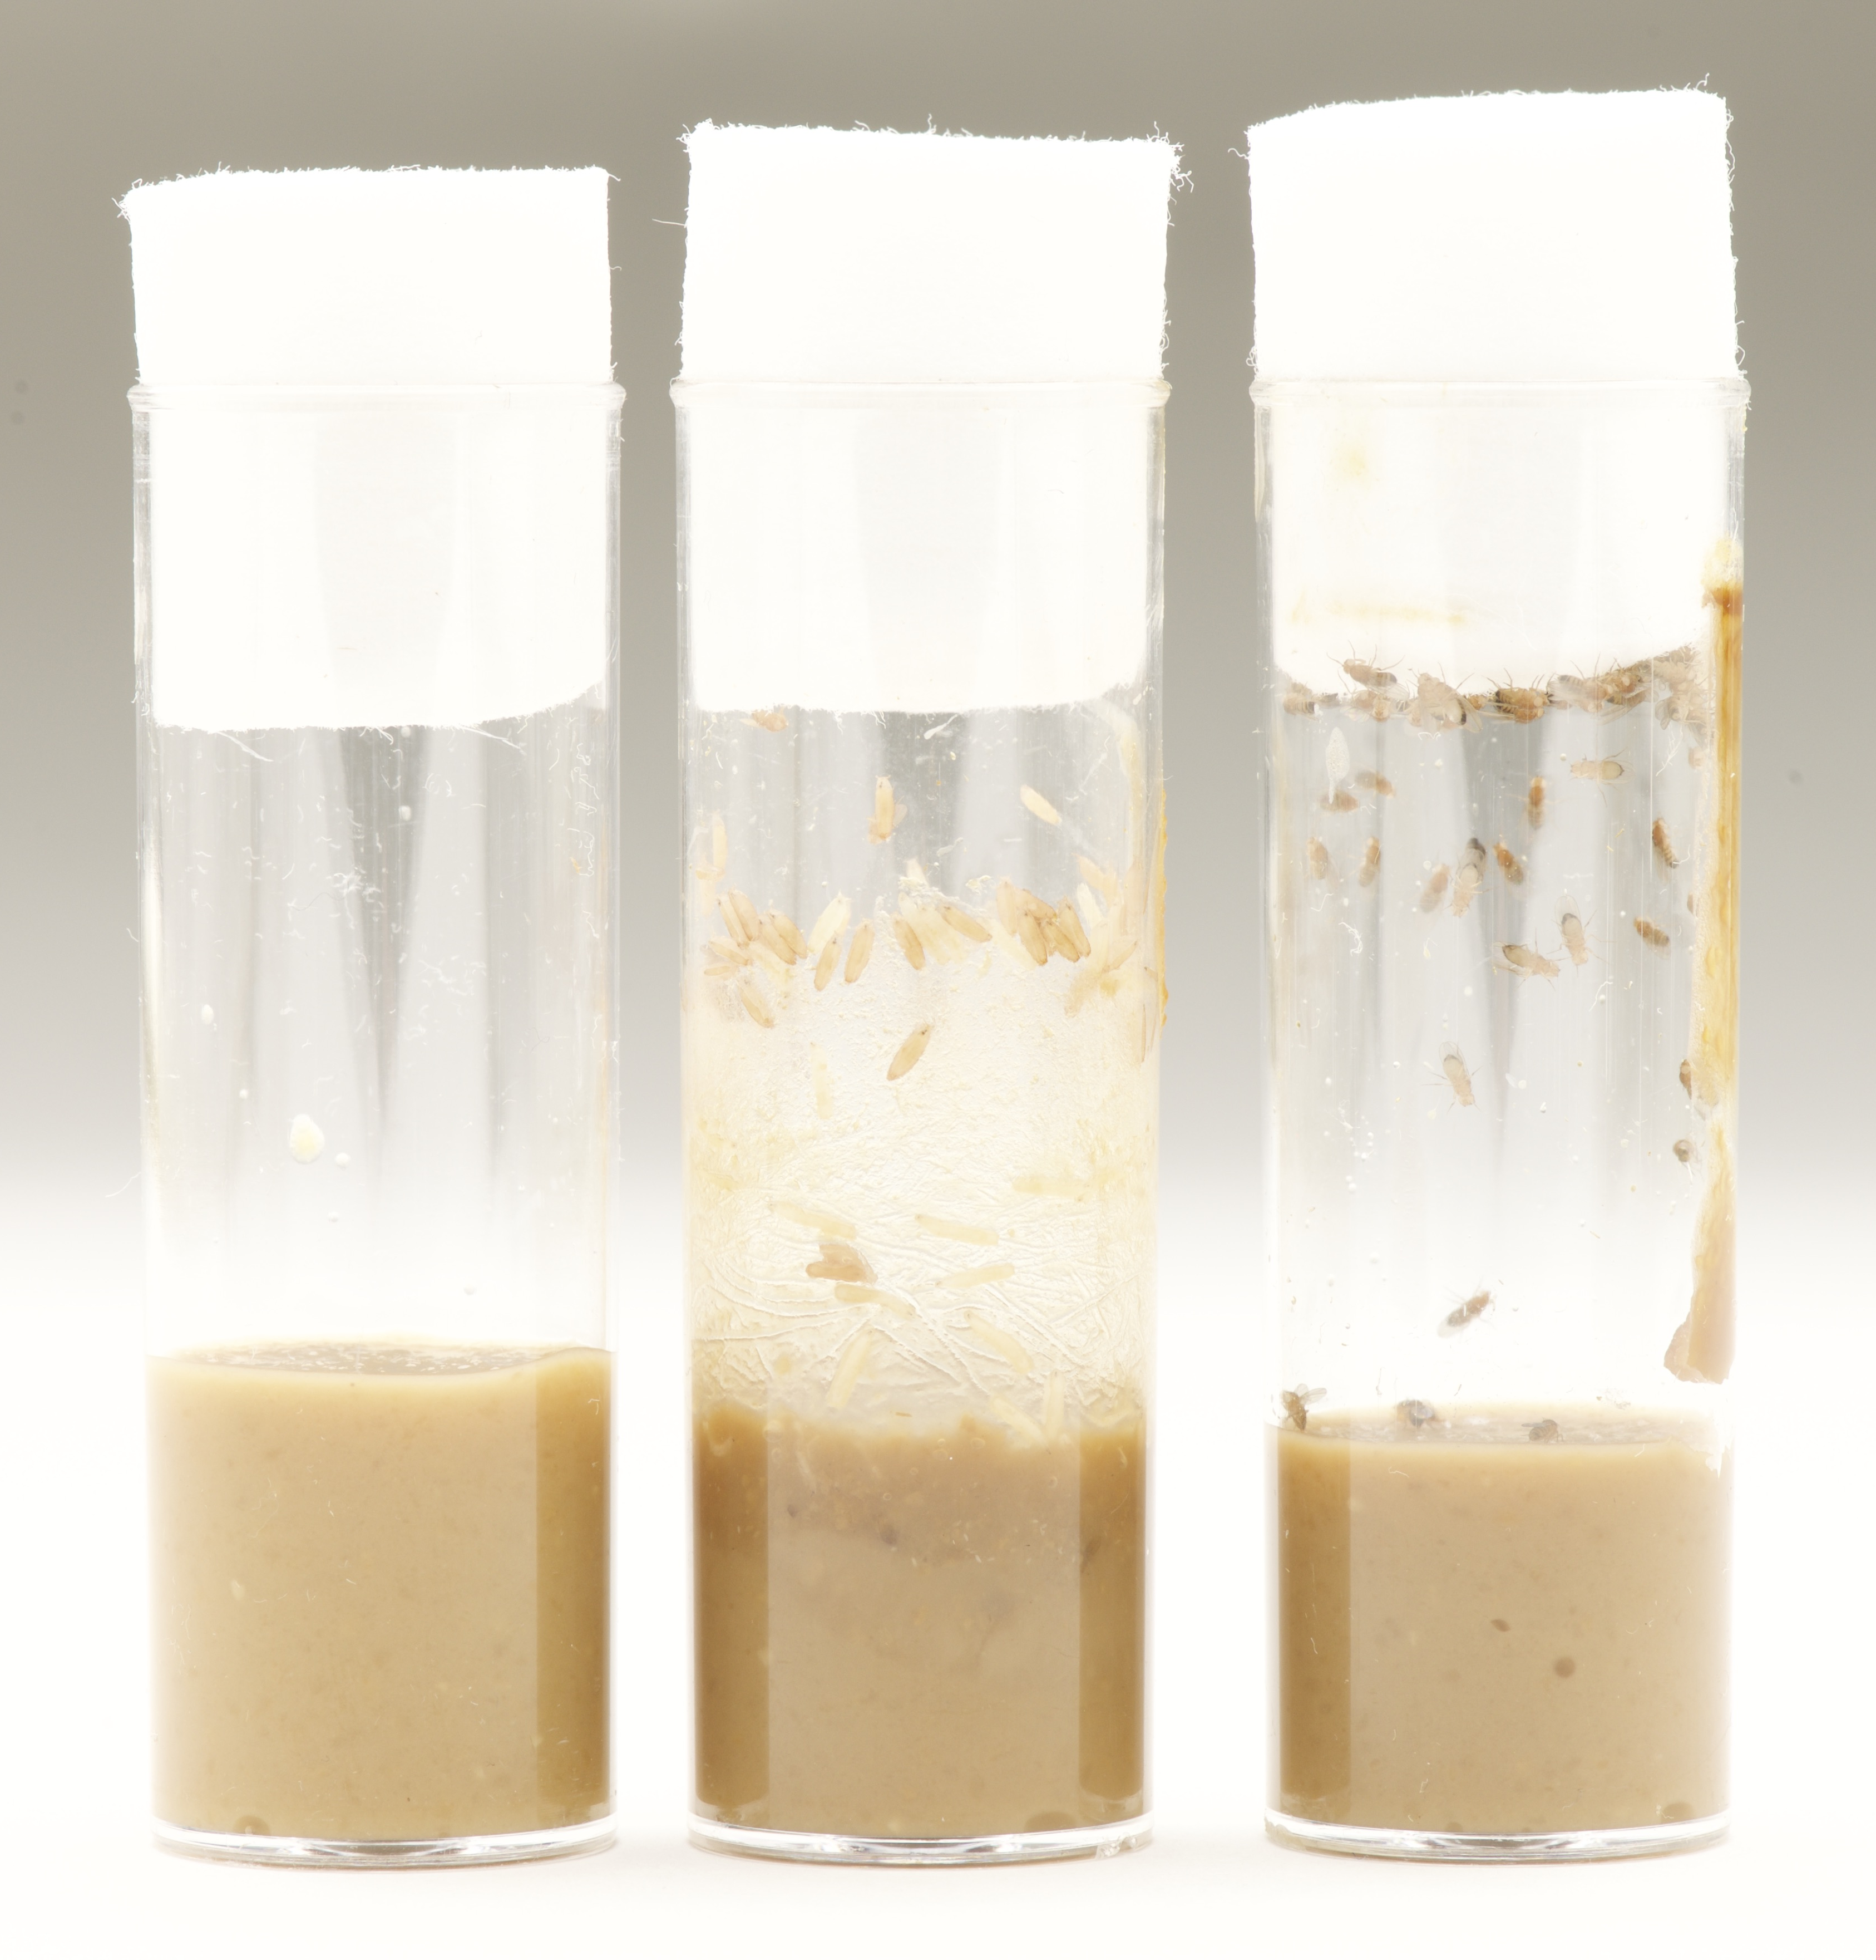
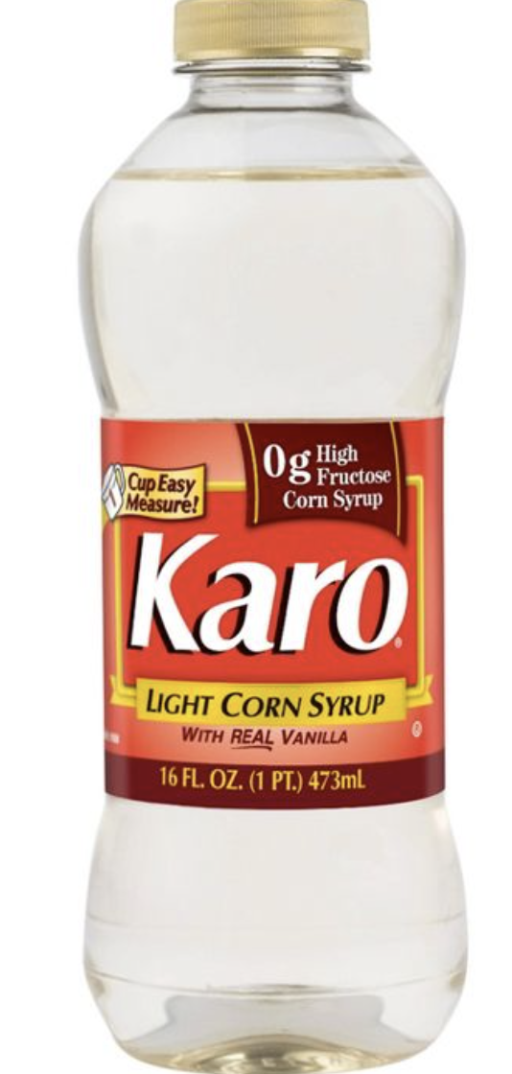
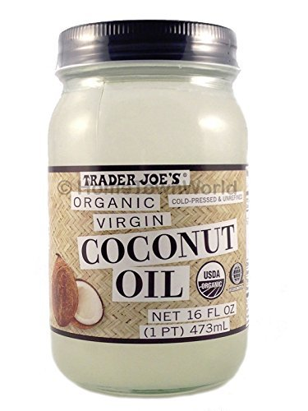

Preparing experimental diets
Experimental diets can be prepared at 5%, 10%, 20%, 40% per weight of a standard diet
Additions by diet include:
  High fructose – high fructose corn syrup
  High protein – soybean extract
  High fat – coconut oil
A higher fat diet than 40% is difficult to use
Flies from the colony can be transferred to the food at intervals appropriate for the activity

Slide 13
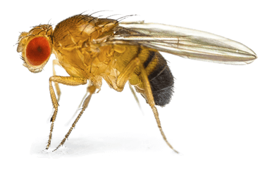
Activity 1: Influence of diet on development
Timeline
2 Weeks Prior
In Lab
In Lab
24 – 72 Hrs. Post Lab
Establish Fly Colony
Collect larvae
Add to diets of choice
Quantify Survival and Pupation
Control
Ketogenic
High Sugar
Control
Ketogenic
High Sugar

Slide 14
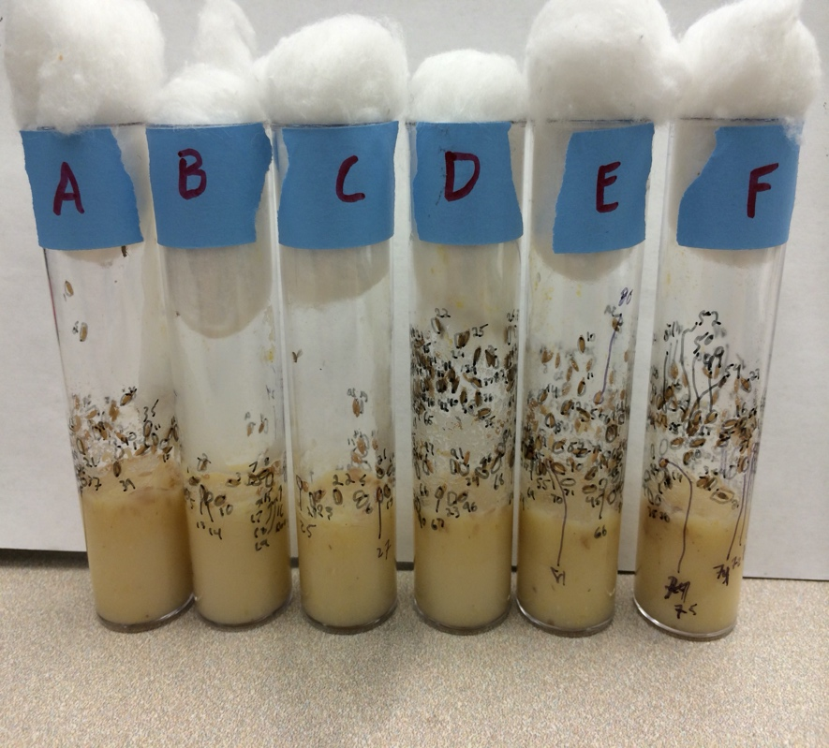
Influence of diet on development
Procedure – Working in groups of 2
Place 10 larvae (1st or 2nd instar) into a control and experimental diet
Have students note what instar they are and how many of each are included in the experiment
Allow larvae to burrow into food (~ 30 minutes)
Mark and index the location of all larvae using a sharpie (right)
Place tubes in a light-controlled environment at 22 degrees Celsius
Check every 24 - 72 hours to determine number of individuals that pupate*
Groups can be treated as replicates in this way
Notes:
* Best if checked every 24 hours

Slide 15
Influence of diet on the development: Sample Data
Analysis –
Each group calculates total pupa as a percent of the number of larva included
Data can be compiled as a class to increase robustness of analysis
Can graph data or run chi-square to test differences
Discuss the physiological mechanisms that may have been effected
A modified fly house will allow for exploration of population dynamics

Slide 16
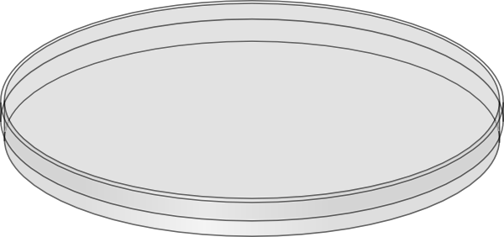

Establish Fly Colony
Activity 2: Effects of diet on behavior
24 – 72 Hrs. Post Transfer
Collect larvae
Conduct Behavioral Assay
Add to diets of choice
Control
Ketogenic
High Sugar
Control
Ketogenic
High Sugar
Notes:
The second activity focuses on the effects of diet on behavior. This provides students with a whole organism view of the influence of diet on potential, underlying physiological mechanisms. This involves stimulating the larvae and observing their reactions.

Slide 17
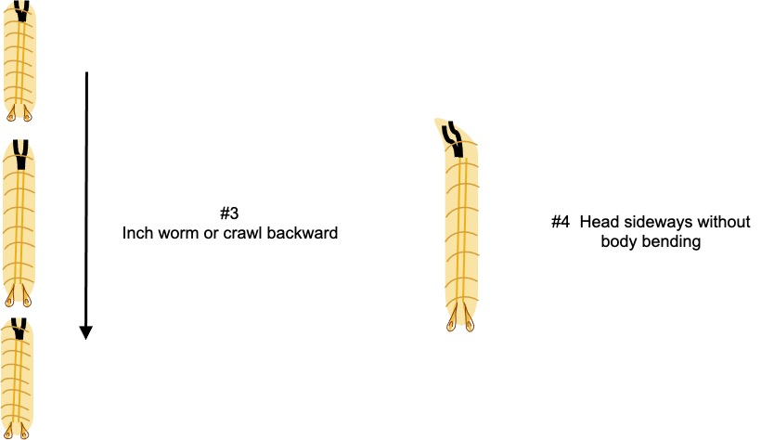
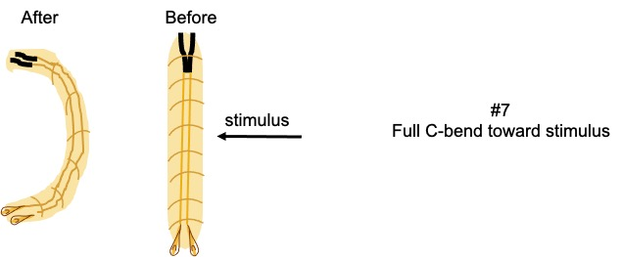
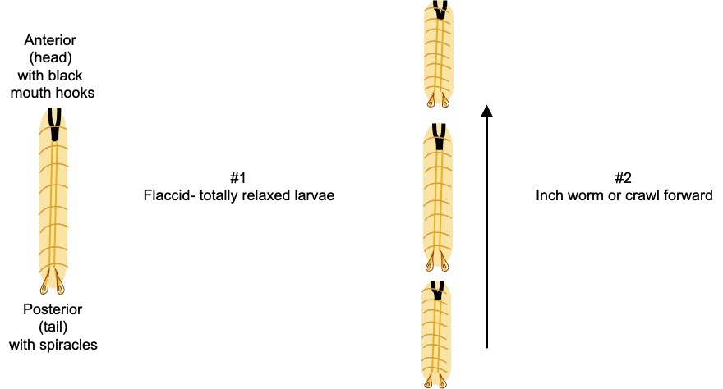
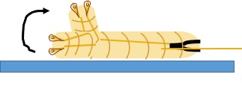
Larval Behaviors
Prior to Lab –
Have students review larval anatomy and behaviors
18 example behaviors are provided
Brainstorm why larvae would react to a stimulus

Slide 18
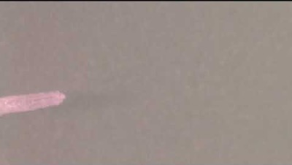
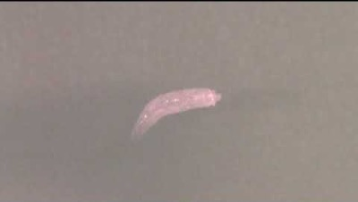
Crawling (peristaltic waves)
C-Bend

Slide 19
Larval Behaviors
Prior to Lab -
After review of behaviors, students can create an ethogram to use during the lab
  Ethogram = a catalog of behaviors
Provides a standardized procedure to quantify qualitative data
Behavior | Head | Abdomen | Tail
Reverse | 2
Head raise | 2
Pause | 1 | 2
C-bend | 5 | 2 | 1
No Reaction |  | 7 | 9
Turn | 1
Head Retract |  | 1
Roll
Tail Flip
Example ethogram from class

Slide 20
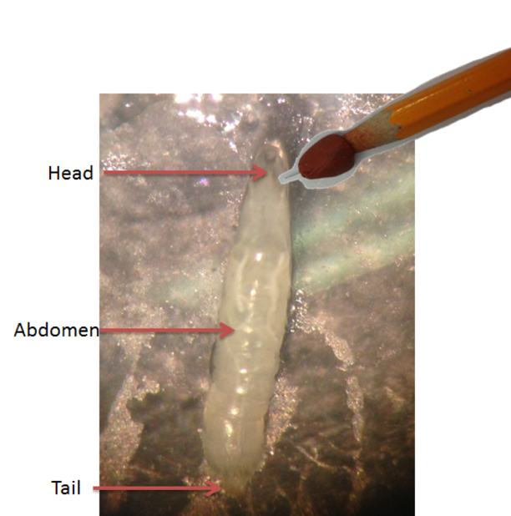
Effects of diet on behavior
Procedure – Working in groups of 2
Remove a larva and place it on a petri dish – identify larval stage
Allow larvae to acclimate for 15 secs prior to beginning the trial
Count the number of peristaltic waves for 15 seconds
Stimulate larvae on the right side on the larva’s body segment
Record the behavioral response
Wait 15 seconds
Repeat steps 5-6 for each additional body segment
Conduct stimulus test on a minimum of 10 larvae per diet type and control

Slide 21
Effects of diet on behavior
Analysis –
Each group calculates number of total behaviors observed by diet type
Data can be compiled as a class to increase robustness of analysis
Can graph data or run chi-square to test differences

Slide 22
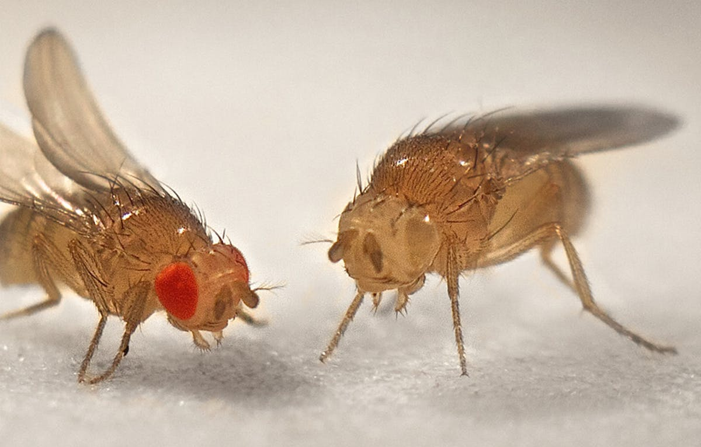
Activities Summary
These activities provide student’s an opportunity to:
  Explore complex topics of health
  Develop and test hypotheses
  Quantify qualitative observations
  Connect concepts with real-world applications
Activities can be expanded on through connections with literature or current CDC statistics

Slide 23
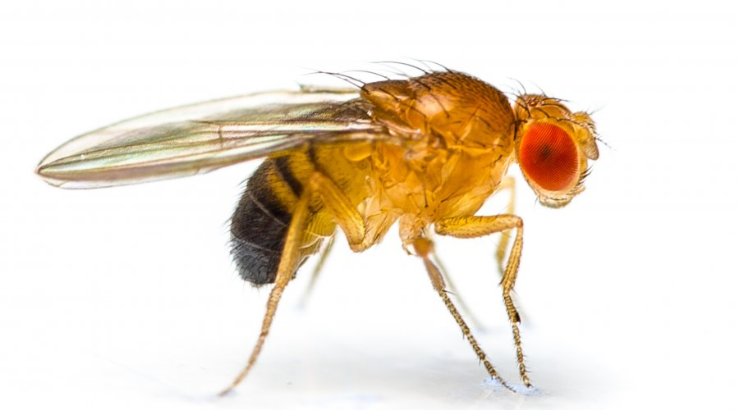

Thank you for your time!
bslabach@trinity.edu
robinlewiscooper@gmail.com
Happy to take any remaining questions

