Slide 1
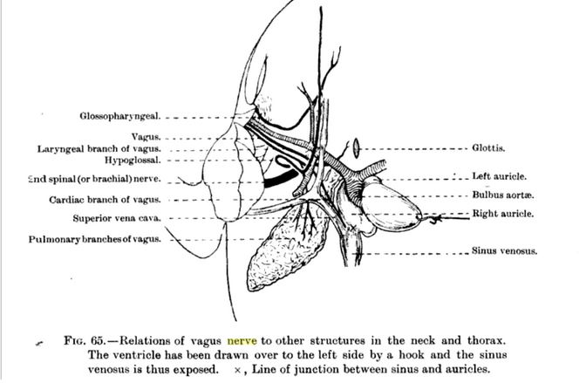
https://books.google.com/books?id=wPpHAQAAIAAJ&pg=PA68&lpg=PA68&dq=Dissection+frog+heart+nerve&source=bl&ots=_KFowex8-X&sig=ACfU3U2vJUnmI4Kmdb0wC10BjLebQ2Xr5A&hl=en&sa=X&ved=2ahUKEwj1qo-IpuHmAhXZWM0KHf6rCDs4MhDoATAFegQIChAB#v=onepage&q=Dissection%20frog%20heart%20nerve&f=false

