Slide 1
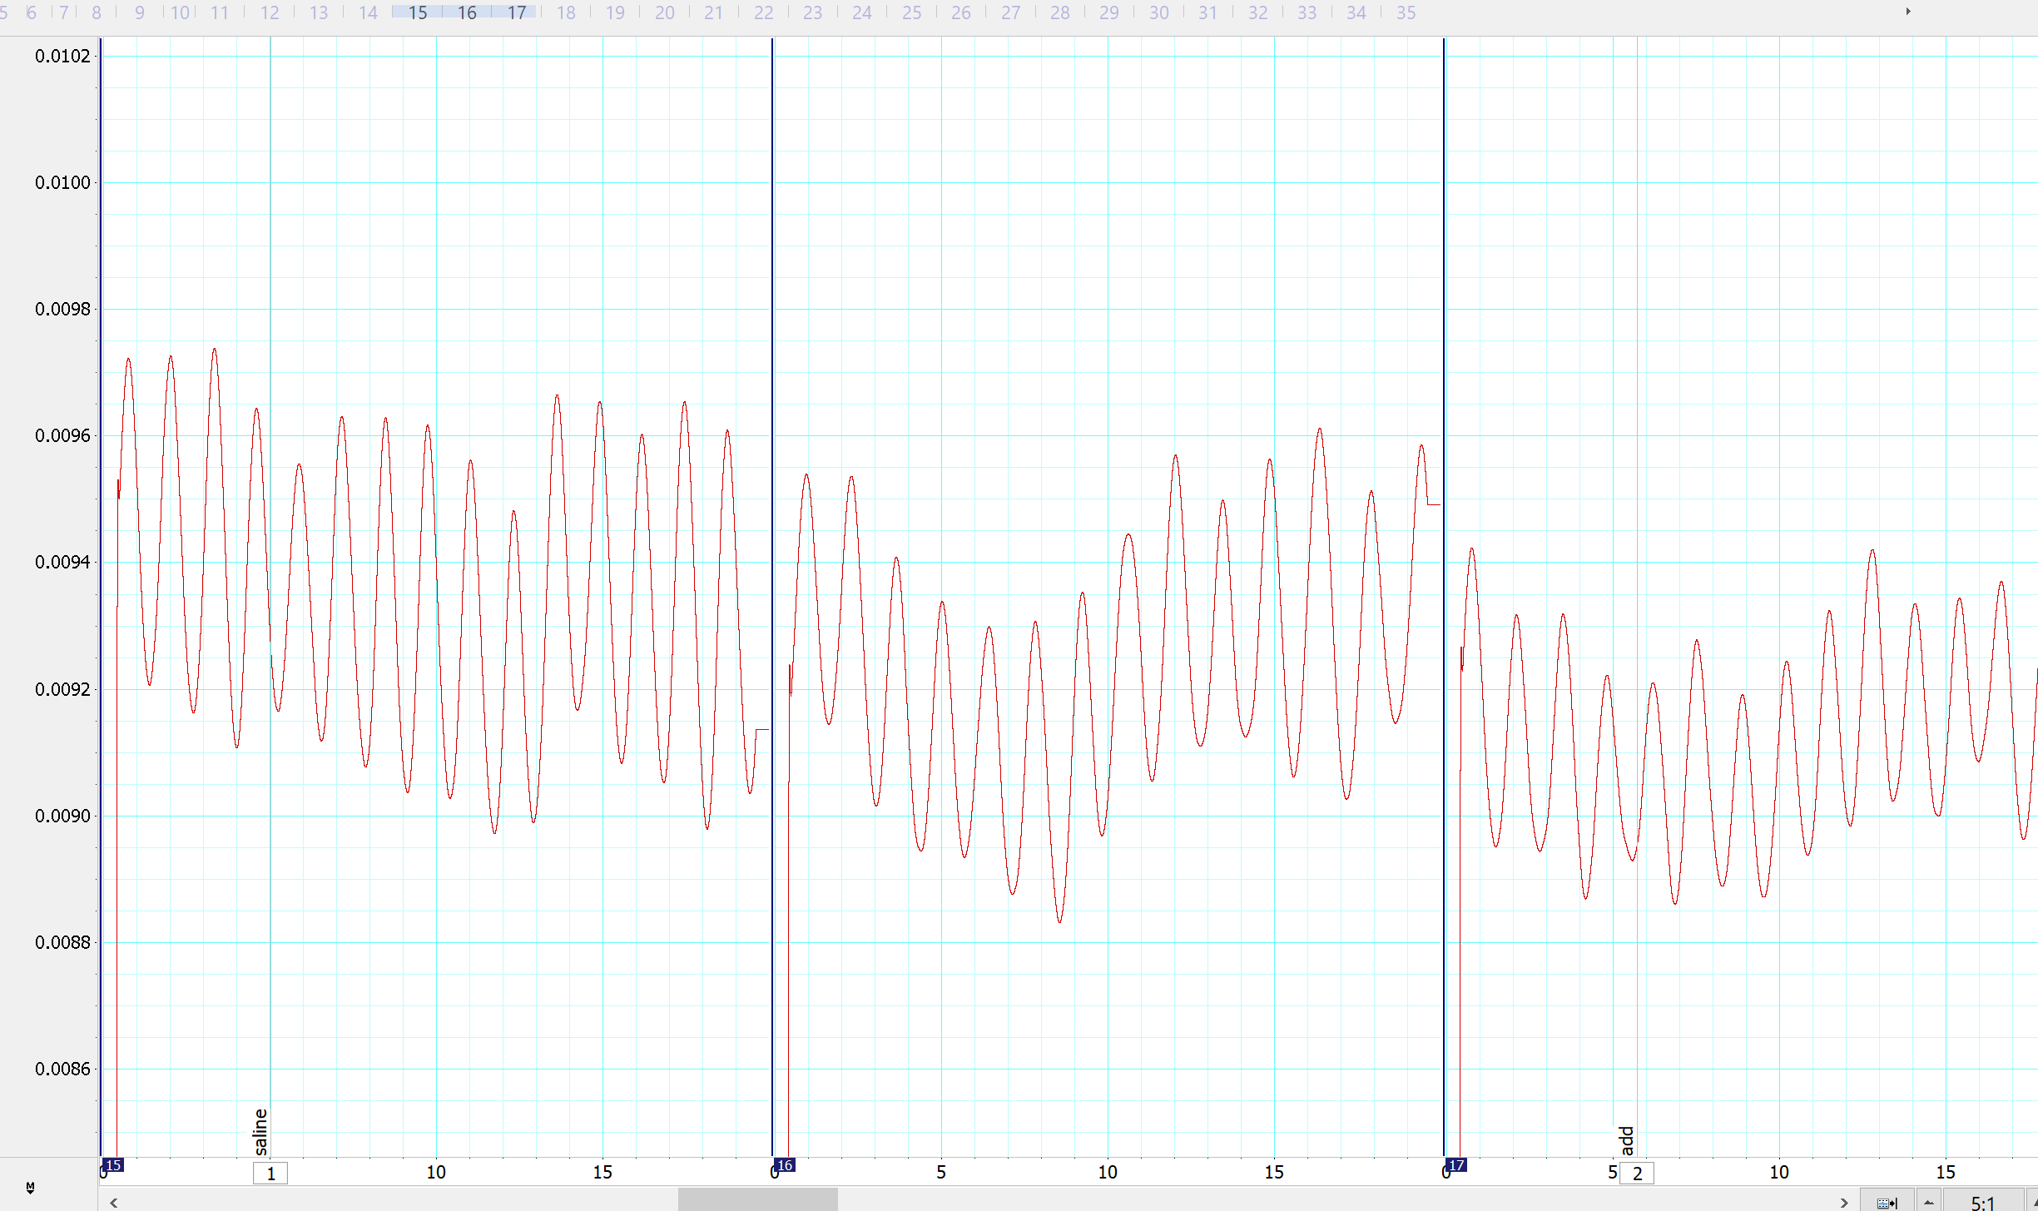
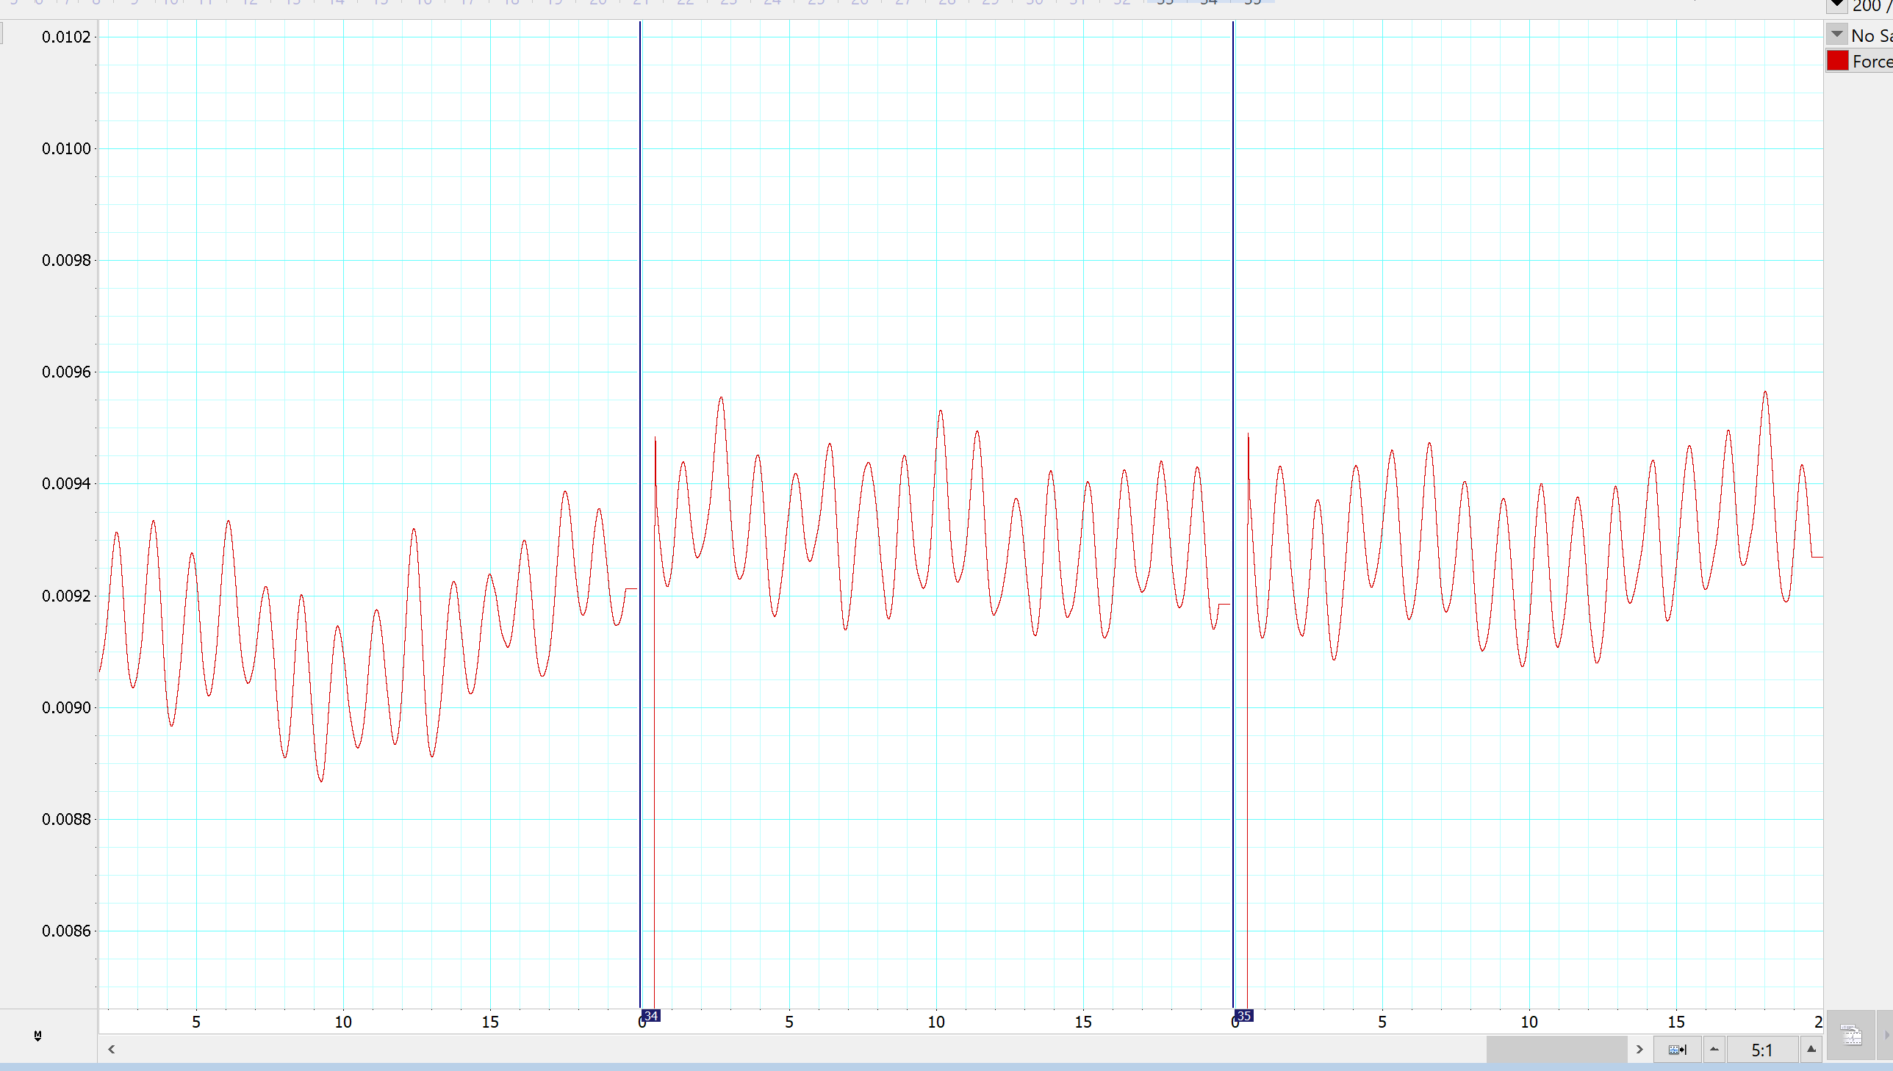
Adding LPS
500 mg/ml
After 300 seconds
START: Saline

