Slide 1
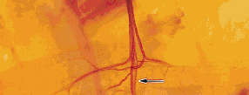
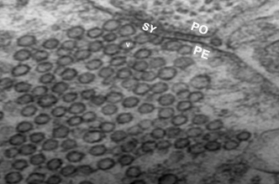
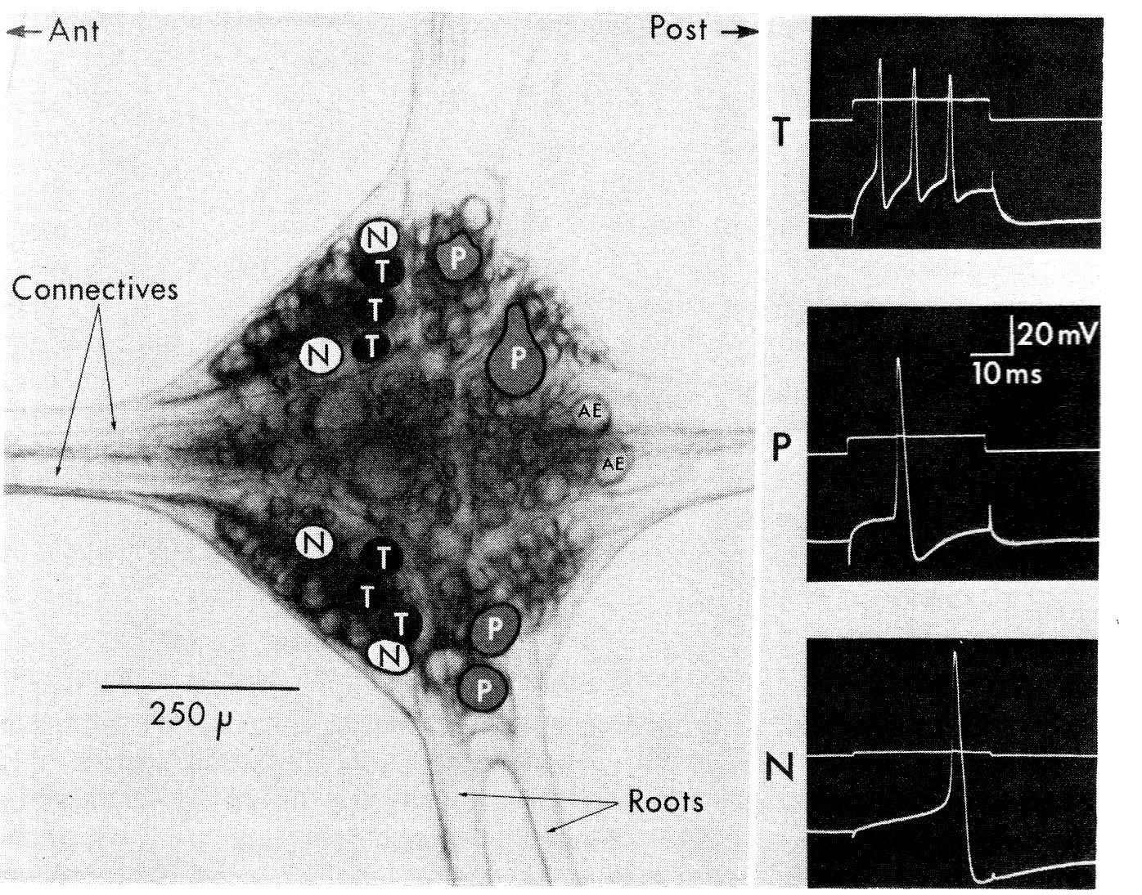
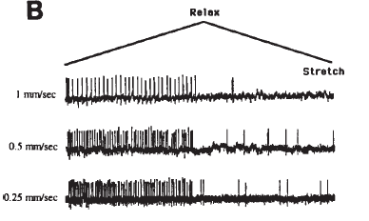
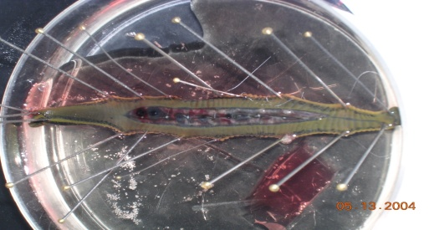
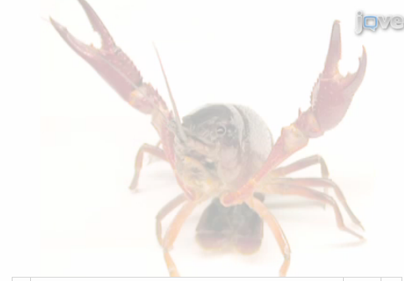
NEUROPHYSIOLOGY LAB
Spring 2015
Bio 380 or Bio 650
Tue & Thur
Tue is lecture 1 hr
Thur is lab 3hr
Taught by
Dr. Robin L. Cooper
RLCOOP1@UKY.EDU

