Slide 1
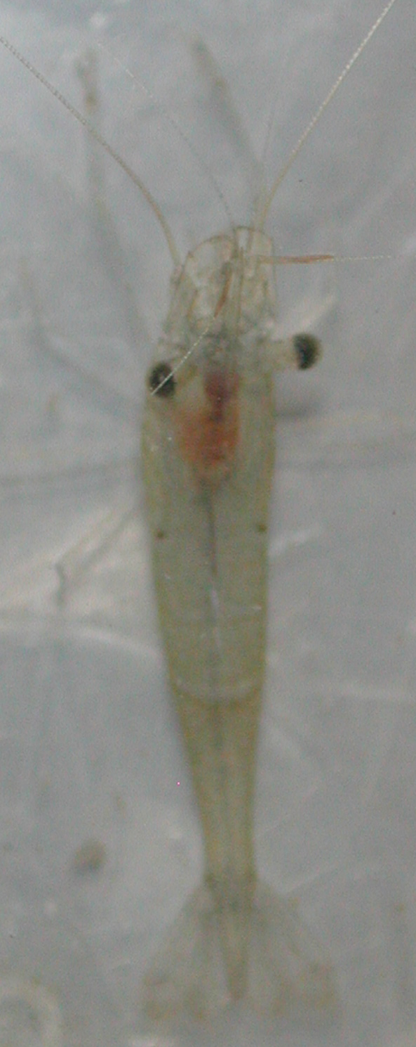
Trough for water
and shrimp
Wooden stick glued
to back of shrimp
Slight depression to hold
wooden stick that is glued
to back of shrimp
Wooden stick with pins
to hold it down
Sylgard filled dish which allows
light to pass through and to
stick pins to.

