Slide 1
Ribble Fellowship / Research Presentation
Fall 2009
Carbon Dioxide Induced Paralysis: Effects on Behavior and Physiology
SONYA M. BIERBOWER, M.S.
DEPARTMENT OF BIOLOGY
DIVISION OF MOLECULAR AND CELLULAR BIOLOGY
UNIVERSITY OF KENTUCKY
ROBIN L. COOPER, ADVISOR

Slide 2
Overview
Background
Behavior
Physiology: Neuromuscular Junction
Physiology: ‘Sensory root – ganglion – motor root’ circuit
Future Directions

Slide 3
Role of Carbon Dioxide
Important environmental cue
CO₂ concentration gradients (chemotaxis)
  Orientation response (ex. beetles, mosquitoes)
  Pheromone detection range
Host-seeking behavior
  Food sources (Floral CO₂)
  CO₂ detection
  Varies in environments
Notes:
Carbon Dioxide plays a very important role in the environment
Concentrations vary from low levels to higher levels such as those found in bee hives or termite nests
CO2 acts like many other odorants by inducing chemotactic (orienting) behaviors based upon concentration gradients
Many of these behaviors can be induced by very small changes in CO2 levels and the behaviors have a very wide range.
A few examples of behaviors induced by CO2 are digging in ants, fanning in bees and tunneling in termites.
A wide range of behaviors is seen because CO2 is considered a Unspecific attract, meaning it does not provide any information other than a gradient towards the source.
Much of the work done with CO2 as an attractant has been done in insects and is what actually led me to the University of Arizona and the Hildebrand Lab.
Research has shown that CO2 can induce host-seeking behavior by orienting and leading to possible food sources (such as in the mosquitoes) or the beetle searching for roots underground.
CO2 can also be important in Mate location by directing towards possible mates to bring in proximity to pheromone detection range….
But with so many things that are good….there is also a bad.

Slide 4
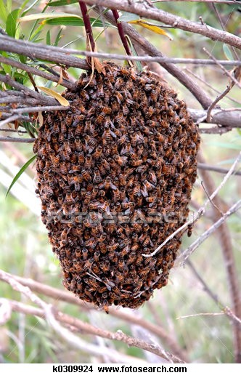
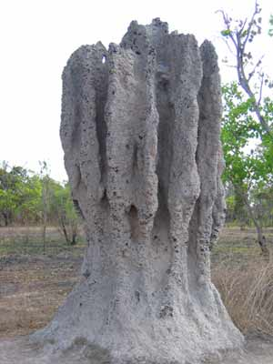
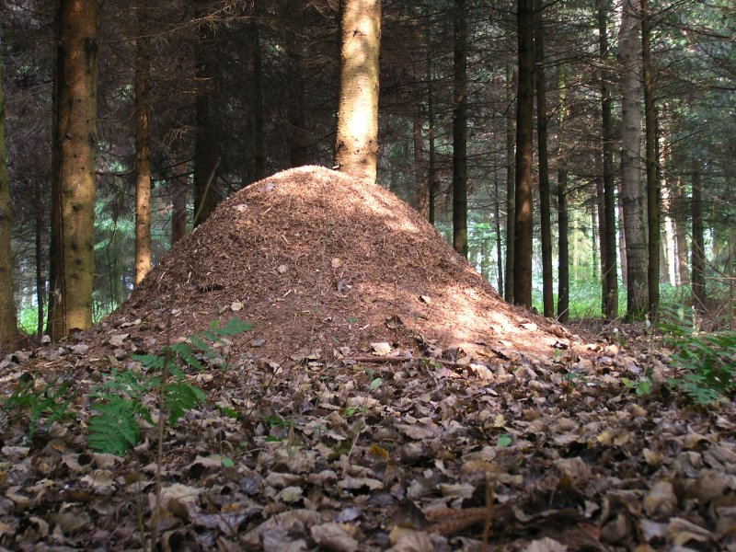
Role of Carbon Dioxide
Repellent Behavior
  Stress Response
  Signal toxic environment
  Induces behaviors…
Fanning in Bees
Tunneling in Termites
Digging in Ants
http://upload.wikimedia.org/wikipedia/commons/a/a5/Xn_ant_hill.jpg
http://www.nma.gov.au/termite_mound/files/10980/termite_mound.jpg
Notes:
A wide range of behaviors is seen because CO2 is considered a Unspecific attract, meaning it does not provide any information other than a gradient towards the source.
Much of the work done with CO2 as an attractant has been done in insects and is what actually led me to the University of Arizona and the Hildebrand Lab.
Research has shown that CO2 can induce host-seeking behavior by orienting and leading to possible food sources (such as in the mosquitoes) or the beetle searching for roots underground.
CO2 can also be important in Mate location by directing towards possible mates to bring in proximity to pheromone detection range….
But with so many things that are good….there is also a bad.

Slide 5
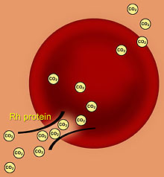
Carbon Dioxide
Effects Vertebrates and Invertebrates alike
Highly efficient → Readily crosses the membrane
Easily reversible in most tissues
Rh Protien Channels (Red Blood Cells)!
Notes:
A wide range of behaviors is seen because CO2 is considered a Unspecific attract, meaning it does not provide any information other than a gradient towards the source.
Much of the work done with CO2 as an attractant has been done in insects and is what actually led me to the University of Arizona and the Hildebrand Lab.
Research has shown that CO2 can induce host-seeking behavior by orienting and leading to possible food sources (such as in the mosquitoes) or the beetle searching for roots underground.
CO2 can also be important in Mate location by directing towards possible mates to bring in proximity to pheromone detection range….
But with so many things that are good….there is also a bad.

Slide 6
Effects on Drosophila
Badre et al. 2005 (Drosophila melanogaster larvae - 3rd instar)
Study results:
Acute CO₂ Exposure
Unresponsiveness to mechanosensory stimulation
Cessation of heart rate (HR)
Excitatory post-synaptic potentials (EPSPs) dropped out at the NMJ
No effect on the CNS, motor root remains active

Slide 7
Study Questions
With Acute Carbon Dioxide Exposure:
Behaviorally, is there an unresponsiveness to mechanosensory stimulation?
Does another invertebrate with similar neuromuscular junction physiologic profile (i.e., quisqualate sensitive glutamatergic) show similar results at the NMJ?
Is there an effect on the CNS?
Notes:
It is these questions that I will be addressing today, as well as possible mechanisms to explain the results….

Slide 8
Hypotheses
Many of the responses in Drosophila will be paralleled in the crayfish such as work at the NMJ and no influence on the CNS
CO₂ will have different modes of action in the crayfish due to the known differences in synaptic communication (i.e., electrical and chemical)
CO₂ may have both an anesthetic and paralytic effects
Anesthetic – effect on the CNS (loosely defined by literature)
Paralytic - effect on muscle (NMJ)
Notes:
A wide range of behaviors is seen because CO2 is considered a Unspecific attract, meaning it does not provide any information other than a gradient towards the source.
Behavior:
Crayfish become unresponsive to tail touch with carbon dioxide exposure indicative of the paralytic effect
Physiology:
Crayfish show a cessation of both heart and ventilatory rates due to neurogenic control of both systems
Synaptic:
Carbon dioxide induces a paralytic effect through post-synaptic blockage or insensitivity to glutamate which results in the cessation of heart and ventilatory rates, as well as the lack of behavioral response
Much of the work done with CO2 as an attractant has been done in insects and is what actually led me to the University of Arizona and the Hildebrand Lab.
Research has shown that CO2 can induce host-seeking behavior by orienting and leading to possible food sources (such as in the mosquitoes) or the beetle searching for roots underground.
CO2 can also be important in Mate location by directing towards possible mates to bring in proximity to pheromone detection range….
But with so many things that are good….there is also a bad.

Slide 9
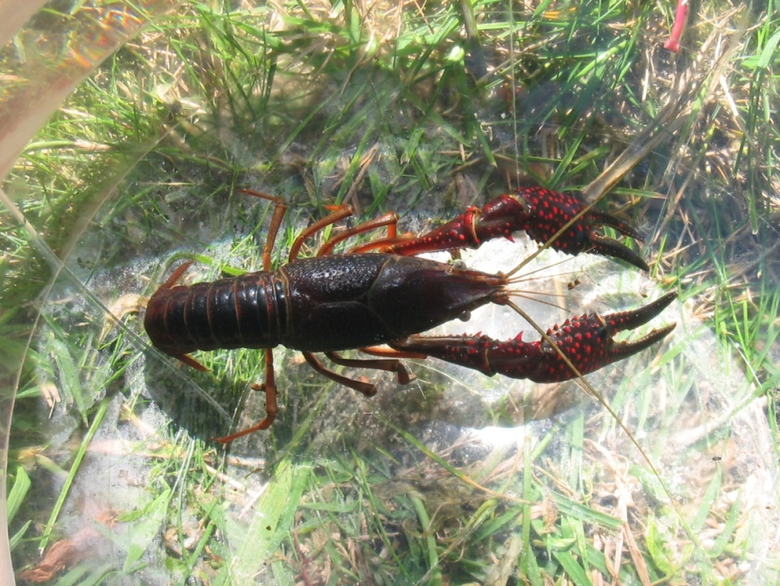
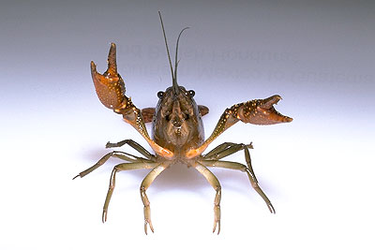
Study Organism
Procambarus clarkii (red swamp crayfish)
  Well known behaviors
  Many well-defined neural circuits
Can I have my hug now???
Notes:
First I would like to introduce you to my study organisms.
I work with a surface species of crayfish, Procambarus clarkii known as the red swamp crayfish
They are characterized by shorter sensory antennules and have visual capabilities.
This is relevant because I also work with a cave species of crayfish, Orconectes packardi australis. These crayfish have enhanced olfactory structures and lack ommatidia, therefore lack visual capabilities. These crayfish also lack pigmentation and are typically more brittle than the sighted crayfish.
And just in case you were wondering…..

Slide 10
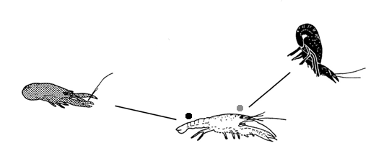
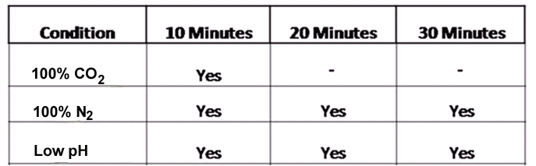
Behavior: Tail Touch
Krasne, et al.. 2002

Slide 11
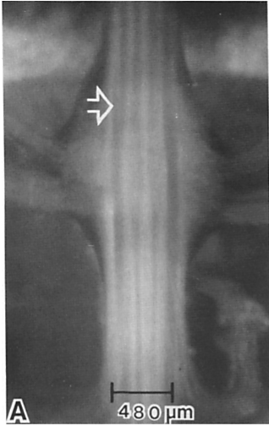
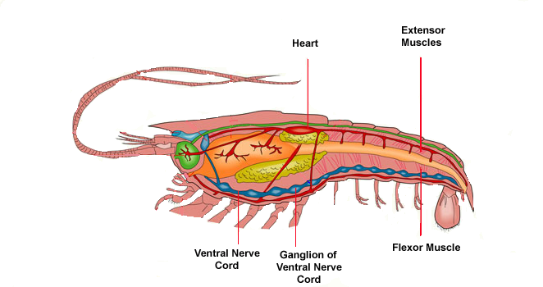
Mechanisms of Behavior
Abdominal VNC Ganglion
www.infovisual.info
Horner et al., 1997

Slide 12
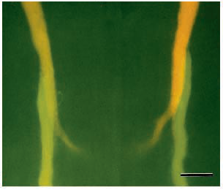
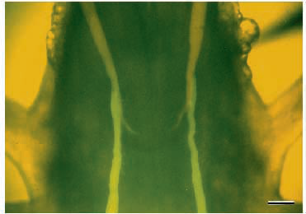
Differential labeling of LG axons of two adjacent segments
(Horner et al., 1997)

Slide 13
Mechanistic Actions of CO₂ on Tail-flip Circuitry
Axon 2
Axon 1
+
H
Gap junctions
CO
2
Protonation = Acidification
CO
2
CO₂ + H₂O
H₂CO₃
HCO₃⁻ + H⁺
Carbonic anhydrase

Slide 14
Intracellular Acidification
Axon 2
Axon 1
+
H
Gap junctions
CO
2
Structural rearrangements of synaptic regions
Decrease in gap junctions in synaptic plaques
Increase in dispersed single channels
Uncoupling of gap junctions (Open channels → Closing)
Why?
CO
2

Slide 15
Acidification and Ca⁺⁺ levels
Axon 2
Axon 1
Ca²⁺
Gap junctions
H⁺
CO₂
Acidification causes an increase in Ca²⁺
Ca²⁺
=
Closing of gap junctions
CO₂
* Protonation possibly changes the affinity of the channel protein for calcium ions
CO₂ → H⁺ → Ca²⁺ → H⁺ + Ca²⁺ → Uncoupling of gap junctions
Notes:
In a saturated-CC>2 Ringer the atrial preparation exhibited smaller action potentials
(AP) with shorter duration and higher threshold. After lOmin, these AP failed to
propagate. The disappearance of propagated AP in high CO2 medium could result
from either alterations in membrane excitability, namely the Na conductance, or in FROG ATRIAL FIBRES
F. Mazet, I. Dunia, G. Vassort andjf. L. Mazet
FROG
ATRIAL FIBRES

Slide 16
SUMMARY: Tail Touch
Crayfish were shown to be unresponsive to tail touch due to CO₂ exposure and not a result of hypoxic or low pH environments.
The mechanism explaining the lack of tail-flip response with CO₂ exposure is known.
However, crayfish were unresponsive to light touches on the cuticle as well, which cannot be accounted for since this does not elicit the lateral giant circuitry.
Interestingly, the effect of CO₂ on the lateral giant circuit cannot explain this effect.

Slide 17
Study Questions
With Acute Carbon Dioxide Exposure:
Behaviorally, is there an unresponsiveness to mechanosensory stimulation?
Does another invertebrate with similar neuromuscular junction physiologic profile (i.e., quisqualate sensitive glutamatergic) show similar results at the NMJ?
Is there an effect on the CNS?
Notes:
It is these questions that I will be addressing today, as well as possible mechanisms to explain the results….

Slide 18
Chemical Communication
http://highered.mcgraw-hill.com/olcweb/cgi/pluginpop.cgi?it=swf::535::535::/sites/dl/free/0072437316/120107/bio_c.swf::Function%20of%20the%20Neuromuscular%20Junction
Notes:
http://highered.mcgraw-hill.com/olcweb/cgi/pluginpop.cgi?it=swf::535::535::/sites/dl/free/0072437316/120107/bio_c.swf::Function%20of%20the%20Neuromuscular%20Junction

Slide 19
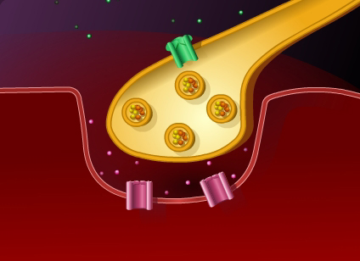
Stimulate
Intracellular Electrode
Record
Excitatory Post-synaptic Potentials (EPSPs)

Slide 20
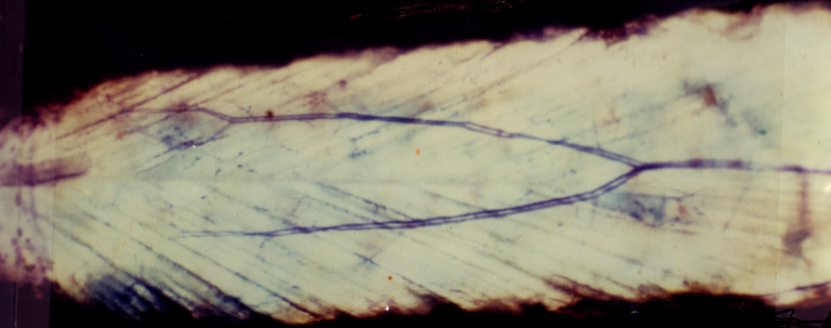
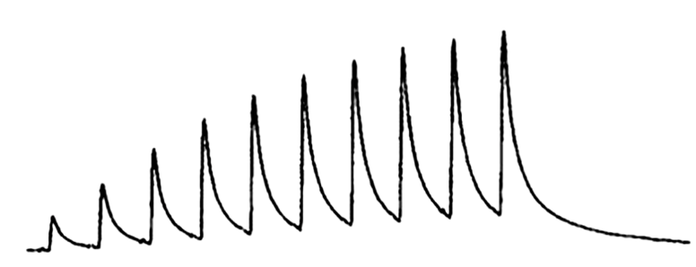
Synaptic Transmission: Neuromuscular Junction
Opener Muscle
Single excitatory motor neuron
Short term facilitation (STF)
  Train of 10 pulses, 40 Hz, 5 second intervals

Slide 21
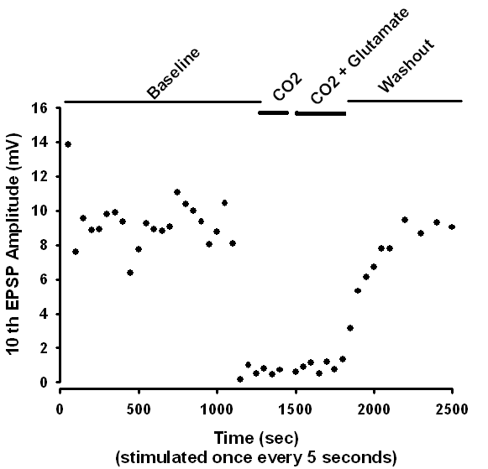
Effect of CO₂ at NMJ
Exogenous
10th EPSP
Before
CO₂
Wash out
CO₂ → EPSPs drop out
CO₂ + Glutamate → No depolarization
Washout → EPSPs Return

Slide 22
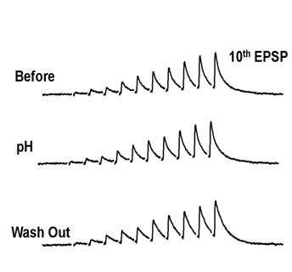
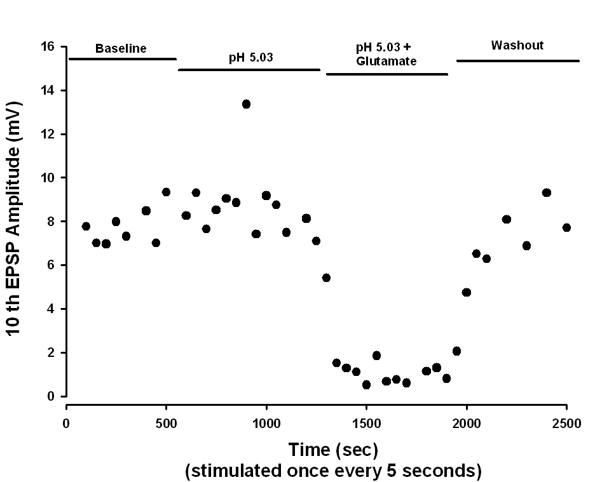
Effect of Low pH at NMJ
Low pH → EPSPs present
Low pH + Glutamate → Quick Depolarization, then desensitization (No EPSPs)
Washout → EPSPs Return

Slide 23
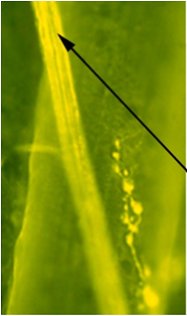
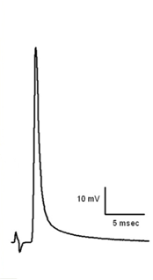
Motor Axon
Examination of the effect on the motor nerve remaining excitable in the presence of CO₂
CO₂ Exposure
Propagation of APs
Low pH
Propagation of APs

Slide 24
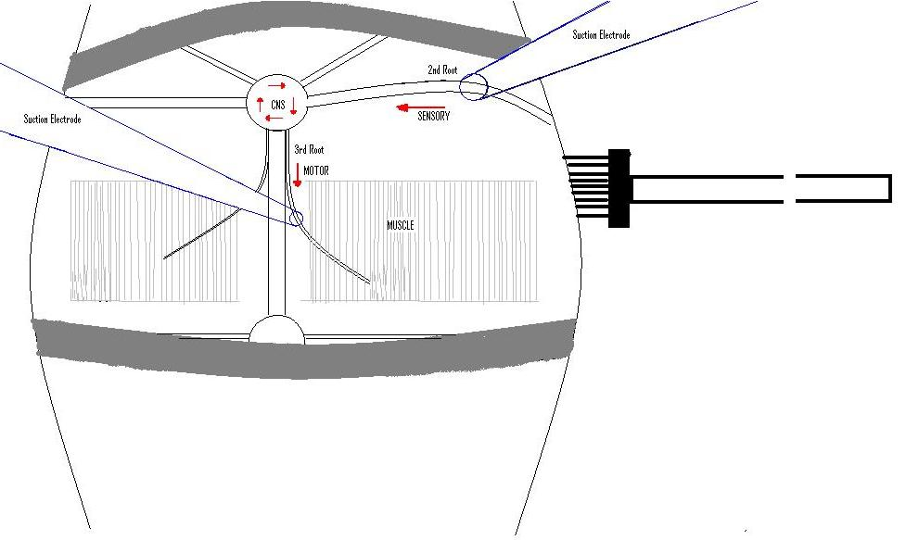
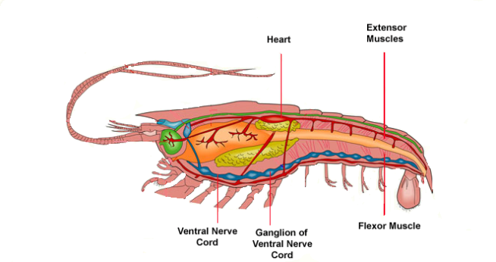
Ventral Nerve Cord: Neural Circuitry
Anterior
Suction Electrode
CNS
Suction Electrode
SENSORY
MOTOR
Brush Sensory Stimulation
3rd Root
MUSCLE
Posterior
2nd Abdominal Segment

Slide 25
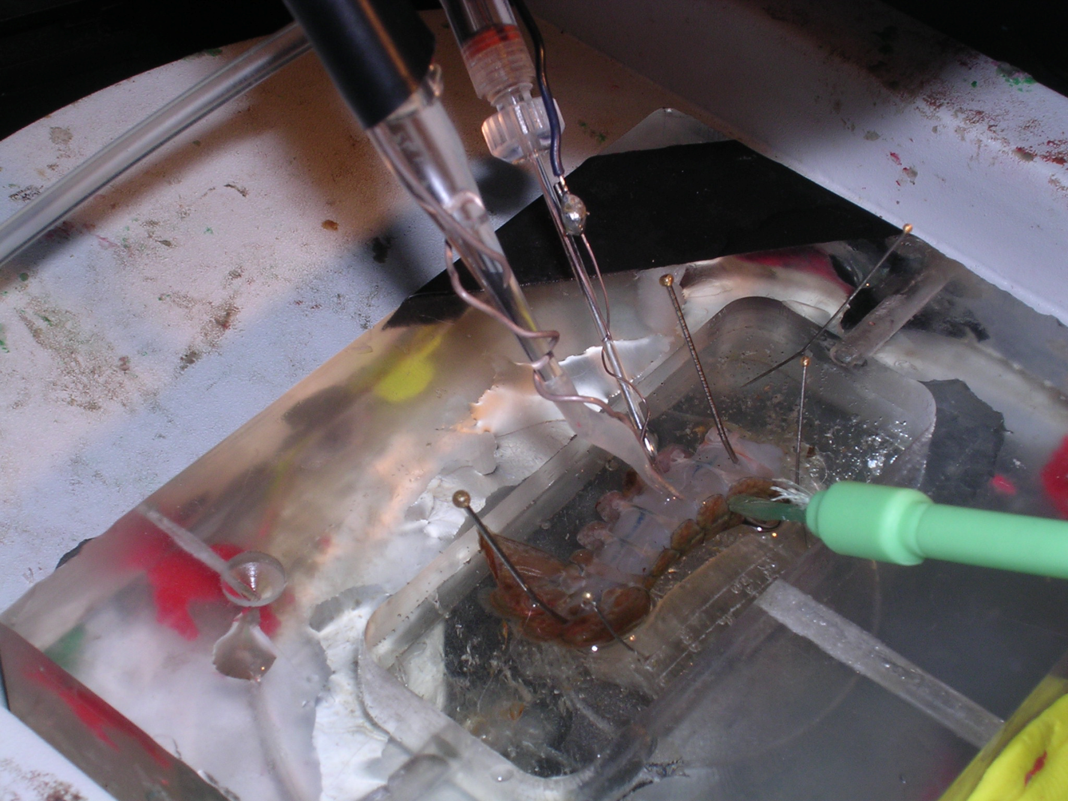
Neural Circuitry
Notes:
Why more points on other scatter plot??

Slide 26
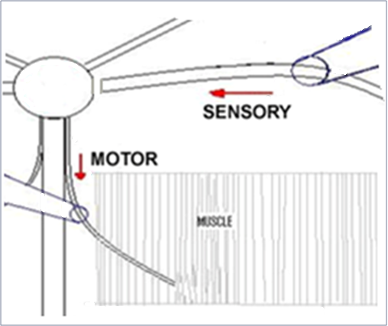
Neural Circuitry
Anterior
Sensory → Cholinergic
Interneurons
Chemical? NT?
Gap Junctions?
Motor Root
Chemical? NT?
Gap Junctions?
NMJ → Glutamate
SENSORY
Ach
?
?
MOTOR
MUSCLE
Glutamate
Posterior

Slide 27
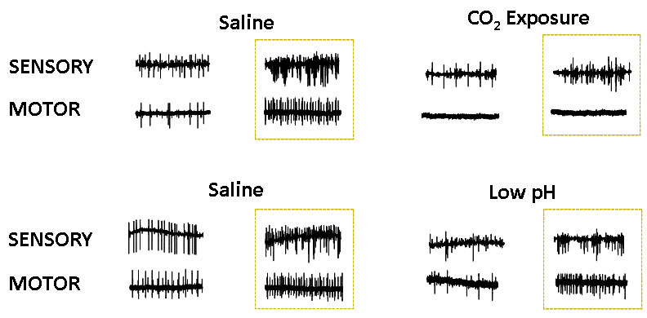
Neural Circuitry: Spike Recordings
2.5 sec
Sensory CNS (Interneurons) Motor

Slide 28
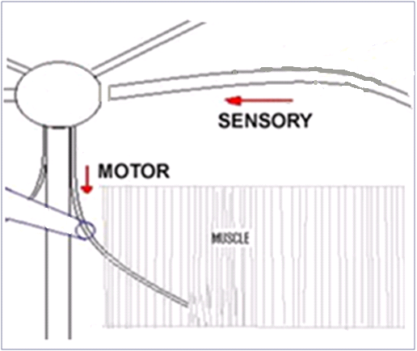
Neural Circuitry: Nicotine
Anterior
Acetylcholine Agonist (Stimulates nicotinic receptors)
Ach
Sensory Root
Nicotine
Motor activity increases
Heightened motor sensitivity to brushing
CO₂ + Nicotine
Motor activity drops out
No activity with stimulation
Evidence for nicotinic drive on motor root somewhere in the CNS
SENSORY
Ach
?
MOTOR
Glutamate
MUSCLE
Activity
Motor Root
Posterior

Slide 29
Neural Circuitry: Glutamate
Anterior
Glutamate
Motor activity increases
Heightened motor sensitivity to brushing
Motor activity drops out (desensitization - minutes)
No activity with stimulation
CO₂ + Glutamate
Motor increases immediately
Motor activity drops out (very quickly - seconds)
No spikes with stimulation
Ach
Possible evidence for glutamatergic interneurons
Sensory Root
SENSORY
Ach
?
MOTOR
Glutamate
MUSCLE
Activity
Motor Root
Posterior

Slide 30
Neural Circuitry: Cadmium
Ca²⁺ channel blocker
Anterior
Cadmium (after 30 minutes)
Motor activity persists
No EPSPs
Cd²⁺ shows no effect on CNS
Possible Evidence for Gap Junctions
SENSORY
MOTOR
MUSCLE
Posterior

Slide 31
Domoic Acid
Domoic Acid = AMPA and Kainate receptor agonist for vertebrates
But…. Fly NMJ… Antagonist
Lee, J.-Y., Bhatt, D., Bhatt, D., Chung, W.-Y., and Cooper, R.L. (2009) Biochemistry and Physiology (In Press)

Slide 32
Comparative Effects
FLY
CRAYFISH
 | CO₂ | Domoic Acid | CO₂ | Domoic Acid
NMJ | No EPSPs** | No EPSPs* | No EPSPs
CNS | Activity Motor Root** |  | No Activity Motor Root
* Lee et al. 2009, ** Badre et al. 2005

Slide 33
Comparative Effects
FLY
CRAYFISH
 | CO₂ | Domoic Acid | CO₂ | Domoic Acid
NMJ | No EPSPs** | No EPSPs* | No EPSPs | No EPSPs
CNS | Activity Motor Root** |  | No Activity Motor Root
* Lee et al. 2009, ** Badre et al. 2005

Slide 34
Comparative Effects
FLY
CRAYFISH
 | CO₂ | Domoic Acid | CO₂ | Domoic Acid
NMJ | No EPSPs** | No EPSPs* | No EPSPs | No EPSPs
CNS | Activity Motor Root** | Activity Motor Root | No Activity Motor Root
* Lee et al. 2009, ** Badre et al. 2005

Slide 35
Comparative Effects
FLY
CRAYFISH
 | CO₂ | Domoic Acid | CO₂ | Domoic Acid
NMJ | No EPSPs** | No EPSPs* | No EPSPs | No EPSPs
CNS | Activity Motor Root** | Activity Motor Root | No Activity Motor Root | Activity Motor Root
* Lee et al. 2009, ** Badre et al. 2005
Suggests no glutamate neurons in this crayfish CNS circuit or receptor subtype is not affected by Domoic acid

Slide 36
Summary
Crayfish: Acute CO2 Exposure
NMJ – CO₂ blockage
Motor Axon – Propagation of Action Potential
Neural Circuit - CO₂ caused motor activity to drop out
Understanding the Circuit: (Electrical, Chemical or both?)
Nicotine – Nicotinic receptors involved; unsure if direct on motor neurons
Glutamate –Likely glutamatergic drive of interneurons; unsure direct on motor neurons
Cadmium – Evidence for possible gap junctions
Domoic Acid – Evidence for absence of quisqualate receptors in the circuit
Overall: Possibly gap junctions directly driving motor neurons

Slide 37
Future Directions
Gap junctions in the circuit
1- Heptanol (known gap junction blocker)
Intracellular pH imaging (BCEF)
Further studies with CO₂ on autonomic response
Heart rate
Ventilation Rate

Slide 38

Acknowledgments
Thank You
Dr. Robin Cooper, Advisor
Lab Mates: Wen-Hui Wu
Undergraduates: Barbie Kelly, Ray Geyer
Cooper Lab
Questions ??

Slide 39
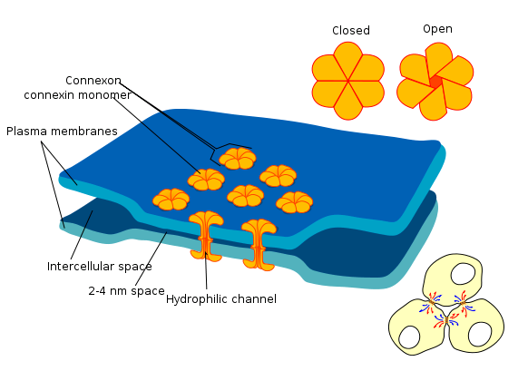
Electrical Communication

Slide 40
Tail-flip Neural Circuit
Other tail-flip
command neurons
Excitatory chemical
Electrical
A
F₁
B
LG
F₂
To tail-flip muscles
C
F₉
Receptors
Interneurons
Command neuron (lateral giant)
Tail-flip motor neurons
(Bryan and Krasne, 1977)
Notes:
????????? Maybe not have in

Slide 41
Domoic Acid: Fly CNS
Segmental Root = Sensory and Motor
Cut sensory going into CNS → Record motor activity out
Domoic Acid
Still Have Motor Activity

Slide 42
Neural Circuitry: Domoic Acid
Anterior
Fly NMJ Antagonist
Domoic Acid
Motor activity increases
Motor activity drops out (desensitization)
Domoic Acid + Glutamate
Motor activity increases initially
Spikes drop out (very quickly)
No motor activity with stimulation
SENSORY
MOTOR
MUSCLE
Activity
Posterior

Slide 43
Neural Circuitry
1- Heptanol = Gap Junction inhibitor
Cadmium (5/5 preps)
After 30 minutes:
Sensory activity
Motor Activity
Evoked EPSPs occur, amplitude diminished
Mini’s (spontaneous events) - none
Anterior
Activity
Ach
SENSORY
MOTOR
MUSCLE
Activity
Posterior

Slide 44
Chemical Synapse
Pre-synaptic Neuron
Post-synaptic Cell
http://highered.mcgraw-hill.com/olcweb/cgi/pluginpop.cgi?it=swf::535::535::/sites/dl/free/0072437316/120107/bio_c.swf::Function%20of%20the%20Neuromuscular%20Junction

Slide 45
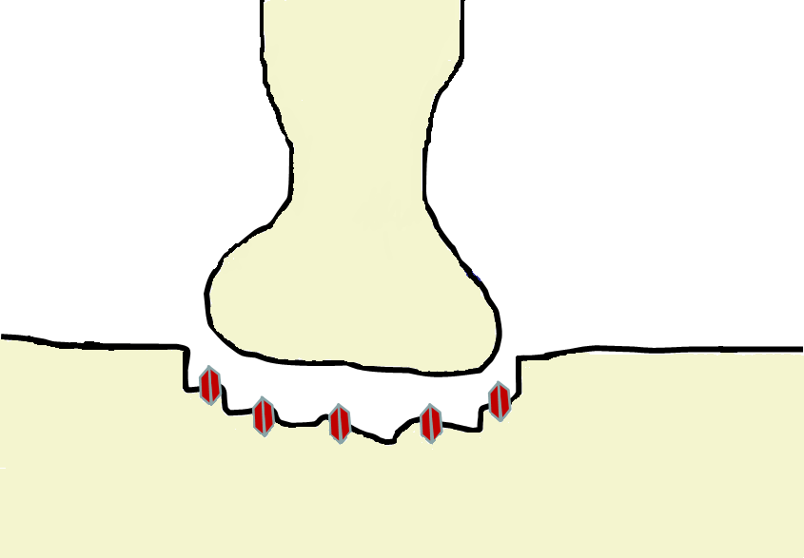
Crayfish NMJ
Pre-synaptic
Intracellular Electrode
Stimulate
Motor Nerve
Ca²⁺
Intracellular Electrode
Glutamate
Muscle Fiber
Record
Excitatory Post-synaptic Potentials (EPSPs)
Post-synaptic

Slide 46
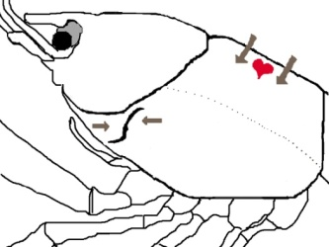
Recording the Autonomic Response
Assessment of intrinsic state of the organism
Counts of Heart Rate (HR) &
Ventilation Rate (VR)
Direct measure of organism’s response to a changing environment
Notes:
Crayfish heart – single-chambered organ, suspended in the pericardial cavity by the elastic ligaments.

Slide 47
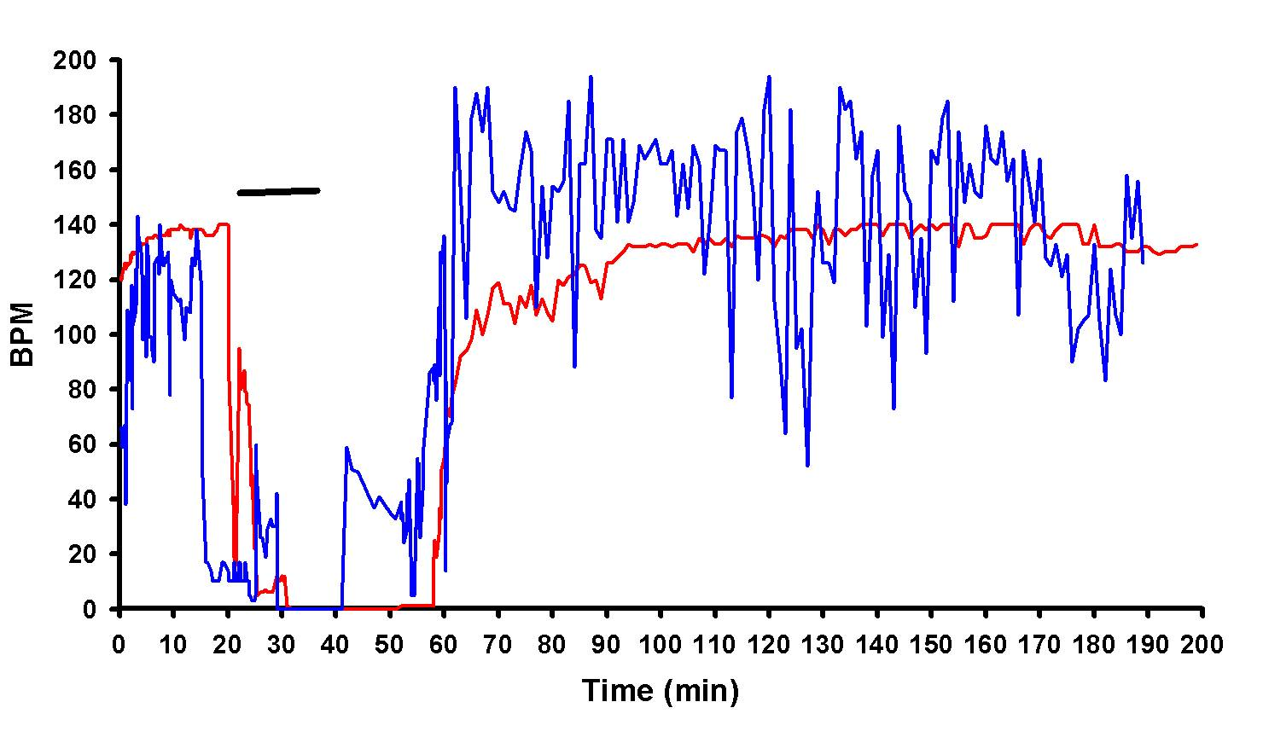
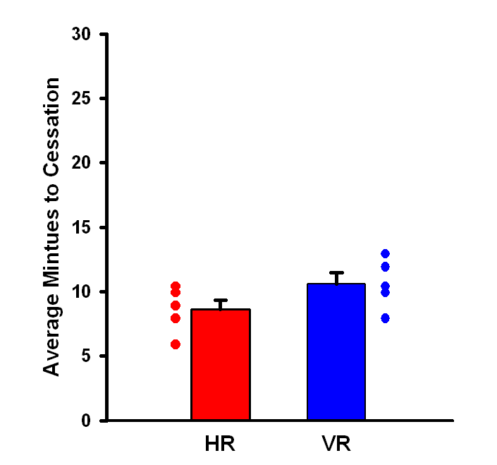
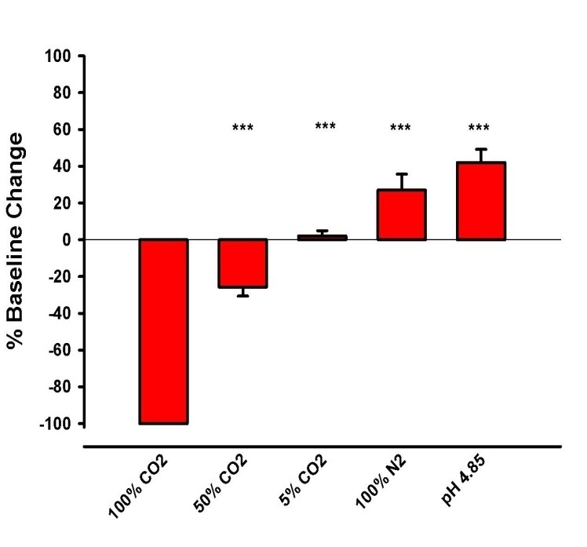
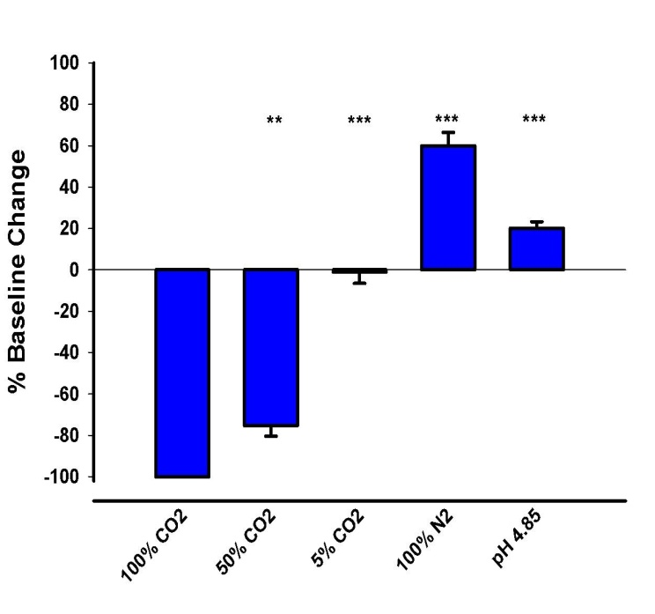
Autonomic Recordings
CO2 Exposure
Ventilation Rate
N=5
Heart Rate

Slide 48
Physiology: Heart & Scaphognathite
HEART
SCAPHOGNATHITE
Neurogenic
Neurogenic
??
Glutamate
Gap junctions
Mechanistic Actions of CO2?

Slide 49
Mechanisms of Autonomic Response
Heart
Glutamate (neurotransmitter), known gap junctions in heart cells
Effect most likely due to CO2 on cardiac gap junctions (as previously described in lateral giant neuron)
Effect at the chemical synapses due to neurogenic control unknown
Scaphognathites
Hemiganglion nerve carries impulses to the muscles going to the SG which are depressors and levators, innervated by a separate nerve trunk. Neurotransmitter unknown.
Gap junctions - unknown
Effect at the chemical synapses - unknown

Slide 50
SUMMARY: Autonomic Response
- The previously identified effect with carbon dioxide exposure is shown here by a cessation heart (HR) and ventilatory (VR) rates after approximately 10 minutes, a steady decrease in locomotor activity, as well as unresponsiveness to stimuli prior to HR and VR cessation.
- In addition, the paralytic effect is not seen with low pH or hypoxic environments, suggesting a CO2 effect.

Slide 51
Effect of CO2 at NMJ
Normal Saline
Saline + CO₂
Saline + CO₂ + Glutamate
Saline
Washout
RMP
~ -75mV
EPSPs
Drop out
No EPSPs;
No Depolarization
Slow to Recover; Normal EPSPs

Slide 52
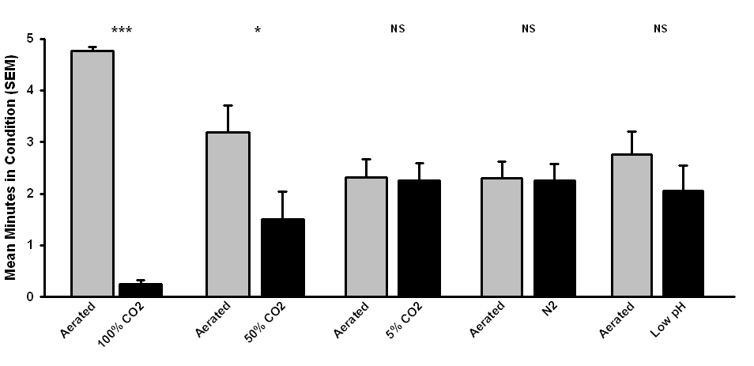
CO2 Repellent?

Slide 53
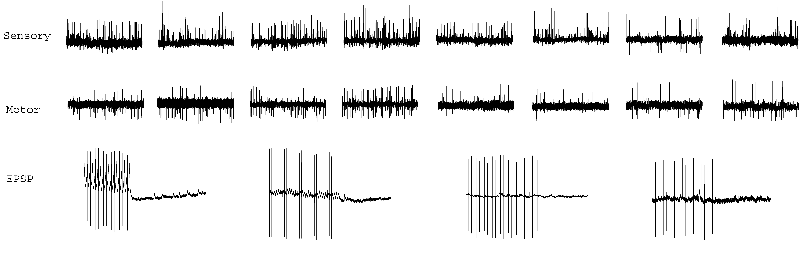

Slide 54
DOMOIC ACID -- Fly
Fly – reduced amplitude and frequency mini’s
No change in RMP
suggests domoic acid is an antagonist to the postsynaptic glutamate receptors.
Reduced frequency of the mEPSPs is due to the gradual reduction in the mEPSP amplitude, such that they are not discernable from noise in the baseline and thus are not detected to monitor their frequency

Slide 55
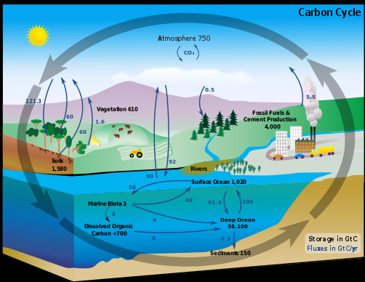
Notes:
Diagram of the carbon cycle. The black numbers indicate how much carbon is stored in various reservoirs, in billions of tons ("GtC" stands for GigaTons of Carbon and figures are circa 2004). The purple numbers indicate how much carbon moves between reservoirs each year. The sediments, as defined in this diagram, do not include the ~70 million GtC of carbonate rock and kerogen

Slide 56
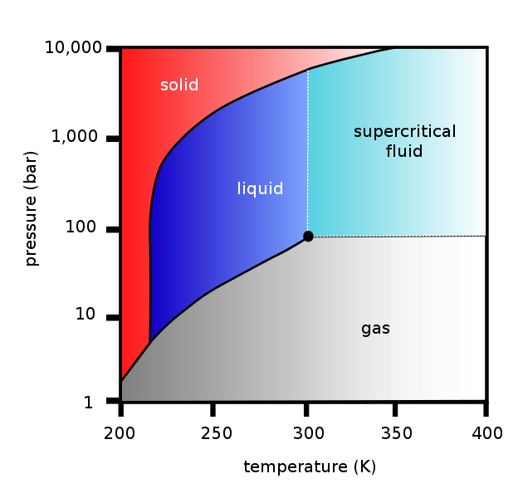
-73
-23
27
77
127
(C)

Slide 57
Properties
Molecular formula | CO₂
Molar mass | 44.010 g/mol
Appearance | colorless, odorless gas
Density | 1.562 g/mL (solid at 1 atm and −78.5 °C) 0.770 g/mL (liquid at 56 atm and 20 °C) 1.977 g/L (gas at 1 atm and 0 °C) 849.6 g/L (supercritical fluid at 150 atm and 30 °C
Melting point | -78 °C, 194.7 K, -109 °F (subl.)
Boiling point | -57 °C, 216.6 K, -70 °F ((at 5.185 bar))
Solubility in water | 1.45 g/L at 25 °C, 100 kPa
Acidity (pK_{a}) | 6.35, 10.33
Refractive index (n_{D}) | 1.1120
Viscosity | 0.07 cP at −78 °C
Dipole moment | zero

Slide 58
Question - Can you tell me how much CO2 can be dissolved in water ? Is there another form of carbon that can have a higher concentration in water? CO or something else?
The solubility of CO2 in water depends upon several factors:
The pressure of CO2 in equilibrium with the solution. Solubility increases with increasing pressure.
The temperature. Solubility decreases with increasing temperature.
The pH. The solubility of CO2 increases with increasing pH.
The presence of other substances.
The solubility tends to decrease with concentration of "inert" ionic solutes like sodium chloride, but may increase or decrease with increasing concentration of organic compounds, depending upon the compound. You can find out "pieces" of the answer if you do a web search, but I do not know of a single reference that tabulates all the variables in one place. In general sodium and potassium carbonate or hydrogen carbonate salts will be more soluble than gaseous CO2 alone.
CO2 solubility depends in part on conditions such as temperature and pressure of the water among other things. It is not clear what you want when you ask about another form of carbon that can have a higher concentration dissolved in water- in terms of total atoms of carbon, or total molecules? For example for many of the alcohols you can essentially add alcohol continuously until the mix approaches 100% alcohol (becoming essentially water dissolved in alcohol) If it must be an inorganic form of carbon then generally the carbonate salts will generally have much higher concentrations than plain CO2 at atmospheric pressure. For example the solubility of sodium carbonate is 455 g/L or about 4 moles/L, which is much higher than the solubility of CO2 at 1 atmosphere (about 0.03 moles/L).

Slide 59
Gas | Percent (in atmosphere) | Solubility* | In water*
Nitrogen | 78.084% | 18.61 | 14.53
Oxygen | 20.946% | 38.46 | 8.06
Carbon Dioxide | 0.033% | 1,194.00 | 0.39
Solubility of Gasses in H₂O at 10º C
* Solubility in ml/l

Slide 60
FACTORS INFLUENCING ABSOLUTE AMOUNT OF GAS IN WATER SOLUTION
Increasing temperature will reduce the amount of gas that water can hold; you are familiar with this fact already, since it is manifested whenever you heat water (the small bubbles that form before the water boils).
Decreasing pressure (increased altitude) will also decrease the amount of gas dissolved. Increasing salinity also decreases the ability of water to dissolve gasses; seawater holds about 20% less gas than freshwater, and hypersaline water holds even less gas.
And, of course, there are other gasses which are dissolved in water besides these three (which are the major ones).

Slide 61
ALKALINITY
Carbon dioxide may also combine with water and metals such as magnesium and calcium to form other bicarbonates.
The amount of CO₂ so combined is referred to as alkalinity, which really has nothing to do with OH⁻ concentration, but much to do with the buffering capacity of the water.
It works like this: Highly alkaline water tends to have a high (basic) pH and will turn a phenolphthalein solution pink. If you add acid to it, the bicarbonates, with their negative charge, attract and bind the positive H⁺ ions, and form carbonic acid.
If you keep adding acid, eventually the pH changes to 8.3, and the pink fades.
The amount of acid added corresponds to the phenolphthalein alkalinity, but not all the bicarbonate is converted at this point; in fact, it is at its peak.
If you now add methyl orange, a dye that will change color at pH 4.4, and continue to add acid, you will drive more bicarbonate to form carbonic acid, which in turn reaches its peak at a pH of 4.4.
The total amount of acid added thus corresponds to the amount of CO₂ present in the sample.
This method works only if there are not significant numbers of non-carbonate negative ions to absorb H⁺ ions.

Slide 62
Henry’s Law
The amount of dissolved CO2 is governed by Henry's Law, which states that:
P(CO2) = Kh * C(CO2)
P(CO2) is the partial pressure of CO2 in the ambient air
Kh is Henry's Law constant
C(CO2) is the concentration of dissolved CO2 in the water.

Slide 63
CO₂ Solubility Calculation for experiments
100% CO₂ equaled normal saturation or slightly super-saturation
Super-saturation estimates for water = 5.0g/L of CO₂
Normal saturation estimates for water = 3.30 g/L of CO₂
Study Conditions: Examined Alkalinity (buffers), Total dissolved solids, pH, Temp
Temperature ~ 22 - 23 C
pH = ~4.53 - 4.54
Alkalinity ~ 77 mg/L CaCO₃ (Calcium carbonate)
Total solid CO₂ ~270 mg/L of solids dissolved (100 mL of CO₂ saturated H₂O)
Saturation level = 3.36 g/L
0.033 mol/L
0.336% CO₂ in H₂O

Slide 64
At pH 4.54, >97% of the inorganic carbon in the water should be free carbon dioxide.
However, that pH is much lower than the tap water it was derived from (since aerated aged tap water).
The formation of carbonic acid drove down the pH to 4.54 (At a more neutral pH, the bicarbonate ion actually dominates).
That makes sense because the alkalinity was 77 mgCaCO3/l as compared to 4.5g CO2/L.
The carbonate portion of that alkalinity is about 46.2 mg CO3/L, right at 1% of the total inorganic carbon.
So I think the water conditions make sense given the pH and the fact that was bubbling pure CO2 through the water.
As carbonate concentrations in water increase, so does the solubility of CO2.
Wetzel states that CO2 dissolved in water from atmospheric sources is 1.1 mg/L at 0 degrees C, 0.6 mg/L at 15 degrees C and 0.4 mg/L at 30 degrees C, so I take it that normal waters at 23 degrees C would be about 10-15% saturated. He further states that as CO2 dissolves in water it achieves “about the same concentration by volume (approximately 10uM) as in the atmosphere”

Slide 65
Wetzel states that CO2 dissolved in water from atmospheric sources is 1.1 mg/L at 0 degrees C, 0.6 mg/L at 15 degrees C and 0.4 mg/L at 30 degrees C, so I take it that normal waters at 23 degrees C would be about 10-15% saturated.
He further states that as CO2 dissolves in water it achieves “about the same concentration by volume (approximately 10uM) as in the atmosphere”

Slide 66
This graph can be used to observe in which pH area which CO₂ species dominates as can be seen
Graph: pH and CO2 species.

Slide 67
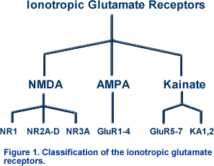
http://www.bris.ac.uk/Depts/Synaptic/info/glutamate.html

Slide 68
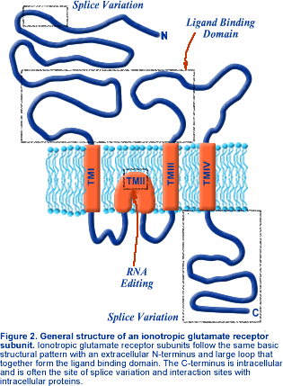
http://www.bris.ac.uk/Depts/Synaptic/info/glutamate.html
Notes:
All ionotropic glutamate receptor subunits share a common basic structure. Like other ligand gated ion channels, such as the GABA_{A} receptor, the ionotropic glutamate receptor subunits possess four hydrophobic regions within the central portion of the sequence (TMI - IV; Figure 2). However, in contrast to other receptor subunits, the TMII domain forms a re-entrant loop giving these receptor subunits an extracellular N-terminus and intracellular C-terminus (Figure 2). In addition, the long loop between TMIII and TMIV, which is intracellular in other ligand gated ion channel subuhnits, is exposed to the cell surface, and forms part of the binding domain with the C-terminal half of the N-terminus. These two sequences show structural similarities to the bacterial periplasmic amino-acid binding protein.

Slide 69
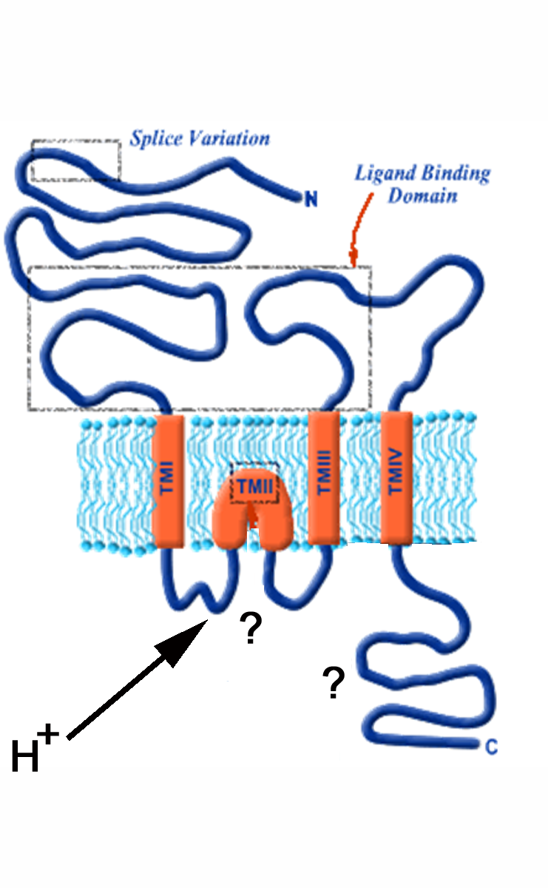
If the effect is due to pH then it must be internal as external
pH does not alter glutamate sensitivity.

Slide 70
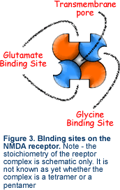
http://www.bris.ac.uk/Depts/Synaptic/info/glutamate.html

Slide 71
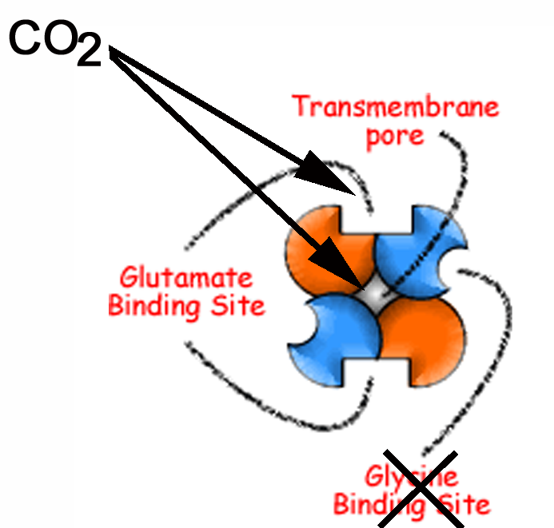
Binding in the pore could occur from outside or inside.
Glutamate binding inhibition only on the outside.

Slide 72
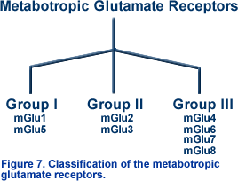
http://www.bris.ac.uk/Depts/Synaptic/info/glutamate.html

Slide 73
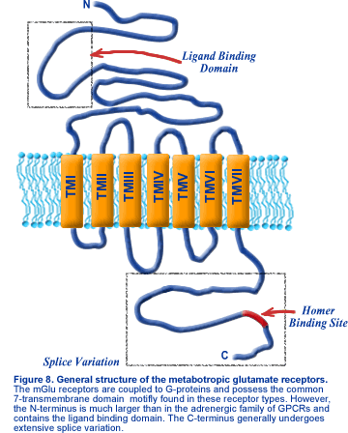

Slide 74
Crayfish Physiological Saline
12g NaCl
0.4g KCl
1.98g CaCL2
0.5g MgCl2
50 ml 0.1M HEPES (pH 7.4)

