Slide 1
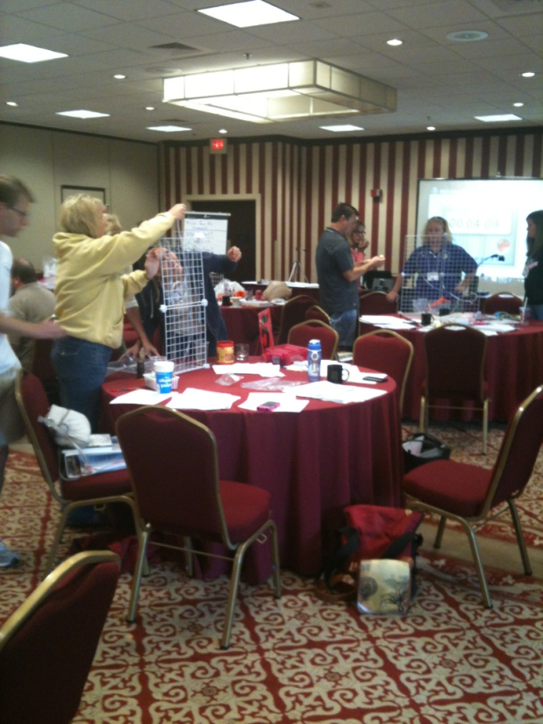
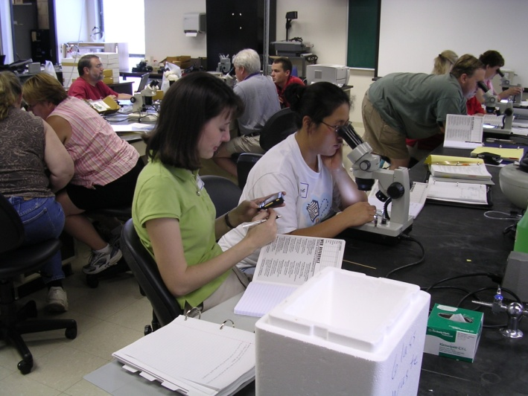
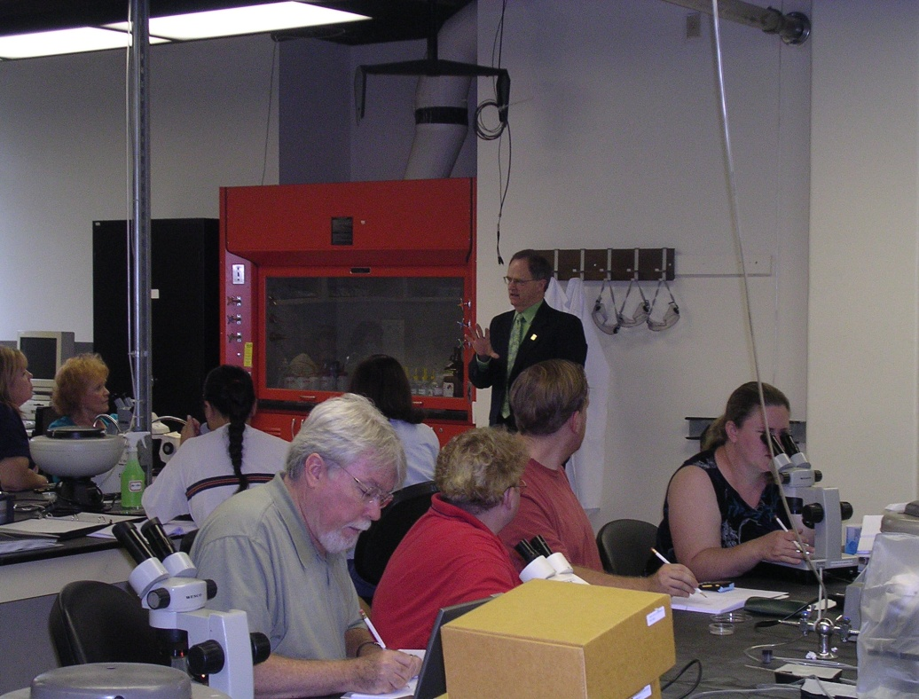
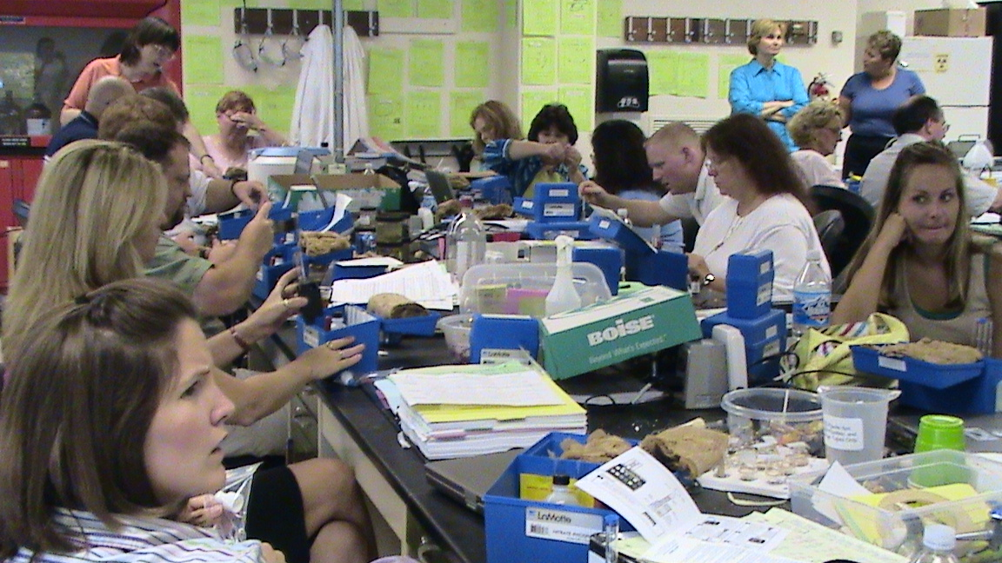
IT IS FUN !

Slide 2
An example activity
NGSS
This way teachers and funding agencies are interested.
Modeling
STEM (with real engineering )
Systems biology
Real life examples
Integrate cross cutting concepts and hits various grade levels
http://web.as.uky.edu/Biology/faculty/cooper/Education-Muscle/Home.htm

Slide 3
Muscle powers health

Slide 4
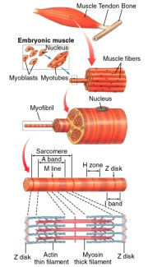
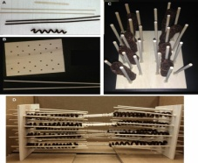
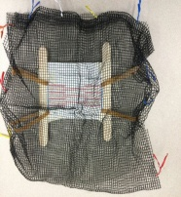
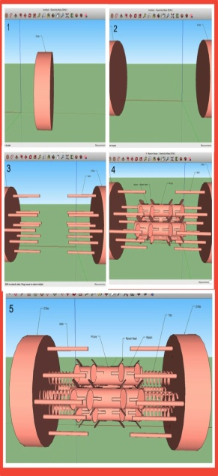
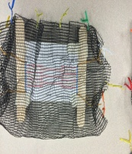
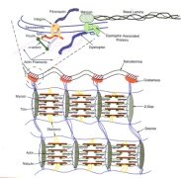
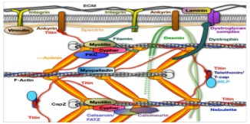
Educational modules of skeletal muscle anatomy and function for middle and high school students with models and active data gathering
MICHAEL P. SCHULTZ¹, REBECCA KRALL², ‎ ESTHER E. DUPONT-VERSTEEGDEN^{3,4} SUSAN MAYO⁵, DIANE JOHNSON⁵, KIM ZEIDLER-WATTERS⁵,AND ROBIN L. COOPER^{1,4}
¹Dept. of Biol., Univ. of KY.; ²Dept. of STEM, Univ. of KY; ³Div. Physical Therapy, Dept. Rehabilitation Sciences, Col. Health Sciences, Univ. of KY;
⁴Center for Muscle Biology, Univ. of KY. and ⁵P-12 Math and Science Outreach Unit of PIMSER.
INTRODUCTION
Middle school level
Students learn anatomy and names of structures
Students determine force in relation to known anatomy of myosin heads attached to actin
Building a diorama of some aspect of skeletal muscle.
CONCLUSIONS
The driving principle behind our research is to build educational content to help with integration of the new national science standards (Achieve, Inc., 2013, USA) with biology, math and engineering topics. The educational products are to design various templates of biological models of skeletal muscle to present form and function by engineering design. The National Academy of Engineering (NAE) and the National Research Council (NRC) (Katehi, Pearson & Feder, 2009) claim several benefits to incorporating engineering in K-12 school curriculum. These are to provide starting blocks for teachers to use for their classrooms for students to then advance in inquiry based investigation.
These educational modules that will be used in KY teacher workshops and presented at NSTA regional and national meetings are to improve learning and understanding for teachers and students in issues in stereology and biological function of skeletal muscle. This will be accomplished by teachers training students to develop potential models that explain anatomical measures. The participants will be guided to develop creative ways to design/demonstrate the movements of skeletal muscle and the forces from various materials. The science that will be used is geometry and algebra, measures of force, building potential models to explain various disease states, and the comparative anatomy with various types of skeletal muscle in various animals. The final goal will be to work with faculty members in the Department of Education at UK and in the Center of Muscle Biology at UK in collaboration with teachers and their classrooms.
To engage students we have used a scenario to start off the various aspects of the lessons. This is designed to engage students in a potential real life integrative problem. The conceptual problem used involves a classmate who is diagnosed with muscular dystrophy and asks his classmates for help in understanding his disease. The class is divided into groups to cover various topics and activities: (1) to model the disease with physical explanations of the cellular anatomy; (2) literature search the disease process and treatments; (3) develop a means of effectively presenting the topics to the classmates and a public awareness poster or display. The biology and medical terms will increase vocabulary and emphasize research in the primary scientific literature. Assessment of the learning could be a team based project which is designed to be presented at an educational heath fair.
The results of this project will be to develop assessment tools of the teachers and students that will serve as beta testers of the modules. Some studies have implicated that engineering design alone helps students learn science (Diaz & Cox, 2013; Lachapelle and Cunningham, 2007; Mehalik, Doppelt & Schuun, 2008; Silk, Schunn, and Cary, 2009), but evaluation is lacking. We hope to develop some evaluation tools and investigate best practices for teaching and assessing science learning in the context of engineering and design of these skeletal muscle models. Pre- and post-tests with treatment and control groups will be used to test for statistically significant differences exist before and after training as well as groups that will not be used in the beta testing and other that will complete the training.
• Provide the history of the sarcomere and cross sections of different bands. (2 D figures)
• List or label the vocabulary for a sarcomere.
• How do the cross sections create a banding pattern? Have the students create their models (2 D-3 D models).
• Possible use of ppt. for modeling.
• Use tongue depressors and Velcro strips to illustrate force. Use of different numbers of patches to
mimic number of myosin heads. Probes or weights used to measure force.
See movies ( 1 myosin head or 2 myosin heads ) Pay attention to the scale measure. You might have to download and then open to see the full screen for the scale.
Vernier force probes or a spring scale (fishing scale) will work will for this activity.
The topic of stereology (3D objects viewed in 2D) is a thread through these different disciplines.
These integrative engineering design-based curriculum module will cut across various disciplines which embrace the goals of the Next Generations Science Standards (NGSS) in cross-cutting concepts.
The depth of the modules allows high and middle school students to understand the concepts with substantive learning objectives and physical activities in addition to addressing scientific literacy.
Provide list of names and students label on drawing (sample below).
Here is an example of "titin" attached to the myosin ends and to the Z-Disks. Also, "actin" is shown for relationship to the "myosin". Variations in the theme can readily be made such as adding myosin heads.
Provide these figures
Show stretched and contracted
states of sarcomere
Stretched
Cross sections
at red lines
Relaxed
< See movies
Students try to determine 3D structures from cross sections
1 myosin head
2 myosin heads
High school level
Build a physical model to help understand the problem with Duchenne's muscular dystrophy.
Use the free version of SketchUp (http://www.sketchup.com/learn), and model in 3D some aspect of skeletal muscle anatomy.
• Discussion of muscle cells and disease.
• Discussion of muscular dystrophy.
• Create muscular dystrophy models to give example as to how the disease works.
(build up from Middle school models)
• Descriptive explanation of the disease and treatments prognosis
• 3D modeling with SketchUp or ppt
Other activities:
Talk or communicate with physicians and/or researchers about skeletal muscle disorders.
Ask about their research (basic or applied).
Types of muscle diseases the person might have seen recently.
What do they foresee in the future for research related to skeletal muscle ?
2. Investigate the comparative differences in skeletal muscle from different animals. Compile a report on the differences with diagrams and/or tables from the literature research.
Normal
FUTURE DIRECTIONS
The class problem:
A fellow student in your class is asking for the whole class to help him understand his disease. He has been informed that he has the beginning stages of muscular dystrophy, but when he asked the doctor about it, he said that he would refer him to a help group about dealing with the disease, and the details of the disease seemed confusing to him. After talking with the parents, the teacher is allowing the class to help the student learn more about the disease. The teacher wants to know what level of knowledge the class has about the disease, so she made a short quiz for the class for you to take. She is dividing the class up in groups to work on various aspects of this project. One group is to conduct a literature search about the disease and then they are to compile information in the form of a presentation. A second group is to understand the basic anatomy and physiology of the disease and then explain it to the class. A third group is to build a physical model to explain the physical and mechanistic issues with this disease.
The results of this project will be to develop assessment tools of the teachers and students that will serve as beta testers of the modules.
Develop some evaluation tools with pre- and post-tests with treatment and control groups .
This will help to determine if this training is useful for the goals.
We hope that modules and the evaluation results can be published in educational based journals.
Pre Quiz (sample questions)
Dystrophic muscle
3. In the figure the scale bar is 1 μm. What is the sarcomere length in the figure ? (hint: estimate with marking your pencil. You can do the math with long hand.)
1 μm
A. About 5 to 6 μm.
B. About 1 to 2 μm.
C. About 2 to 3 μm
D. About 13 μm
E. About 3 to 4 μm
4. Draw in the location of “Titin” for the middle sarcomere for a couple of the myosin units.
5. Where does the calcium come from that enters human skeletal muscle cells
A. ECF (extracellular fluid)
B. SR (sarcoplasmic reticulum)
C. mitochondria
D. A, B, and C
E. A and B
6. Which of the following best describes an isometric contraction?
tension (or force) increases, but length stays the same.
tension (or force) stays the same, but length increases.
tension (or force) stays the same, and length stays the same.
tension (or force) stays the same, but length decreases.
e. tension (or force) decreases, and length decreases.
1 μm
Diagram the details of the skeletal muscle and explain mechanistically the problems in this disease related to muscle function. Use scientific resources for information gathering. Sample figures below from primary articles.
References
Diaz, NV, Cox, MF. An overview of the literature: Research in P-12 engineering education. Advances in Engineering Education 3 (2), 1-37.
Katehi, L., Pearson, G., & Feder, M. (Eds.). National Academy of Engineering and National Research Council. Engineering in K-12 education: Understanding the status and improving the prospects. Washington, DC: National Academies Press.
Lachapelle, C. P., & Cunningham, C. M. (2007). Engineering in elementary schools. In J. Strobel, S. Purzer, M. Cardella (Eds.), Engineering in PreCollege Settings: Research in Practice. Sense Publishers: Rotterdam.
Mehalik, M. M., & Doppelt, Y., & Schunn, C. D. (2008). Middle-school science through design-based learning versus scripted inquiry: Better overall science concept learning and equity gap reduction. Journal of Engineering Education, 97(1), 71-85.
Silk, E., Schunn, C. D., & Strand-Cary, M. (2009). The impact of an engineering design curriculum on science reasoning in an urban setting. Journal of Science Education and Technology, 18(3), 209-223.
See movies
Normal
Dystrophic muscle

Slide 5
Educational modules of skeletal muscle anatomy and function for middle and high school students with models and active data gathering
The results of this project will be to develop assessment tools of the teachers and students that will serve as beta testers of the modules. Some studies have implicated that engineering design alone helps students learn science (Diaz & Cox, 2013; Lachapelle and Cunningham, 2007; Mehalik, Doppelt & Schuun, 2008; Silk, Schunn, and Cary, 2009), but evaluation is lacking.
We hope to develop some evaluation tools and investigate best practices for teaching and assessing science learning in the context of engineering and design of these skeletal muscle models.
Pre- and post-tests with treatment and control groups will be used to test for statistically significant differences exist before and after training as well as groups that will not be used in the beta testing and other that will complete the training.

Slide 6
Pre Quiz (sample questions)
3. In the figure the scale bar is 1 μm. What is the sarcomere length in the figure ? (hint: estimate with marking your pencil. You can do the math with long hand.)
1 μm
A. About 5 to 6 μm.
B. About 1 to 2 μm.
C. About 2 to 3 μm
D. About 13 μm
E. About 3 to 4 μm
4. Draw in the location of “Titin” for the middle sarcomere for a couple of the myosin units.
5. Where does the calcium come from that allows human skeletal muscle cells to contract
A. ECF (extracellular fluid)
B. SR (sarcoplasmic reticulum)
C. mitochondria
D. A, B, and C
E. A and B
1 μm

Slide 7
Middle school level
• Provide the history of the sarcomere and cross sections of different bands. (2 D figures)
• List or label the vocabulary for a sarcomere.
• How do the cross sections create a banding pattern? Have the students create their models (2 D-3 D models).
• Possible use of ppt. for modeling.
• Use tongue depressors and Velcro strips to illustrate force. Use of different numbers of patches to
mimic number of myosin heads. Probes or weights used to measure force.

Slide 8
Middle school level
• Provide the history of the sarcomere and cross sections of different bands. (2 D figures)
• List or label the vocabulary for a sarcomere.
• How do the cross sections create a banding pattern? Have the students create their models (2 D-3 D models).
• Possible use of ppt. for modeling.
• Use tongue depressors and Velcro strips to illustrate force. Use of different numbers of patches to
mimic number of myosin heads. Probes or weights used to measure force.
Show stretched and contracted
states of sarcomere
Stretched
Contracted
Relaxed
Cross sections
at red lines
Students try to determine 3D structures from cross sections

Slide 9
Students learn anatomy and names of structures
Provide list of names and students label on drawing (sample below).

Slide 10
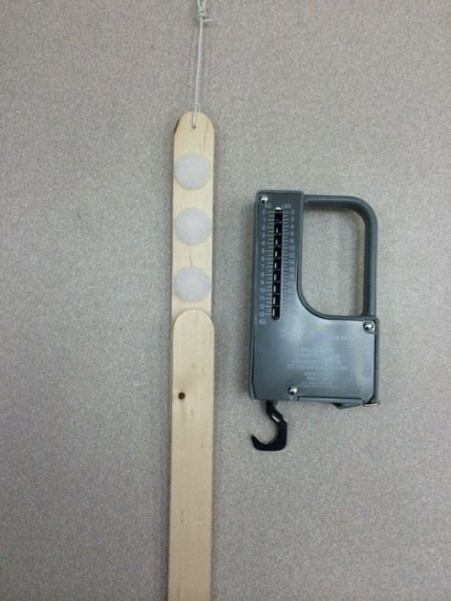
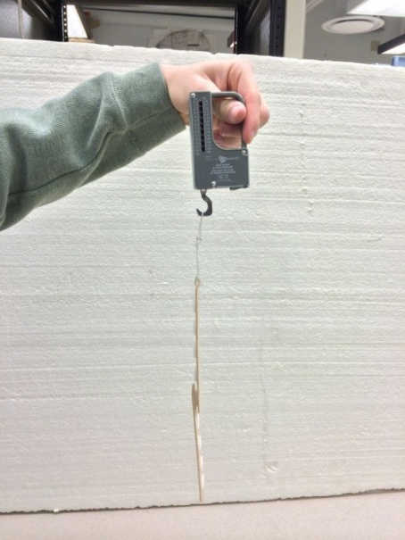
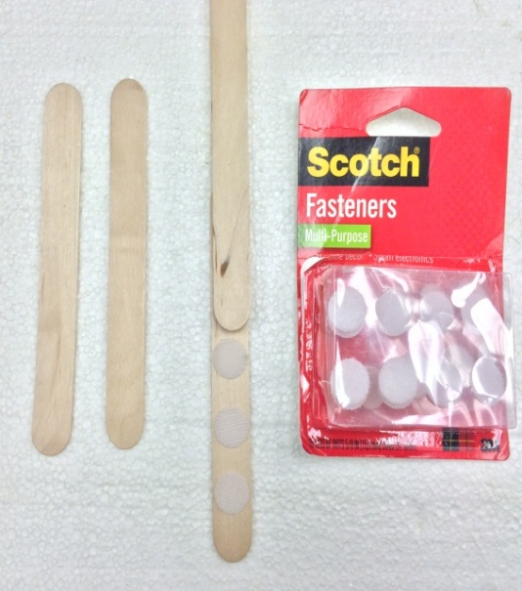
Students determine force in relation to known anatomy of myosin heads attached to actin
Vernier force probes or a spring scale (fishing scale) will work will for this activity.
1 myosin head
2 myosin heads
< See movies

Slide 11
Building a diorama of some aspect of skeletal muscle.
Here is an example of "titin" attached to the myosin ends and to the Z-Disks. Also, "actin" is shown for relationship to the "myosin". Variations in the theme can readily be made such as adding myosin heads.

Slide 12
High school level
The class problem:
A fellow student in your class is asking for the whole class to help him understand his disease. He has been informed that he has the beginning stages of muscular dystrophy, but when he asked the doctor about it, he said that he would refer him to a help group about dealing with the disease, and the details of the disease seemed confusing to him. After talking with the parents, the teacher is allowing the class to help the student learn more about the disease. The teacher wants to know what level of knowledge the class has about the disease, so she made a short quiz for the class for you to take. She is dividing the class up in groups to work on various aspects of this project. One group is to conduct a literature search about the disease and then they are to compile information in the form of a presentation. A second group is to understand the basic anatomy and physiology of the disease and then explain it to the class. A third group is to build a physical model to explain the physical and mechanistic issues with this disease.

Slide 13
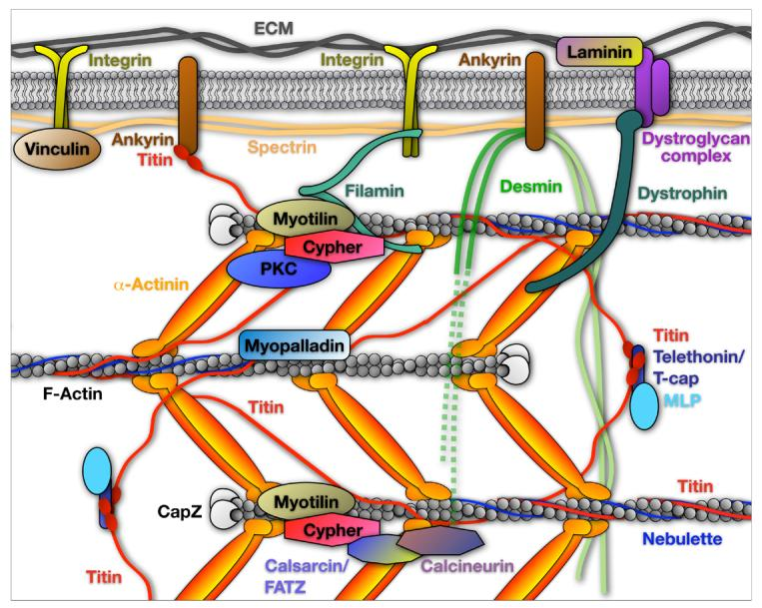

Slide 14
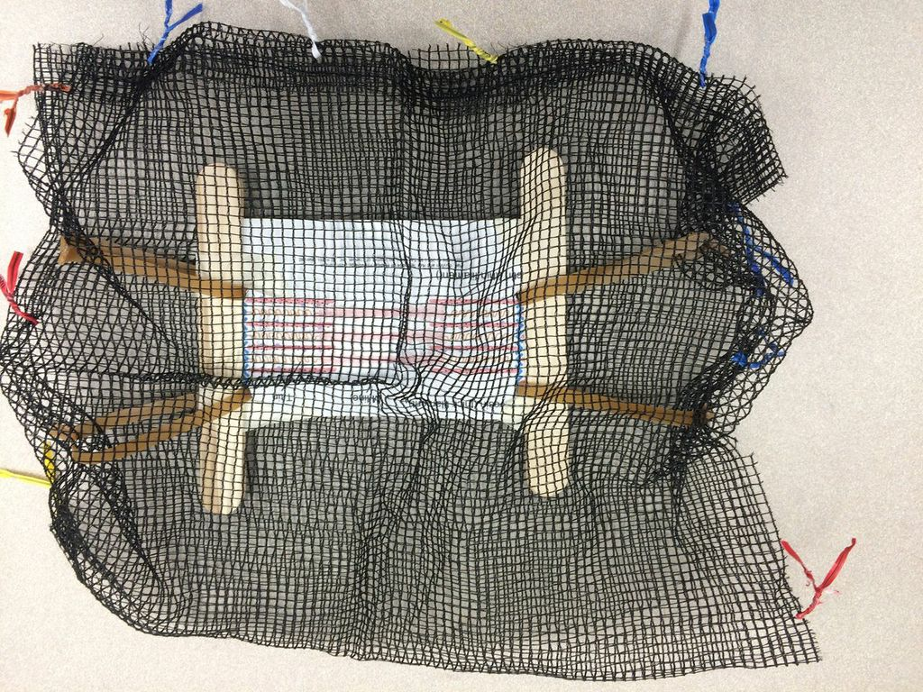
Build a physical model to help understand the problem with Duchenne's muscular dystrophy.

Slide 15
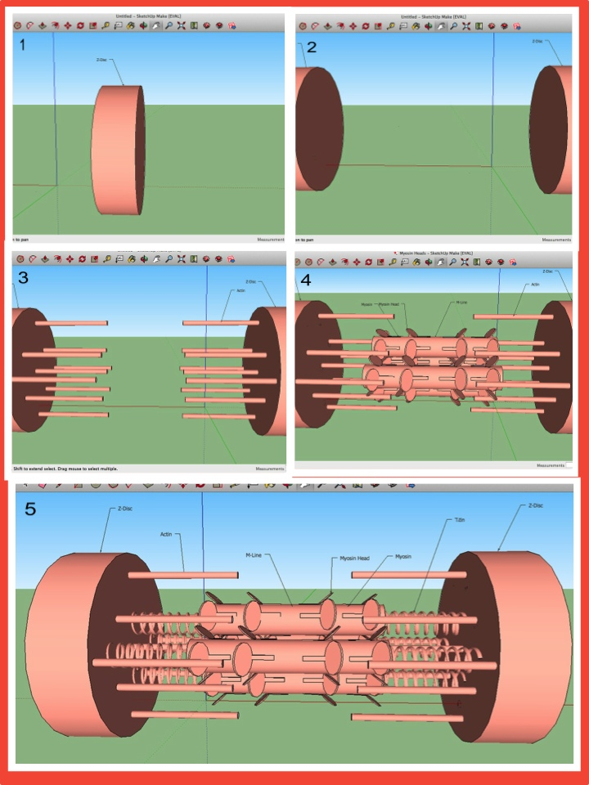
Use the free version of SketchUp http://www.sketchup.com/learn) and model in 3D some aspect of skeletal muscle anatomy.

Slide 16
Other activities:
Talk or communicate with physicians and/or researchers about skeletal muscle disorders.
Ask about their research (basic or applied).
Types of muscle diseases the person might have seen recently.
What do they foresee in the future for research related to skeletal muscle ?
2. Investigate the comparative differences in skeletal muscle from different animals. Compile a report on the differences with diagrams and/or tables from the literature research.

Slide 17
Summary of this project
1. The topic of stereology (3D objects viewed in 2D) is a thread through these different disciplines.
2. These integrative engineering design-based curriculum module will cut across various disciplines which embrace the goals of the Next Generations Science Standards (NGSS) in cross-cutting concepts.
3. The depth of the modules allows high and middle school students to understand the concepts with substantive learning objectives and physical activities in addition to addressing scientific literacy.

Slide 18
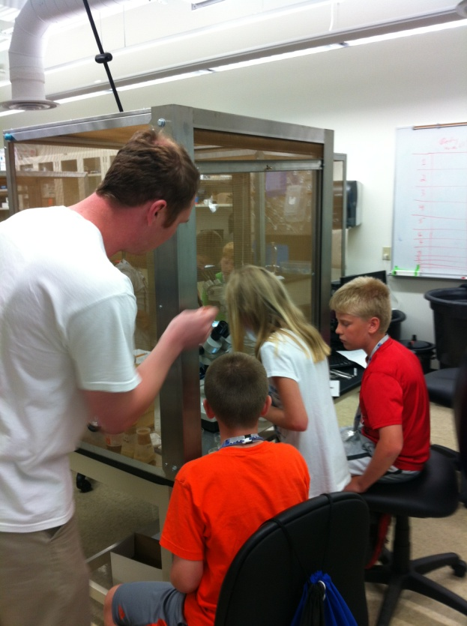
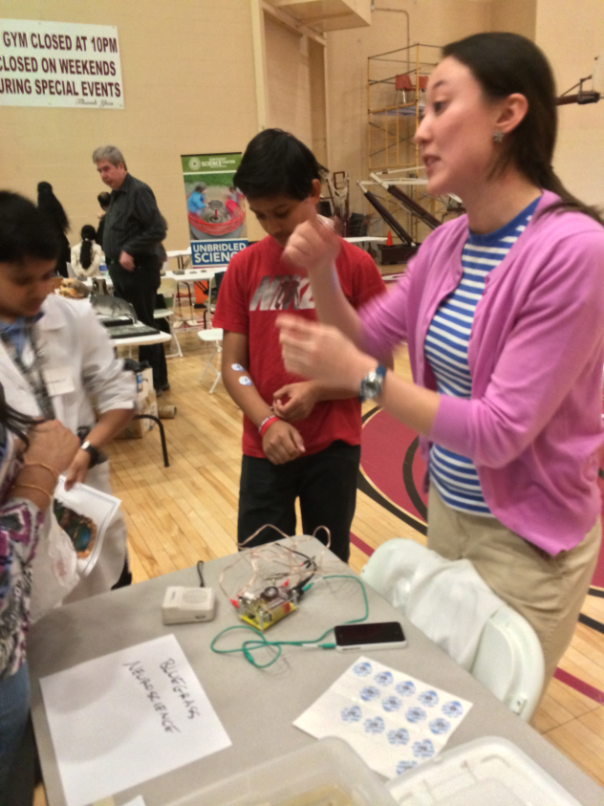
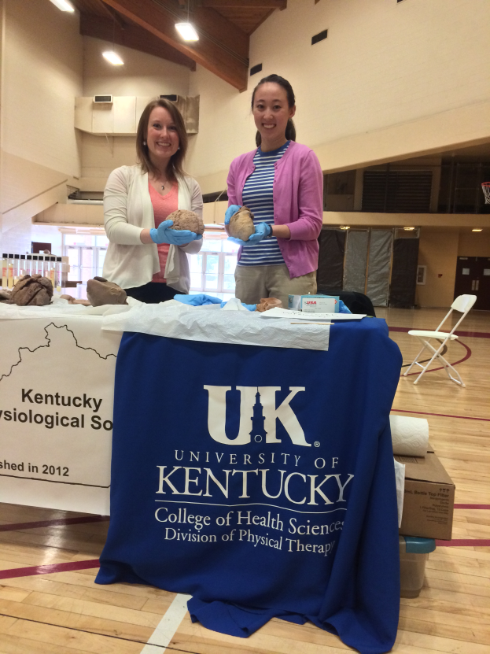
More activities:
Heath awareness days- Fy County
Science fairs –tables
BG SfN
KY-PHYS
Other 1 day activities
STEM BLUE (middle school) June 23 or 24th. COULD USE HELP HERE
Lexington Youth Science Summit will take place on Saturday, June 28th at Lexmark International. COULD USE HELP HERE

Slide 19
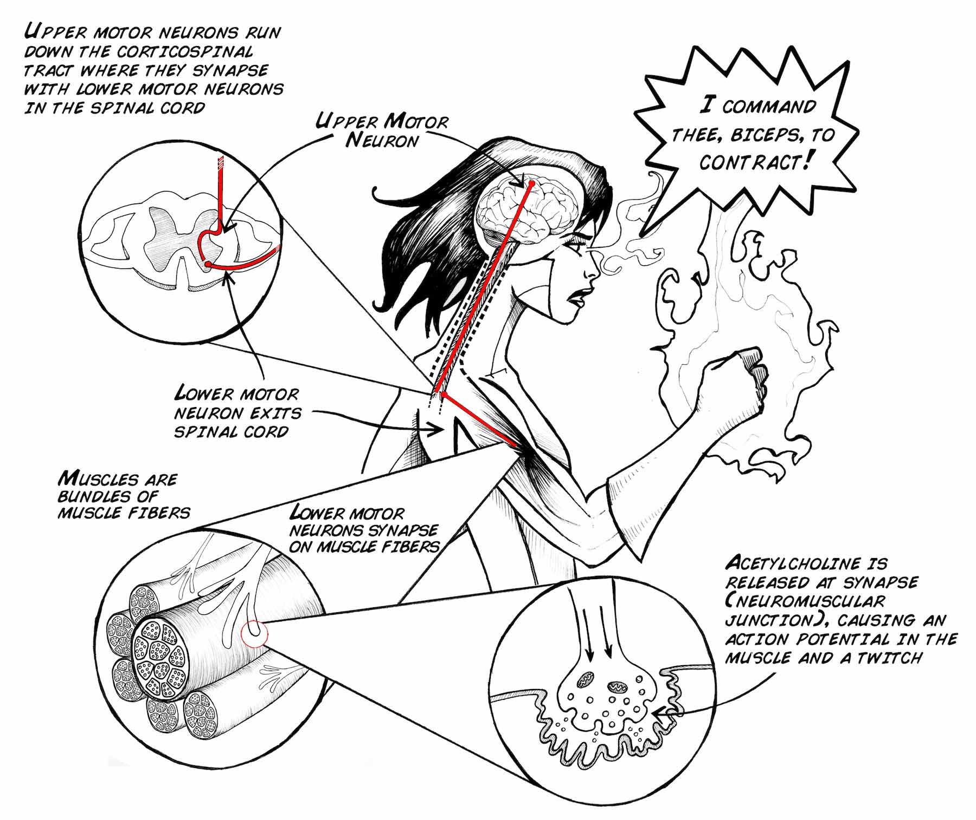
https://backyardbrains.com/

