Slide 1
Chapter 16: Lower Motor Neuron Circuits

Slide 2
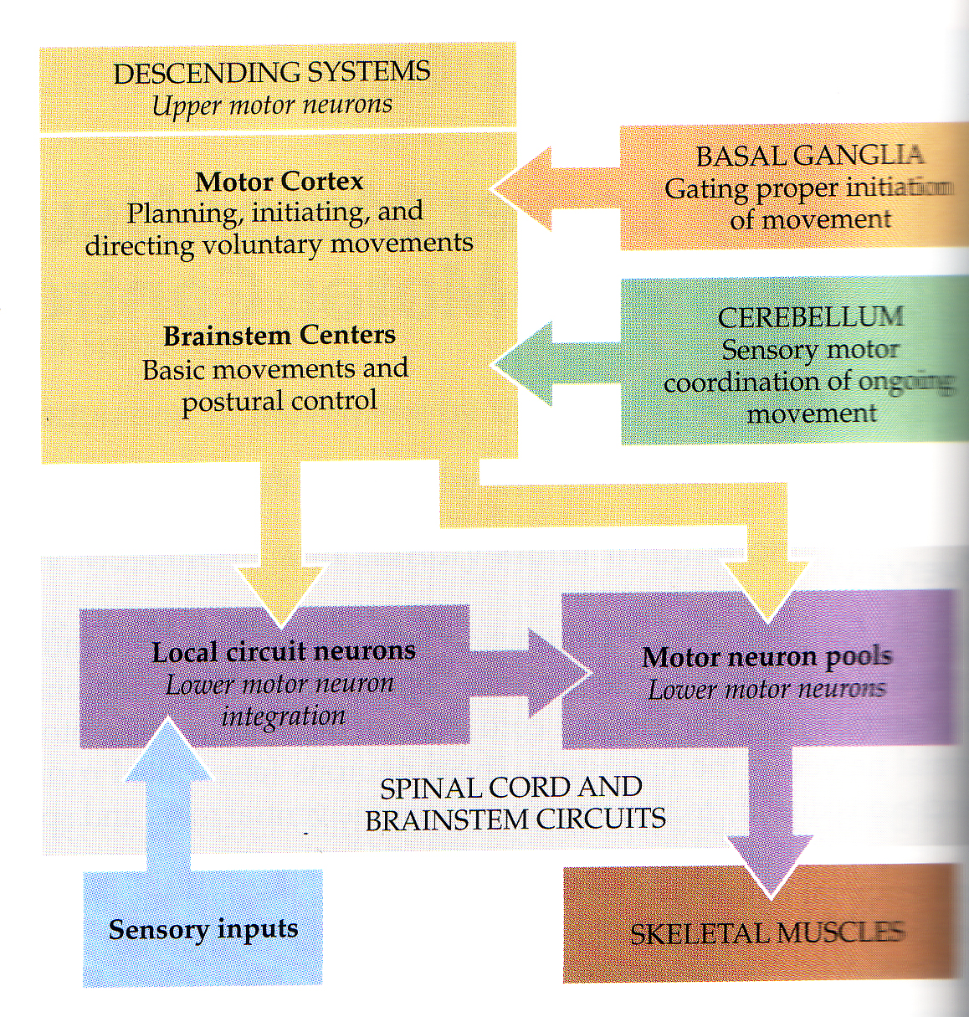

Slide 3
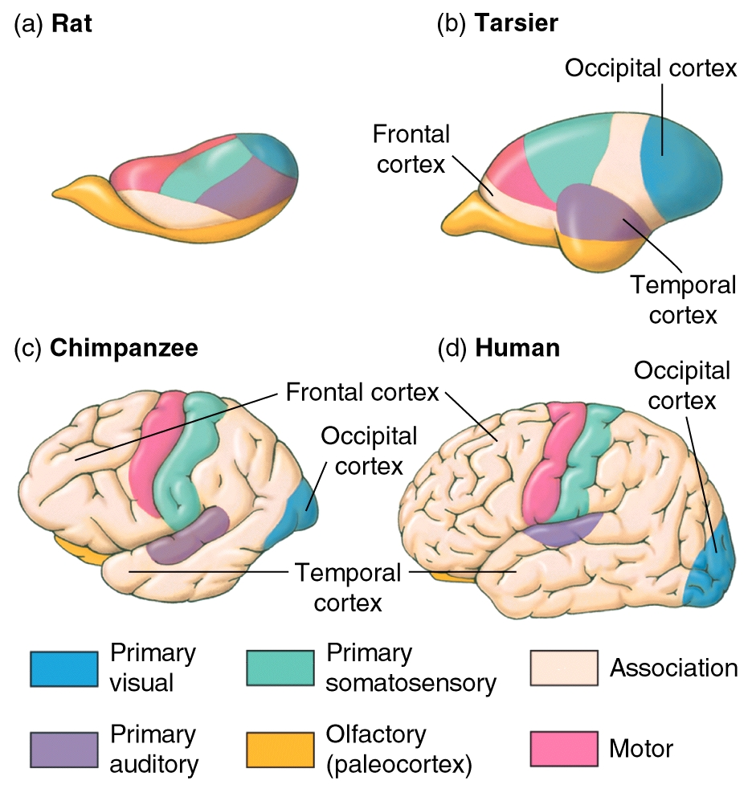
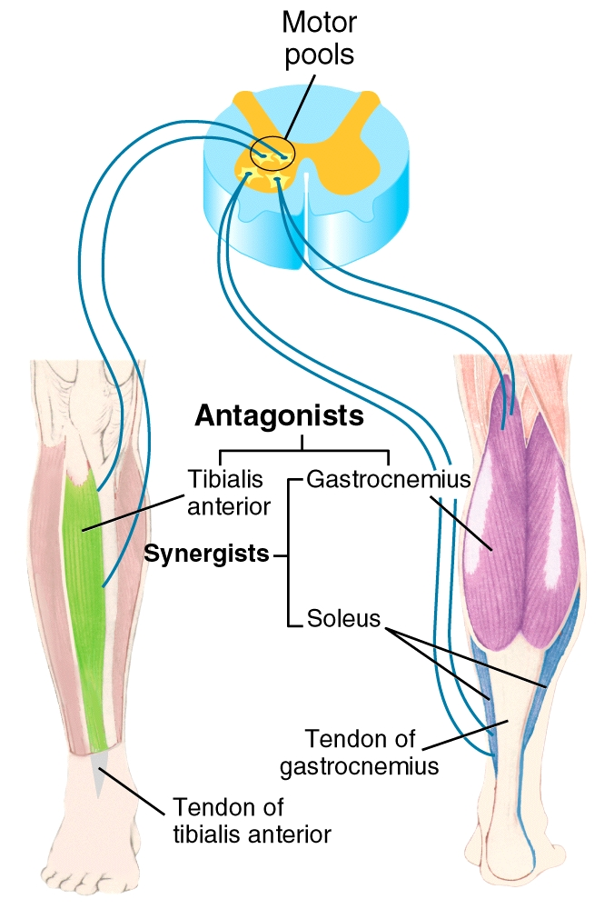
Upper motor neurons: CNS ( premotor & primary motor cortex)
Lower motor neurons: Motor neurons from the spinal cord

Slide 4
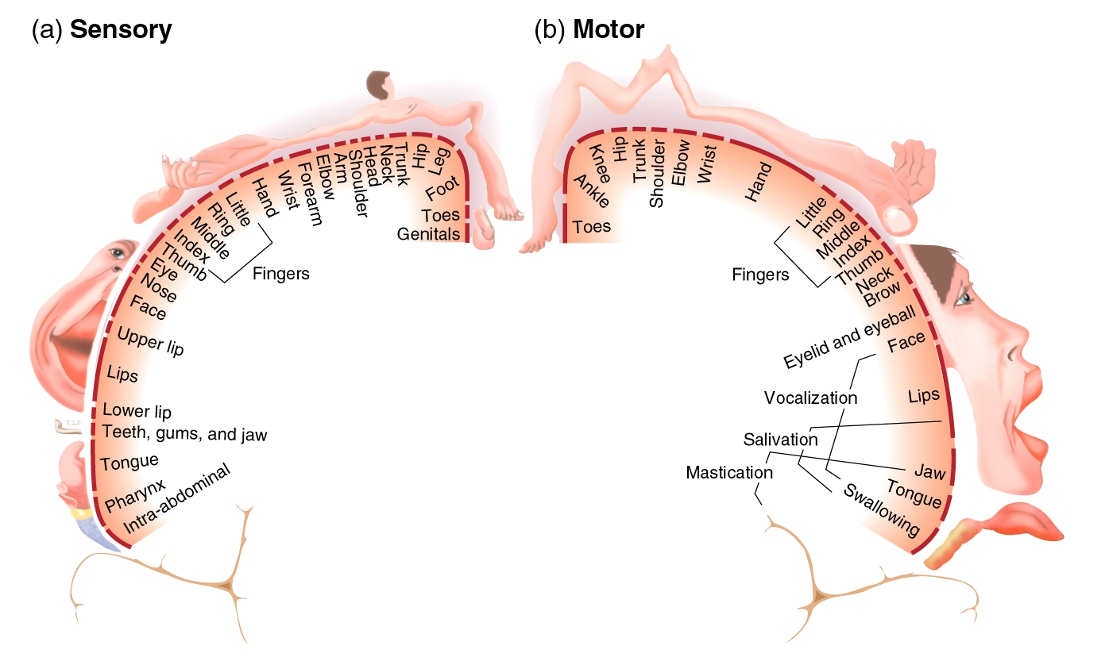
Wilder Penfield
WWW I
1934 he founded and became the first Director of McGill University's world-famous Montreal Neurological Institute and the associated Montreal Neurological Hospital
Published 1951 the homunculus

Slide 5
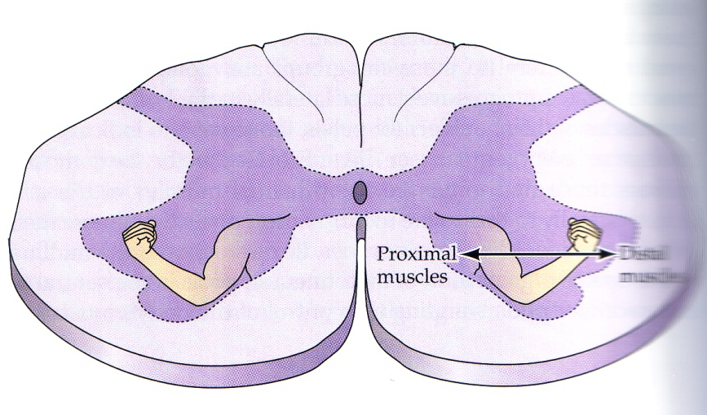
Spinal cord cross section
Distal

Slide 6
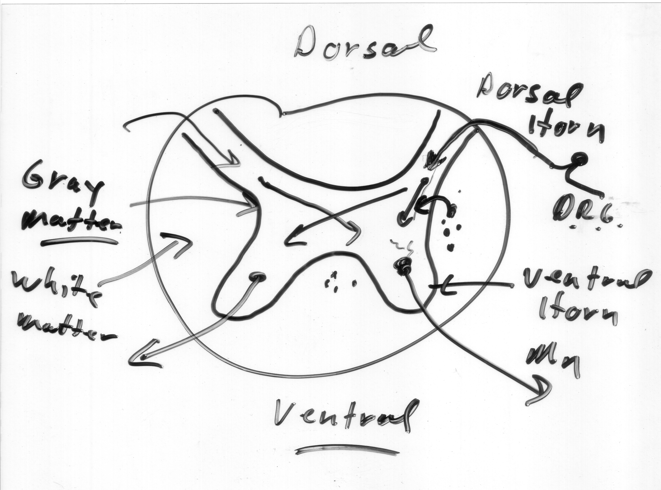

Slide 8
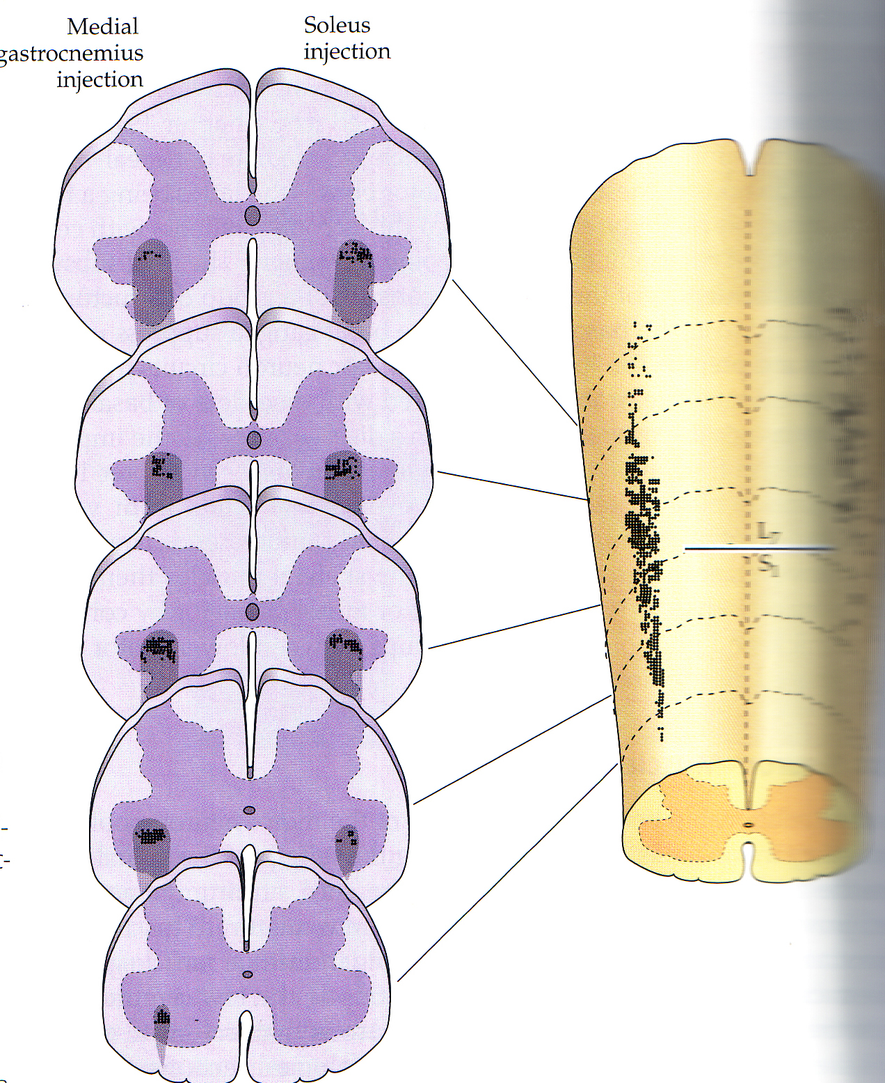

Slide 9
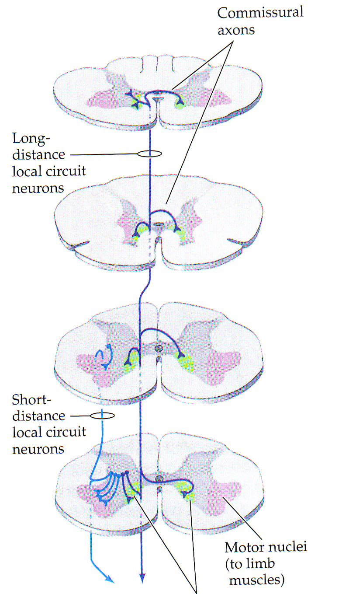

Slide 10
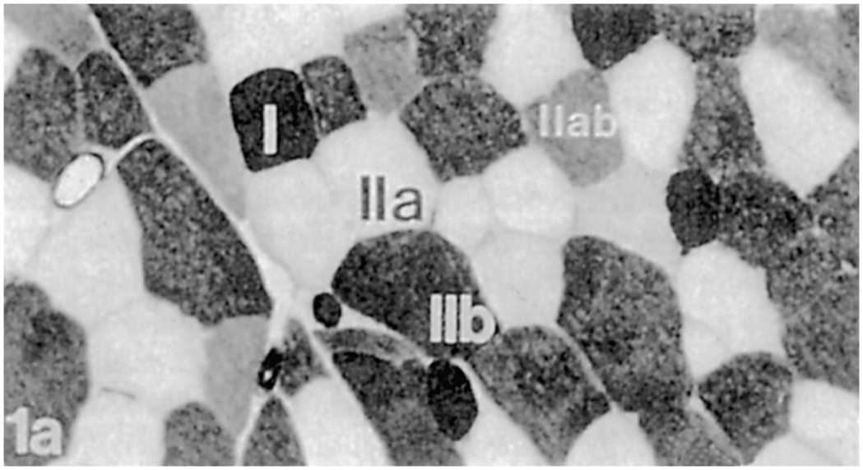
Motor unit
Alpha motor neuron and muscle
Types
Slow, fast fatigable, fast fatigue-resistant
----muscle fiber types match

Slide 11
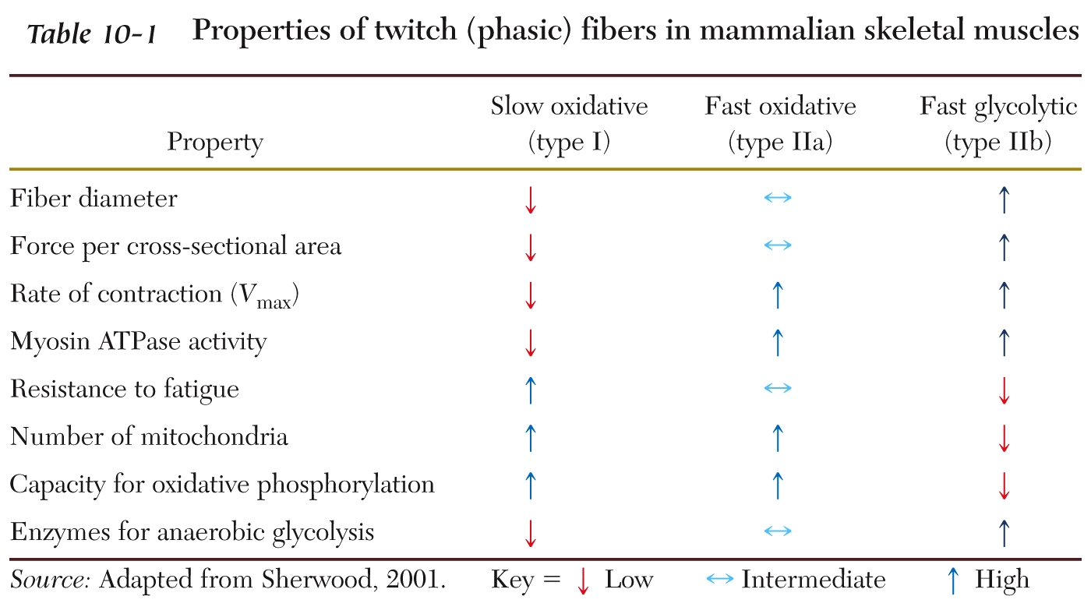

Slide 12
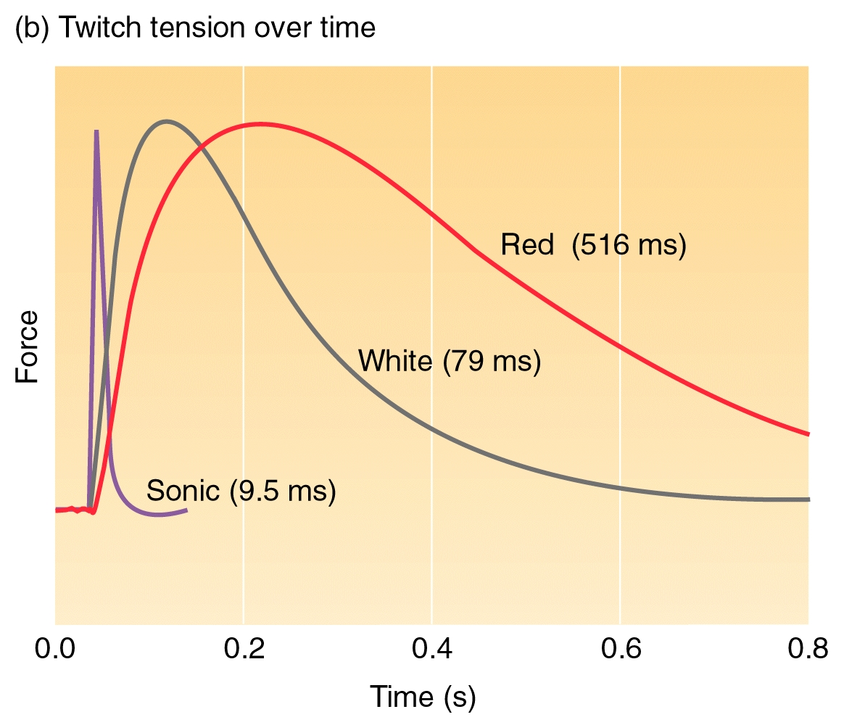

Slide 13
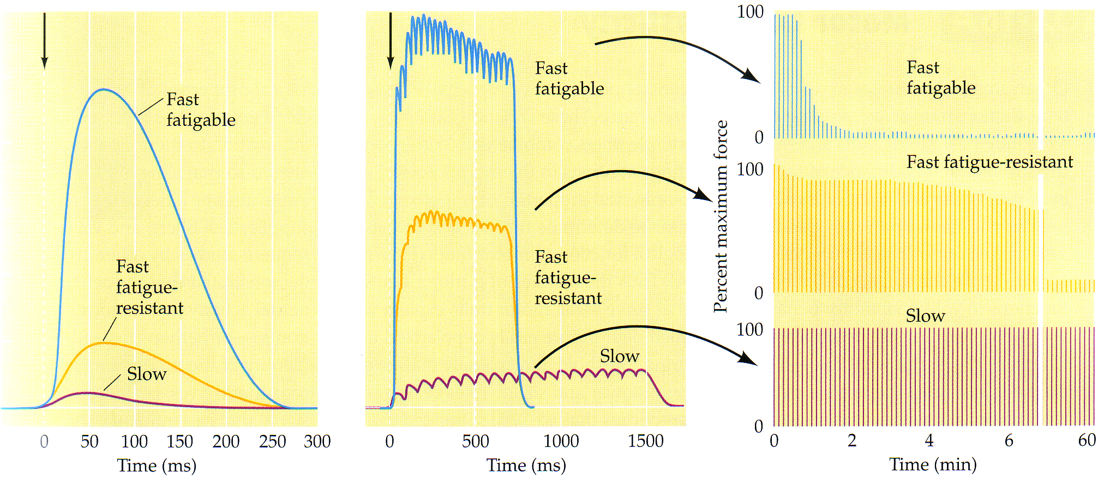

Slide 15
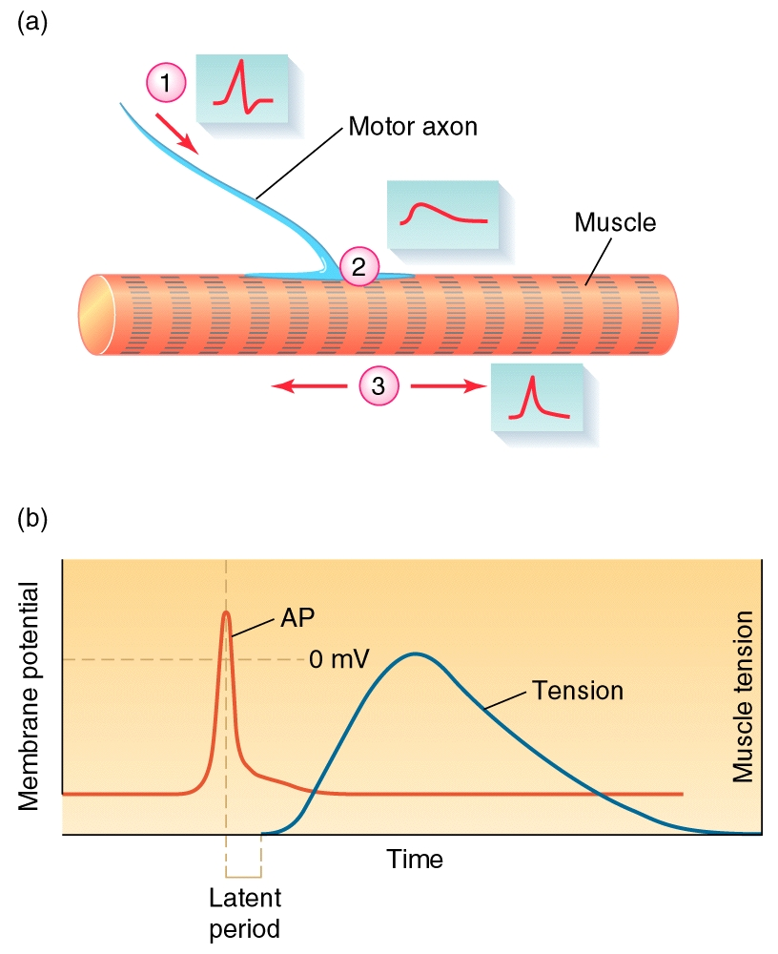
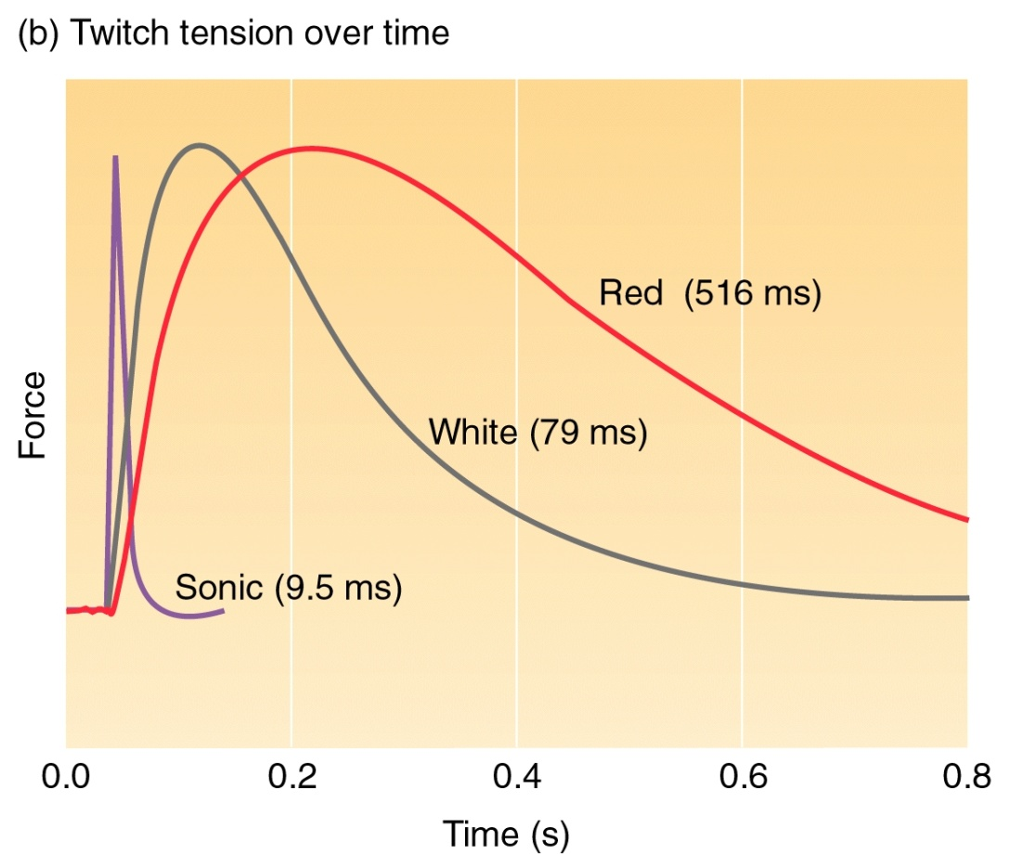
Muscle responses: force and electrical events (think comparative: vertebrate vs. invertebrate)

Slide 16
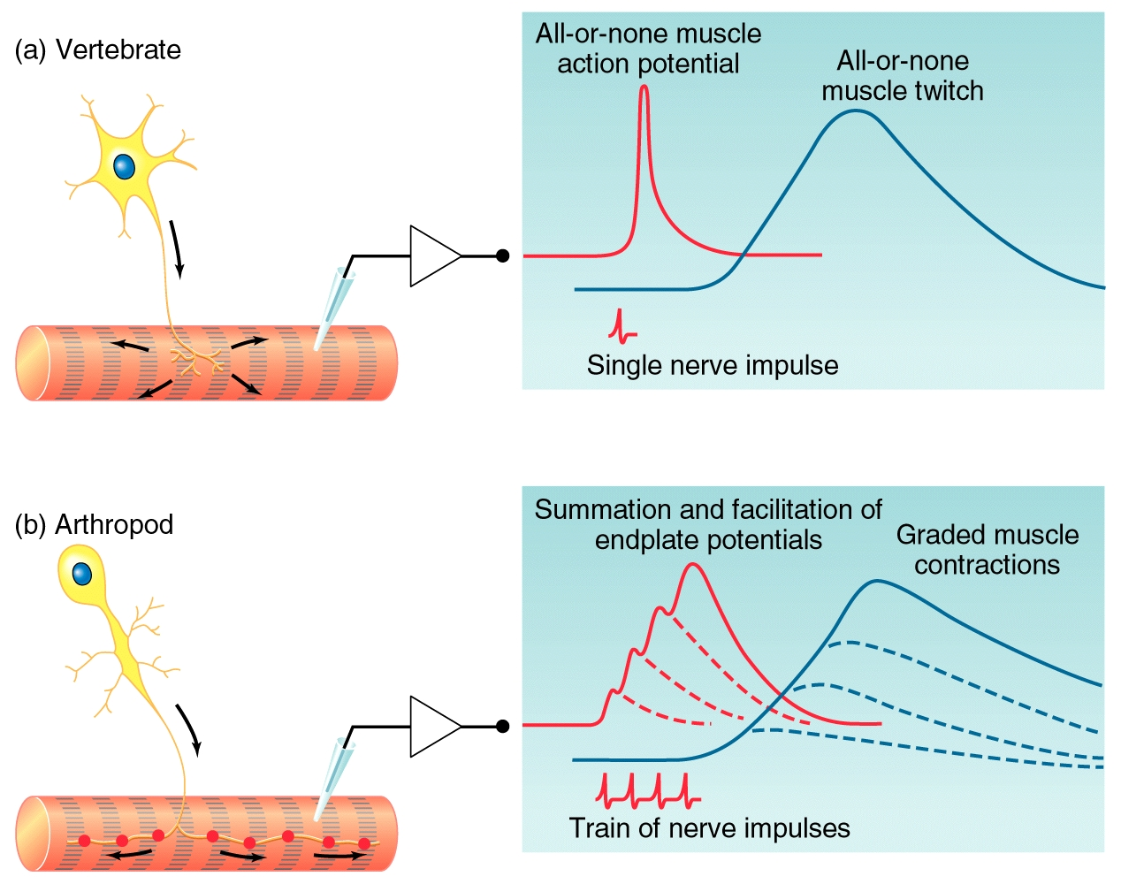

Slide 17
LIST OF DIFFERENCES

Slide 18
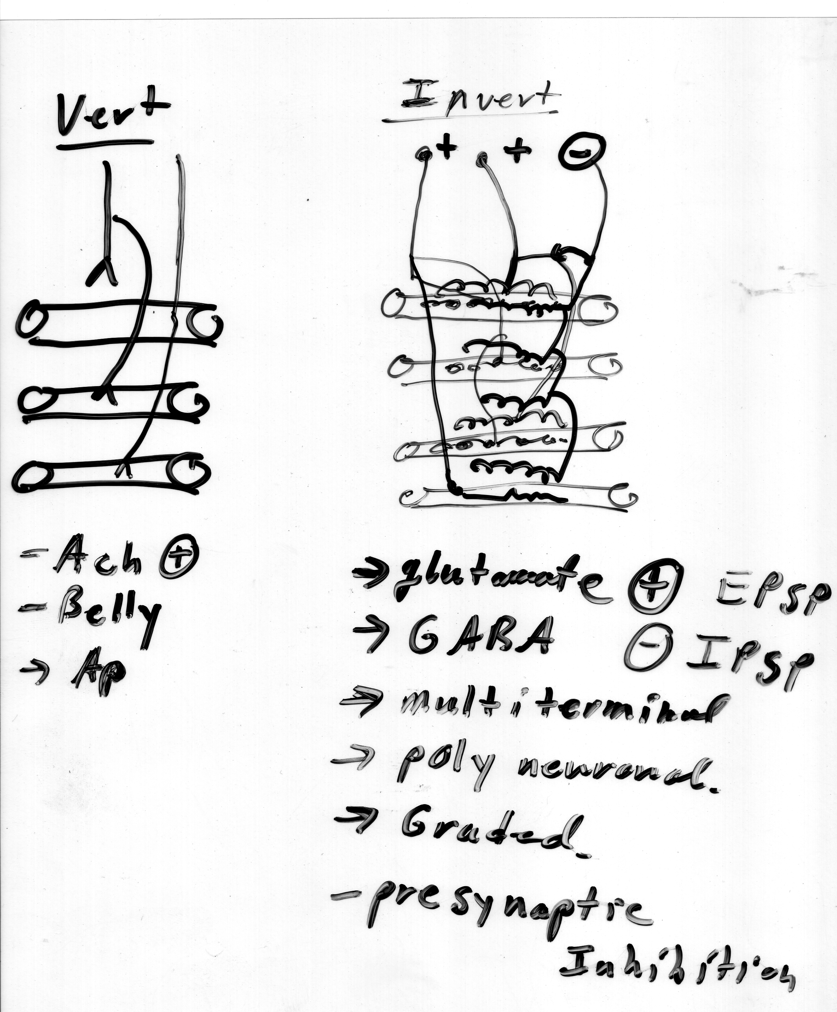

Slide 19
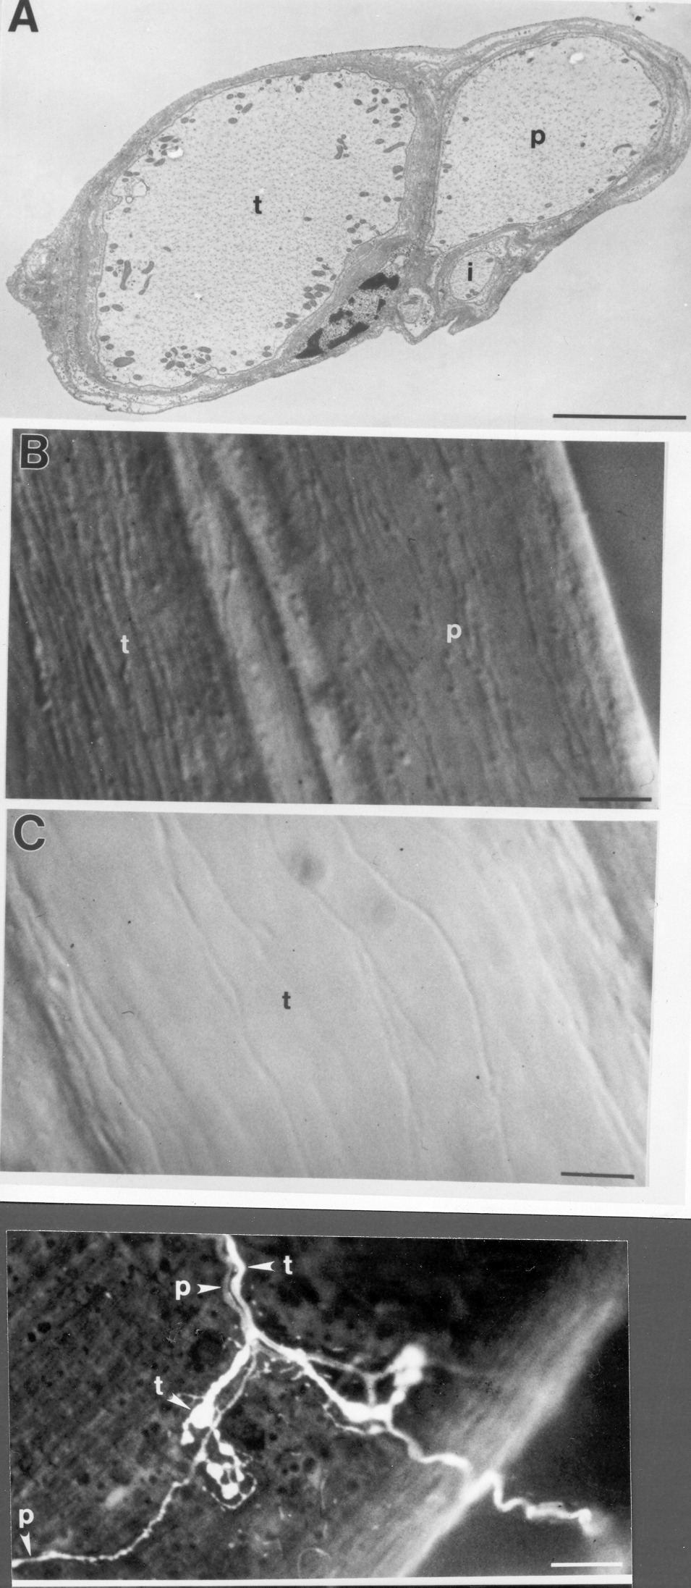

Slide 20
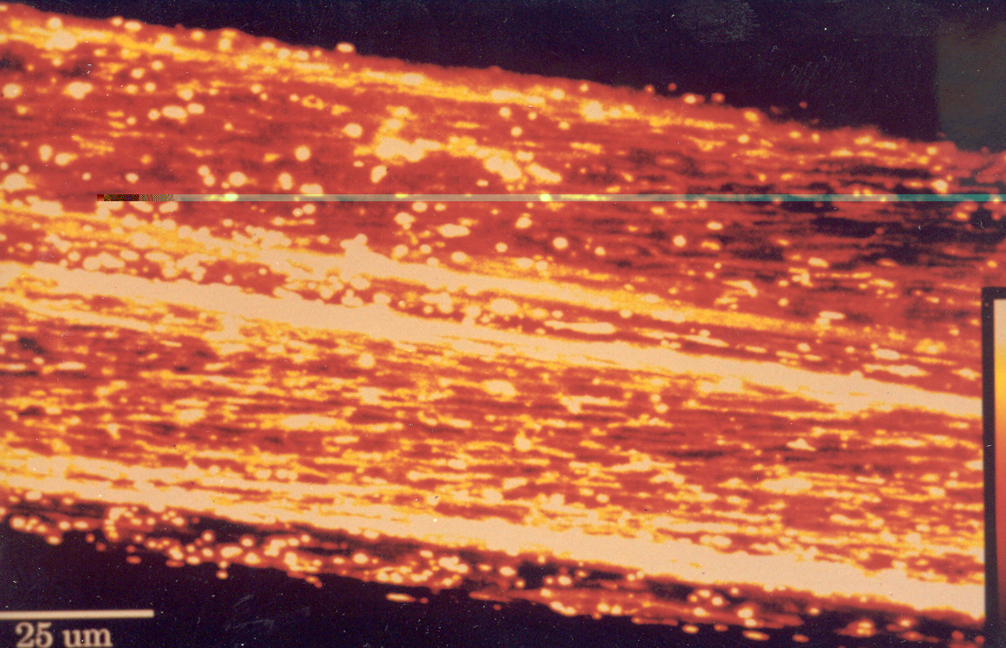

Slide 21
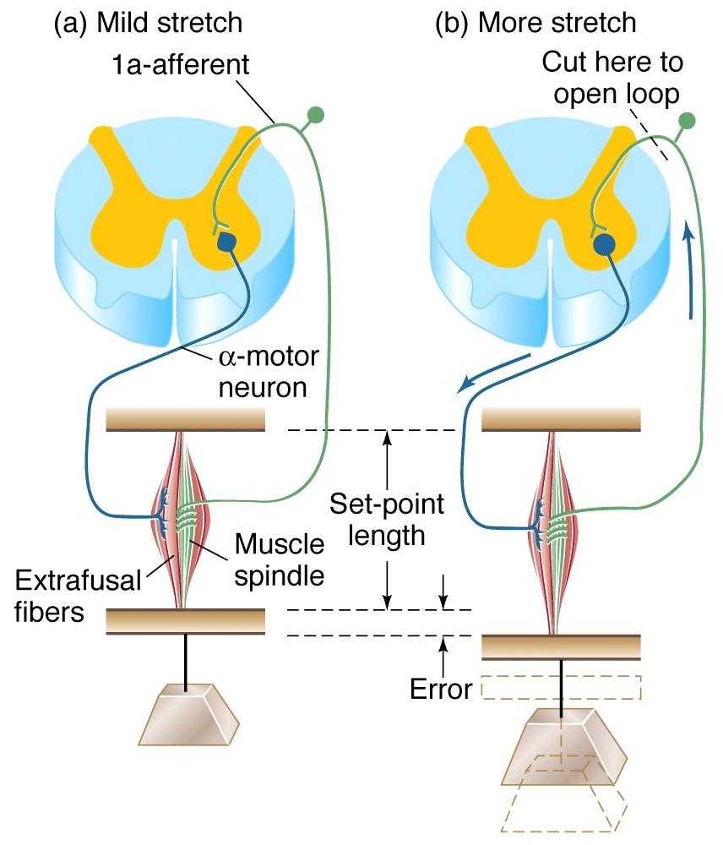
Muscle Stretch Reflexes (page 408 text)

Slide 22
The electrical activity and control

Slide 23
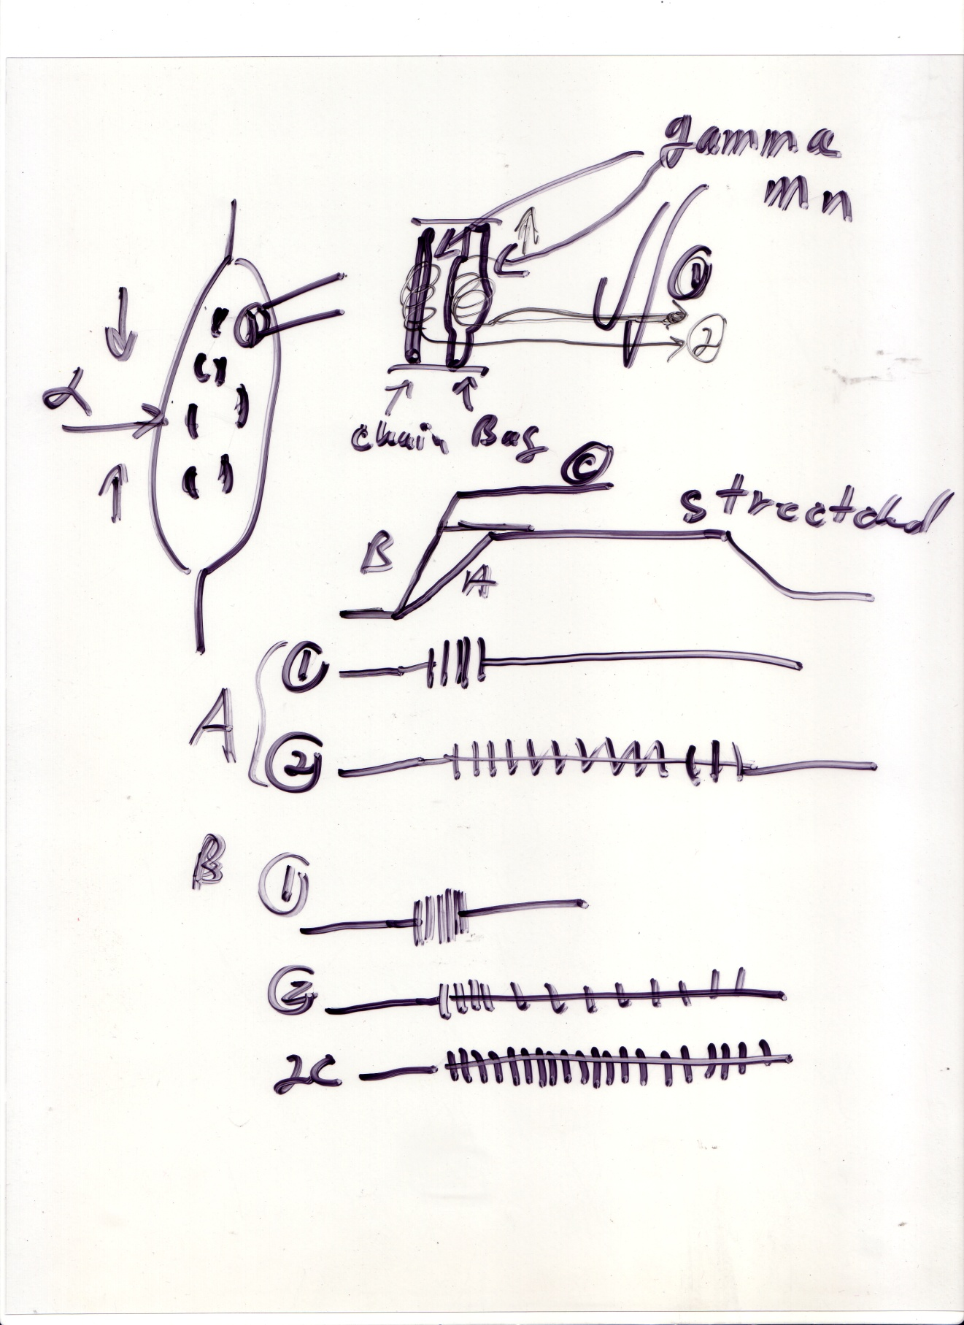

Slide 24
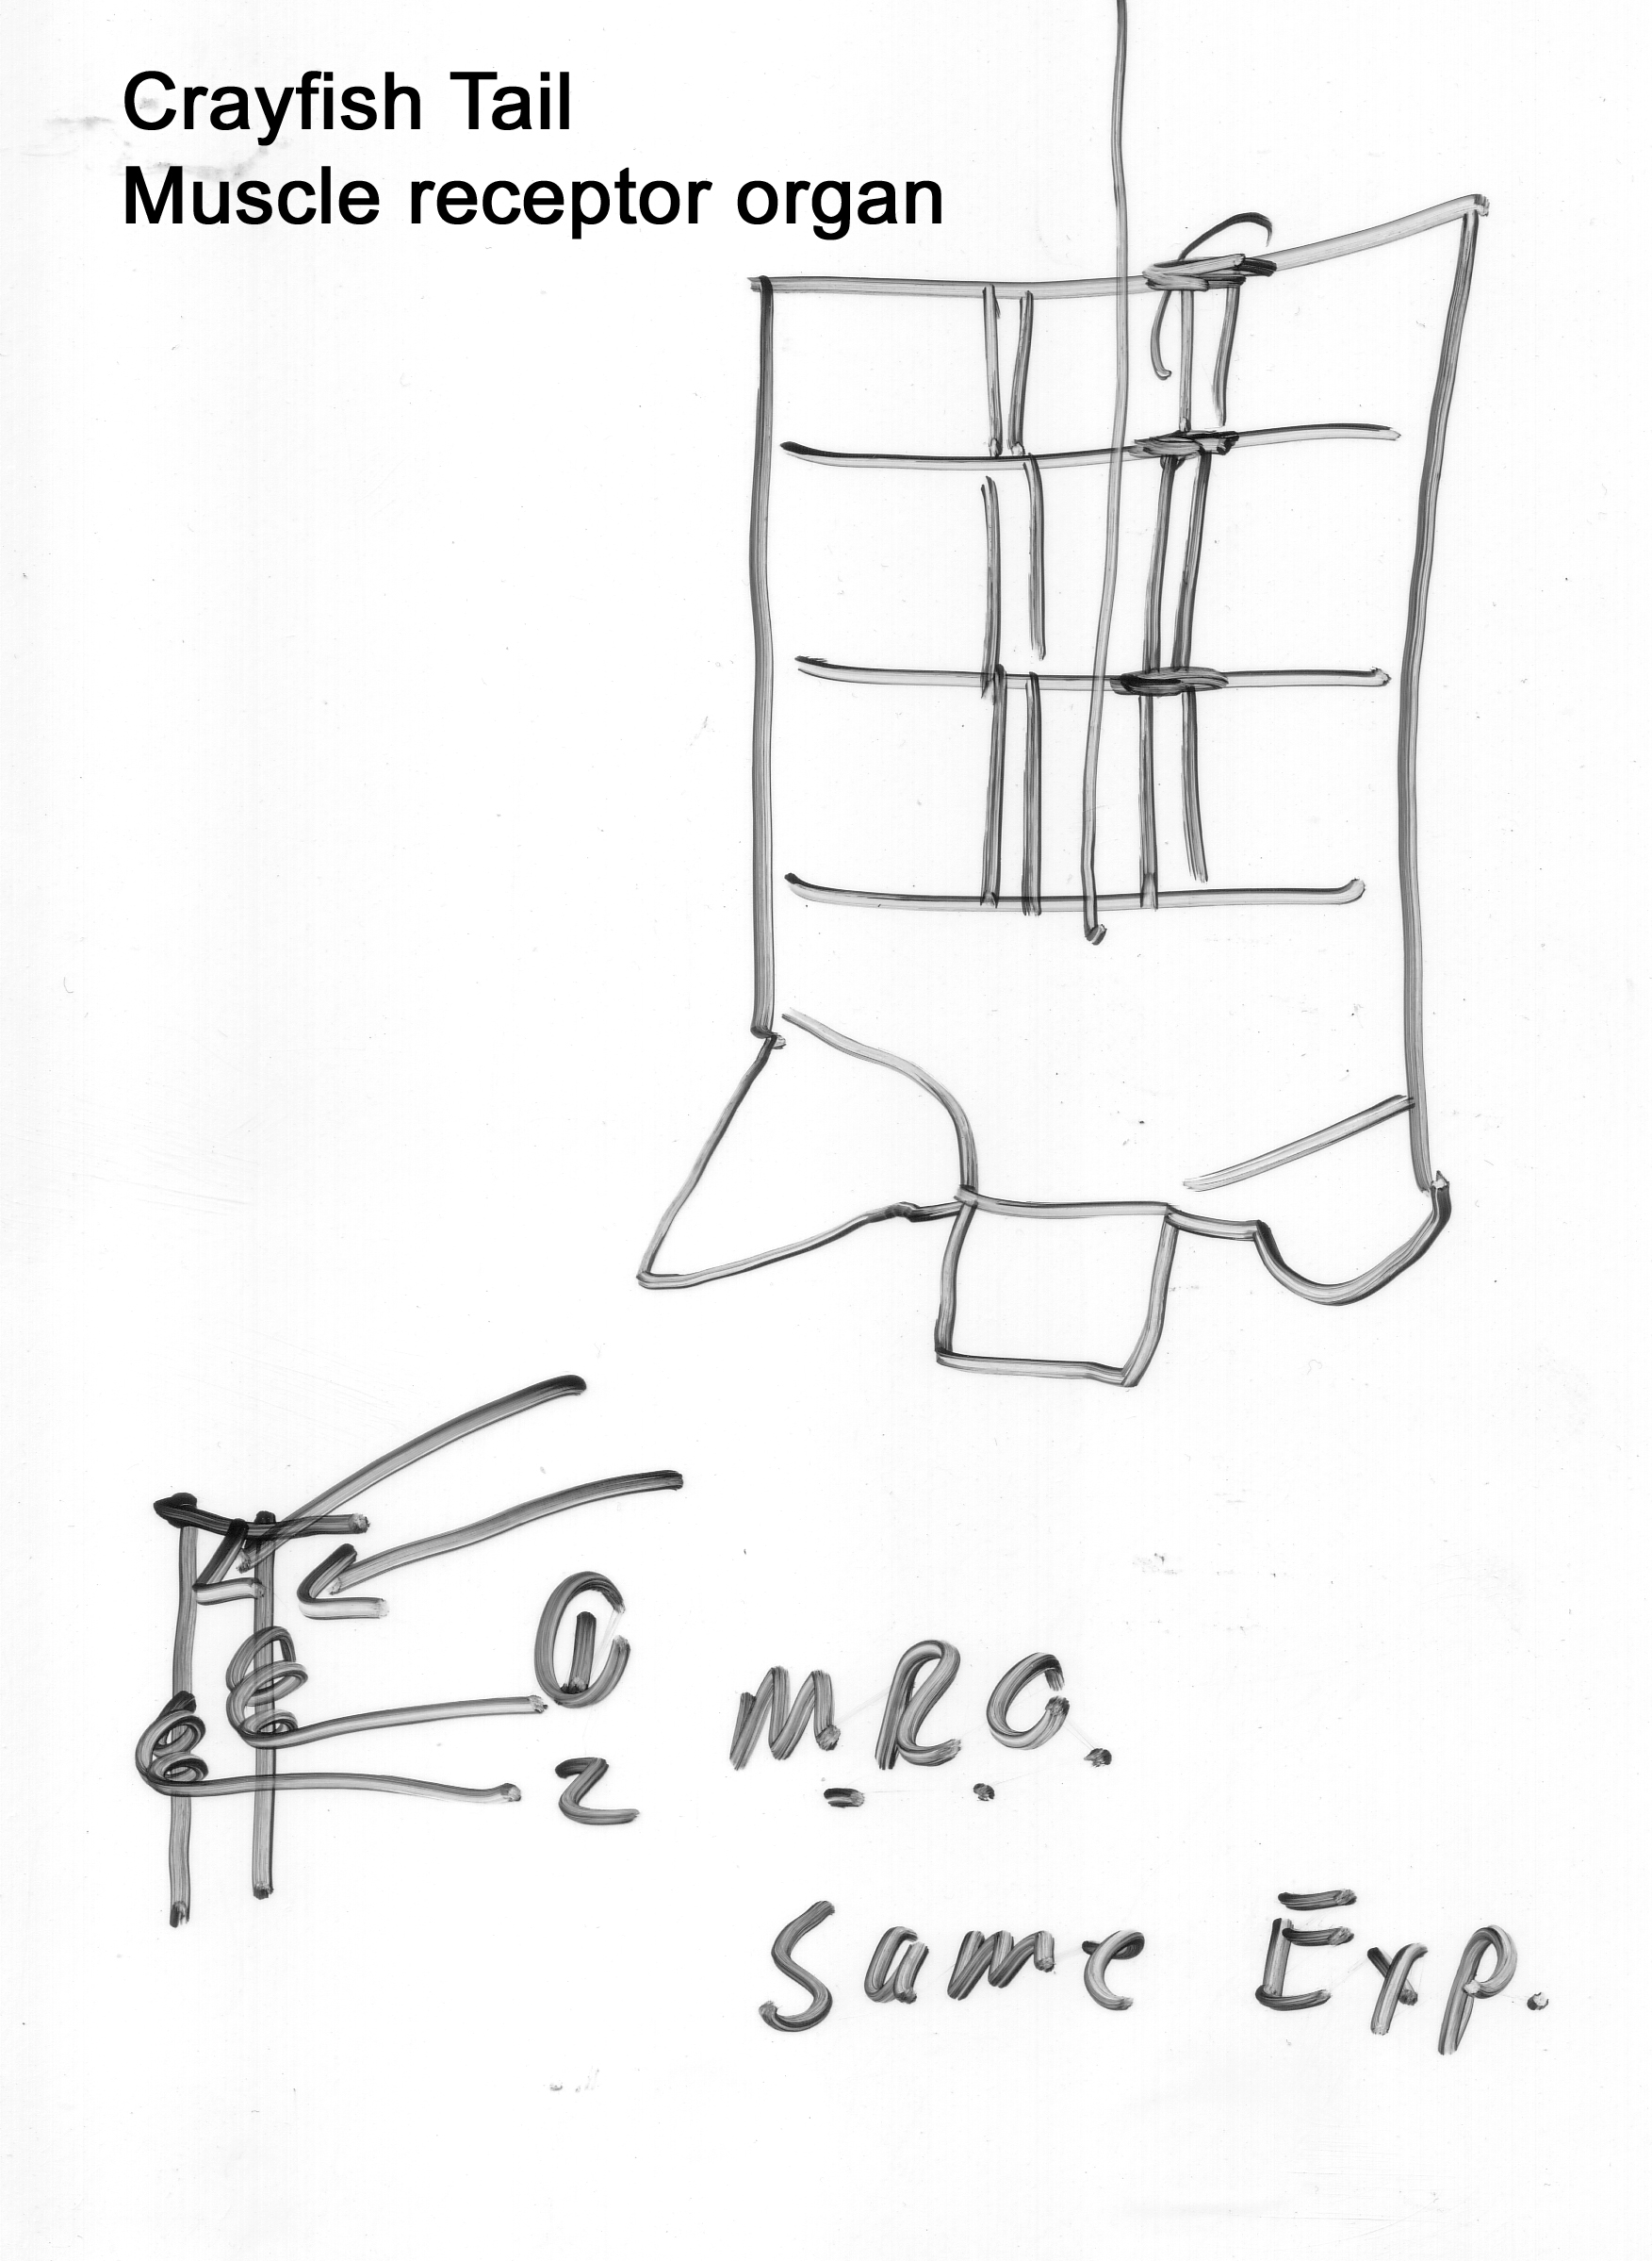

Slide 25
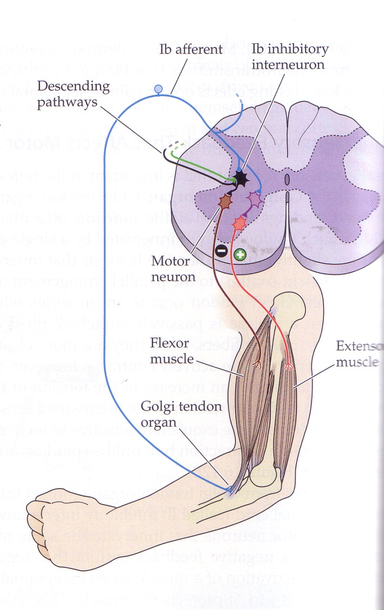
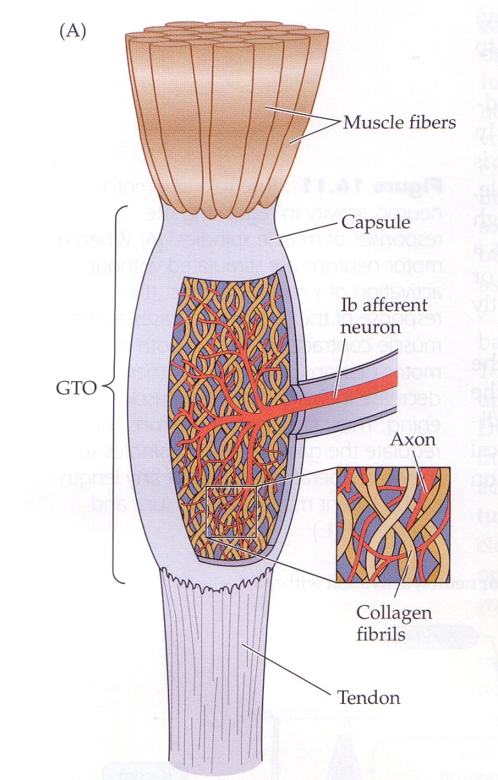

Slide 26
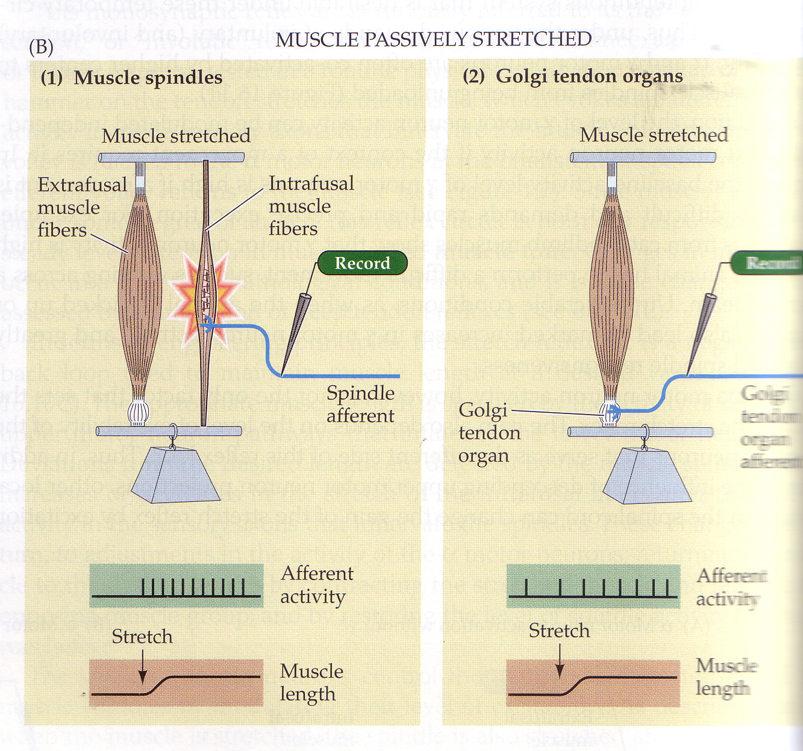

Slide 27
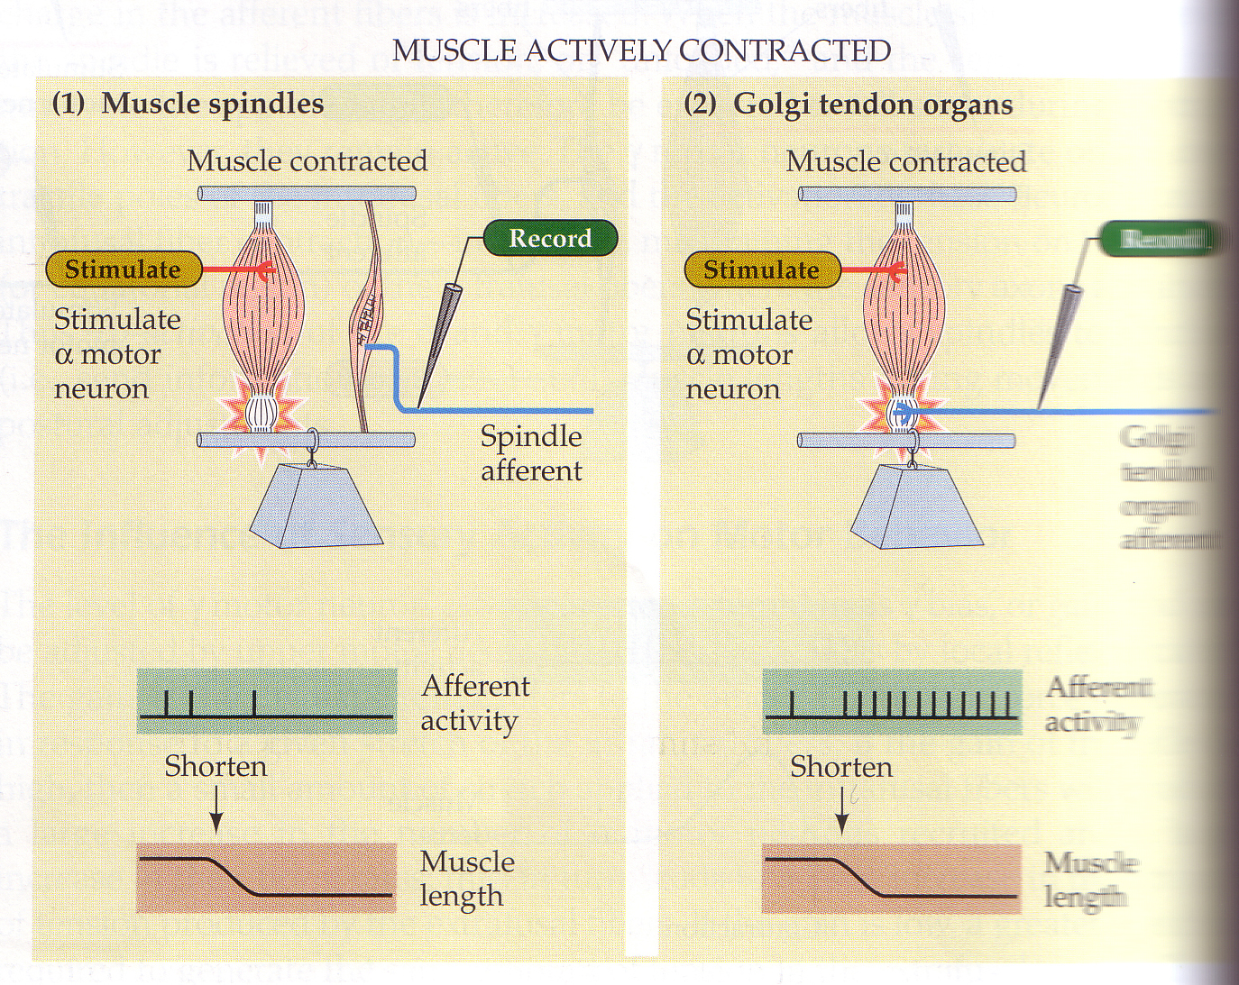

Slide 28
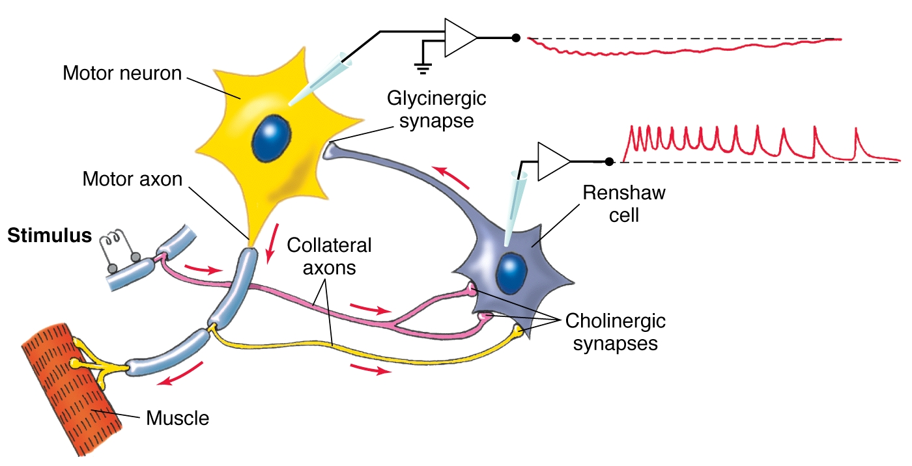
Within the spinal cord circuits: (mammal)

Slide 29
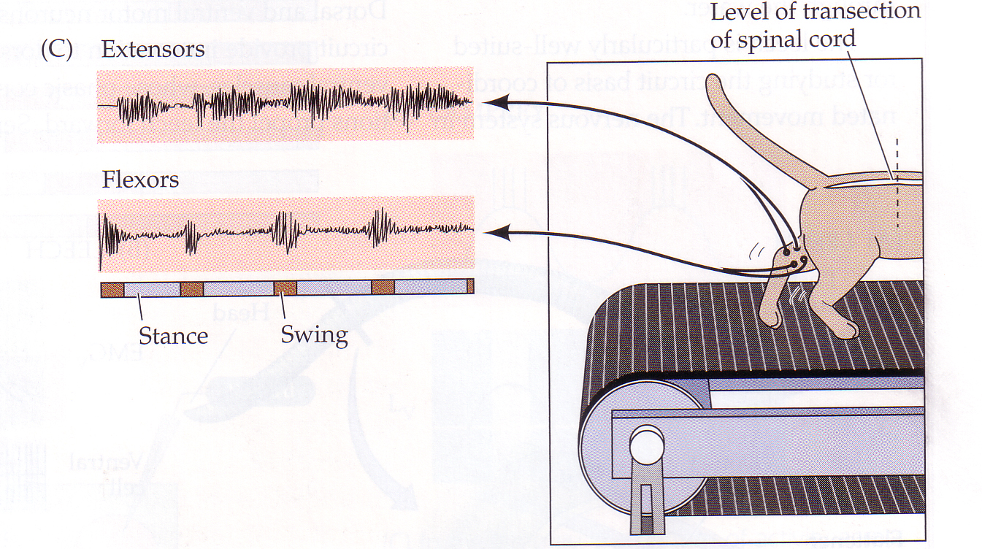

Slide 30
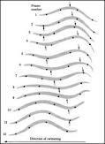
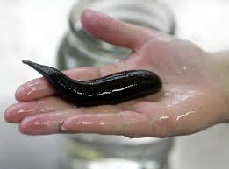
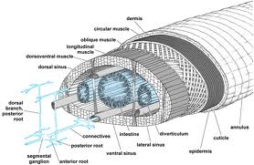
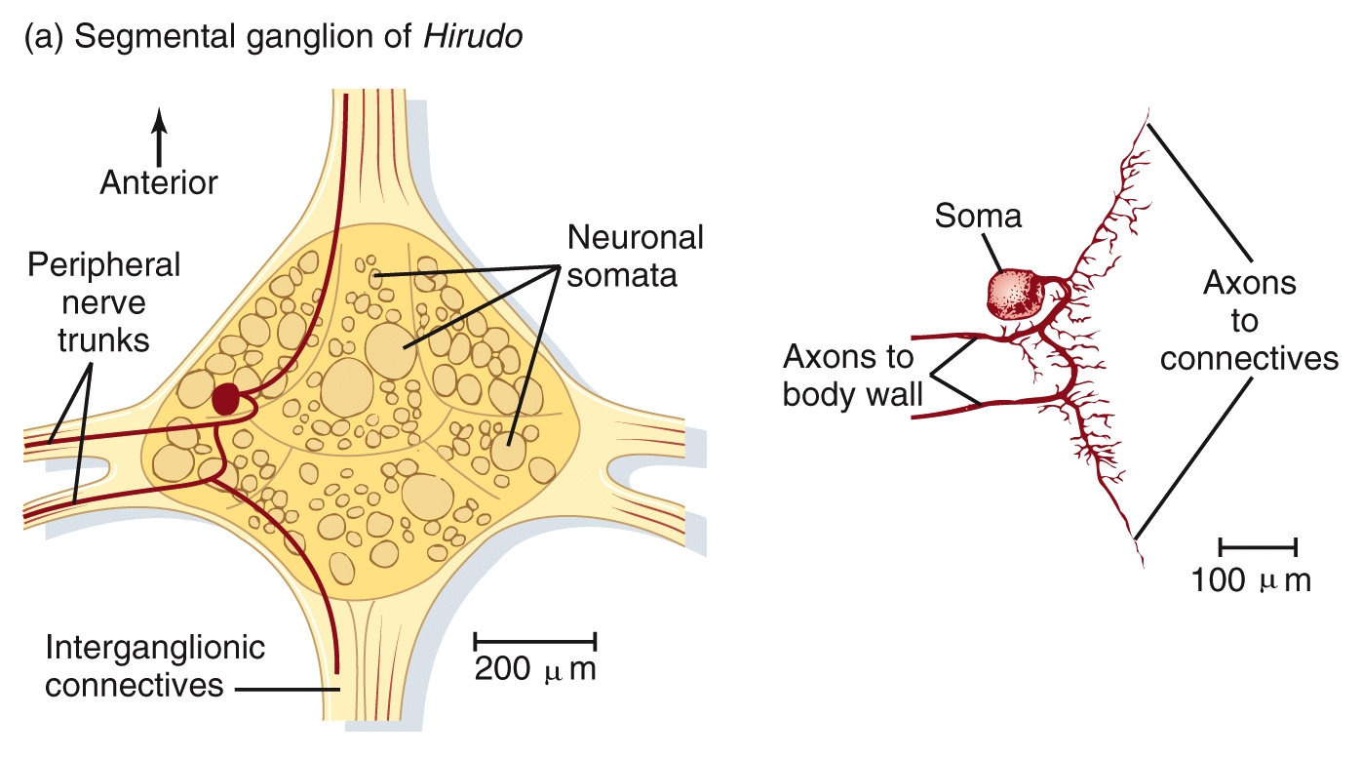
LEECH

Slide 31
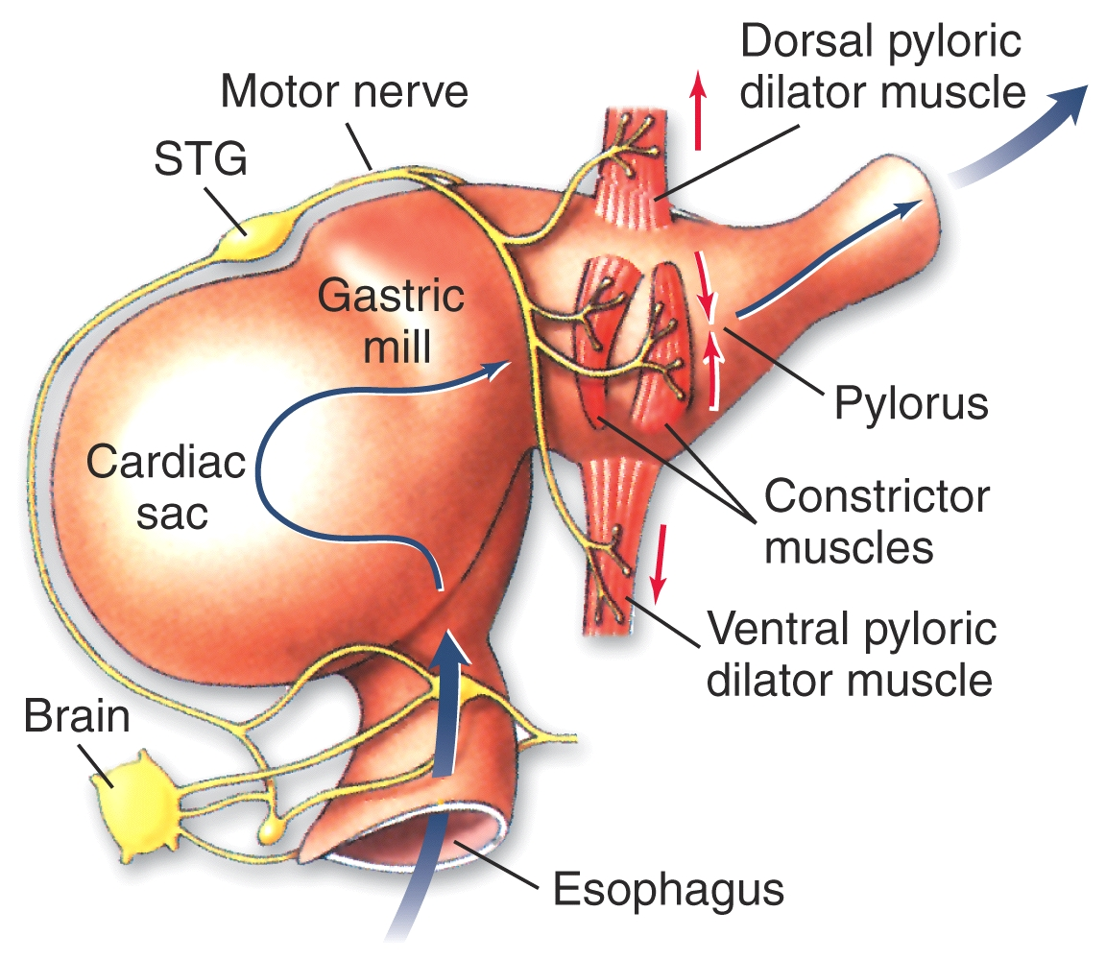

Slide 32
Diseases of motor unit:
Amyotrophic lateral sclerosis (ALS) ( Lou Gehrig's disease) a form of motor neurone disease caused by the degeneration of upper and lower neurons, located in the ventral horn of the spinal cord and the cortical neurons that provide their efferent input.
Peripheral nerve damage (peripheral neuropathy)
Mononeuropathy-Mononeuropathy and radiculopathy is most often due to trauma of some type.
Radiculopathy-Radiculopathy indicates damage to nerve root(s), and typically occurs as a component of several spinal diseases.
Polyneuropathy-Polyneuropathy is a common condition. It is not always easy to determine its cause. In this condition the longest peripheral nerve fibers are usually first. Peripheral neuropathy can affect either the axon, or myelin sheaths (demyelinating), or both.
Mononeuritis Multiplex "Mononeuritis multiplex" is a relatively rare presentation of certain disorders that damage nerves primarily by interfering with blood flow to nerves or plexi or by an autoimmune process damaging either the myelin or axon.

Slide 33
Continue of diseases of motor unit:
End-plate (neuromuscular junction)
Acetylcholine is the neurotransmitter at this synapse that couples motor nerve activity with response in the muscles. Botulinum toxin or a block of nicotinic ACh receptor (such as curare).
Myasthenia gravis.
Myasthenia gravis is the most common disorder affecting neuromuscular transmission. This condition is autoimmune, with antibodies directed against nicotinic acetylcholine receptors of the neuromuscular junction. It is not extremely common (about 1:10,000) and incidence is highest in young adult women. * thymic tumors.
Myasthenic syndrome. There is another interesting and uncommon disorder of neuromuscular transmission -- the myasthenic syndrome or Lambert Eaton Syndrome (LEMS).
Muscle Disease (myopathy)
There are many things that can go wrong in muscles

Slide 34
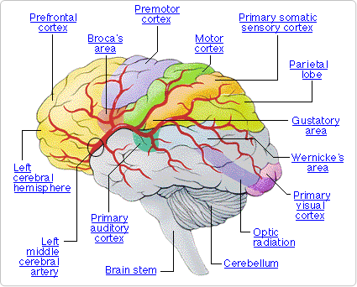
Chapter 17: Upper motor neurons

Slide 35
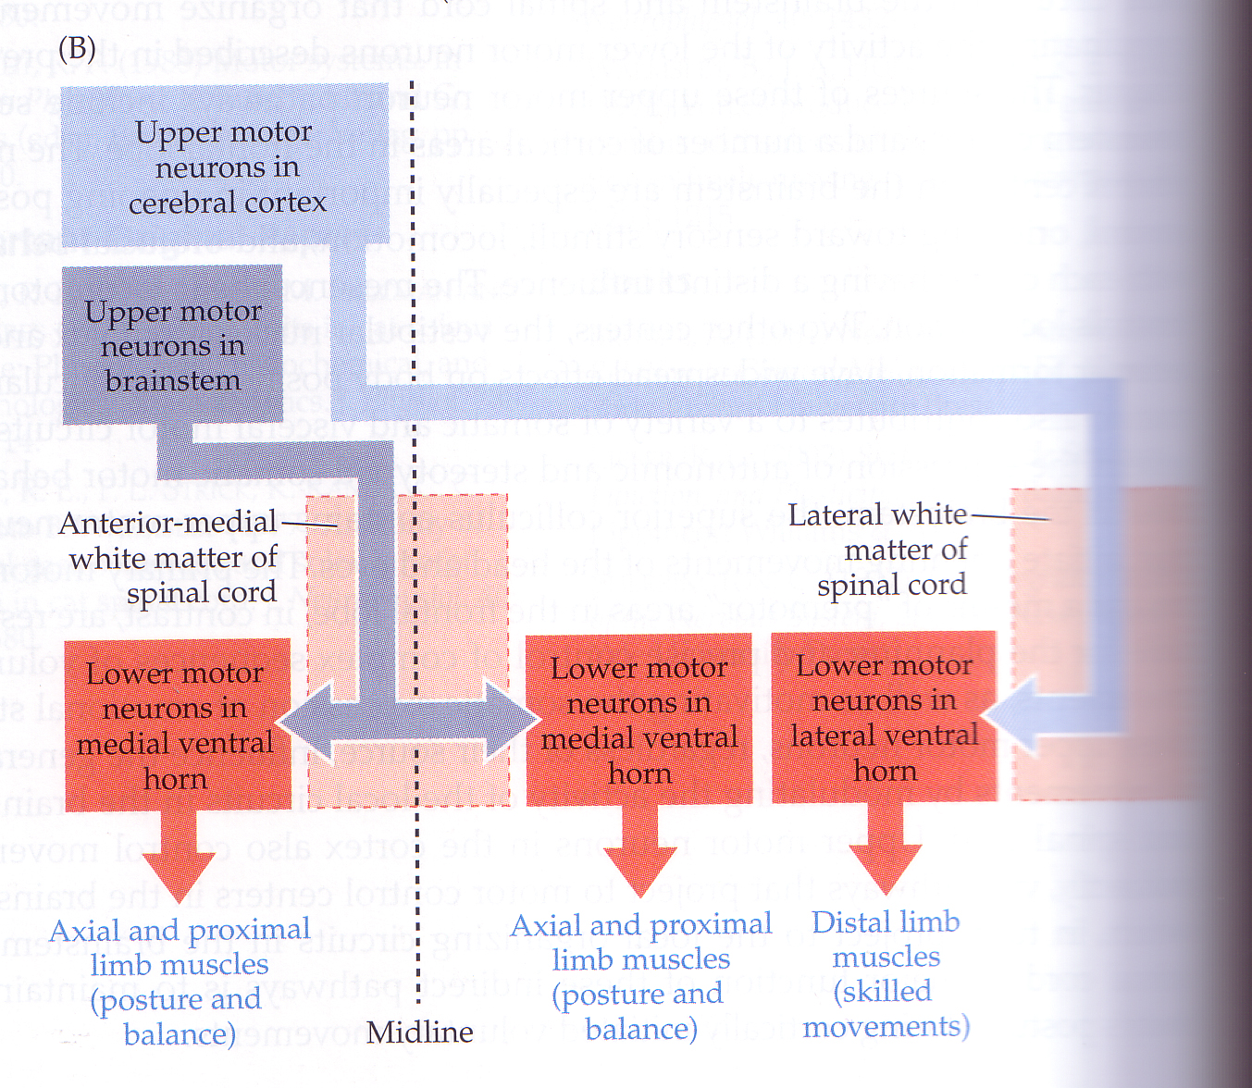

Slide 36
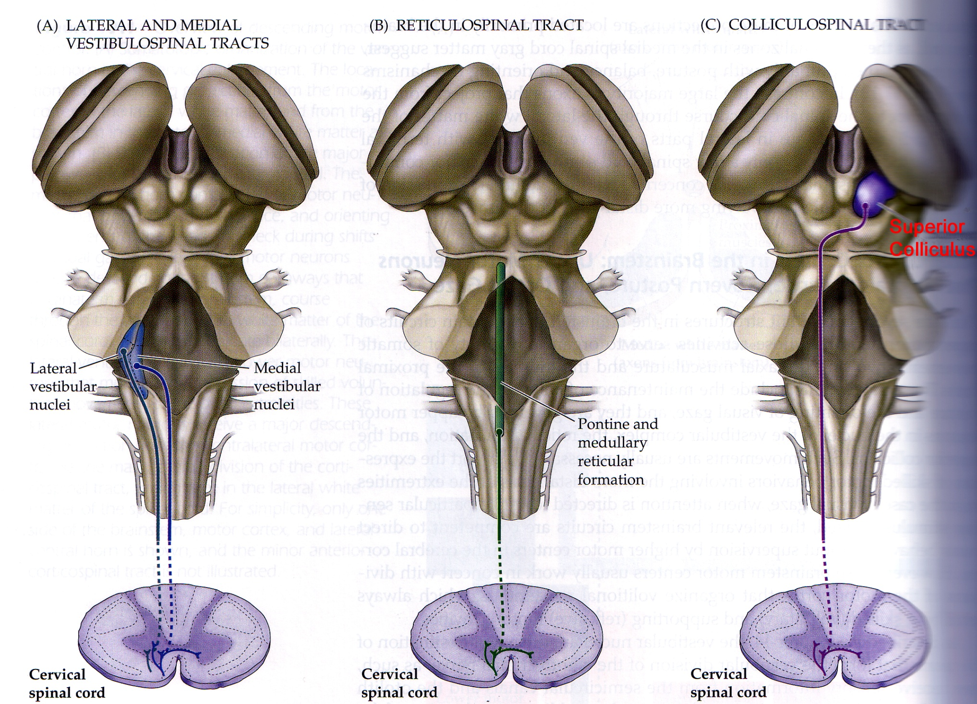

Slide 37
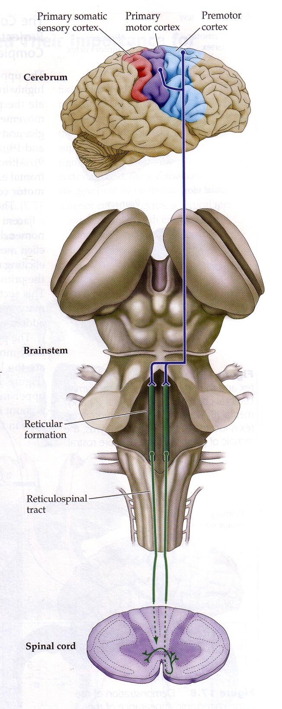

Slide 38
Decorticate
Decorticate posturing is also called decorticate response, decorticate rigidity, flexor posturing, or, colloquially, mummy baby
Decorticate posturing indicates that there may be damage to areas including the cerebral hemispheres, the internal capsule, and the thalamus. It may also indicate damage to the midbrain.
Decorticate posturing, with elbows, wrists and fingers flexed, and legs extended and rotated inward

Slide 39
Decerebrate
Decerebrate posturing is also called decerebrate response, decerebrate rigidity, or extensor posturing. It describes the involuntary extension of the upper extremities in response to external stimuli.
Decerebrate rigidity or abnormal extensor posturing.

Slide 40
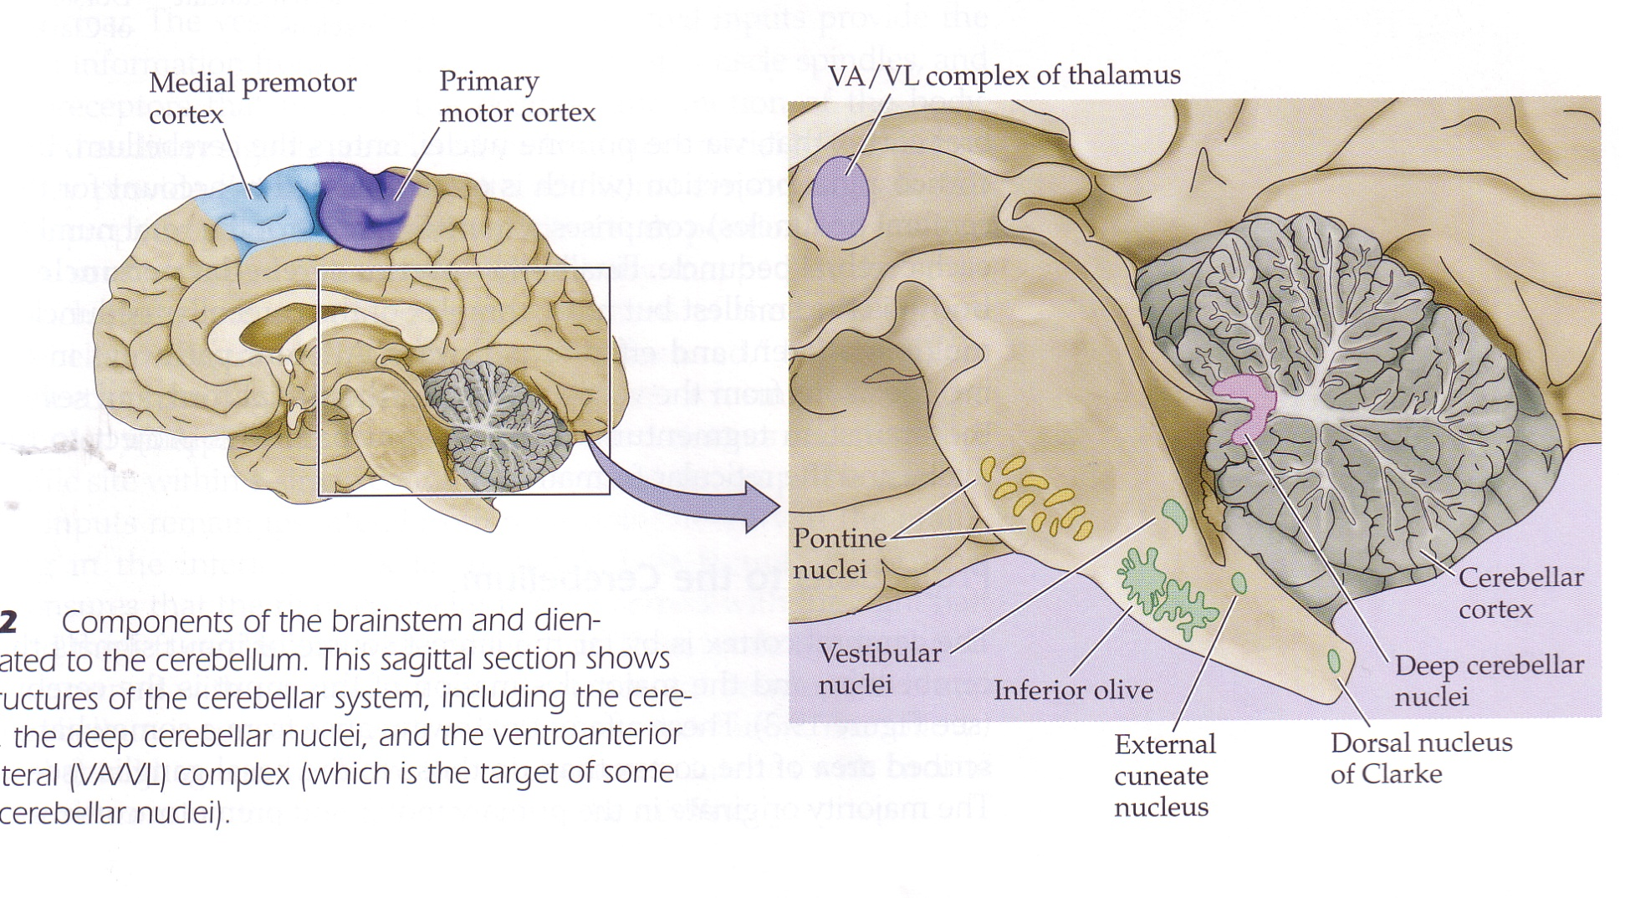
Chapter 19: Modulation of Movement

Slide 41
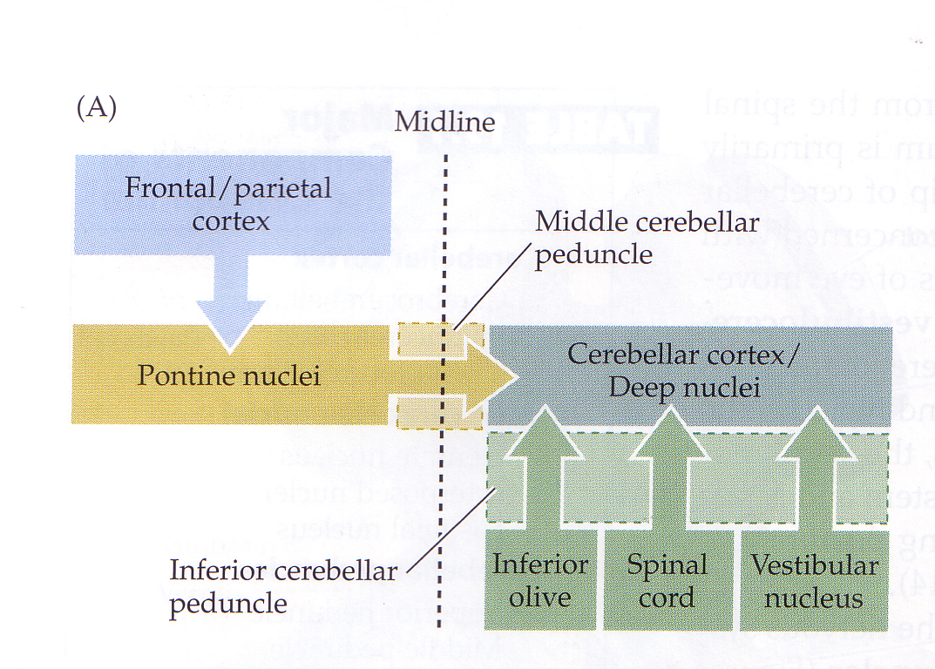

Slide 42
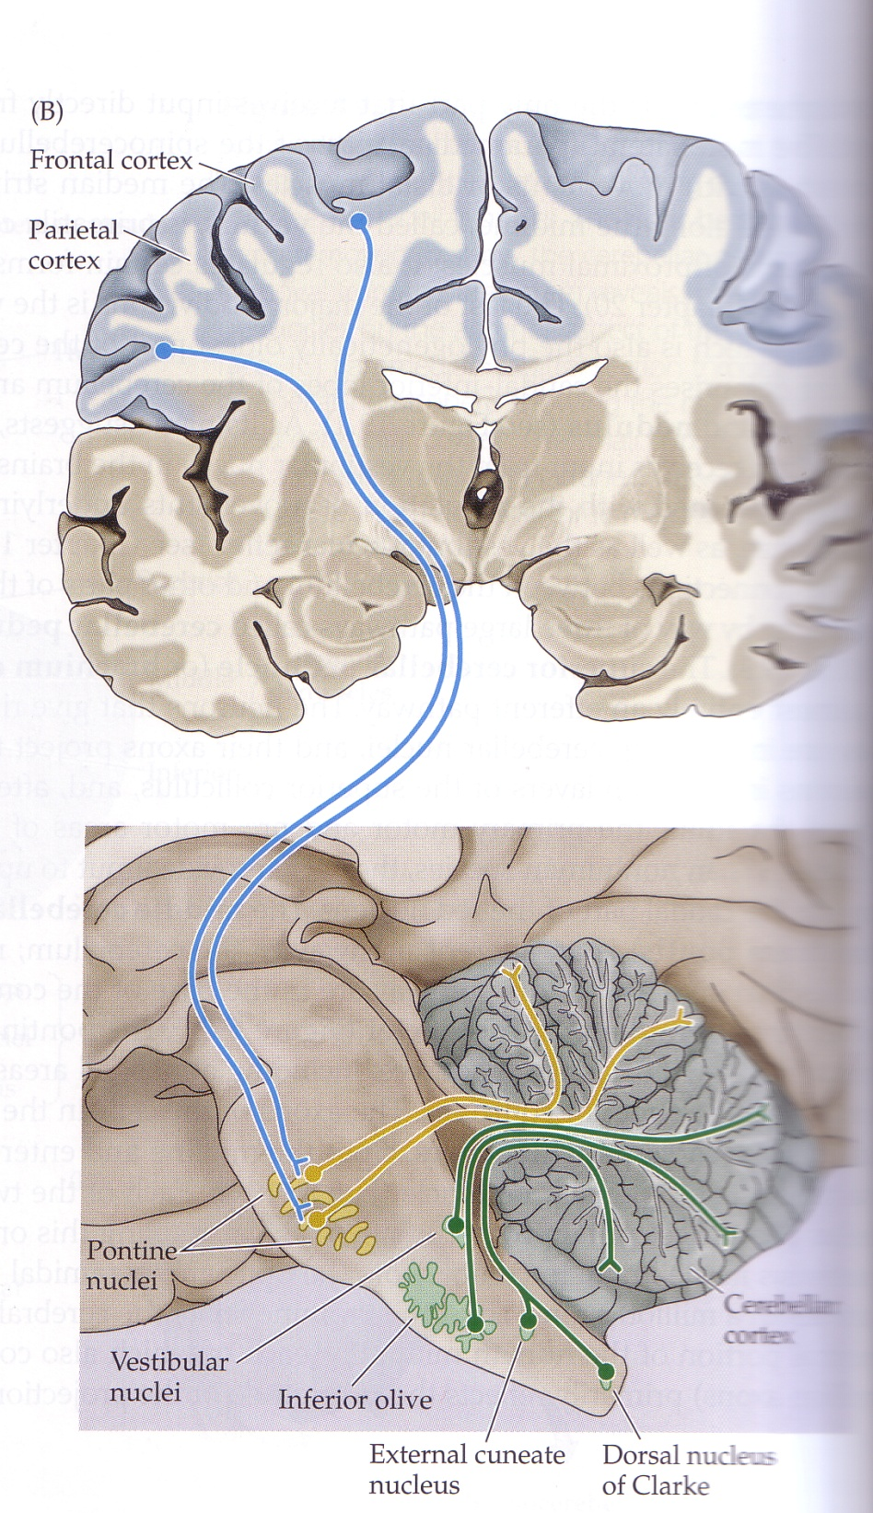

Slide 43
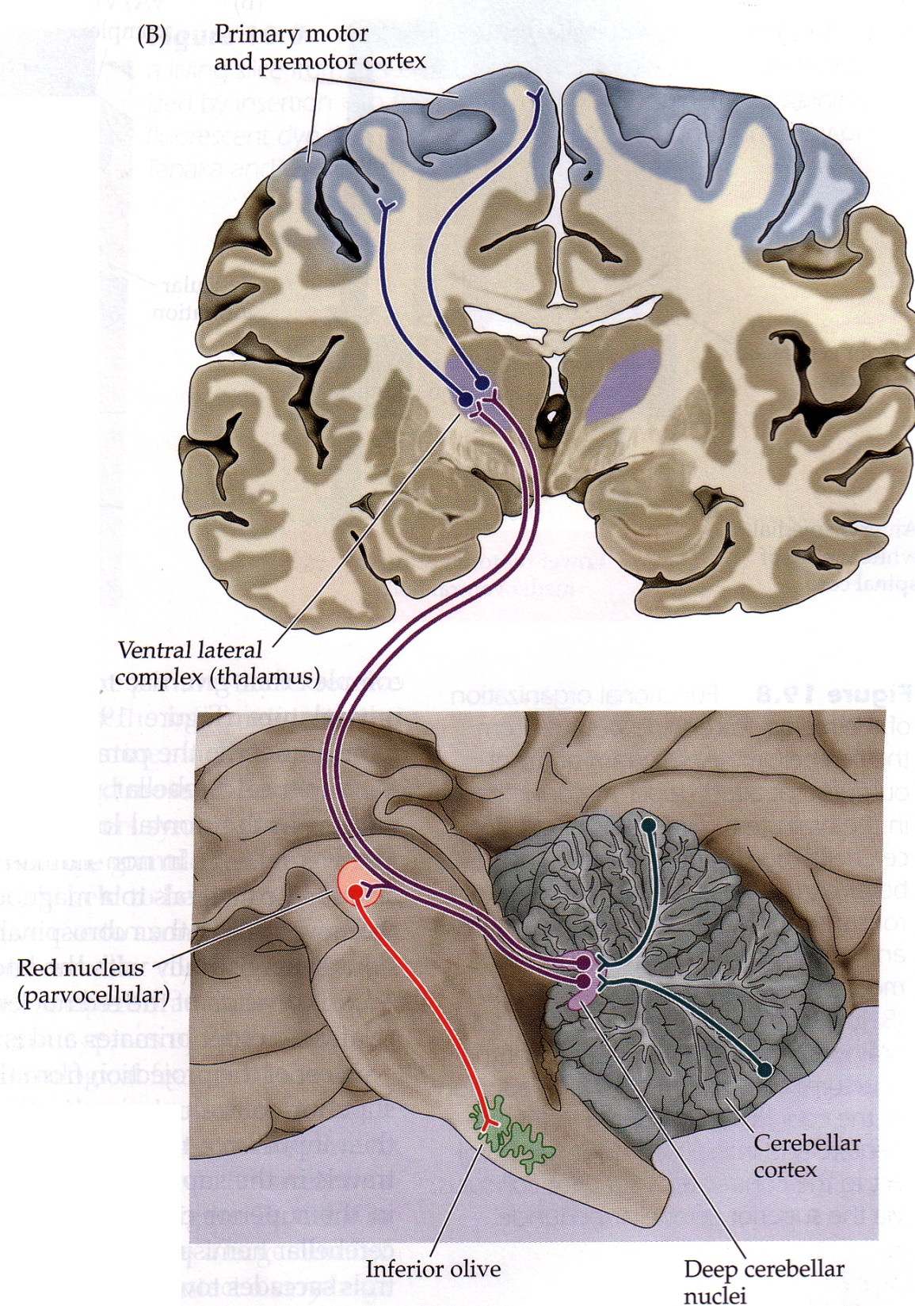

Slide 44
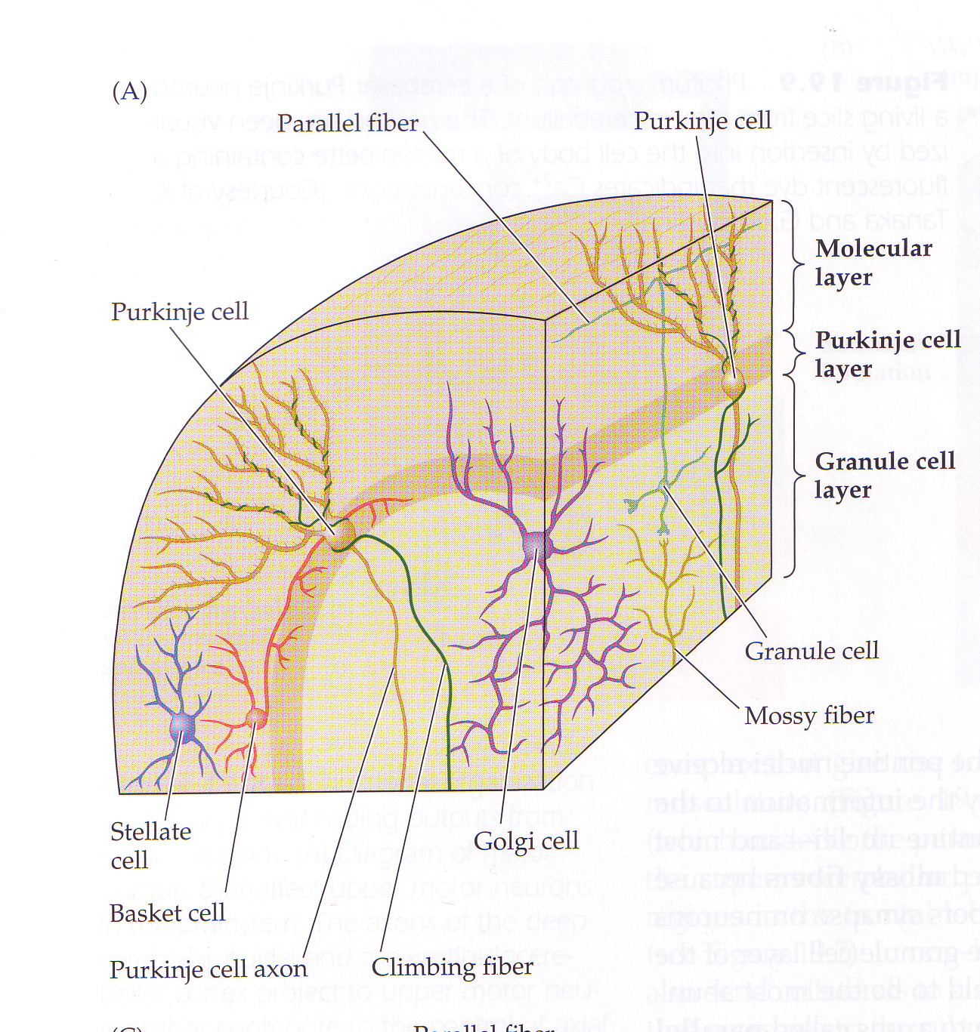

Slide 45
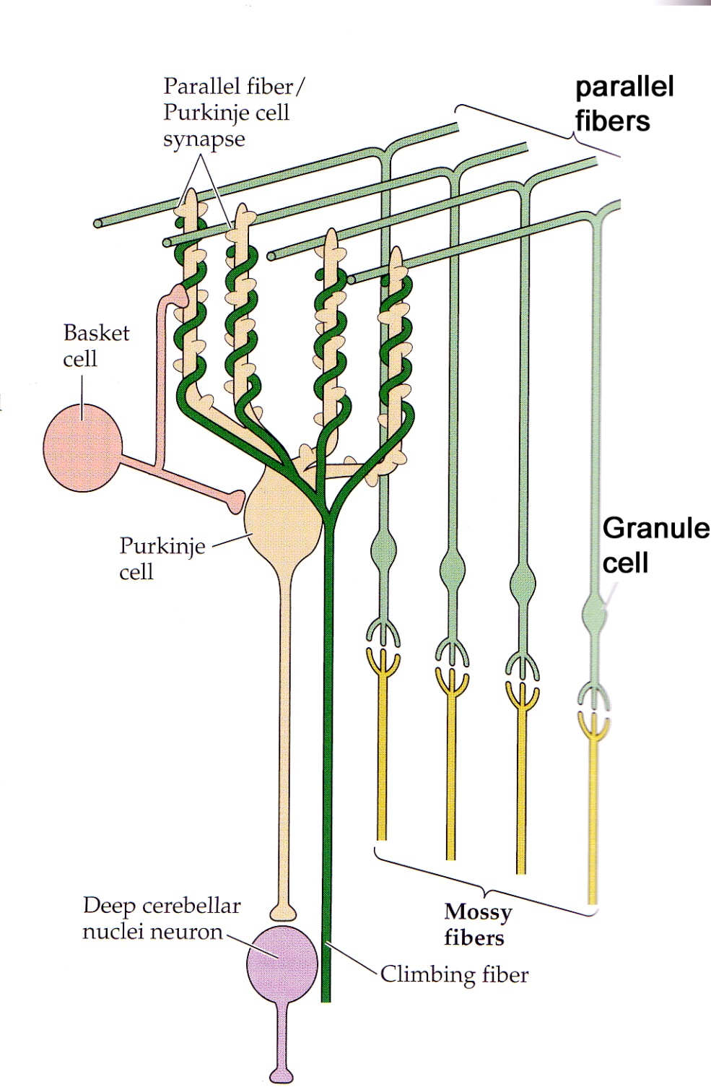

Slide 46
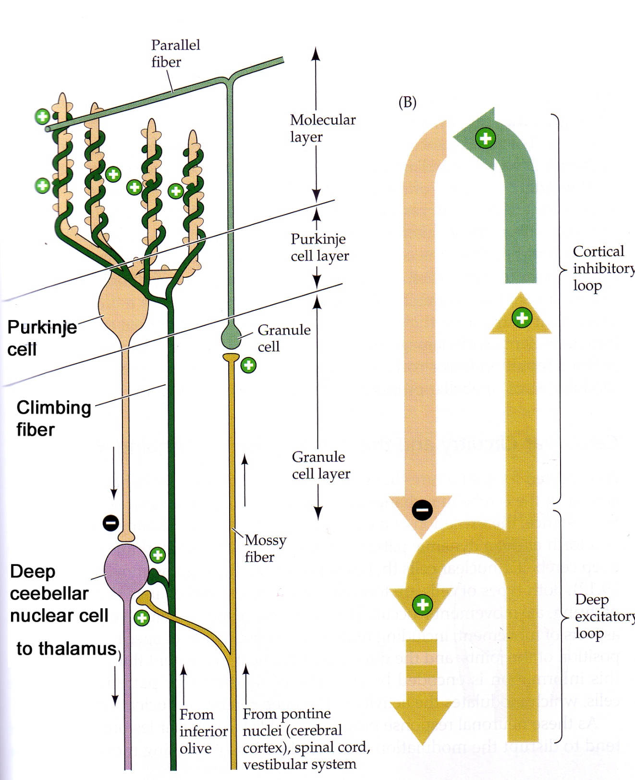

Slide 47
Critical Period
Central circuits are well defined after a critical period, which is due to the sensory input early in the life.
The central circuits are altered by hormones and neuromodulators throughout development.

Slide 48
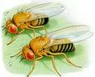
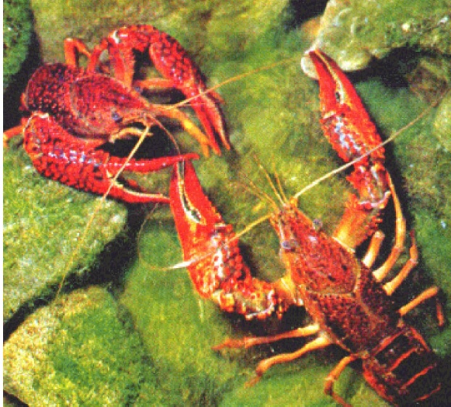
Comparative
Drosophila

Slide 49
Sensory input early in developmental stages.
The central circuits are altered by hormones and neuromodulators.
Challenge in the field is: Integration of sensory input that controls the muscular movement in a coordinated fashion.
Notes:
The sensory inputs in the early developmental stages of an animal leads to well characterization of most of the central circuits. This aspect was shown in vertebrates such as cats and monkeys back in 1960s. This well characterization of the central circuits are equally important in invertebrates also.
Alteration of the central circuits by the hormones and the neuromodulators takes place through out the development of the animal and also in its adult life. For eg The ecdysone and juvinile hormone has been shown to alter the neural development and the differentiation of the neurons in insects. Also ecdysone is shown to effect the neural circuit and the motor unit function in drosophila.

Slide 50
Neuromodulators
Recovery of locomotion by using selective agonists and antagonists of neurotransmitters involved in sensory-CNS-motor circuits.
(Chau et al., 2002 )
Notes:
In the spinal cord injury of the cats and humans, treatment with agonists and antagonists of the neurotransmitters enhanced the recovery of the locomotion.

Slide 51
contd…
Rapid changes in the neural circuit activity can be induced by neuromodulators.
Eg: aggressive behavior of Drosophila
(Baier et al., 2002)
3 common neuromodulators:
Serotonin
Octopamine
Dopamine
Notes:
Neuromodulators cause a rapid detectable changes in the neural circuitry which inturn is reflected as a behavior change. Eg is the aggressive behavior of the drosophila.
The 3 common neuromodulators in the arthopod studies and in the invertbrates are ………
Octopamine and dopamine have a effect but not serotonin

Slide 52
In Drosophila
5-HT modulate the heart rate and voltage dependent potassium channels.
DA is known to alter the sexual behavior in adult flies.
OA is expressed in stress conditions.
Notes:
So there is a good potential for these neuromodulators to have effect on the central nervous system in drosophila.

Slide 53
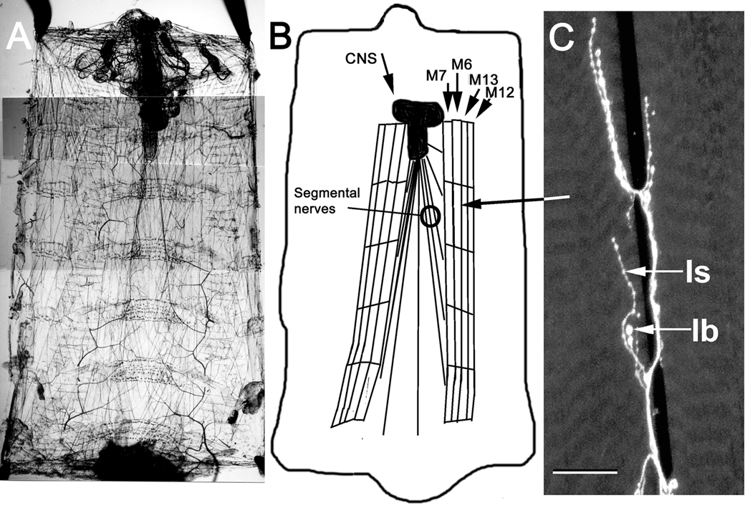
Preliminary Studies
Brain
Notes:
A early 3rd instar larvae is taken and it is cut open from the dorsal side. Heart, guts and the viscera is removed and then we will be just left with the body wall, body wall muscles and the neural circuit.
We can see the segments and the nerves going to each of these segments. The muscles m6,7,12,13 are well defined for their innervation pattern. We used m6 and 12 for these studies. 2 nerve terminals 1s and 1b come on to the m6 muscle but only 1s will be innervating m12.

Slide 56
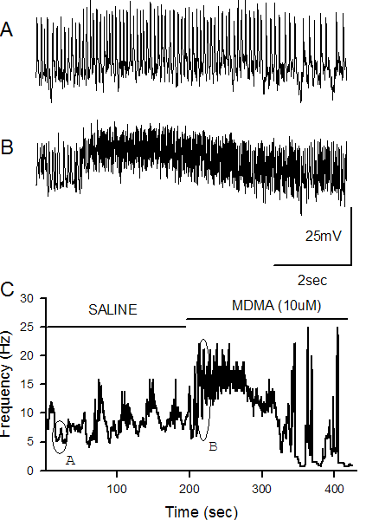

Slide 58
